Slide 1
Software Licence Selection and Management in GÉANT
Open Source and Licence Support
Branko Marović, UoB/AMRES
Kirij Kjiroski, UKIM/MARNET
December 2024
Public (PU)

Slide 2
Introduction
Course objective: Explain licence selection, declaration, compliance and related tasks in software development
Structure
  Essential aspects and elements of software licensing
  Compliance and required artefacts
  Open source licences used in GÉANT

Slide 3
Part 1
Essential Aspects and Elements of Software Licensing

Slide 4
Essential Aspects and Elements of Software Licensing
Open Source Software (OSS) and licensing
OSS conditions
Compatibility of licences commonly used in GÉANT
GÉANT Intellectual Property Rights (IPR) Policy
Licence governance in GÉANT
Software Composition Analysis (SCA) service and Mend SCA tool
Software Licence Analysis (SLA)
Licensing governance and related artefacts
Licensing and tracking of documentation, data and other works

Slide 5
Essential Aspects and Elements of Software Licensing
Hidden Slide
Open Source Software (OSS) and licensing
OSS conditions
Compatibility of licences commonly used in GÉANT
GÉANT Intellectual Property Rights (IPR) Policy
Licence governance in GÉANT
Software Composition Analysis (SCA) service and Mend SCA tool
Software Licence Analysis (SLA)
Licensing governance and related artefacts
Licensing and tracking of documentation, data and other works

Slide 6
Open Source Software and Licensing
Key Benefits
Cost-effectiveness
Education and learning
Compatibility
Ethical values
Global accessibility
Transparency
Community collaboration
Customisation
Vendor independence
Longevity
Security

Slide 7
Open Source Software and Licensing
Key Benefits
Cost-effectiveness
Transparency
Community collaboration
Customisation
Vendor independence
Longevity
Security
Education and learning
Compatibility
Ethical values
Global accessibility

Slide 8
Open Source Software and Licensing
Specific Requirements and Recommendations
Establish clear naming and branding
Select and apply an OSS licence early (whenever possible)
Ensure the selected licence is compatible with dependencies
Use GÉANT SCA and SLA services
Clearly indicate licences and address copyright
Assess components and contributions
Set up workflows for contribution, communication and governance
Adhere to domain standards and community expectations
Facilitate citation and referencing

Slide 9
Open Source Software and Licensing
Specific Requirements and Recommendations
Establish clear naming and branding
Select and apply an OSS licence early (whenever possible)
Ensure the selected licence is compatible with dependencies
Use GÉANT SCA and SLA services
Clearly indicate licences and address copyright
Assess components and contributions
Set up workflows for contribution, communication and governance
Adhere to domain standards and community expectations
Facilitate citation and referencing

Slide 10
OSS Conditions
Rights – Permissions granted by the licence
Obligations – Compliance requirements, including copyright, notices, source code, build and installation instructions
Restrictions – Prohibitions and limitations
Other aspects – Typical uses, legal features, compatibility, origin and community endorsements

Slide 11
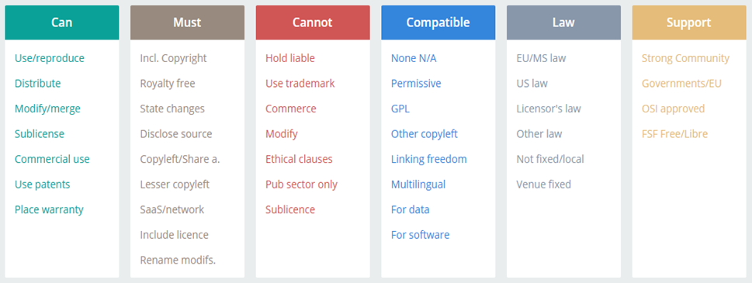
OSS Conditions
OSS conditions from JLA – Find and Compare Software Licenses

Slide 12
GÉANT IPR Policy
Binding from January 2023
Establishes a framework for intellectual property (IP) generated by the GÉANT project, applying to all GÉANT participants
Providess practical guidance on IPR and seeks to establish a cooperative approach to IP protection and fair use in GÉANT projects
Upholds principles of findability, accessibility, interoperability and reusability (FAIR) for the use of GÉANT project IP
Permits all OSI- and FSF-approved licences
  Recommends permissive licences
  Allows copyleft (weak, strong or network-protective) as needed
Final recommendations provided by the IPR Coordinator, who maintains the IP Register

Slide 13
Licence Governance in GÉANT: Roles and Services
Led by the IPR Coordinator
Supported by the Open Source and Licence Support (OSLS) Team, also known as software licensing team
  Assists users in understanding and manageing OSS licences, mastering the tools provided, and applying them effectively
  Provides knowledge, guidance and support to solution designers and developers on licences and IPR
Services include
  Software Composition Analysis (SCA) – Analyses software components, their licences and IP risks ¶
  Software Licence Analysis (SLA) – Assists with licence selection and compliance

Slide 14
Licence Governance in GÉANT: SCA and SLA
SCA and SLA address key licensing concerns by
  Assessing the licences of components and prior IP
  Selecting an open source licence aligned with project needs
  Ensuring compatibility with component licences
  Ensuring compliance with the selected licence
Registering and publishing software using GÉANT’s internal tools
  Aligning with established practices and expectations

Slide 15
Licence Governance in GÉANT: Licensing
Completing licensing and formalising the licence
  Positive indicators for project maturity and compliance within GÉANT
Achieving satisfactory IPR status through iterative analysis and adjustments
Software licensing
  Provides an opportunity to evaluate project components and their licences
  Standardises projects while addressing authorship, ownership, external relations and documentation artefacts
  Encourages participant engagement
    New team members assess and validate the software
    Original developers evaluate and consolidate their work
Licensing analysis and resultant reports
  Provide valuable insights into software solutions
  Support evaluations and decision-making

Slide 16
Licence Governance in GÉANT: Additional information
Guides and supporting materials
  Software Licence Selection and Management in GÉANT (https://wiki.geant.org/pages/viewpage.action?pageId=725614690)
  Reference Information about OSS Licences and Tools (https://wiki.geant.org/display/GSD/Reference+information+about+OSS+licences+and+tools)
  Templates and Examples (https://wiki.geant.org/display/gn51wp9t2/Templates+and+Examples+for+Project+Artefacts)
Contact
  Slack: #sw-licences at https://geant-project.slack.com
  Email: sw-licences@software.geant.org
Requests are posted and tracked via the GÉANT Jira Help Desk (https://jira.software.geant.org/servicedesk/customer/portal/2/create/55)

Slide 17
Software Composition Analysis (SCA) Service
Provides one-time analysis or continuous monitoring via Mend
  Analyses software components and their licences
  Supports licence compatibility and compliance actions taken by developers
  Mitigates IPR infringement risks which may have significant financial consequences
  Reports security vulnerabilities, complementing SonarQube and extended code reviews
Steps
  Set up the project in the Mend SCA tool
  Scan source code
  Generate and review the report
  Provide the report to the designated project leader/expert
  They are expected to provide feedback on request handling
  Repeat as needed

Slide 18
Mend SCA Tool
An online service used by GÉANT for open source licence analysis
  Detects components, licences and vulnerabilities
  Creates a software components inventory
  Provides licence information
  Can be used for security compliance
Overview of Mend usage is on the following slides
How Mend works
  Scans directories to find software components and identify vulnerable libraries, licensing conflicts or risks
  Displays results in the Mend web application
  Checks the digital signatures of components in the Mend database to detect and describe open source or commercial component
Adding project to Mend is done by the licensing team
  Mend supports integration with GÉANT’s GitLab and Bitbucket with Bamboo (https://wiki.geant.org/pages/viewpage.action?pageId=219938818)
  Details for scanning the locally stored code (https://wiki.geant.org/pages/viewpage.action?pageId=240844905)

Slide 19
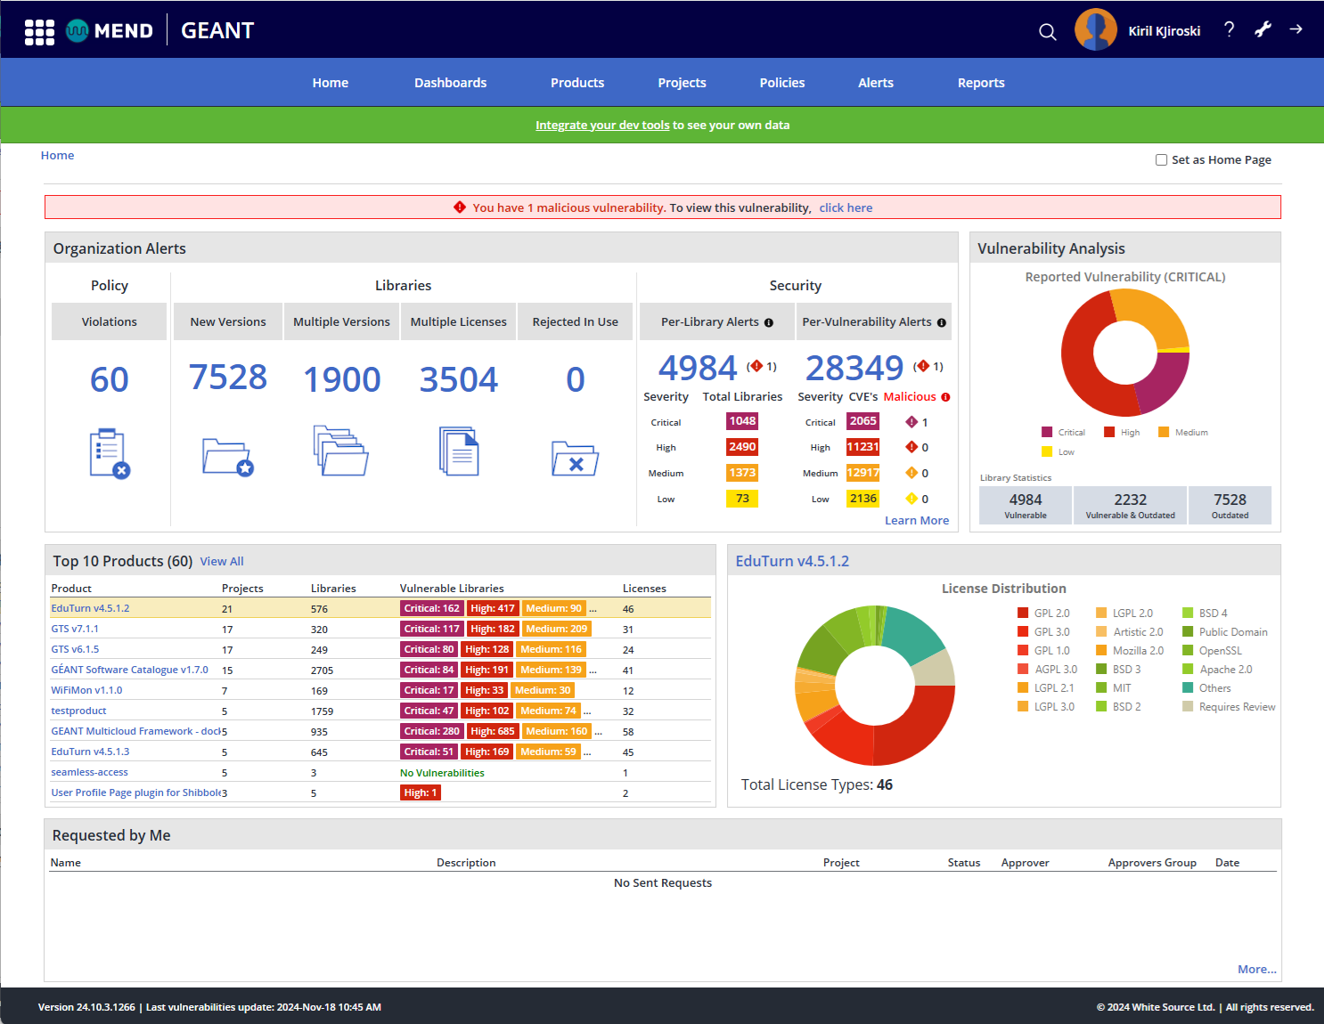
Mend SCA Tool
Mend dashboard
Licences dashboard
Product view
Inventory report
Alerts

Slide 20
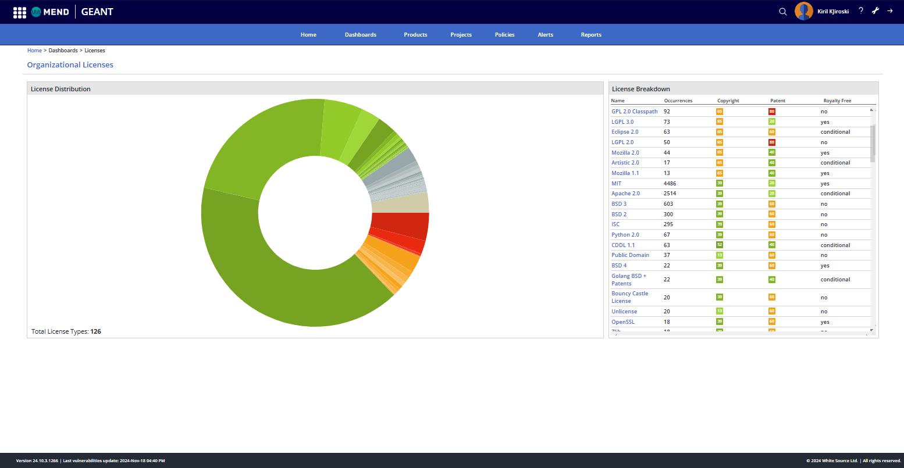
Mend SCA Tool
Mend dashboard
Licences dashboard
Product view
Inventory report
Alerts

Slide 21
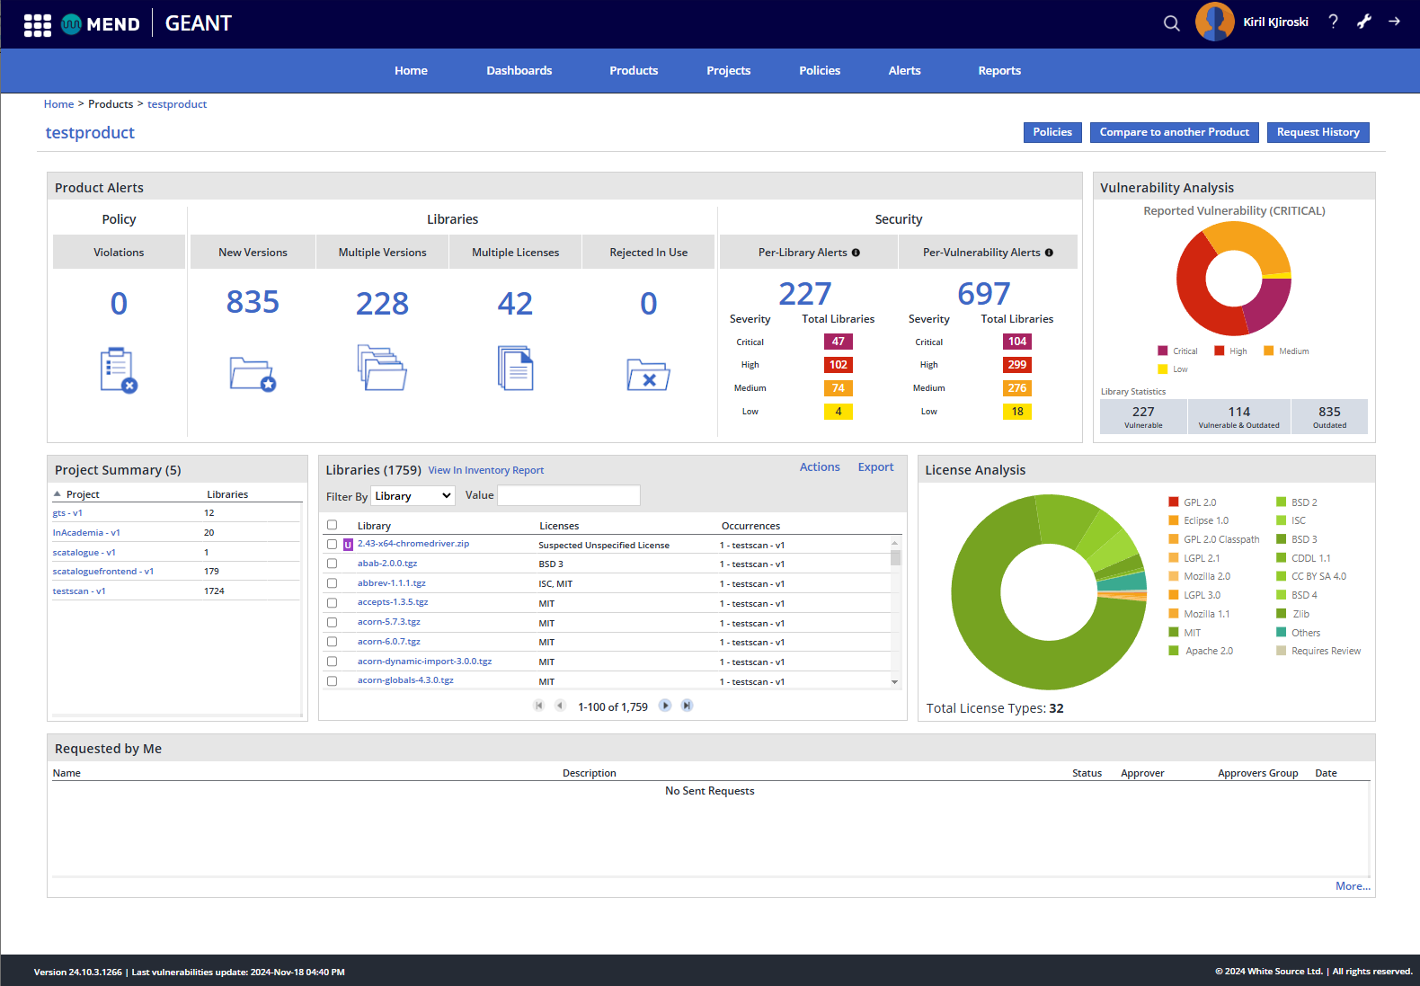
Mend SCA Tool
Mend dashboard
Licences dashboard
Product view
Inventory report
Alerts

Slide 22
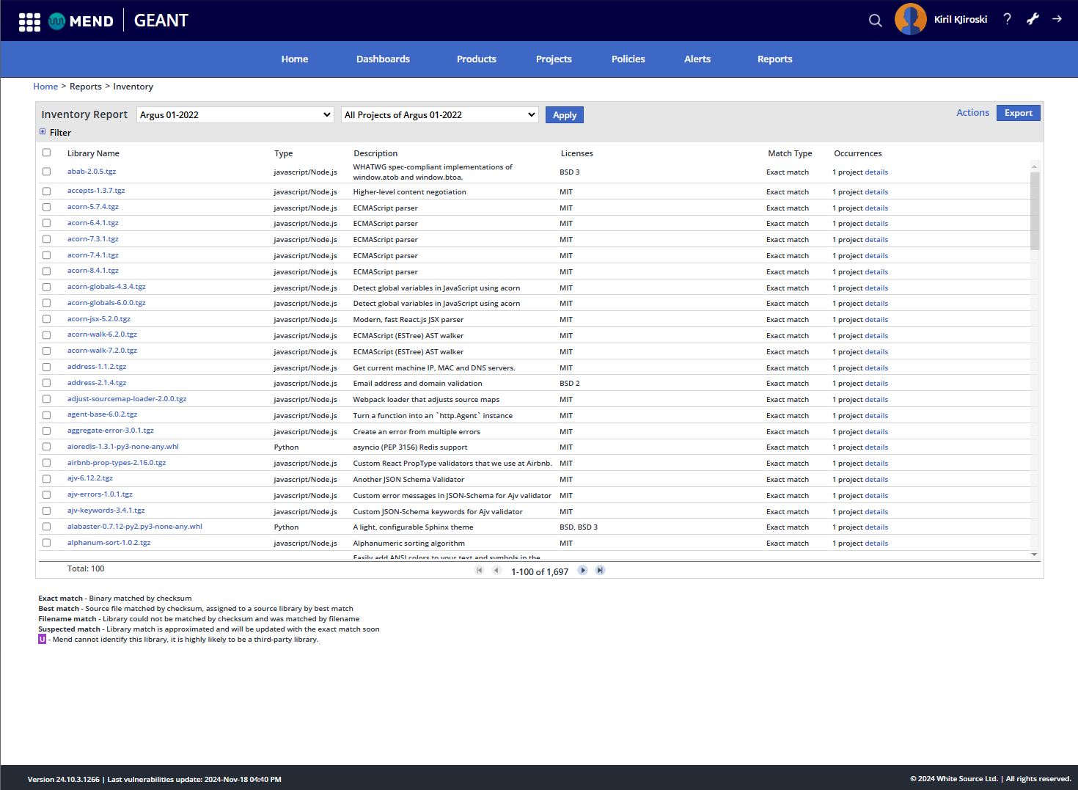
Mend SCA Tool
Mend dashboard
Licences dashboard
Product view
Inventory report
Alerts

Slide 23
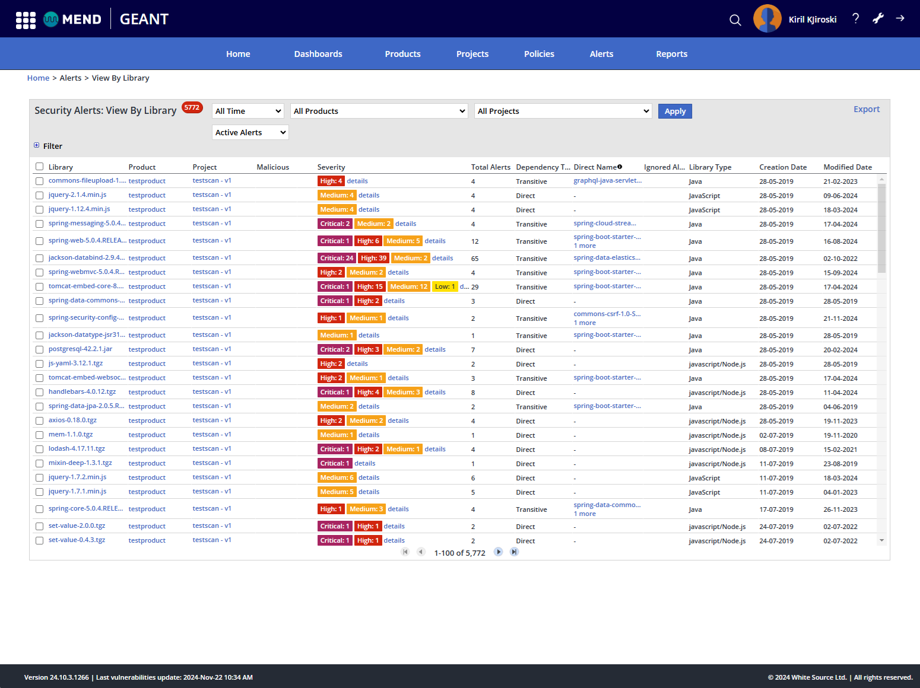
Mend SCA Tool
Mend dashboard
Licences dashboard
Product view
Inventory report
Alerts
  Libraries
  Licences
  Vulnerabilities

Slide 24
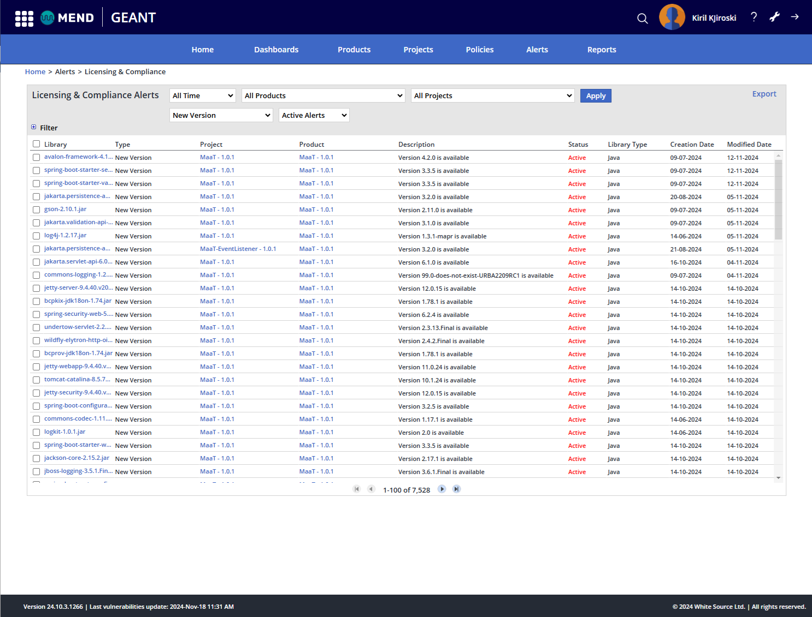
Mend SCA Tool
Mend dashboard
Licences dashboard
Product view
Inventory report
Alerts
  Libraries
  Licences
  Vulnerabilities

Slide 25
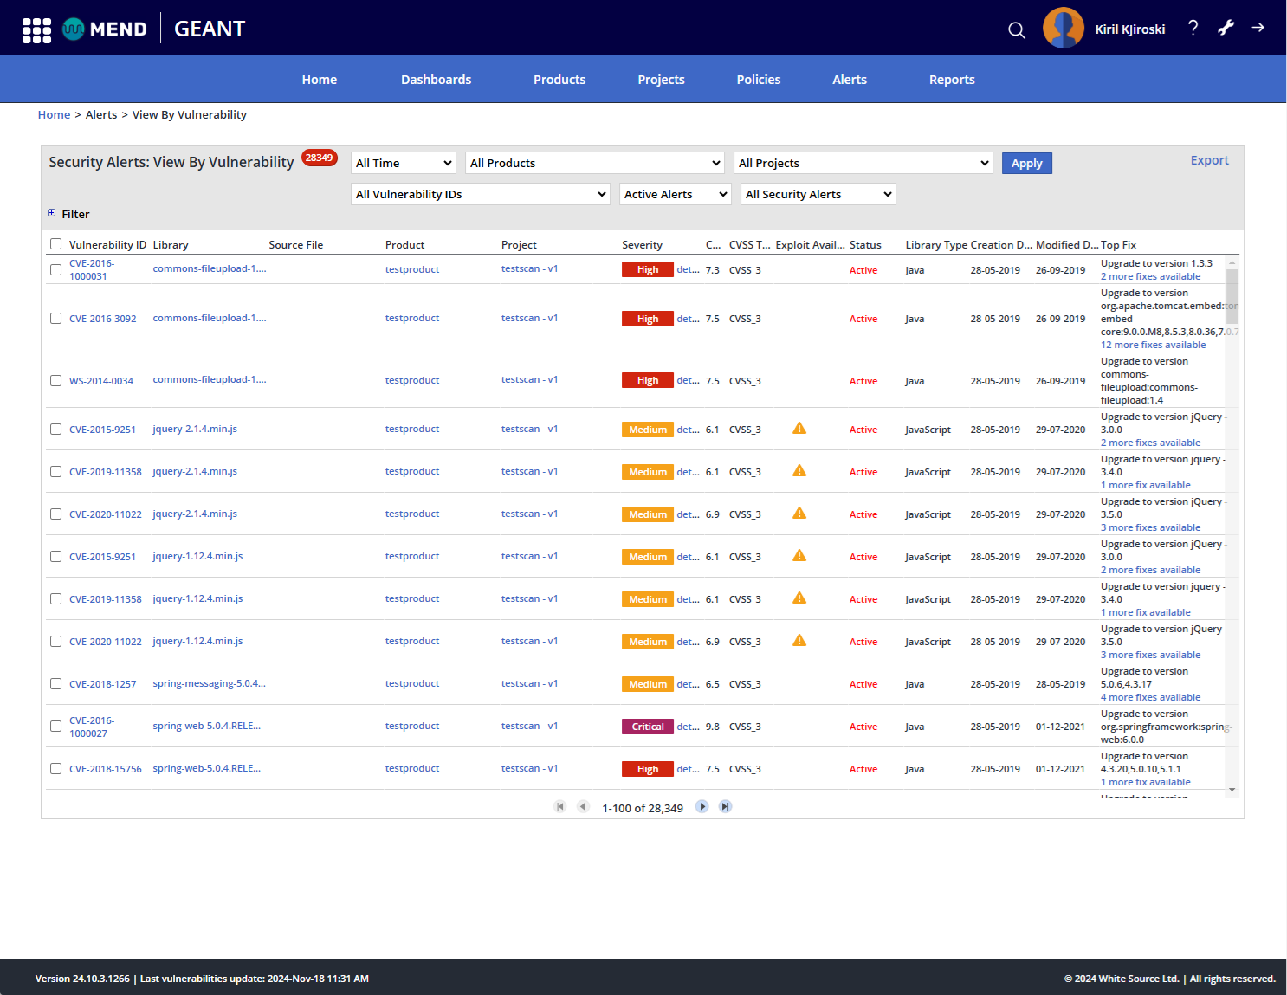
Mend SCA Tool
Mend dashboard
Licences dashboard
Product view
Inventory report
Alerts
  Libraries
  Licences
  Vulnerabilities

Slide 26
Mend SCA Tool (cont.)
Supports compliance but requires manual oversight
  Does not ensure fully accurate licence detection
  Manual verification of indicative (“suspect”) licences is needed
  Handling of multi-licences and relicensing options often leads to false positives (as if all licences apply at the same time)
  No support for software versioning or differential reports
→ Need for manual Software Licence Analysis (SLA) service

Slide 27
Software Licence Analysis (SLA) Service
SLA provides technical consultancy on
  Complex relationships between permissive and restrictive licences often found in projects
  Issues with incomplete or incorrect licence detection
  Multi-licensing, as all licences are individually observed by Mend
  Comprehensive understanding of third-party libraries used in a software project and their licences
  In-depth analysis and assistance with licence selection and licence implications
  Recommendations and validation of project documentation artefacts

Slide 28
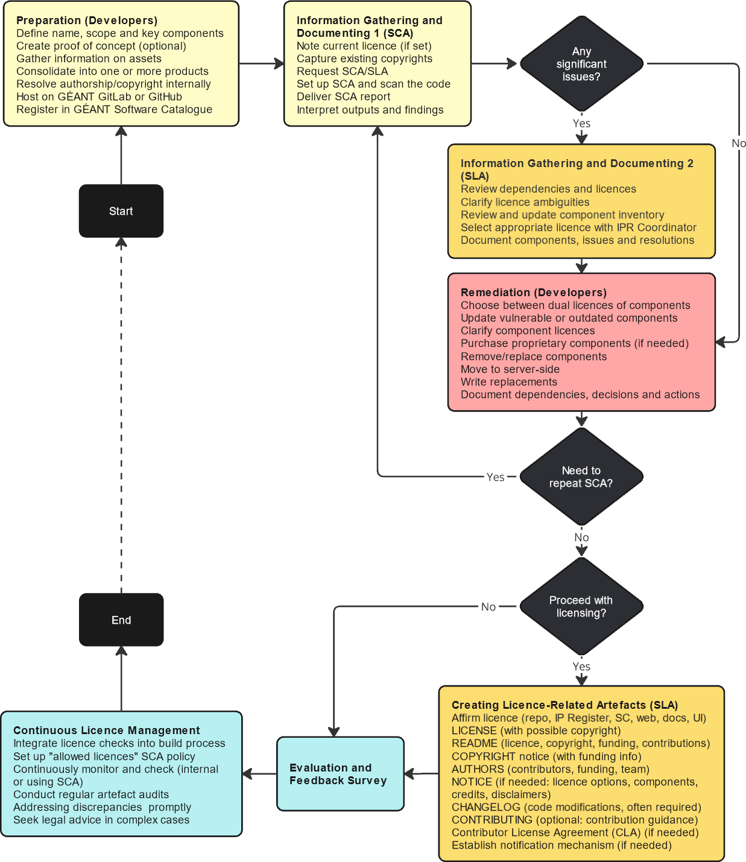
Licensing Process Steps and Artefacts
Gathering information
  Mostly using Mend
Documenting
  Partially by Mend
Remediating
  By development team
Creating licence-related artefacts
  By developers team, checked by licensing team

Slide 29
Licensing Process Steps and Artefacts
Preparation
Decide software name, subproject grouping and usage of available IPR (source code, libraries, frameworks, datasets…)
For new projects, create a proof of concept or prototype to validate key components
Gather pre-existing information and documentation for components, models, assets and other contributions
Consolidate internal components into a single project or clarify relationships if they remain in separate projects
Resolve authorship and copyright matters internally
Host the project on GÉANT GitLab or GitHub
Register the project in the GÉANT Software Catalogue

Slide 30
Licensing Process Steps and Artefacts
One or Several Projects?
Identify components for SCA analysis
Conduct integrated analysis for larger projects and their subprojects to ensure a comprehensive understanding of components
  Integrated view ensures that the larger project’s licence governance is sound
However, a wide scope can lead to a loss of focus
  Include additional components only when necessary
  Ensure licence governance aligns with the project scope
Use Mend sparingly for non-GÉANT projects
Align project grouping with features, products or branding decisions

Slide 31
Licensing Process Steps and Artefacts
Information Gathering and Documenting
Specify the current licence
Record copyrights
Request SCA and SLA services
Scan the project codebase
Review SCA outputs and findings
Use the SLA service for unresolved issues or additional assistance
Document dependencies and their licences
Review and update the component inventory
Clarify ambiguities or doubts
Document all findings
Consult the licensing team and IPR Coordinator
Select an appropriate licence
Document decisions

Slide 32
Licensing Process Steps and Artefacts
Information Gathering and Documenting
Specify the current licence
Record copyrights
Request SCA and SLA services
Scan the project codebase
Review SCA outputs and findings
Use the SLA service for unresolved issues or additional assistance
Document dependencies and their licences
Review and update the component inventory
Clarify ambiguities or doubts
Document all findings
Consult the licensing team and IPR Coordinator
Select an appropriate licence
Document decisions

Slide 33
Licensing Process Steps and Artefacts
Remediation
Typical actions
  Select a more appropriate project licence
  Implement quick fixes
    Updating or replacing vulnerable or outdated open source components where possible
    Investigating unclear component licences or seeking clarification or relicensing from authors
    Purchasing necessary proprietary software licences
    Choosing among dual-licence options for components
  Identify remaining incompatible licences and decide on actions for components with these licences
    Removing non-essential components
    Replacing them with available alternatives
    Moving them to a server-side setup by providing functionality via a central service
    Developing alternatives to meet required functionality
  Accept certain risks where unavoidable and unlikely
Internally document all dependencies, their licences, features they provide, decisions and remediation actions
Repeat SCA and remediation steps as necessary

Slide 34
Licensing Process Steps and Artefacts
Creating Licence-Related Artefacts
Provide a LICENSE file
Place it in the root directory
Ensure it contains the exact text of the selected licence
Header comments in source code files are generally unnecessary
Declare the licence
Update project documentation to reflect the selected OSS licence
Use any available repository features to declare the licence
Declare licence options
Some options must be explicitly stated
Accepting later licence versions or relicensing under specific licences
These are declared in the README and, if needed, elaborated in NOTICE
Document the project licence
GÉANT Software Catalogue
IP Register is managed by the IPR Coordinator

Slide 35
Licensing Process Steps and Artefacts
Creating Licence-Related Artefacts
Provide a LICENSE file
  Place it in the root directory
  Ensure it contains the exact text of the selected licence
  Header comments in source code files are generally unnecessary
Declare the licence
  Update project documentation to reflect the selected OSS licence
  Use any available repository features to declare the licence
Declare licence options
  Some options must be explicitly stated
  Accepting later licence versions or relicensing under specific licences
  These are declared in the README and, if needed, elaborated in NOTICE
Document the project licence
  GÉANT Software Catalogue
  IP Register is managed by the IPR Coordinator

Slide 36
Licensing Process Steps and Artefacts
Creating Licence-Related Artefacts (cont.)
Provide a copyright notice
In the COPYRIGHT, including funding information
Copyright information for third-party components
Produce a README file
Include licence information
Provide instructions for accessing the full licence text
Explain the licence’s implications for users and contributors
Add licensing badges to the README file
Document code modifications
Check the licence text to determine whether documenting code modifications is necessary
Document the history of changes the CHANGELOG if required by the licence
Document dependencies
List the licences of directly included dependencies in a dedicated file or project documentation
Credit contributors, acknowledge funding and reference relevant work packages or tasks
For source code components in subfolders, store their licences, copyrights and notices

Slide 37
Licensing Process Steps and Artefacts
Creating Licence-Related Artefacts (cont.)
Provide a copyright notice
  In the COPYRIGHT, including funding information
  Copyright information for third-party components
Produce a README file
  Include licence information
  Provide instructions for accessing the full licence text
  Explain the licence’s implications for users and contributors
  Add licensing badges to the README file
Document code modifications
  Check the licence text to determine whether documenting code modifications is necessary
  Document the history of changes the CHANGELOG if required by the licence
Document dependencies
  List the licences of directly included dependencies in a dedicated file or project documentation
  Credit contributors, acknowledge funding and reference relevant work packages or tasks
  For source code components in subfolders, store their licences, copyrights and notices

Slide 38
Licensing Process Steps and Artefacts
Creating Licence-Related Artefacts (cont.)
Document licence adherence, contribution and updating
Provide guidance for users and contributors on adhering to licensing requirements in an appropriate file
Outline contribution and copyright guidelines
Contributor License Agreement (CLA) if necessary
If the selected licence requires a CLA, establish one to define contribution terms and ensure mutual understanding
Some licences offer suitable CLA forms
Clearly outline the CLA process in the README and detail it in the CONTRIBUTING file
Place the CLA in the appropriate file
Creating a Developer Certificate of Origin (DCO) is a lightweight alternative to a CLA
Establish a licence notification mechanism
Once licence artefacts are complete, they should be assessed by the SLA team and the IPR Coordinator
Complete the SLA/SCA Evaluation and Feedback Survey

Slide 39
Licensing Process Steps and Artefacts
Creating Licence-Related Artefacts (cont.)
Document licence adherence, contribution and updating
  Provide guidance for users and contributors on adhering to licensing requirements in an appropriate file
  Outline contribution and copyright guidelines
Contributor License Agreement (CLA) if necessary
  If the selected licence requires a CLA, establish one to define contribution terms and ensure mutual understanding
  Some licences offer suitable CLA forms
  Clearly outline the CLA process in the README and detail it in the CONTRIBUTING file
  Place the CLA in the appropriate file
  Creating a Developer Certificate of Origin (DCO) is a lightweight alternative to a CLA
Establish a licence notification mechanism
Once licence artefacts are complete, they should be assessed by the SLA team and the IPR Coordinator
Complete the SLA/SCA Evaluation and Feedback Survey

Slide 40
Licensing Process Steps and Artefacts
Continuous Licence Management
Integrate licence-related checks into the build process
Can be partially automated by integrating dependency and licence checks into CI/CD toolchains
Using tools such as the License Maven Plugin to generate a list of dependencies and their licences, download licence files, check, update or remove licence headers in source files, and update (or create) the main project licence file
Verify and review tool outputs
Establish continuous monitoring and compliance checks
Stay informed about updates to the chosen OSS licence
Review the potential impact of component licence updates on the project
Establish processes for continuous compliance checks, repeating SCA and SLA as needed
Perform regular audits of licence-related artefacts
Ensure the project’s licence-related artefacts are accurate and up to date
Resolve discrepancies promptly
Seek legal advice from the IPR Coordinator when necessary

Slide 41
Licensing Process Steps and Artefacts
Continuous Licence Management
Integrate licence-related checks into the build process
  Can be partially automated by integrating dependency and licence checks into CI/CD toolchains
  Using tools such as the License Maven Plugin to generate a list of dependencies and their licences, download licence files, check, update or remove licence headers in source files, and update (or create) the main project licence file
  Verify and review tool outputs
Establish continuous monitoring and compliance checks
  Stay informed about updates to the chosen OSS licence
  Review the potential impact of component licence updates on the project
  Establish processes for continuous compliance checks, repeating SCA and SLA as needed
Perform regular audits of licence-related artefacts
  Ensure the project’s licence-related artefacts are accurate and up to date
Resolve discrepancies promptly
Seek legal advice from the IPR Coordinator when necessary

Slide 42
Tracking and Licensing Documentation, Data and Other Works
Documentation, data and datasets licences
Tutorials, presentations, training or promotional materials – use Creative Commons BY, CC BY-NC, or GNU FDL
Data – embedded data under OSS licences, standalone data under data-oriented (such as Open Data Commons) or CC licences
Datasets – commonly under CC and ODC
Document and attribute external data sources
In the software itself or in its documentation
Data may come with specific licence requirements or restrictions
Applies to all data provided with the software or used for its operation
Compliance with terms for proprietary or open data licences
Specific terms for public reference information, data contained in external libraries or modules
Use or modification of externally developed work other than software
Database models, architectural designs, development frameworks, or code generated by tools
Software must comply with specific licence terms
Special cases for copyleft OSS licences or non-OSS licences like Creative Commons with NC (NonCommercial), ND (NoDerivatives) or SA (ShareAlike) clauses
Such works are unlikely to be detected by SCA tools
Document and communicate their use and licences as soon as they are incorporated
Annotate assets, configuration files, scripts, and guides with provenance and licence details for traceability
Failure to state necessary details when adding such assets can make their identification and tracing difficult later

Slide 43
Tracking and Licensing Documentation, Data and Other Works
Documentation, data and datasets licences
  Tutorials, presentations, training or promotional materials – use Creative Commons BY, CC BY-NC, or GNU FDL
  Data – embedded data under OSS licences, standalone data under data-oriented (such as Open Data Commons) or CC licences
  Datasets – commonly under CC and ODC
Document and attribute external data sources
  In the software itself or in its documentation
  Data may come with specific licence requirements or restrictions
  Applies to all data provided with the software or used for its operation
  Compliance with terms for proprietary or open data licences
  Specific terms for public reference information, data contained in external libraries or modules
Use or modification of externally developed work other than software
  Database models, architectural designs, development frameworks, or code generated by tools
  Software must comply with specific licence terms
  Special cases for copyleft OSS licences or non-OSS licences like Creative Commons with NC (NonCommercial), ND (NoDerivatives) or SA (ShareAlike) clauses
Such works are unlikely to be detected by SCA tools
  Document and communicate their use and licences as soon as they are incorporated
  Annotate assets, configuration files, scripts, and guides with provenance and licence details for traceability
  Failure to state necessary details when adding such assets can make their identification and tracing difficult later

Slide 44
Part 2
Complying with a Selected Licence

Slide 45
Complying with a Selected Licence
This section guides developers through the process after selecting a licence
Developers must comply with the chosen licence
The refinement of artefacts should ensure the licence is applied to the software
This is mandatory if the software is not intended for
  Internal use only
  Publicly available service without any AGPL-licensed dependencies
The licence must be clearly stated in the documentation
Minimal documentation typically includes
  README for project information
  LICENSE for licensing details
  CONTRIBUTING for contribution guidelines
The licence may require a CHANGELOG or CHANGES file to track updates
All files are placed in the project or component root folder
Online tools like Dillinger and StackEdit can help create the required files in markdown format

Slide 46
Details of Compliance Requirements
Placement of Information
Complying with Licences of Used Code
LICENSE
README
COPYRIGHT
AUTHORS
NOTICE
CHANGELOG
Copyright and Licence Notices in Source Code
Checklist for Preparing and Validating Project Files

Slide 47
Details of Compliance Requirements
Placement of Information
Complying with Licences of Used Code
LICENSE
README
COPYRIGHT
AUTHORS
NOTICE
CHANGELOG
Copyright and Licence Notices in Source Code
Checklist for Preparing and Validating Project Files

Slide 48
Placement of Information
README serves as the primary entry point for users
Highlighted by platforms like GitHub, where its content is displayed when the project’s root folder is opened
Summarises key information, including copyright and licence
COPYRIGHT states who owns the copyright over the software
Typically copyrighted by GÉANT, NRENs or other organisations
LICENSE includes the full licence text
It is not usually modified to reflect specific options used in a project
NOTICE includes additional legal information
Statement confirming the licence applied to the project and any disclaimers
AUTHORS lists contributors
Data on individuals or organisations contributing to the software
CHANGELOG tracks the project’s development history
Data on changes, facilitating troubleshooting and identifying potential issues

Slide 49
Placement of Information
README serves as the primary entry point for users
  Highlighted by platforms like GitHub, where its content is displayed when the project’s root folder is opened
  Summarises key information, including copyright and licence
COPYRIGHT states who owns the copyright over the software
  Typically copyrighted by GÉANT, NRENs or other organisations
LICENSE includes the full licence text
  It is not usually modified to reflect specific options used in a project
NOTICE includes additional legal information
  Statement confirming the licence applied to the project and any disclaimers
AUTHORS lists contributors
  Data on individuals or organisations contributing to the software
CHANGELOG tracks the project’s development history
  Data on changes, facilitating troubleshooting and identifying potential issues

Slide 50
Compliance with Licences of Used Code
Meet obligations imposed by licences governing dependencies or reused code
Explicitly declare and credit dependencies or reused code in README, COPYRIGHT and NOTICE
Retain existing licence/copyright files and notices
Attribute and document modifications, updating change history and contributor list
Monitor licence updates for used code
Eclipse- and Mozilla-licensed dependencies require explicit references in project documentation
When using dependencies under Apache 2.0 in projects with a different licence
Include the original copyright notice
Provide a copy of the Apache licence
Describe significant code changes
Maintain a NOTICE file with attribution

Slide 51
Compliance with Licences of Used Code
Meet obligations imposed by licences governing dependencies or reused code
  Explicitly declare and credit dependencies or reused code in README, COPYRIGHT and NOTICE
  Retain existing licence/copyright files and notices
  Attribute and document modifications, updating change history and contributor list
  Monitor licence updates for used code
Eclipse- and Mozilla-licensed dependencies require explicit references in project documentation
When using dependencies under Apache 2.0 in projects with a different licence
  Include the original copyright notice
  Provide a copy of the Apache licence
  Describe significant code changes
  Maintain a NOTICE file with attribution

Slide 52
README File
Provides a project overview and key technical and legal details
Purpose and features
Scope, requirements and supported settings
Installation and configuration
Usage
Documentation
Roadmap and known issues
Community contributions
Funding, acknowledgements, dependencies and tools used
Licence and copyright

Slide 53
README File
Provides a project overview and key technical and legal details
Purpose and features
Scope, requirements and supported settings
Installation and configuration
Usage
Documentation
Roadmap and known issues
Community contributions
Funding, acknowledgements, dependencies and tools used
Licence and copyright

Slide 54
LICENSE File
Includes the full licence text, defining terms of use, modification and distribution
Copy from the official source
Licence text typically explains available licensing options and how they should be declared
Statement confirming the licence applied to the project should be included, in
README file – indicate “or later” if applicable
NOTICE file – elaborate on all applied licensing options
Confirm with the GÉANT IPR Coordinator

Slide 55
LICENSE File
Includes the full licence text, defining terms of use, modification and distribution
  Copy from the official source
  Licence text typically explains available licensing options and how they should be declared
Statement confirming the licence applied to the project should be included, in
  README file – indicate “or later” if applicable
  NOTICE file – elaborate on all applied licensing options
Confirm with the GÉANT IPR Coordinator

Slide 56
COPYRIGHT File
Documents copyright ownership and associated project details
Expressed through a copyright statement
Copyright statement referencing GÉANT and work years
MIT, BSD and ISC include a one-line copyright statement in LICENSE
A detailed statement and disclaimer are also required
Developers must indicate the copyright but are often not familiar with this
Software is protected by copyright law
Additional statements require IPR Coordinator approval
OSS licences often mandate retaining original copyrights and specific user rights

Slide 57
COPYRIGHT File
Documents copyright ownership and associated project details
  Expressed through a copyright statement
  Copyright statement referencing GÉANT and work years
  MIT, BSD and ISC include a one-line copyright statement in LICENSE
  A detailed statement and disclaimer are also required
Developers must indicate the copyright but are often not familiar with this
  Software is protected by copyright law
  Additional statements require IPR Coordinator approval
  OSS licences often mandate retaining original copyrights and specific user rights

Slide 58
AUTHORS File
Lists contributors and acknowledges individuals or organisations
May be named CONTRIBUTORS
Credit all significant contributors, not just developers
Can refer to GÉANT work packages or tasks
Acknowledge contributions from external teams or individuals
Include funding information
Add additional acknowledgements as needed

Slide 59
AUTHORS File
Lists contributors and acknowledges individuals or organisations
  May be named CONTRIBUTORS
  Credit all significant contributors, not just developers
  Can refer to GÉANT work packages or tasks
  Acknowledge contributions from external teams or individuals
  Include funding information
  Add additional acknowledgements as needed

Slide 60
NOTICE File
Documents legal information, credits and attributions for dependencies
Required by some licences
Considered good practice
Update if already in the project
Credit libraries, frameworks, tools or any other intellectual property used
Content and format
Chosen licence, with information about licence options, secondary licences, exceptions, additional permissions or disclaimers
Some licences require preserving content from existing NOTICE or dependencies

Slide 61
NOTICE File
Documents legal information, credits and attributions for dependencies
  Required by some licences
  Considered good practice
  Update if already in the project
  Credit libraries, frameworks, tools or any other intellectual property used
Content and format
  Chosen licence, with information about licence options, secondary licences, exceptions, additional permissions or disclaimers
  Some licences require preserving content from existing NOTICE or dependencies

Slide 62
CHANGELOG File
Tracks the high-level history of changes (features, fixes, updates)
Required by some licences
Considered good practice
May also be named CHANGES or HISTORY
Chronological history
The latest changes appear at the top
New features, significant changes, additions, bug fixes and other modifications
Each entry corresponds to a release and may contain sub-items
Supported by systematic tracking via commit notes and the roadmap
Use simple version numbers

Slide 63
CHANGELOG File
Tracks the high-level history of changes (features, fixes, updates)
Required by some licences
Considered good practice
May also be named CHANGES or HISTORY
Chronological history
  The latest changes appear at the top
  New features, significant changes, additions, bug fixes and other modifications
  Each entry corresponds to a release and may contain sub-items
  Supported by systematic tracking via commit notes and the roadmap
  Use simple version numbers

Slide 64
Checklist for Preparing and Validating Project Files
README (Mandatory)
AUTHORS (Optional)
Software name
Optional key attributes and badges
Sections with subtitles
Purpose, context and prerequisites
Brief installation, configuration and usage
Credit GÉANT and relevant parties
EU logo
Simple copyright statement
Licence and options like “or later”
Keep ir concise
LICENSE (Mandatory)
Confirm with the IPR Coordinator
Use official licence text
COPYRIGHT (Mandatory)
Verify with the IPR Coordinator
EU logo and required text
Contributors with contact details
May credit project phases or tasks
NOTICE (Optional)
Not necessary if all information is in the README
Acknowledge third-party components with licences, URLs and copyrights
Optionally mention tools used
Include required notices for components, if applicable
CHANGELOG (Recommended)
Required for many licences
High-level change history
Use a standard format
“Initial public (or production) release” at the bottom

Slide 65
Checklist for Preparing and Validating Project Files
README (Mandatory)
  Software name
  Optional key attributes and badges
  Sections with subtitles
  Purpose, context and prerequisites
  Brief installation, configuration and usage
  Credit GÉANT and relevant parties
  EU logo
  Simple copyright statement
  Licence and options like “or later”
  Keep ir concise
LICENSE (Mandatory)
  Confirm with the IPR Coordinator
  Use official licence text
COPYRIGHT (Mandatory)
  Verify with the IPR Coordinator
  EU logo and required text

Slide 66
Checklist for Preparing and Validating Project Files (cont.)
AUTHORS (Optional)
  Contributors with contact details
  May credit project phases or tasks
NOTICE (Optional)
  Not necessary if all information is in the README
  Acknowledge third-party components with licences, URLs and copyrights
  Optionally mention tools used
  Include required notices for components, if applicable
CHANGELOG (Recommended)
  Required for many licences
  High-level change history
  Use a standard format
  “Initial public (or production) release” at the bottom

Slide 67
Part 3
Open Source Licences Used in GÉANT

Slide 68
Open Source Licences Used in GÉANT
Classification of Open Source Licences
Compatibility of Licences Frequently Used in GÉANT
Relationships Between Licences
Project Licence Options
Low Risk Licences
Medium Risk Licences
High Risk Licences
Used Terms
Licence Cheat Sheet

Slide 69
Open Source Licences Used in GÉANT
Classification of Open Source Licences
Compatibility of Licences Frequently Used in GÉANT
Relationships Between Licences
Project Licence Options
Low Risk Licences
Medium Risk Licences
High Risk Licences
Used Terms
Licence Cheat Sheet

Slide 70
Classification of Open Source Licences
Public domain-equivalent licences
Permissive licences
Copyleft licences
  Weak copyleft licences
  Strong copyleft licences
  Network protective licences

Slide 71
Compatibility of Licences Frequently Used in GÉANT
Limited set of licences used in GÉANT
Two interpretations of licence compatibility
  Components with distinct licences can be used in the same project
  A component under one licence may be used in software governed by another licence
Licence selection process and rules
  OSS Licences and Licence Selection (https://wiki.geant.org/display/GSD/OSS+licences+and+licence+selection)
Hints for specific licences
  Important Licences for Licence Selection (https://wiki.geant.org/display/GSD/Important+licences+for+licence+selection)

Slide 72
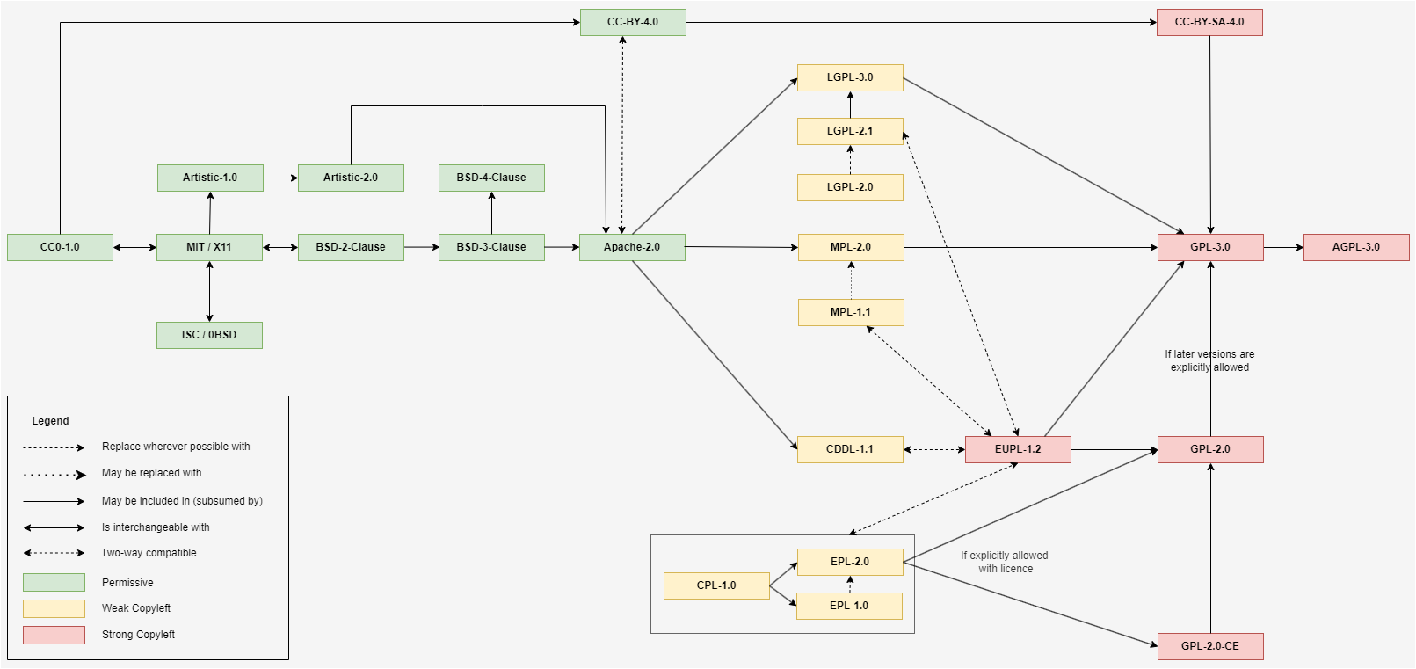
Relationships Between Most Frequently Used Licences in GÉANT

Slide 73
Relationships Between Licences – Explanation
One-way solid arrow – Subsuming licences
One-way dashed arrow – Suggested replacing
One-way dotted arrow – Possible replacement
Two-way solid arrow – Interchangeable
Two-way dashed arrow – Combining work under either licence

Slide 74
Project Licence Options
Permitting later licence versions
Basically, a licence-endorsed open-ended multilicensing
Allows compatibility with future licence versions
Common in GPL licences
Relicensing under a different licence
Enables relicensing under a secondary licence endorsed by the original or chosen by the licensor
Found in licences like EPL and MPL
Extending rights beyond standard terms
Permits commercial use without open sourcing modifications, provides patent grants or allows proprietary versions distribution
Often found in Apache licences
Placing limitations on certain uses or modifications
Some licences may allow the addition of conditions
Apache 2.0 permits adding specific conditions
Choosing jurisdiction
Licensors can choose governing jurisdiction
EUPL licence: litigations are subject to the jurisdiction of the licensor’s location

Slide 75
Project Licence Options
Permitting later licence versions
  Basically, a licence-endorsed open-ended multilicensing
  Allows compatibility with future licence versions
  Common in GPL licences
Relicensing under a different licence
  Enables relicensing under a secondary licence endorsed by the original or chosen by the licensor
  Found in licences like EPL and MPL
Extending rights beyond standard terms
  Permits commercial use without open sourcing modifications, provides patent grants or allows proprietary versions distribution
  Often found in Apache licences
Placing limitations on certain uses or modifications
  Some licences may allow the addition of conditions
  Apache 2.0 permits adding specific conditions
Choosing jurisdiction
  Licensors can choose governing jurisdiction
  EUPL licence: litigations are subject to the jurisdiction of the licensor’s location

Slide 76
Licence Categories According to Mend
Low Risk
Medium Risk
High Risk
Apache-2.0
Bouncy Castle License
BSD 2-Clause
BSD-3-Clause
BSD-4-Clause
BSL-1.0
CC0-1.0 / WTFPL / Unlicense
CC-BY-4.0
CC-BY-SA-4.0
CDDL-1.0
CDDL-1.1
Golang BSD + Patents
ISC / 0BSD
MIT / X11
NUnit
OpenSSL
Public Domain
Python-2.0
Zlib
Artistic-1.0
Artistic-2.0
EPL-1.0
EPL-2.0
EUPL-1.2
GPL-2.0-with-classpath-exception
LGPL-2.0
LGPL-2.1
LGPL-3.0
MPL-1.1
MPL-2.0
AGPL-3.0
GPL-1.0
GPL-2.0
GPL-3.0

Slide 77
Licence Categories According to Mend
Low Risk
  Apache-2.0
  Bouncy Castle License
  BSD 2-Clause
  BSD-3-Clause
  BSD-4-Clause
  BSL-1.0
  CC0-1.0 / WTFPL / Unlicense
  CC-BY-4.0
  CC-BY-SA-4.0
  CDDL-1.0
  CDDL-1.1
  Golang BSD + Patents
  ISC / 0BSD
  MIT / X11
  NUnit
  OpenSSL
  Public Domain
  Python-2.0
  Zlib
Medium Risk
  Artistic-1.0
  Artistic-2.0
  EPL-1.0
  EPL-2.0
  EUPL-1.2
  GPL-2.0-with-classpath-exception
  LGPL-2.0
  LGPL-2.1
  LGPL-3.0
  MPL-1.1
  MPL-2.0
High Risk
  AGPL-3.0
  GPL-1.0
  GPL-2.0
  GPL-3.0

Slide 78
Open Source licences found in GÉANT Projects
Detailed descriptions of licences used in GÉANT projects (https://wiki.geant.org/display/GSD/Important+licences+for+licence+selection)
A few more important licences are described
Each describtion includes
  Category (e.g., permissive, copyleft)
  Description
  Requirements
  Compatibility, linking and mixing
  Patent rights
  Additional remarks

Slide 79
“Who Wants to be a Millionaire?” Questions
What is …?
Copyleft
Derivative Work
FOSS (Free and Open Source Software)
FSF (Free Software Foundation)
GPL (General Public License)
IPR (Intellectual Property Rights)
Licensing
OSI (Open Source Initiative)
OSS (Open Source Software)
Permissive Licence
Software Licence
Strong Copyleft
Weak Copyleft

Slide 80
Licence Cheat Sheet
Low-Risk Licences
Licence | Patent Grant | Notes
Apache-2.0 | Yes, all | Permissive, widely used. Grants patent rights for using the software, reciprocal grants may be required
Bouncy Castle License | No | Similar to MIT, used for cryptographic libraries
BSD 2-Clause | No | Similar to MIT, simple, widely used, minimal requirements
BSD-3-Clause | No | Similar to BSD-2-Clause, widely used, with non-endorsement clause for promotional use
BSD-4-Clause | No | Includes advertising clause, less common
BSL-1.0 | No | Business-friendly, converts to MIT after a set period, for Boost C++ libraries
CC0-1.0 / WTFPL / Unlicense | No | Dedicate works to the public domain, no restrictions, not open source
CC-BY-4.0 | No | Attribution license for creative works, not for software
CC-BY-SA-4.0 | No | Strong copyleft, attribution and share-alike required, for creative works and publicly managed docs

Slide 81
Licence Cheat Sheet
Low-Risk Licences (cont.)
Licence | Patent Grant | Notes
CDDL-1.0 | No | Similar to MPL-2.0.
CDDL-1.1 | No | Minor updates to CDDL-1.0.
Golang BSD + Patents | Yes, all | BSD-3-Clause with patent grant for all patents (like Apache-2.0).
ISC / 0BSD | No | Similar to MIT, minimal restrictions.
MIT / X11 | No | Simple, widely used, minimal restrictions.
NUnit | No | Minimal restrictions, for NUnit testing framework.
OpenSSL | Essential | Apache-2.0-like, with specific requirements for OpenSSL libraries, grants rights to essential patents.
Public Domain | No | Works not subject to copyright, no restrictions.
Python-2.0 | No | Similar to Apache-2.0, with specific terms for Python.
Zlib | No | Minimal restrictions, for zlib compression library.

Slide 82
Licence Cheat Sheet
Medium-Risk Licences
Licence | Patent Grant | Notes
Artistic-1.0 | No | Weak copyleft, mainly used for Perl.
Artistic-2.0 | No | Clarified terms from Artistic-1.0.
EPL-1.0 | Essential | Primarily for Eclipse projects, grants rights to essential patents.
EPL-2.0 | Essential | Similar to EPL-1.0, popular among open-source projects.
EUPL-1.2 | Essential | Compatible with GPL, multi-lingual, grants rights to essential patents.
GPL-2.0-with-classpath-exception | Implicit | GPL-2.0 with linking exception, used mainly for Java.
LGPL-2.0 | Yes | Allows linking with non-GPL software while ensuring open source derivatives.
LGPL-2.1 | Yes | More explicit linking terms than LGPL-2.0.
LGPL-3.0 | Yes | Prohibits practices that restrict installing or running modified versions.
MPL-1.1 | Limited | Semi-permissive, file-level, older version, allows combining with GPL code.
MPL-2.0 | Yes | Flexible – and widely used, file-level.

Slide 83
Licence Cheat Sheet
High-Risk Licences
Licence | Patent Grant | Notes
AGPL-3.0 | Yes | GPL-3.0 with server-side source code disclosure required.
GPL-1.0 | No | Early version, less common.
GPL-2.0 | Implicit | Widely used, incompatible with GPL-3.0 unless “or later”.
GPL-3.0 | Yes | More explicit terms, incompatible with GPL-2.0-only.

Slide 84
Thank You

