Slide 1
Software Licence Selection and Management in GÉANT
Open Source and Licence Support
Branko Marović, UoB/AMRES
Kiril Kjiroski, UKIM/MARNET
December 2024
Public (PU)

Slide 2
Introduction
The course objective is to explain:
Tasks in Software Development
Licence Selection
Declaration
Compliance
WAY TO SUCCESS
2

Slide 3


Part 1
Essential Aspects of Software Licensing
Paul can we have an agenda slide?
3
Part 1
Essential Aspects of Software Licensing in GÉANT
3

Slide 4





Course Organisation
Essential aspects of software licensing
Open source licences used in GÉANT
Licensing and artefacts creation process
Compliance and required artefacts
Structure

Slide 5
Course Organisation
Essential aspects of software licensing
Open source licences used in GÉANT
Licensing and artefacts creation process
Compliance and required artefacts
Structure

Slide 6
Essential Aspects of Software Licensing in GÉANT
Open Source Software (OSS) and licensing
OSS conditions
Compatibility of licences commonly used in GÉANT
GÉANT Intellectual Property Rights (IPR) Policy
Licence governance in GÉANT
Software Composition Analysis (SCA) service and Mend SCA tool
Software Licence Analysis (SLA)

Slide 7
Open-Source Software and Licensing
Key Benefits
Cost-effectiveness
Education and learning
Compatibility
Ethical values
Global accessibility
Transparency
Community collaboration
Customisation
Vendor independence
Longevity
Security

Slide 8
Open-Source Software and Licensing
Specific Requirements and Recommendations
Establish branding and packaging
Select and apply an OSS licence early
Ensure licence is compatible with dependencies
Use GÉANT SCA and SLA services
Clearly indicate licences and address copyright
Assess components and contributions
Set up workflows for contribution
Keep standards and community expectations
Facilitate citation and referencing

Slide 9
OSS Conditions
Compliance requirements:
copyright, notices, source code, build and installation instructions
Permissions granted by the licence
OBLIGATIONS
RIGHTS
OSS CONDITIONS
OTHER ASPECTS
Typical uses, legal features, compatibility, origin and community endorsements
Prohibitions and limitations
RESTRICTIONS

Slide 10
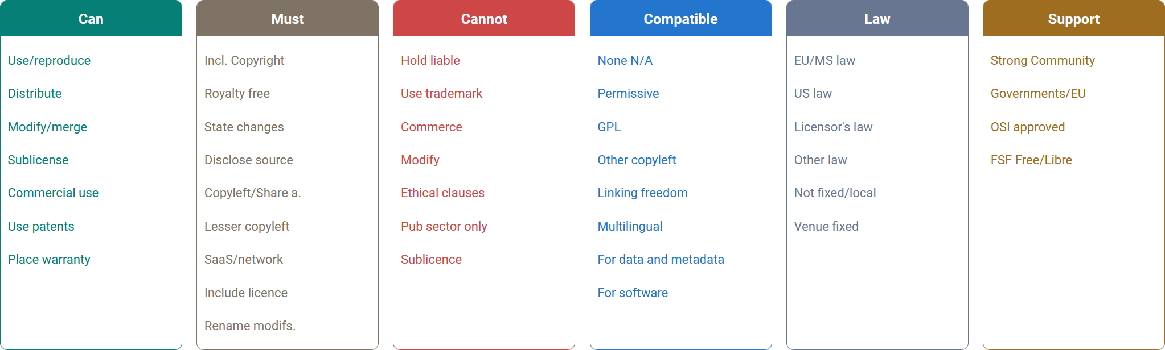
Example of Detailed OSS Conditions Classification
OSS conditions from Joinup Licensing Assistant (JLA)
(https://interoperable-europe.ec.europa.eu/collection/eupl/solution/licensing-assistant/find-and-compare-software-licenses)

Slide 11
GÉANT IPR Policy
Binding from January 2023
A framework for GÉANT participants on intellectual property (IP)
Practical guidance on IPR
Promotes a cooperative approach to IP protection and fair use in GÉANT projects
Upholds the principles of findability, accessibility, interoperability and reusability (FAIR) for the use of GÉANT project IP
Permits all OSI- and FSF-approved licences
  Recommends permissive licences
  Allows copyleft (weak, strong or network-protective) as needed
Final recommendations by the IPR Coordinator, who maintains the IP Register

Slide 12



Licence Governance in GÉANT: Roles
Led by the IPR Coordinator.
Supported by the Open Source and Licence Support (OSLS) Team, also known as the software licensing team:
  Assists users in understanding and managing OSS licences, mastering the tools provided, and applying them effectively.
  Provides knowledge, guidance and support to solution designers and developers on licences and IPR.
IPR Coordinator
Open Source and Licence Support (OSLS) Team
Assist users
Provides knowledge

Slide 13


Licence Governance in GÉANT: Services
  Software Licence Analysis (SLA) – Assists with licence selection and compliance
  Software Composition Analysis (SCA) – Analyses software components, their licences and IP risks
SLA
SCA

Slide 14
Licence Governance in GÉANT: Services
SCA and SLA address key licensing concerns by:
  Assessing the licences of components and prior IP
  Selecting an open source licence aligned with project needs
  Ensuring compatibility with component licences
  Ensuring compliance with the selected licence
Registering and publishing software using GÉANT’s internal tools
  Aligning with established practices and expectations
Notes:
Do ndertojme nje gje, e cila do permbaje textin qe ka 4 ppikat me bullet point dhe dy fjalet SCA dhe SLA qe vijne drejt ksaj struktures.

Slide 15

Licence Governance in GÉANT: Licensing
Completing licensing and formalising the licence
  Indicates for project maturity and compliance within GÉANT
Achieving satisfactory IPR status through iterative analysis and adjustments
Software licensing
  Identifies and assesses project components and their licences
  Standardises projects while addressing authorship, ownership, external relations and documentation artefacts
  Encourages participant engagement
    New team members assess and validate the software
    Original developers evaluate and consolidate their work
Licensing analysis and resultant reports
  Provide valuable insights into software solutions
  Support evaluations and decision-making

Slide 16




Licence Governance in GÉANT: Additional information
Guides and supporting materials
  Software Licence Selection and Management in GÉANT (https://wiki.geant.org/pages/viewpage.action?pageId=725614690)
  Reference Information about OSS Licences and Tools (https://wiki.geant.org/display/GSD/Reference+information+about+OSS+licences+and+tools)
  Templates and Examples (https://wiki.geant.org/display/gn51wp9t2/Templates+and+Examples+for+Project+Artefacts)
Contact
  Slack: #sw-licences at https://geant-project.slack.com
  Email: sw-licences@software.geant.org
Requests are posted and tracked via the GÉANT Jira Help Desk (https://jira.software.geant.org/servicedesk/customer/portal/2/create/55)

Slide 17

Software Composition Analysis (SCA) Service
Provides one-time analysis or continuous monitoring via Mend
  Analyses software components and their licences
  Supports licence compatibility and compliance actions taken by developers
  Mitigates IPR infringement risks which may have significant financial consequences
  Reports security vulnerabilities, complementing SonarQube and
  extended code reviews
Steps
  Set up the project in the Mend SCA tool
  Scan the source code
  Generate and review the report
  Provide the report to the designated project leader/expert
  Feedback on request handling
  Repeat as needed
Notes:
Steps ta bejme sikur ngjit shkallen dhe per secilen shkalle do vendoet teksti.

Slide 18

Mend SCA Tool
An online service used by GÉANT for open source licence analysis
  Detects components, licences and vulnerabilities
  Creates a software components inventory
  Provides licence information
  Can be used for security compliance
Overview of Mend usage is on the following slides
How Mend works
  Scans directories to find software components and identify vulnerable libraries, licensing conflicts or risks
  Displays results in the Mend web application
  Checks the digital signatures of components in the Mend database to detect and describe open source or commercial component
Projects are added to Mend by the licensing team
  Mend supports integration with GÉANT’s GitLab and Bitbucket with Bamboo (https://wiki.geant.org/pages/viewpage.action?pageId=219938818)
  Guidance for scanning locally stored code (https://wiki.geant.org/pages/viewpage.action?pageId=240844905)

Slide 19
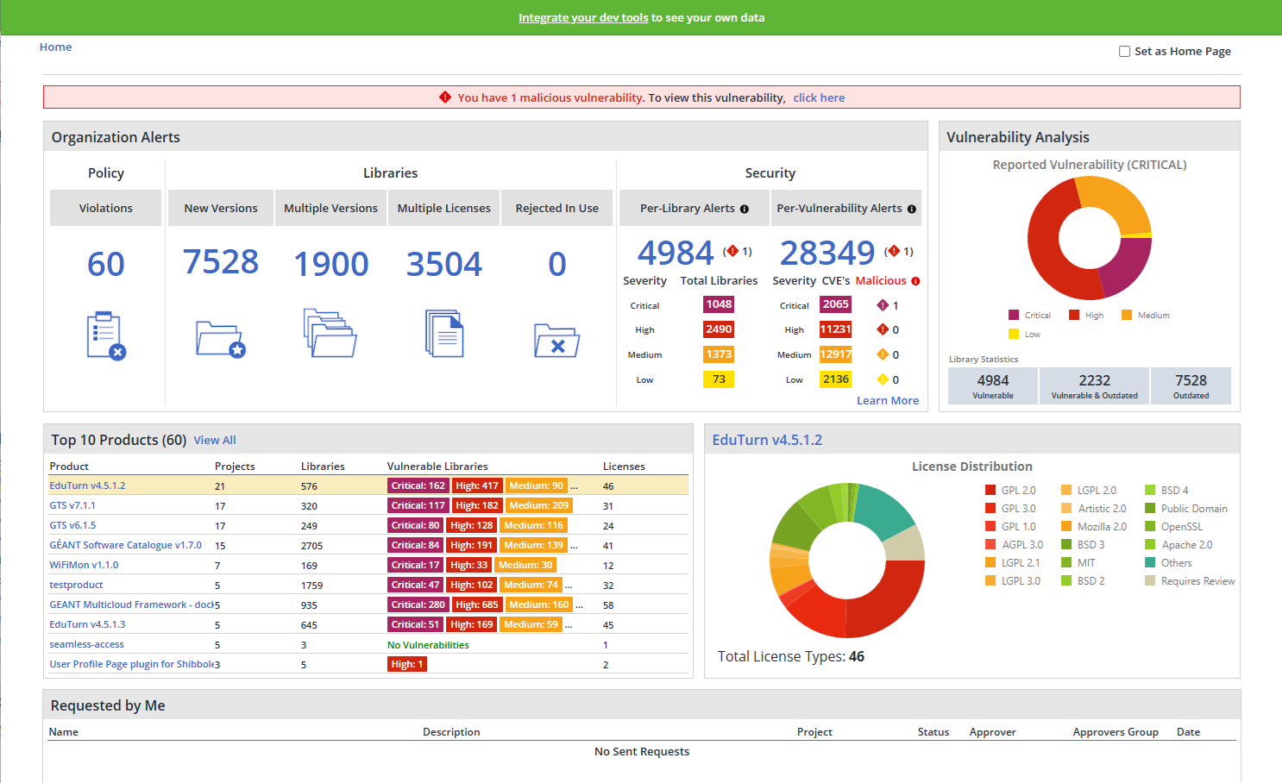
Mend SCA Tool
Mend dashboard
Licences dashboard
Product view
Inventory report
Security alerts

Slide 20
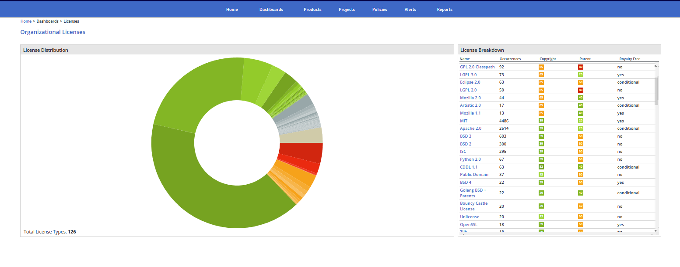
Mend SCA Tool
Mend dashboard
Licences dashboard
Product view
Inventory report
Security alerts

Slide 21
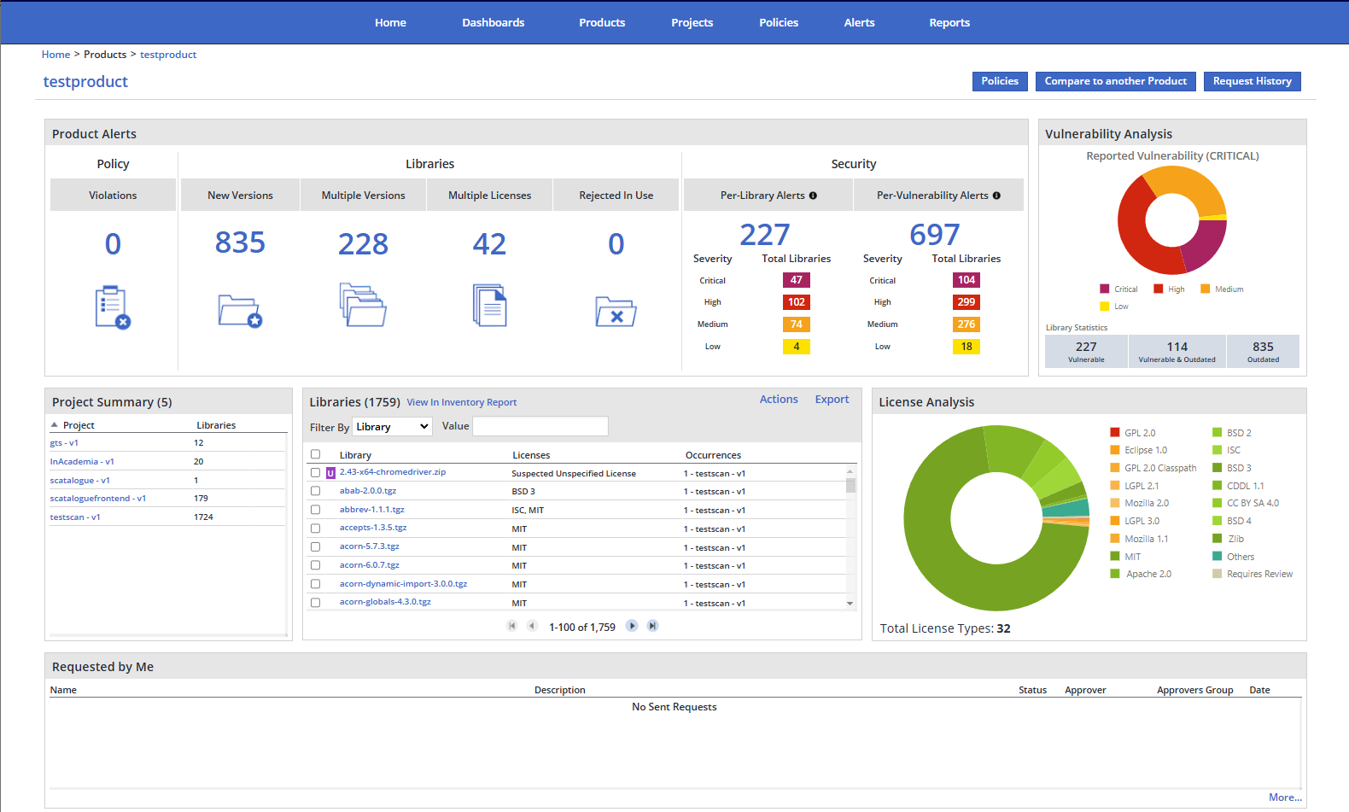
Mend SCA Tool
Mend dashboard
Licences dashboard
Product view
Inventory report
Security alerts

Slide 22
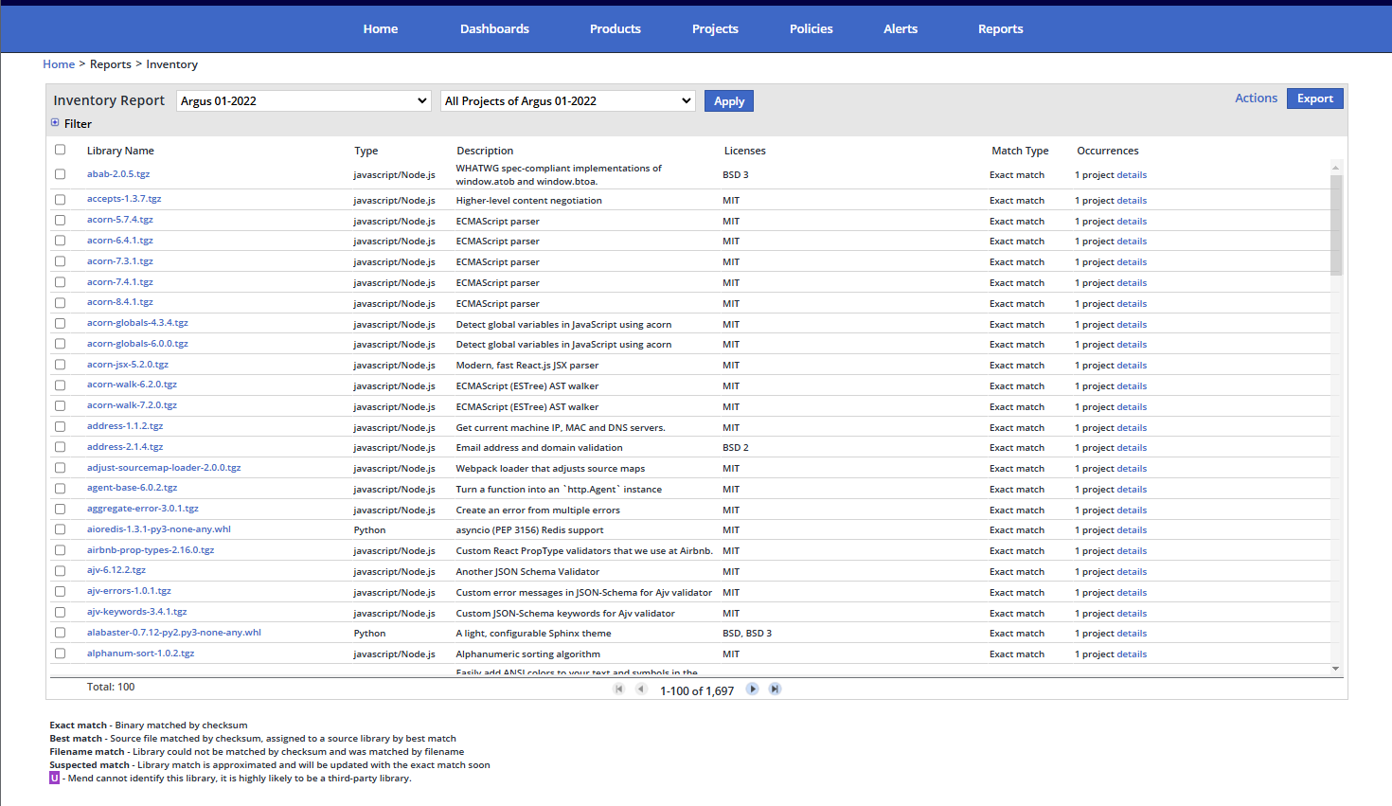
Mend SCA Tool
Mend dashboard
Licences dashboard
Product view
Inventory report
Security alerts

Slide 23
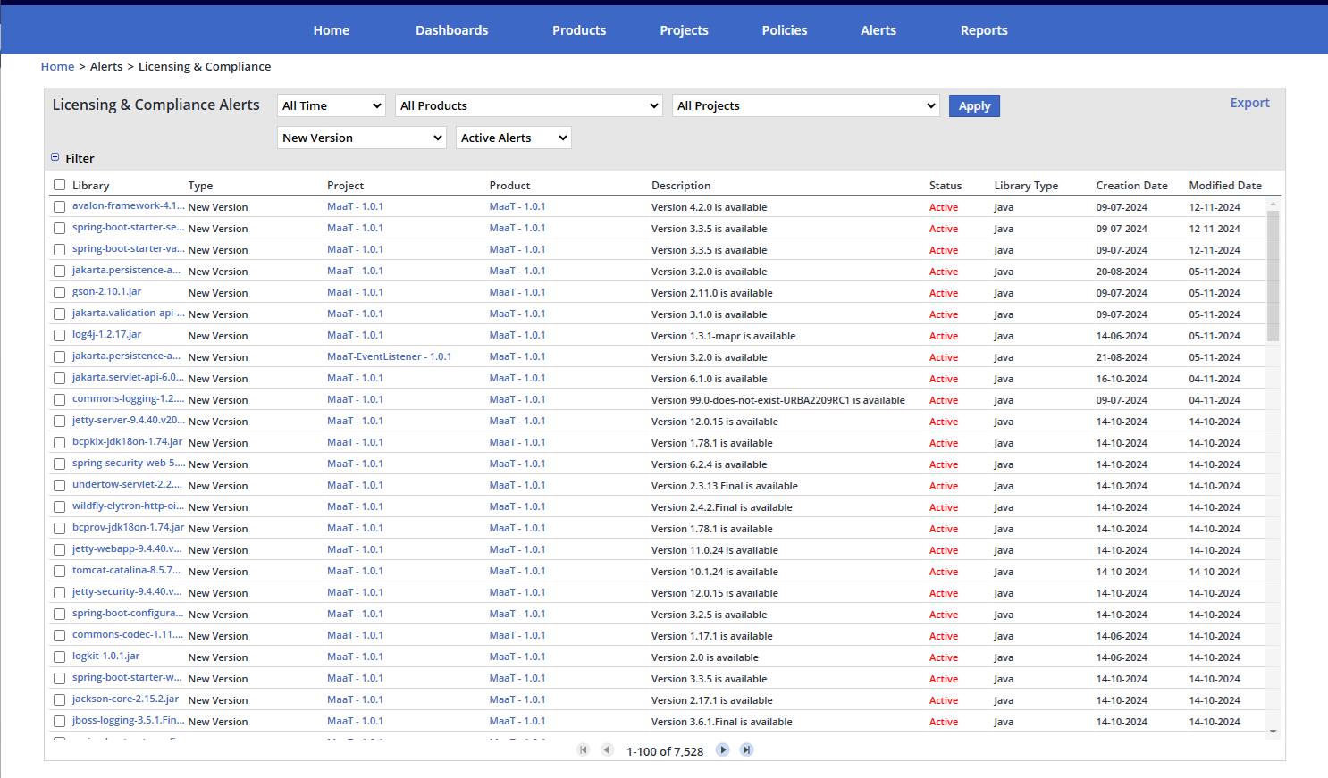
Mend SCA Tool
Mend dashboard
Licences dashboard
Product view
Inventory report
Security alerts
  Obsolete libraries
  By library
  By vulnerability

Slide 24
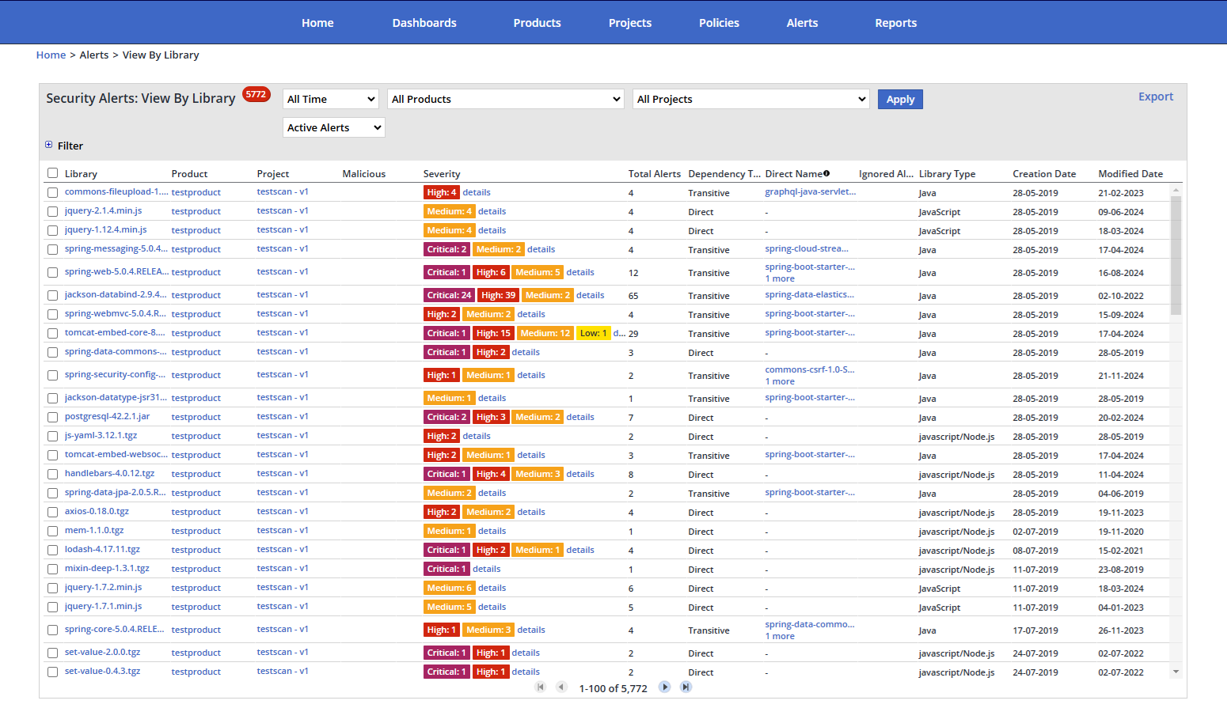
Mend SCA Tool
Mend dashboard
Licences dashboard
Product view
Inventory report
Security alerts
  Obsolete libraries
  By library
  By vulnerability

Slide 25
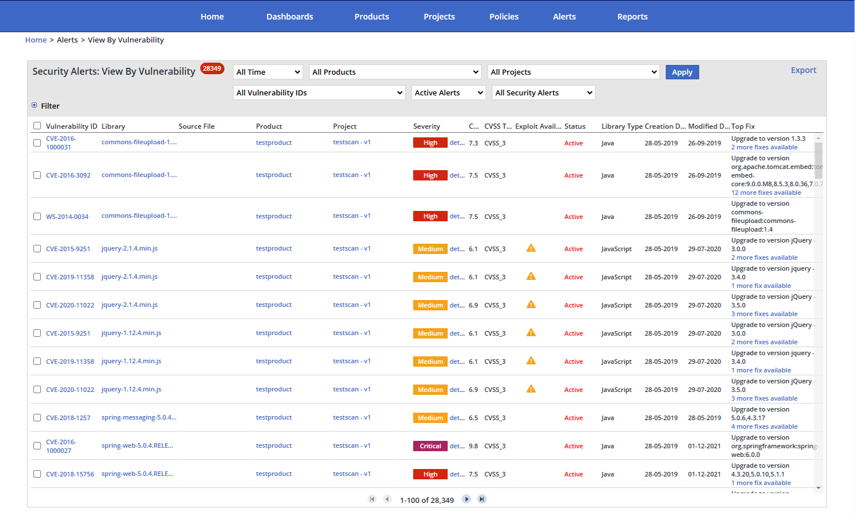
Mend SCA Tool
Mend dashboard
Licences dashboard
Product view
Inventory report
Security alerts
  Obsolete libraries
  By library
  By vulnerability

Slide 26

Mend SCA Tool (Cont.)
Supports compliance but requires manual oversight
  Does not ensure fully accurate licence detection
  Manual verification of indicative (“suspect”) licences is needed
  Multi-licensing and relicensing options often leads to false positives (as if all licences apply at the same time)
  Lacks support for software versioning or differential reports
Manual Software Licence Analysis (SLA) service is recommended.
Notes:
Njw skeme me suport

Slide 27

Software Licence Analysis (SLA) Service
SLA provides technical consultancy on
  Complex relationships between permissive and restrictive licences
  Issues with incomplete or incorrect licence detection
  Multi-licensing, where Mend does not observe licences as alternatives
  Understanding third-party libraries and their licences in a software project
  In-depth analysis and assistance with licence selection and implications
  Recommendations and validation of project documentation artefacts
Notes:
Nje skeme qe ka SLA ne mes dhe pikat qe e rrethojne qe e perbejne

Slide 28
Paul can we have an agenda slide?
Part 2
Open Source Licences Used in GÉANT
28

Slide 29
Course Organisation
Essential aspects of software licensing
Open source licences used in GÉANT
Licensing and artefacts creation process
Compliance and required artefacts
Structure

Slide 30
Open Source Licences Used in GÉANT
Classification of Open Source Licences
Compatibility of Licences Frequently Used in GÉANT
Relationships Between Licences
Project Licence Options
Common Rules and Requirements
Open Source Licences Used in GÉANT
Licence Cheat Sheet
Common Terms
12 Most Frequent Licences

Slide 31

Classification of Open Source Licences
Public domain-equivalent licences
Permissive licences – Requires all combined work to be under same license
Copyleft licences
  Weak copyleft – Minimal restrictions, allow proprietary use
  Strong copyleft – Require sharing modifications under same license, but allow linking with code under other licenses
  Network protective – Prohibits practices on devices restricting modifications

Slide 32

Compatibility of Licences Frequently Used in GÉANT
A limited set of licences is used in GÉANT
Two interpretations of licence compatibility
  Components with distinct licences can be used in the same project
  A component under one licence may be used in software governed by another licence
Licence selection process and rules
  OSS Licences and Licence Selection (https://wiki.geant.org/display/GSD/OSS+licences+and+licence+selection)
Hints for specific licences
  Important Licences for Licence Selection (https://wiki.geant.org/display/GSD/Important+licences+for+licence+selection)

Slide 33
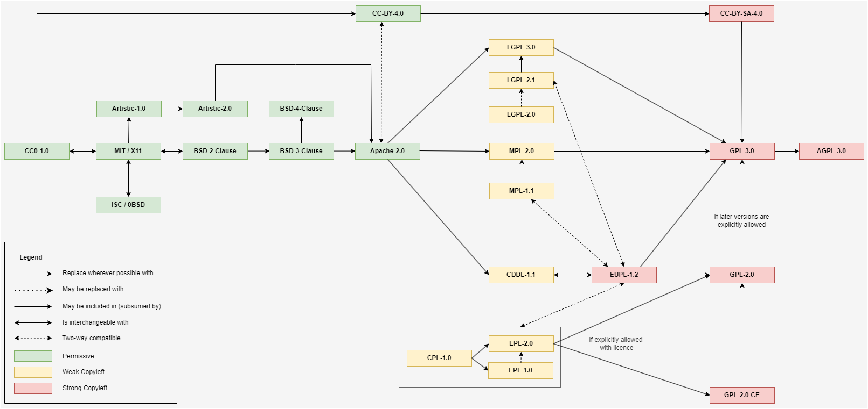
Relationships Between Most Frequently Used Licences in GÉANT

Slide 34

Relationships Between Licences
One-way solid arrow – Subsuming licences
One-way dashed arrow – Suggested replacing
One-way dotted arrow – Possible replacement
Two-way solid arrow – Interchangeable
Two-way dashed arrow – Combining work under either licence

Slide 35
Project Licence Options
Permitting later licence versions
Basically, a licence-endorsed open-ended multilicensing
Allows compatibility with future licence versions
Common in GPL licences
Relicensing under a different licence
Enables relicensing under a secondary licence endorsed by the original or chosen by the licensor and agreed upon by all contributors
Found in licences like EPL and MPL
Extending rights beyond standard terms
Permits commercial use without open sourcing modifications, provides patent grants or allows proprietary versions distribution
Often found in Apache licences
Placing limitations on certain uses or modifications
Some licences allow the addition of specific conditions
Apache 2.0 permits adding such conditions
Choosing jurisdiction
Licensors can choose governing jurisdiction
EUPL licence: litigations are subject to the jurisdiction of the licensor’s location

Slide 36
Common Rules and Requirements
  Original copyrights and other notices typically must be preserved – it is a fair practice anyway
  Right to sublicense (license under different terms) is important
  Permissive licences allow it, which may be undesired sometimes
  Copyleft licences prohibit it (for the relevant code)
Several common licences (GPL family, Apache, Artistic 2.0, EPL, EUPL…) mention patents and include explicit patent grants (explicit provisions)
  Defensive termination: granted patent rights are automatically terminated if the licensee initiates patent litigation against authors or contributors
  Broad patent grants cover all current and future patents owned by contributors that could be infringed by the entire codebase, not just specific contributions
Licences rarely regulate the use of trademarks
  By default, use of names to promote derived products requires specific prior written permission and is governed by trademark law
  The requirement to include copyright notice helps preserve trademarks
  Some licences explicitly restrict or require permission for promotion of derived products

Slide 37
Open Source Licences Used in GÉANT
Detailed descriptions of licences used in GÉANT projects (https://wiki.geant.org/display/GSD/Important+licences+for+licence+selection)
A few more significant licences are also described
Each description includes
  Category (e.g., permissive, copyleft)
  Description
  Requirements
  Compatibility, linking and mixing
  Patent rights
  Additional remarks
Notes:
Duhet bere dicka qe te perfshije pikat

Slide 38
Licence Categories According to Mend
Low Risk
Medium Risk
High Risk
Apache-2.0
Bouncy Castle License
BSD 2-Clause
BSD-3-Clause
BSD-4-Clause
BSL-1.0
CC0-1.0 / WTFPL / Unlicense
CC-BY-4.0
CC-BY-SA-4.0
CDDL-1.0
CDDL-1.1
Golang BSD + Patents
ISC / 0BSD
MIT / X11
NUnit
OpenSSL
Public Domain
Python-2.0
Zlib
Artistic-1.0
Artistic-2.0
EPL-1.0
EPL-2.0
EUPL-1.2
GPL-2.0-with-classpath-exception
LGPL-2.0
LGPL-2.1
LGPL-3.0
MPL-1.1
MPL-2.0
AGPL-3.0
GPL-1.0
GPL-2.0
GPL-3.0

Slide 39

MIT and X11
Permissive, simple, widely used, compatible with other permissive licences
Requirements
Include the original copyright notice in the licence text
Add the licence text to the source code (e.g., in LICENSE)
Change notices are not required
No obligation to disclose source code
Sublicensing is allowed
Compatibility, linking and mixing
Linking-permissive
Can be freely combined with 2-Clause BSD, ISC or MIT code and published under them
Two-way compatible with BSD 3-Clause, MPL and Apache 2.0
Code can be used in GPL, LGPL and CDDL projects
Patent grant: Not mentioned (implicit permission due to “without restriction” is unclear and debated in the US)
Trademark use: Not mentioned; X11 requires written consent for use of the X Consortium name

Slide 40

Apache 2.0
Permissive, widely used, compatible with many open-source licences, grants patent rights
Requirements
Include the original copyright notice in a separate file
Copy and update the original NOTICE file with attribution notes (if present)
Include a notice of significant changes in modified files
No obligation to disclose source code unless distributing derivative works
Sublicensing is permitted
Compatibility, linking, and mixing
Linking-permissive
Two-way compatible with MIT, BSD (2- and 3-Clause), and MPL 2.0
Subsumed by GPL 3.0, LGPL 3.0, and CDDL
Patent rights: Explicit with defensive termination
Trademark use
Explicit prohibition on using trademarks to promote derived products without permission; must preserve all trademark notices

Slide 41

BSD 2- and 3-Clause (Berkeley Software Distribution)
Permissive, simple, widely used, with minimal restrictions on redistribution
The BSD 2-Clause is the simplest BSD licence and the most compatible with other licences
Requirements
Include the original copyright notice in the licence text
No obligation to include a notice of significant changes
No obligation to disclose affected source code
Sublicensing is permitted
BSD 3-Clause: Use of the author’s name to endorse/promote derived products requires written permission
Compatibility, linking and mixing
Linking-permissive
Subsumed by the entire GPL family (including LGPL and AGPL)
Interchangeable with MIT and ISC
Two-way compatible with MPL and Apache 2.0
The BSD 2-Clause is subsumed by BSD 3-Clause and 4-Clause; BSD 3-Clause is subsumed by 4-Clause
Patent rights: Not mentioned
Trademark use
BSD 2-Clause: Not mentioned
BSD 3-Clause: The name of the project or contributors may not be used without written permission

Slide 42
BSD 4-Clause
Permissive, but the most restrictive BSD licence and less common
Requirements
Include the original copyright notice in the licence text
Include an acknowledgment statement
No obligation to include a notice of significant changes
No obligation to disclose affected source code
Sublicensing is permitted
Use of authors’, contributors’ or copyright holders’ names for derived products requires written permission
Compatibility, linking and mixing
Not compatible with GPL; issues may arise when combined with other copyleft licences
Advertising clause: all advertising materials must display: "This product includes software developed by ..." listing all contributors (even for a single component under BSD 4-Clause)
Not compatible with licences prohibiting such a requirement
Subsumes other BSD licences
Patent rights: Not mentioned
Trademark use: Requires written permission plus advertising clause

Slide 43
ISC (Internet Software Consortium) and 0BSD (Zero-BSD)
Permissive, simple and short with minimal requirements
ISC: a “stripped-down” version of the MIT and BSD 2-Clause
0BSD: a simplified version of the ISC, removes the requirement to include a copyright notice
Requirements
Include the original copyright notice in the licence text (not for 0BSD)
No obligation to include a notice of significant changes
No obligation to disclose affected source code
Sublicensing is permitted
Compatibility, linking and mixing
Linking-permissive
Interchangeable with permissive licences like MIT and BSD 2-Clause
Two-way compatible with BSD 3-Clause
Code can be included in projects under GPL, LGPL, MPL, Apache 2.0 and CDDL
Patent rights: Not mentioned
Trademark use: Not mentioned

Slide 44
Public Domain, CC0 1.0 / WTFPL / Unlicense
Public domain dedication and its substitute licence
Public domain is a dedication, not a licence; there are no restrictions
Requirements
No copyright notice or licence text is required (CC0 suggests attribution)
No obligation to include a notice of significant changes
No obligation to disclose modified source code
Sublicensing is permitted
Compatibility, linking and mixing
Linking-permissive
Can be subsumed by all licences and works
Patent rights
Not mentioned
For PD vary by jurisdiction
CC0: Explicit waiver (patent owners retain their rights, users should obtain patent licenses), rights vary by jurisdiction
Trademark use: Not mentioned, for PD varies by jurisdiction
CC0-1.0, WTFPL and Unlicense effectively dedicate a work to the public domain to the extent permitted by law; used when a licence is legally required

Slide 45
LGPL 2.1 and 3.0 (GNU Lesser General Public License)
Weak copyleft, allow linking with modules under licences not considered free by the FSF
LGPL 3.0 prohibits practices that restrict installing or running modified versions
Requirements
Include the original copyright notice and licence text
Include notices of significant changes with dates
Disclose affected source code when distributing the work
No sublicensing is allowed
Modifications to the licensed library must be released under the same licence; the rest of the application can use any licence
Compatibility, linking and mixing
Permits dynamic linking with code under MIT, BSD (2- and 3-Clause), Apache 2.0 and MPL
Derivative works of LGPL 2.1 code must be licensed under the same version (or, if allowed by the licensor, a later version of LGPL) or GPL 2.0 or later
Derivative works of LGPL 3.0 code must use LGPL 3.0 or GPL 3.0 or later
Explicit two-way compatibility with EUPL 1.2
Patent rights
LGPL 2.1: Not mentioned
LGPL 3.0: Explicitly granted (as in GPL 3.0)
Trademark use: Not mentioned

Slide 46
GPL 2.0 with Classpath Exception (GNU General Public License…)
Strong copyleft, Classpath exception allows libraries to be linked without enforcing GPL on the entire work; mainly for Java
The copyright holder can customize the exception in license notice to by listing applicable libraries, defining particular circumstances or use cases, constraining types of linking, or specifying excluded components or situations
Requirements
Include the original copyright notice and licence text
Include notices of significant changes with dates
Disclose the affected source code when distributing the work
No sublicensing allowed
Modifications to the licensed library must be released under the same licence; the rest of the application can use any licence
Compatibility, linking and mixing
Linking-permissive only for executables
The Classpath exception allows GPL-licensed code to be linked with specific non-GPL libraries without forcing GPL requirements on the entire work
Subsumed by the entire GPL family (including LGPL and AGPL)
Modification can preserve the Classpath Exception or revert to the plain GPL 2.0
Patent rights: Not mentioned
Trademark use: Not mentioned

Slide 47
EPL 1.0 and 2.0 (Eclipse Public License)
Weak copyleft; allows releasing the program under a different licence but requires EPL-licensed code to remain under EPL
EPL 1.0 is primarily used by Eclipse projects, but EPL 2.0 is often used by other open source
Requirements
Include the original copyright notice, licence text and notices of significant changes
Disclose affected source code when distributing the work
Sublicensing is permitted
EPL 1.0 code can be relicensed to EPL 2.0
Compatibility, linking and mixing
Linking permissive
EPL 1.0 is not compatible with the entire GPL family (including LGPL and AGPL)
EPL 2.0 can designate GPL 2.0 or later as a secondary licence for explicit compatibility
EPL 1.0 code can be relicensed to EPL 2.0 and vice versa
Code under MIT, Apache 2.0, MPL 2.0 and BSD (2- and 3-Clause) licences can be combined with EPL
Patent rights: Explicit with defensive termination
EPL 1.0: For all contributions and patents necessarily infringed by them, but not the entire program
EPL 2.0: Also for combinations of contributions with the program (broader)
Trademark use
EPL 1.0: Not mentioned
EPL 2.0: Explicit license to use trademarks for "Reasonable and customary use", including includes contributor names in notices and documenting the origin of the program
EPL 1.0 is unsuitable for scripting languages and should be replaced with EPL 2.0 wherever possible

Slide 48
MPL 1.1 and 2.0 (Mozilla Public License)
Weak copyleft with file-level licence
MPL 1.1 is incompatible with GPL without licensor explicitly specifying it as an Alternative License
MPL 2.0 permits relicensing to GPL unless explicitly denied; it is widely used
Requirements
Include the original copyright notice and licence text
MPL 1.1: Include notices of significant changes, including dates; when distributing combined work, disclose affected source code under the same licence
MPL 2.0: include the original copyright notice but no requirement to state significant changes; can sublicense binaries of aggregate works; derivative works can be licensed under any future version of MPL
Compatibility, linking and mixing
Linking permissive
MPL 1.1 is incompatible with the GPL family, including LGPL and AGPL unless the Alternative License option is used, or Larger Work Exception is applied to combine the MPL code into a larger work under other license (except for the MPL part)
MPL 2.0 is subsumed by GPL 2.0, LGPL 2.1, AGPL 3.0 and their later versions
Code under MPL licences can include code under Apache 2.0, ISC, MIT and BSD 2- and 3-Clause
Patent rights
MPL 1.1: Explicit with defensive termination
MPL 2.0: Explicitly granted
Trademark use
MPL 1.1: Cannot use Mozilla’s trademarks without permission; must remove Mozilla trademarks when distributing modified versions
MPL 2.0: Cannot use names of initial developers or contributors to promote derived products without permission

Slide 49
GPL 2.0 and 3.0 (GNU General Public License)
Strong copyleft
GPL 2.0 is considered very US-centric and is widely used
GPL 3.0 is incompatible with GPL 2.0-only, provides an option for licensors to add or upgrade to any later version
GPL 3.0 addresses issues with hardware restrictions ('tivoization'), digital rights management, and patent rights not covered in GPL 2.0, ensuring that users can modify and run the software on their devices
Requirements
Include the original copyright notice and licence text
Include notices of significant changes with dates
Disclose affected source code when distributing derived works, except for private use
Cannot be sublicensed
Compatibility, linking and mixing
Not linking permissive
GPL 2.0: Compatible with the same version of GPL only unless “or later”; original authors can upgrade to GPL 3.0 or later
Can be combined with AGPL 3.0-licensed code under AGPL 3.0
Code under GPL 2.0 can be combined with LGPL 2.1; can be licensed under either GPL 2.0 or LGPL 2.1
Code under GPL 3.0 can be combined with LGPL 3.0; the resulting work is under GPL 3.0
GPL 3.0 can be combined with Apache 2.0; GPL 2.0 is not compatible with Apache 2.0
Code under MIT, ISC and BSD 2- and 3-Clause can be included in GPL projects
Patent rights
GPL 2.0: Not mentioned !CS Implicit
GPL 3.0: Explicit with defensive termination
Trademark use: Not mentioned

Slide 50
AGPL 3.0 (Affero GPL)
Strong copyleft with server-side source code disclosure required
Similar to GPL 3.0 but requiring to enable source code access on remote use
Recommended for “freeing” network-based software
If modified AGPL software is used over a network, must provide access to the source code
Requirements
Include the original copyright notice and licence text
Include notices of significant changes with dates
Disclose affected source code when distributing combined work
No sublicensing allowed
Compatibility, linking and mixing
Not linking permissive
Subsumes GPL 3.0
Patent rights: Explicit with defensive termination
Trademark use: Not mentioned

Slide 51
“Who Wants to Be a Millionaire?” Questions
What is…?
Copyleft
Derivative Work
FOSS (Free and Open Source Software)
FSF (Free Software Foundation)
GPL (General Public License)
IPR (Intellectual Property Rights)
Licensing
OSI (Open Source Initiative)
OSS (Open Source Software)
Patents
Permissive Licence
Software Licence
Strong Copyleft
Trademark
Weak Copyleft
Notes:
Bej nje design te ngjashem me Who wants to be a millionaire?

Slide 52
Licence Cheat Sheet
Low-Risk Licences
Licence | Patent Grant | Notes
Apache-2.0 | Yes (defensive, broad) | Permissive, widely used. Grants patent rights for using the software, reciprocal patent grants may be required.
Bouncy Castle License | No | MIT-like, specific to cryptographic libraries.
BSD 2-Clause | No | Similar to MIT, widely used, requires only preservation of copyright and license notices.
BSD-3-Clause | No | Similar to BSD-2-Clause, widely used, adds only non-endorsement clause for promotional use.
BSD-4-Clause | No | Adds advertising clause to BSD-3-Clause, generally deprecated.
BSL-1.0 | No | Used for Boost C++ libraries, business-friendly, converts to MIT after specified period.
CC0-1.0 / WTFPL / Unlicense | No | Public domain dedication licences, no restrictions, not considered open source.
CC-BY-4.0 | No | Attribution license for creative works, not for software.
CC-BY-SA-4.0 | No | Copyleft, attribution required, for creative works and publicly managed docs.

Slide 53
Licence Cheat Sheet
Low-Risk Licences (cont.)
Licence | Patent Grant | Notes
CDDL-1.0 | Yes (defensive) | Weak file-level copyleft, similar to MPL, not compatible with GPL.
CDDL-1.1 | Yes (defensive) | Minor updates to CDDL-1.0.
Golang BSD + Patents | Yes (defensive, broad) | BSD-3-Clause with patent grant for all patents similar to Apache-2.0.
ISC / 0BSD | No | Similar to MIT but with simpler language.
MIT / X11 | No | Simple, widely used, requires only preservation of copyright and license notices.
NUnit | No | For NUnit testing framework, minimal restrictions.
OpenSSL | Yes (essential) | Apache-2.0-like, with specific requirements for OpenSSL libraries, grants rights to essential patents.
Public Domain | No | Works not subject to copyright, no restrictions.
Python-2.0 | Yes (limited) | Similar to Apache-2.0, compatible with GPL, with specific terms for Python.
Zlib | No | For zlib compression library, minimal restrictions, requires notice for modifications.

Slide 54
Licence Cheat Sheet
Medium-Risk Licences
Licence | Patent Grant | Notes
Artistic-1.0 | No | Weak copyleft with flexible terms, mainly used for Perl.
Artistic-2.0 | No | Clarified terms from Artistic-1.0, GPL compatible.
EPL-1.0 | Yes (defensive) | Primarily for Eclipse projects, commercial-friendly, not GPL compatible, replaceable with EPL 2.0.
EPL-2.0 | Yes (defensive, broad) | Similar to EPL-1.0, popular among open-source projects, commercial-friendly.
EUPL-1.2 | Yes | Strong copyleft compatible with GPL and other, multi-lingual.
GPL-2.0-with-classpath-exception | No | GPL-2.0 with linking exception, used mainly for Java.
LGPL-2.0 | Yes | Allows linking with non-GPL software while ensuring open source modifications.
LGPL-2.1 | No | More explicit linking terms than LGPL-2.0.
LGPL-3.0 | Yes | LGPL-2.1 update prohibiting restricting practices on devices.
MPL-1.1 | Yes (defensive) | Weak file-level copyleft, older version, can be explicitly relicensed to GPL.
MPL-2.0 | Yes (defensive, broad) | Flexible and widely used, weak file-level copyleft, permits relicensing to GPL unless denied.

Slide 55
Licence Cheat Sheet
High-Risk Licences
Licence | Patent Grant | Notes
AGPL-3.0 | Yes (defensive) | GPL-3.0 with source requiring code disclosure network use.
GPL-1.0 | No | Early version, less common.
GPL-2.0 | No | Widely used, incompatible with GPL-3.0 unless “or later”.
GPL-3.0 | Yes (defensive) | More explicit terms, incompatible with GPL-2.0-only, prohibits restricting practices on devices.

Slide 56
Part 1
Essential Aspects of Software Licensing
Paul can we have an agenda slide?
56
Part 3
Licensing and Artefacts Creation Process
56

Slide 57
Course Organisation
Essential aspects of software licensing
Open source licences used in GÉANT
Licensing and artefacts creation process
Compliance and required artefacts
Structure

Slide 58
Essential Aspects of Software Licensing
Licensing Process Overview
Preparation
One or Several Projects?
Information Gathering and Documenting
Remediation
Creating Licence-Related Artefacts
Continuous Licence Management
Tracking and Licensing Documentation, Data and Other Works

Slide 59
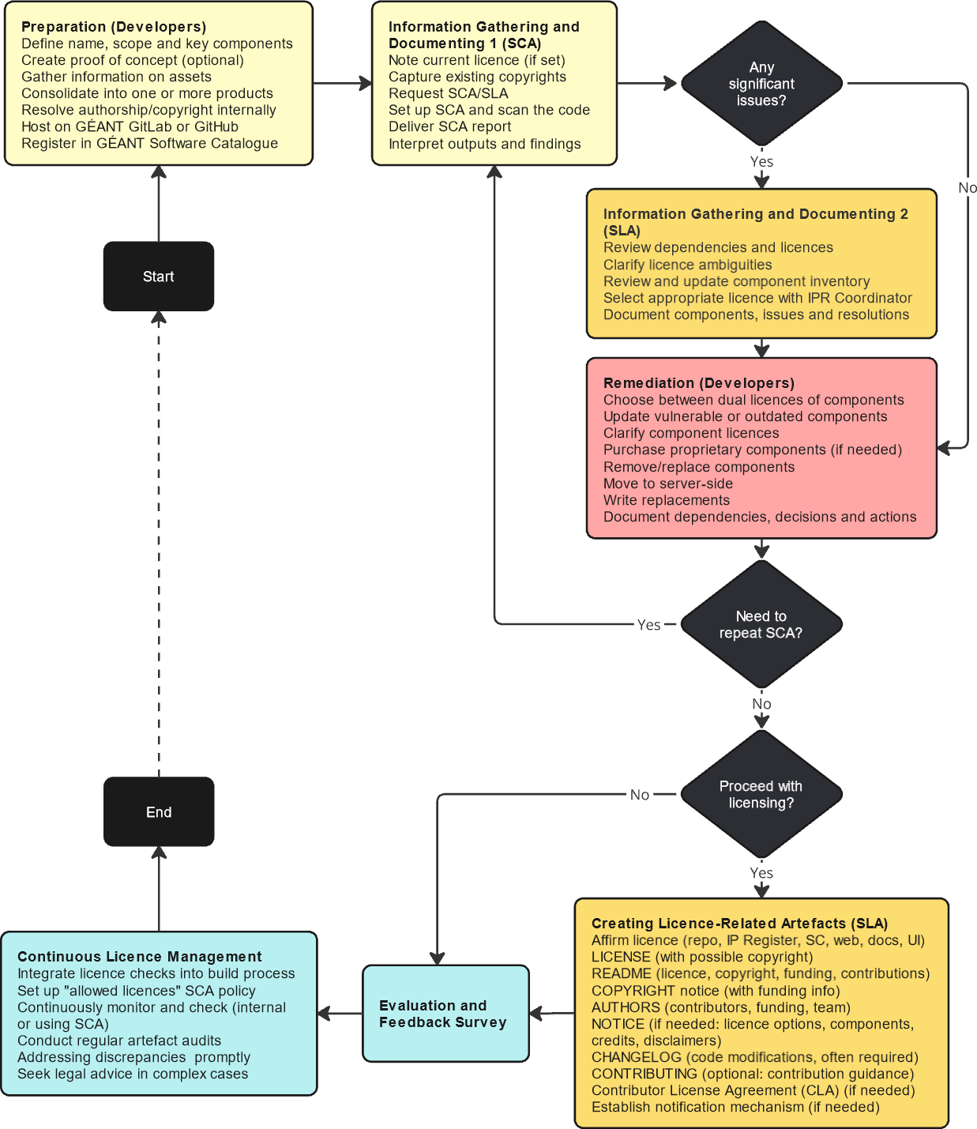
Licensing Process Overview
Gathering information
  Primarily using Mend
Documenting
  Partially by Mend
Remediating
  By the development team
Creating licence-related artefacts
  Prepared by developers, checked by the licensing team
Notes:
Te ndryshohet skema

Slide 60
Licensing Process Steps and Artefacts
Preparation
Decide on the software name, project grouping and usage of IPR (source code, libraries, frameworks, datasets…)
1
For new projects, create a proof of concept or prototype to validate key components
2
Gather pre-existing information and documentation for components, models, assets and other contributions
3
Consolidate internal components into a single project or clarify relationships if they remain separate
4
Resolve authorship and copyright matters internally
5
Host the project on GÉANT GitLab or GitHub
6
Register the project in the GÉANT Software Catalogue
7

Slide 61
Licensing Process Steps and Artefacts
One or Several Projects?
Identify components for SCA analysis
Conduct integrated analysis for larger projects and their subprojects to ensure understanding of components
  Integrated view ensures sound licence governance of the entire project
However, a wide scope can lead to loss of focus
  Include additional components only when necessary
  Ensure licence governance aligns with the project scope
Use Mend sparingly for non-GÉANT projects
Align project grouping with features, products or branding decisions
Notes:
Mendohet dicka….

Slide 62
Licensing Process Steps and Artefacts
Information Gathering and Documenting
Specify the current licence
Record copyrights
Request SCA and SLA services
Scan the project codebase
Review SCA outputs and findings
Use the SLA service for unresolved issues or additional assistance
Document dependencies and their licences
Review and update the component inventory
Clarify ambiguities or doubts
Document all findings
Consult the licensing team and IPR Coordinator
Select an appropriate licence
Document decisions

Slide 63
Licensing Process Steps and Artefacts
Remediation Actions
Select a more appropriate project licence
Implement quick fixes
Updating or replacing vulnerable or outdated open source components where possible
Investigating unclear component licences or seeking clarification or relicensing from authors
Purchasing necessary proprietary software licences
Choosing among dual-licence options for components
Identify remaining incompatible licences and decide on actions
Removing non-essential components
Replacing them with available alternatives
Moving them to a server-side setup by providing functionality via a central service
Developing alternatives to meet required functionality
Accept certain risks where unavoidable and unlikely
Notes:
Nje skeme per veprime tipike

Slide 64
Licensing Process Steps and Artefacts
After Remediation
Update internal information about document
  All detected and tackled dependencies
  Their licences
  Features they provide (and how critical they are)
  Licensing and remediation decisions
  Remediation actions conducted
Repeat SCA and remediation steps as necessary
Notes:
Nje skeme per veprime tipike

Slide 65
Licensing Process Steps and Artefacts
Creating Licence-Related Artefacts
Provide a LICENSE file
Place it in the root directory
Ensure it contains the exact text of the selected licence
Header comments in source code files are generally unnecessary
Declare the licence
Update project documentation to reflect the selected OSS licence
Use any available repository features to declare the licence
Declare licence options
Some options must be explicitly stated
Accepting later licence versions or relicensing under specific licences
These are declared in the README and, if needed, elaborated in NOTICE
Document the project licence
GÉANT Software Catalogue
IP Register is managed by the IPR Coordinator

Slide 66
Licensing Process Steps and Artefacts
Creating Licence-Related Artefacts (cont.)
Provide a copyright notice
In the COPYRIGHT, including funding information
Copyright information for third-party components
Produce a README file
Include licence information
Provide instructions for accessing the full licence text
Explain the licence’s implications for users and contributors
Add licensing badges to the README file
Document code modifications
Check the licence text to determine whether documenting code modifications is necessary
Document the history of changes the CHANGELOG if required by the licence
Document dependencies
List the licences of directly included dependencies in a dedicated file or project documentation
Credit contributors, acknowledge funding and reference relevant work packages or tasks
For source code components in subfolders, store their licences, copyrights and notices

Slide 67
Licensing Process Steps and Artefacts
Creating Licence-Related Artefacts (cont.)
Document licence adherence, contribution and updating
Provide guidance for users and contributors on adhering to licensing requirements in an appropriate file
Outline contribution and copyright guidelines
Contributor License Agreement (CLA) if necessary
If the selected licence requires a CLA, establish one to define contribution terms and ensure mutual understanding
Some licences offer suitable CLA forms
Clearly outline the CLA process in the README and detail it in the CONTRIBUTING file
Place the CLA in the appropriate file
Creating a Developer Certificate of Origin (DCO) is a lightweight alternative to a CLA
Establish a licence notification mechanism
Once licence artefacts are complete, they should be assessed by the SLA team and the IPR Coordinator
Complete the SLA/SCA Evaluation and Feedback Survey

Slide 68
Licensing Process Steps and Artefacts
Continuous Licence Management
Integrate licence-related checks into the build process
Can be partially automated by integrating dependency and licence checks into CI/CD toolchains
Using tools such as the License Maven Plugin to generate a list of dependencies and their licences, download licence files, check, update or remove licence headers in source files, and update (or create) the main project licence file
Verify and review tool outputs
Establish continuous monitoring and compliance checks
Stay informed about updates to the chosen OSS licence
Review the potential impact of component licence updates on the project
Establish processes for continuous compliance checks, repeating SCA and SLA as needed
Perform regular audits of licence-related artefacts
Ensure the project’s licence-related artefacts are accurate and up to date
Resolve discrepancies promptly
Seek legal advice from the IPR Coordinator when necessary

Slide 69
Tracking and Licensing Documentation, Data and Other Works
Documentation, data and datasets licences
Tutorials, presentations, training or promotional materials – use Creative Commons BY, CC BY-NC, or GNU FDL
Data – embedded data under OSS licences, standalone data under data-oriented (such as Open Data Commons) or CC licences
Datasets – commonly under CC and ODC
Document and attribute external data sources
In the software itself or in its documentation
Data may come with specific licence requirements or restrictions
Applies to all data provided with the software or used for its operation
Compliance with terms for proprietary or open data licences
Specific terms for public reference information, data contained in external libraries or modules
Use or modification of externally developed work other than software
Database models, architectural designs, development frameworks, or code generated by tools
Software must comply with specific licence terms
Special cases for copyleft OSS licences or non-OSS licences like Creative Commons with NC (NonCommercial), ND (NoDerivatives) or SA (ShareAlike) clauses
Such works are unlikely to be detected by SCA tools
Document and communicate their use and licences as soon as they are incorporated
Annotate assets, configuration files, scripts, and guides with provenance and licence details for traceability
Failure to state necessary details when adding such assets can make their identification and tracing difficult later

Slide 70
Part 1
Essential Aspects of Software Licensing
Paul can we have an agenda slide?
70
Part 4
Compliance and Required Artefacts
70

Slide 71
Course Organisation
Essential aspects of software licensing
Open source licences used in GÉANT
Licensing and artefacts creation process
Compliance and required artefacts
Structure

Slide 72
Compliance and Required Artefacts
Complying with Licences of Used Code
LICENSE
README
COPYRIGHT
AUTHORS
NOTICE
CHANGELOG
Copyright and Licence Notices in Source Code
Checklist for Preparing and Validating Project Files
Placement of Information
Complying with Selected Licence

Slide 73
Placement of Information
README is the primary entry point for users
Highlighted by GitHub and GitLab - displayed when the project’s root folder is opened
Summarises key information, including copyright and licence
COPYRIGHT states who owns the copyright over the software
Typically copyrighted by GÉANT, NRENs or other organisations
LICENSE includes the full licence text
Usually not modified to reflect specific options used in a project
NOTICE includes additional legal information
Statement confirming the licence applied to the project and any disclaimers
AUTHORS lists contributors
Data on individuals or organisations contributing to the software
CHANGELOG tracks the project’s development history
Data on changes, facilitating troubleshooting and identifying potential issues

Slide 74
Complying with a Selected Licence: What and When?
This section guides developers after selecting a licence
Developers must comply with all requirements (obligations and restrictions) of the chosen licence
Project artefacts should make it clear which licence is applied and how
The licence must be also clearly stated in the documentation
This is mandatory unless the software is intended for
Internal use only
Publicly available service without any AGPL-licensed dependencies
Notes:
Mendohet dicka….

Slide 75
Complying with a Selected Licence: Where and How?
Minimal documentation typically includes:
  README for project information
  LICENSE for licensing details
  CONTRIBUTING for contribution guidelines
The licence may also require a CHANGELOG or CHANGES file to track updates
All files should be placed in the project or component root folder
Templates and examples are available to assist in creating artefacts (https://wiki.geant.org/display/gn51wp9t2/Templates+and+Examples+for+Project+Artefacts)
Online tools like Dillinger and StackEdit can help create required files in markdown format
Notes:
Mendohet dicka….

Slide 76
Compliance with Licences of Used Code
Meet obligations imposed by licences governing dependencies or reused code
  Explicitly declare and credit dependencies or reused code in README, COPYRIGHT and NOTICE
  Retain existing licence/copyright files and notices
  Attribute and document modifications, updating change history and contributor list
  Monitor licence updates for used code
Eclipse- and Mozilla-licensed dependencies require explicit references in project documentation
When using dependencies under Apache 2.0 in projects with a different licence
  Include the original copyright notice
  Provide a copy of the Apache licence
  Describe significant code changes
  Maintain a NOTICE file with attribution

Slide 77
README File
Provides a project overview and key technical and legal details
Purpose and features
Scope, requirements and supported settings
Installation and configuration
Usage
Documentation
Roadmap and known issues
Community contributions
Funding, acknowledgements, dependencies and tools used
Licence and copyright
Keep it as short as possible

Slide 78
LICENSE File
Includes the full licence text, defining terms of use, modification and distribution
Copy from the official source
Licence text typically explains available licensing options and how they should be declared
Include a statement confirming the licence applied to the project
README file – indicate “or later” if applicable
NOTICE file – elaborate on all applied licensing options
Confirm with the GÉANT IPR Coordinator

Slide 79
COPYRIGHT File
Documents copyright ownership and associated project details
Expressed through a copyright statement
Copyright statement referencing GÉANT and work years
MIT, BSD and ISC include a one-line copyright statement in LICENSE
A detailed statement and disclaimer are also required
Developers must indicate the copyright but are often not familiar with this
Software is protected by copyright law
Additional statements require IPR Coordinator approval
OSS licences often mandate retaining original copyrights and specific user rights

Slide 80
AUTHORS File
Lists contributors and acknowledges individuals or organisations
May be named CONTRIBUTORS
Credit all significant contributors, not just developers
Can refer to GÉANT work packages or tasks
Acknowledge contributions from external teams or individuals
Include funding information
Add additional acknowledgements as needed

Slide 81
NOTICE File
Documents legal information, credits and attributions for dependencies
Required by some licences
Considered good practice
Update if already in the project
Credit libraries, frameworks, tools or any other intellectual property used
Content and format
Chosen licence, with information about licence options, secondary licences, exceptions, additional permissions or disclaimers
Some licences require preserving content from existing NOTICE or dependencies

Slide 82
CHANGELOG File
High-level history of changes (features, fixes, updates)
Required by some licences
May also be named CHANGES or HISTORY
Chronological history
The latest changes appear at the top
New features, significant changes, additions, bug fixes and other modifications
Each entry corresponds to a release and may contain sub-items
Supported by systematic tracking via commit notes and the roadmap
Use simple version numbers
Considered good practice

Slide 83
Checklist for Preparing and Validating Project Files
README (Mandatory)
AUTHORS (Optional)
Software name
Optional key attributes and badges
Sections with subtitles
Purpose, context and prerequisites
Brief installation, configuration and usage
Credit GÉANT and relevant parties
Include the EU logo
Simple copyright statement
Licence and options like “or later”
Keep ir concise
LICENSE (Mandatory)
Confirm with the IPR Coordinator
Use the official licence text
COPYRIGHT (Mandatory)
Verify with the IPR Coordinator
Include the EU logo and required text
List contributors with contact details
May credit project phases or tasks
NOTICE (Optional)
Not necessary if all information is in the README
Acknowledge third-party components with licences, URLs and copyrights
Optionally mention tools used
Include required notices for components, if applicable
CHANGELOG (Recommended)
Required for many licences
Provide a high-level change history
Use a standard format
“Initial public (or production) release” at the bottom

Slide 84
Thank You

