Slide 1


GÉANT Cloud update
GÉANT updates sessioon
Maria Ristkok
GÉANT Cloud Team, Adoption Support, Task Leader
SIG-Marcomms, Lisbon, 28 September 2018
www.geant.org

Slide 2

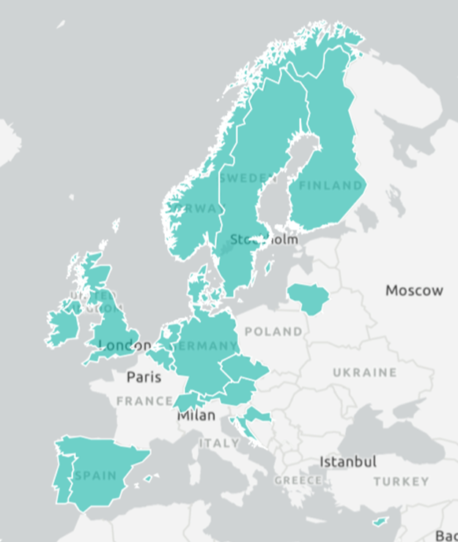
Consumption of the Infrastructure as a Service Framework
Austria
Belgium
Croatia
Czech Republic
Cyprus
Denmark
Finland
Germany
Ireland
Lithuania
Luxembourg
Netherlands
Norway
Portugal
Spain
Sweden
Switzerland
UK

Slide 3
Adoption Support for NRENs since March 2018
Workshops on IaaS: Microsoft Azure and Amazon Web Services (AWS)
Preferential offers through GÉANT
GDPR amendments for IaaS Framework
Presentations at conferences and other events
New IaaS Framework use cases
Weekly Forums and Webinars
Cost Benchmarking Report
Button Project

Slide 4
IaaS Framework Use Cases
Azure:
Quality and Qualification Ireland (QQI, Ireland)
ROC Midden Nederland (Netherlands)
Vancis:
Arcus College (Netherlands)
CloudSigma
Lycée des Arts et Metiers-Luxemburg (LAM, Luxembourg)
In process:
Royal College of Surgeons in Ireland (RCSI)
InHolland University of Applied Sciences

Slide 5
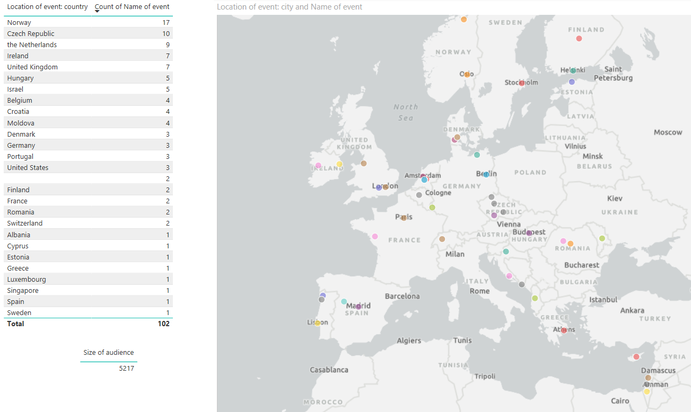
Cloud Events 2018: presentations, attendance, workshops, etc
Ca 100 events covered all over Europe

Slide 6
Technical workshops on Azure and AWS in Utrecht, 4-5 September 2018
Institutions all over Europe using IaaS Framework
40 people: 33 participants, 5 instructors, 2 GÉANT Cloud Team (1 woman!) + a dog
Taylor made workshops by concrete use cases
Very positive feedback both from participants and instructors (by evaluation form)
Most valued: meeting colleagues from other universities and sharing experiences
Future need: more hands-on deep dive workshops, but also webinars

Slide 7
Weekly Forums and Webinars
Weekly Forums:
  Cloud Management Platforms
  Cloud Strategy and Security
  IaaS FW offers + preferential offers (Dropbox, ENTER)
  AWS Spot Market
  GÉANT Cloud Team Button Project
  Cost Benchmarking Report
  Norwegian HE cloudification project
  Cloud Survey
Webinars:
  IaaS FW for CEE countries
  Azure
  AWS

Slide 8
Preferential Cloud Offers and GDPR Amendments
Preferential pricing offers (not framework)
Dropbox
ENTER
WIRE
GDPR Amendments for IaaS FW contracts

Slide 9
Cloud survey planned for institutions
Respondents
Timeframe
Sent out latest early October 2018
Time to answer ca 1 month
Analysis in November, results ready in December
Content
Needs for clouds
Input for GÉANT for next 4 years (GN4-3, OCRE)
Institutions

Slide 10
Commercial clouds
for research
GÉANT will ensure tender outcomes are available
to education as well
GN4-3 WP4
Hybrid multi-clouds for education and research
Commercial clouds (for education)
Community clouds - opportunity

Slide 11
GN4-3 and OCRE (2019-2021)
Ensure
Ensure even better cloud service delivery
Hybrid cloud delivery platforms
Cloud security
Connectivity and easy access
Utilize and scale up
Utilize and scale up the delivery system we have set up to provide more services
Community cloud services
Learning management, educational tools
Explore
Explore new areas
Machine learning
Artificial intelligence
Container-based virtualization

Slide 12

OCRE project:
2019 “Mother of all cloud tenders”
Commodity type commercial digital services:
  Infrastructure as a Service (IaaS)
  Providing compute, storage, network
  Platform as a Service (PaaS)
  Software as a Service (SaaS)
    File storage (sync & share)
    Online collaboration
    Simulation and virtualisation tools
Plus secure Earth Observation commercial service
  Making use of Copernicus Data Information Access Services (DIAS)

Slide 13


OCRE
GÉANT is the project coordinator.
Adoption funds 9.5 MEURO
For research community
Through a number of adoption waves
User segments:
  Individual researchers
  Individual institutions
  Groups of institutes (buyer groups)

Slide 14

Thank you!
maria.ristkok@eenet.ee

