Slide 1


Social media communications
25/09/2018
Maximising the advocacy of projects and people
Notes:
Go to ‘View’ menu > ‘Header and Footer…’ to edit the footers on this slide (click ‘Apply’ to change only the currently selected slide, or ‘Apply to All’ to change the footers on all slides).
To add a background image to this slide; drag a picture to the placeholder or click the icon in the centre of the placeholder to browse for and add another image. Once added, the image can be cropped, resized or repositioned to suit.

Slide 2
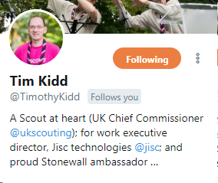
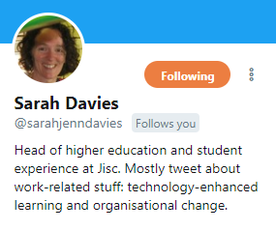
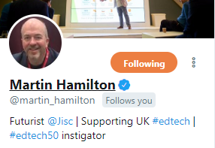
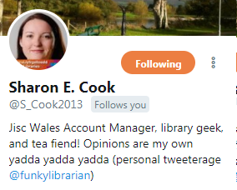

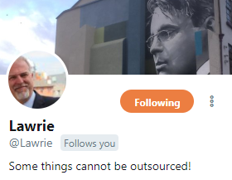
Colleagues as advocates
You can’t stop staff using social media to talk about their work.
What are the risks?
  Conflicting messages / timing of announcement from central communications
  Confidential information being shared
  Mixing personal and professional views
What are the potential advantages?
  Grow your organisation’s social media reach
  Connect with hard-to-reach industry professionals
  Present the human side of the organisation
How do you minimise the risks while getting the most out of the potential benefits…?
A policy and training that encourages the use of social media professionally and gives staff the confidence it use it effectively.
Notes:
Key points:
Without good confidentially reasons, you can’t stop employees/colleagues using social media to talk about their work. This comes at a risk e.g. announcing projects before they are ready, criticism of employer or partners, personal views confused with professional ones.
The challenge is harnessing their enthusiasm rather than policing their activity, which is what we do at Jisc
In addition to the potential risks, their social media activities can also have many advantages. They be of great benefit to themselves (raise their profile in the industry, get their own work noticed by others, networking and connecting with key influential people etc.) but it can also be huge benefit to the organisation. On social media people like connecting with people more than they like connecting with corporate logos. Therefore, employees give organisations the opportunity to grow the reach of their network and reach people who wouldn’t normally follow or associate with a corporate account.
This means that if you have a network of people (employees) sharing and talking about your organisation, your reach and influence can grow exponentially. This is especially powerful if your colleagues represent a wide range of subject areas/industries as each will have their own unique network which the organisation can tap into. At Jisc we have 23 highly active social media users tweeting and sharing posts about their work at Jisc, and approximately 75 or so other members of staff regularly mentioning the work of Jisc on social media.
How to minimise the risks while capitalising on the advantages? First step is to create a social media policy. Jisc’s was developed in partnership with the most active social media users in the organisation – the majority of whom were not in communication roles.
The policy needs to encourage the right kind of social media activity without being so prescriptive that it damages creativity and enthusiasm. It also needs to give colleagues confidence in understanding what is and isn’t acceptable use so that it becomes second nature. It should also highlight the benefits of being part of the organisation’s network of social media users – that they will have a much more influential reach working together i.e. not premeditating project launches/updates and working with central comms etc, than they will on their own.
Once a policy is implemented, it gives credibility to the work of those active users and can encourage others to follow suit.
One of the ways we monitor what our network of advocates are saying is a Twitter list of the colleagues most active on Twitter: https://twitter.com/Jisc/lists/tweeting-jiscies

Slide 3
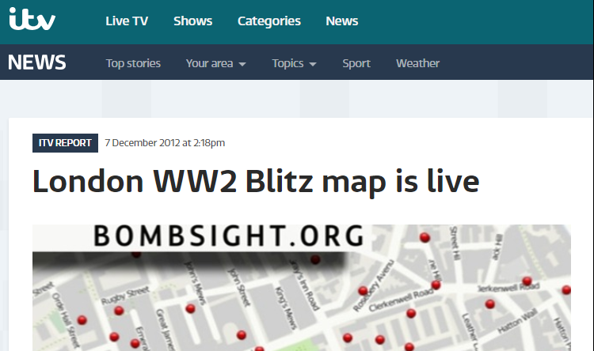
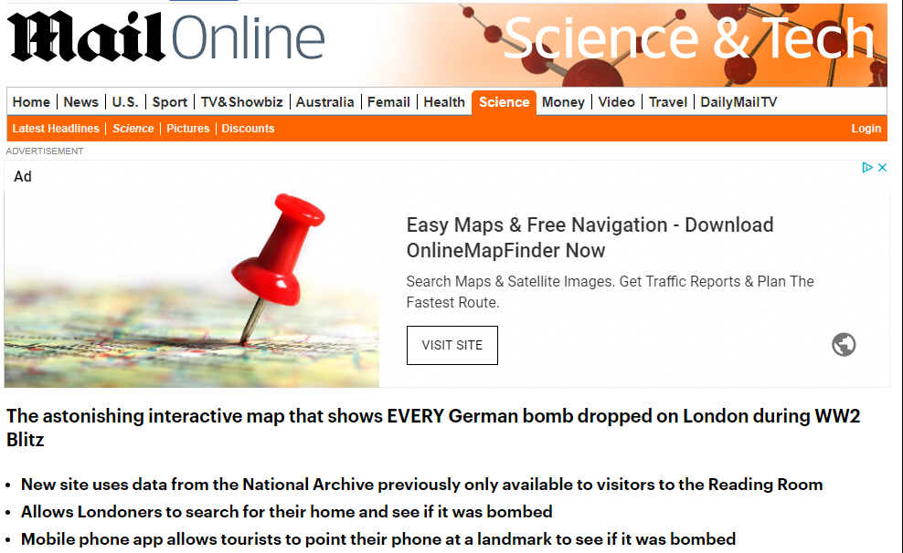
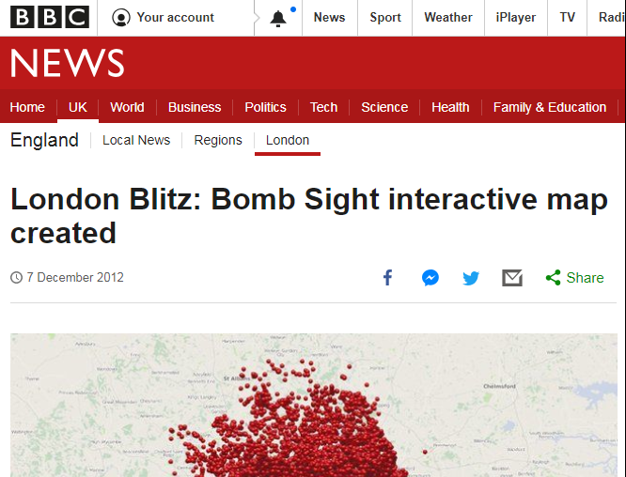
What can go wrong?
A Jisc-funded project called Bomb Sight was one week off launching and tested a beta link on its Twitter feed
Immediately picked up by national media
Web server struggled to keep up with the volume of traffic
Jisc supported them with PR, media interviews and social media activity.
Worked quickly to make sure Jisc was mentioned
Notes:
On the 6 December 2012 a Jisc-funded project called Bomb Sight, tested a beta link on its Twitter feed – not realising the impact - the link went viral.
The UK’s media picked up the story immediately with coverage in the DailyMail, BBC Newsnight online and many others.
https://www.dailymail.co.uk/sciencetech/article-2243951/The-astonishing-interactive-map-EVERY-bomb-dropped-London-Blitz.html
The project wasn’t due to launch until the following week. Their web server struggled to keep up with the volume of traffic but as funder of the project we supported them with PR, media interviews and social media activity.

Slide 4
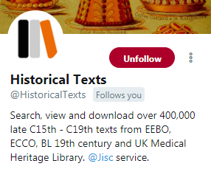


Benefiting from funded projects
Be clear – specify in the terms of funding the level of acknowledgement you expect on specific social media channels
Be realistic – acknowledging a funder shouldn’t come at the expense of clear communication
Be flexible – are there alternative ways to benefit from each others social media networks?
Notes:
Key points:
Specify the level of accreditation you require on social media from projects you’ve funded. Because social media content is usually short-form, this can easily be overlooked. Unlike a press release where you might specify a mention as the funder, it can be harder to expect acknowledgement in every single tweet for example. There are a number of options you could adopt depending on how much prominence you want: 1) Have the brand name included within the channel names; have a brand mention within any bio, specify a certain number of posts within a certain timeframe that references your brand as a funder; agree that you’ll mutually share a certain amount of each others’ content – although this last idea might not explicitly state where the funding has come from, it comes with the benefit on having our other content reaching a new network in the same way that colleagues give you access to new networks. I would recommend adopting a combination of these ideas.

Slide 5






Tools of the trade
GaggleAMP – enables content to be shared across the network of staff
Falcon, Sprout Social ( + others) – one single unified inbox for managing all incoming comments and posts
Falcon, Socialbakers – analysing the performance of content from our channels. Highlights what works and what doesn’t
Pulsar – monitors conversations on specific topics / hashtags or by specific audiences
Buffer, Hootsuite, Tweetdeck – scheduling social media activity and highlighting peak times to post
Notes:
Key tools:
GaggleAMP – colleagues from across the business sign up to Jisc’s “gaggle” which means they receive notifications whenever the central communications team adds activities to the gaggle. Activities can be a range of things from suggesting everyone follows a certain Twitter user (great for building relationships with influencers); requesting everyone retweets a certain tweet of yours or a key influencer; liking or sharing a post on LinkedIn. GaggleAMP makes it easy to manage the network of Jisc social media users by providing them with content and activities to share or action with the social media network with just the click of the button. This could also be done without the software by perhaps using Microsoft teams or an email thread updated regularly whenever you have new actions you want colleagues to action.
Falcon / Socialbakers / Sprout social provide a unified inbox so any in-coming post, comment or message is in one place and nothing is ever missed.
Pulsar – monitors all social media activity and can be filtered to highlight conversations around a particular hashtags, say for example #Digifest. Or it can be used to track the conversations of particular audiences, say for example identify what a group of key academics are all talking about on Twitter this week, this month, this year etc.
Buffer – to ensure we reach our audiences not just in office hours but when users are most likely to be on social media, we schedule activity throughout the day from 6am to 11pm. Buffer enables us to do this and also highlights the best performing content.

