Slide 1
Global R&E Network Interactive Map
SIG-MARCOMMS Meeting
27 September 2018
Lisbon, Portugal

Slide 2
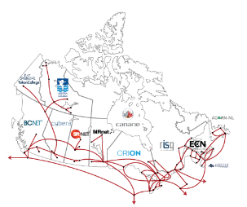
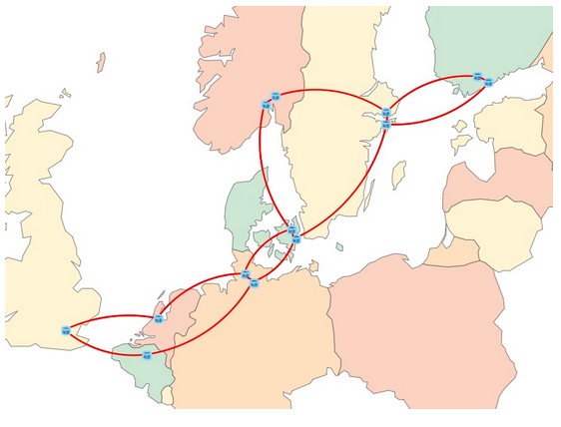
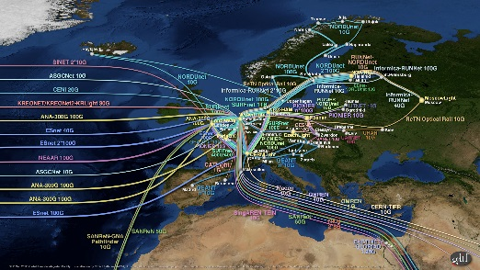
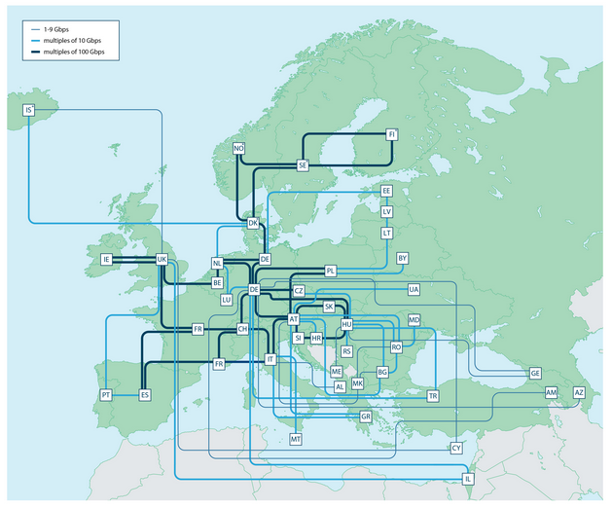
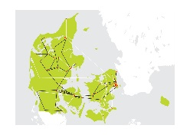
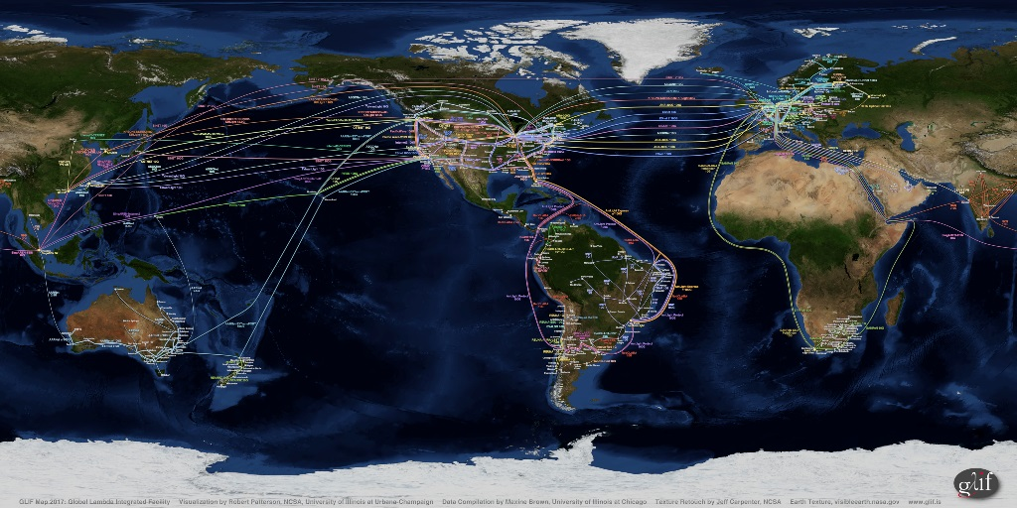
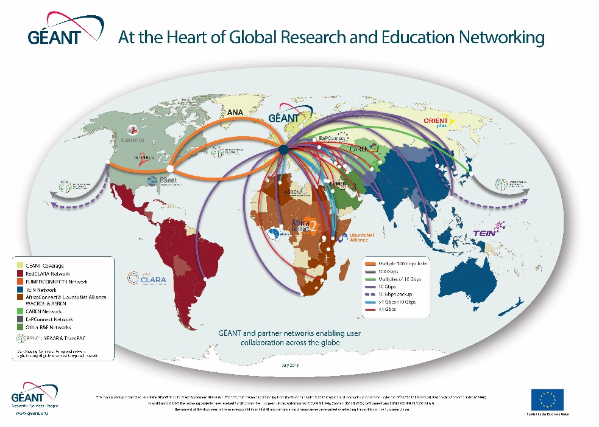
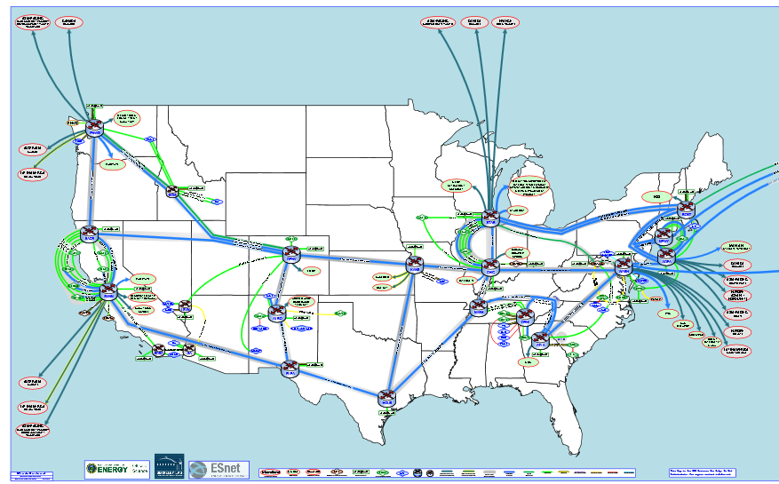
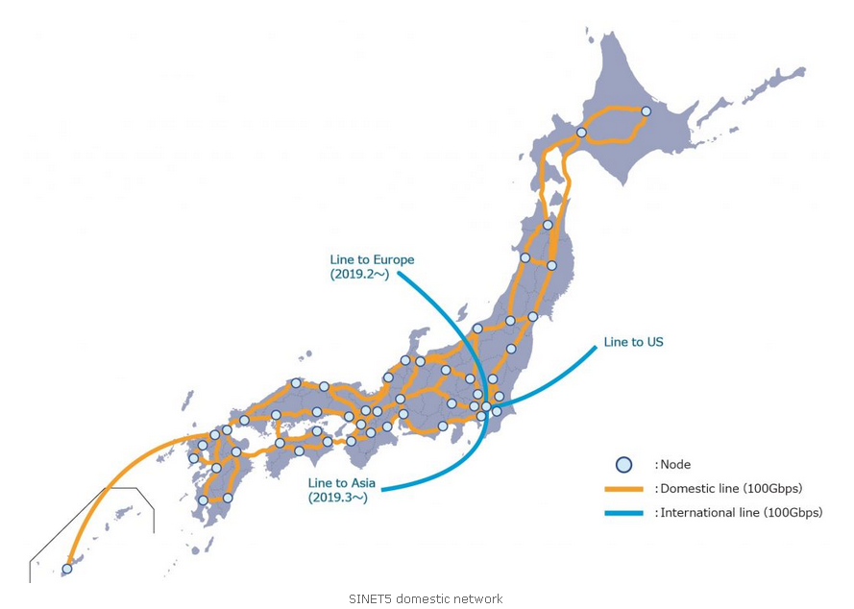
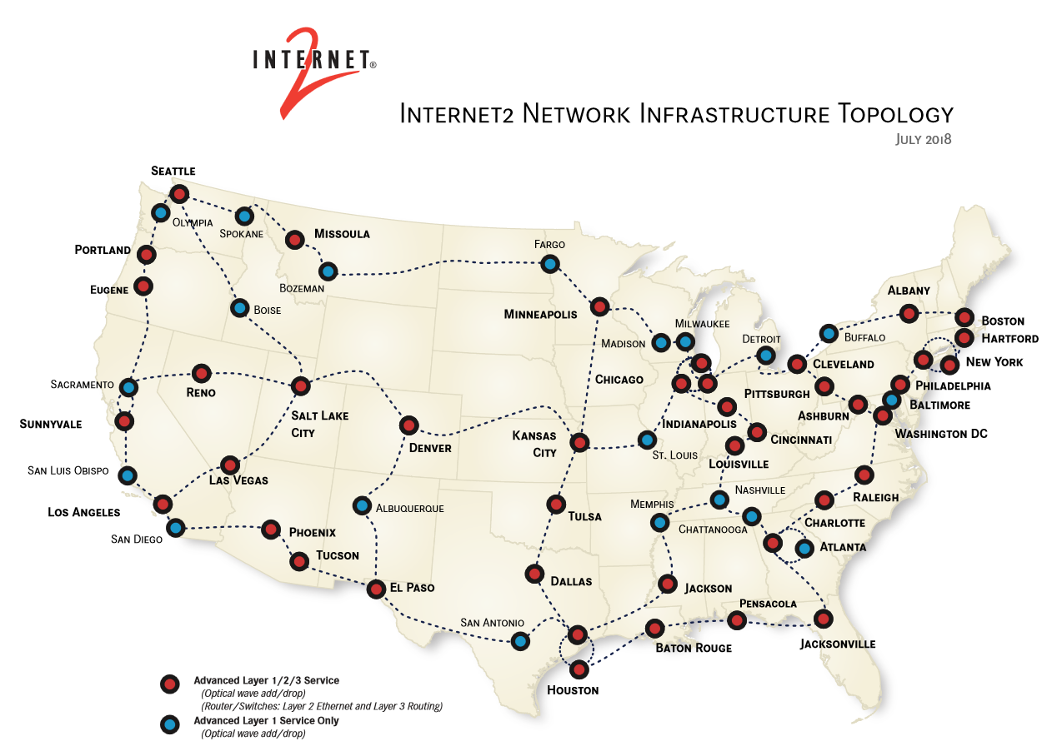
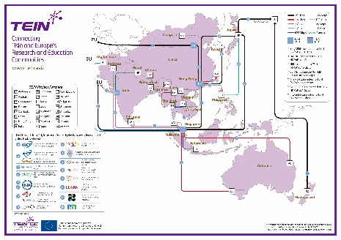
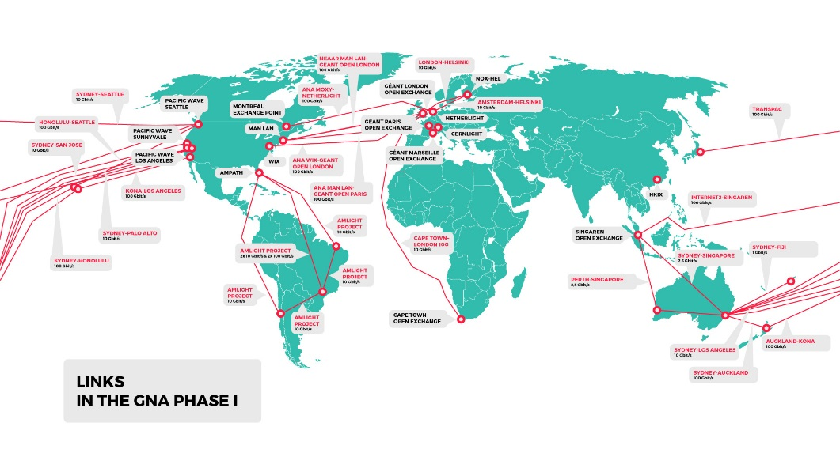
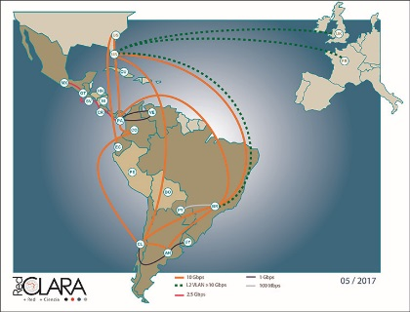
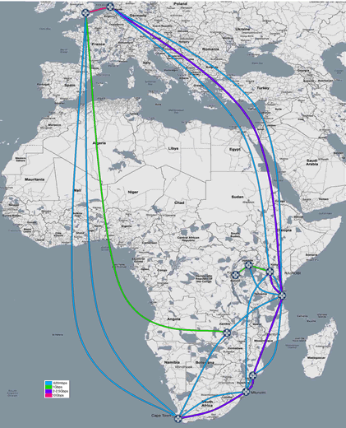
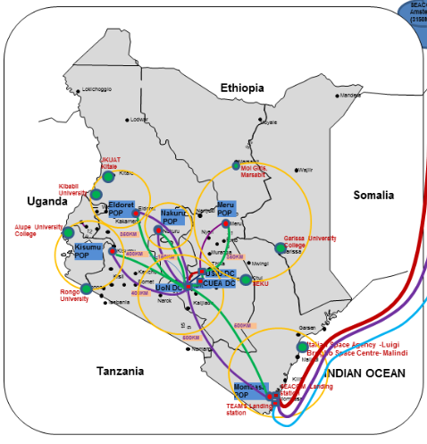
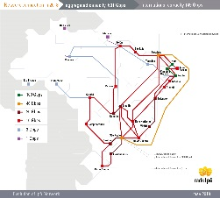
The (Static) Story so Far…
GLIF Maps
Global, Regional and National Backbone Maps
GNA Map
Notes:
Static maps produced by networks and collaborations to show present corresponding connectivity. Anyone trying to get a fuller global picture though has to look at multiple resources, sometimes not easy find. Also, information is limited (link speeds, end points, etc. not always clear, who pays for what, etc.)

Slide 3
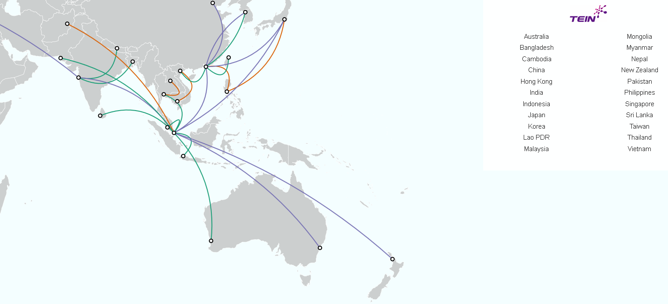
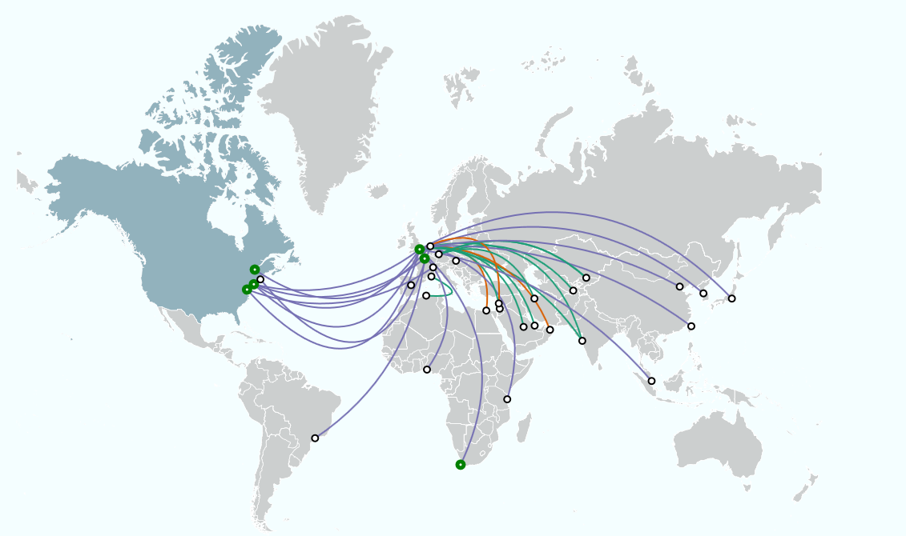
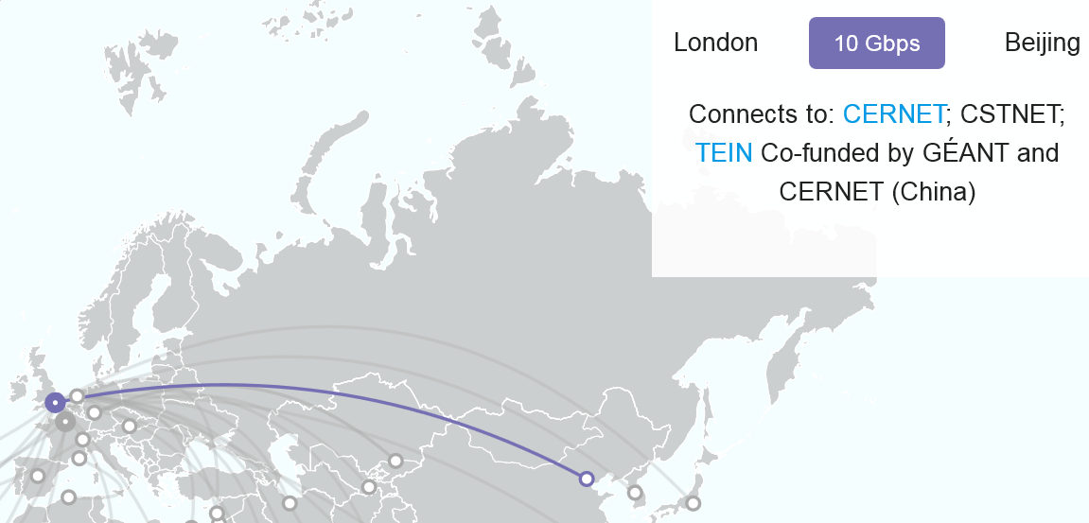
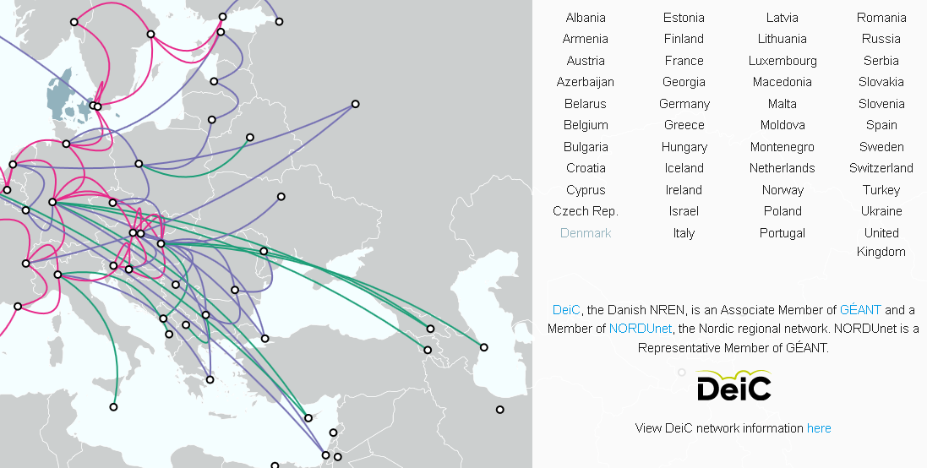
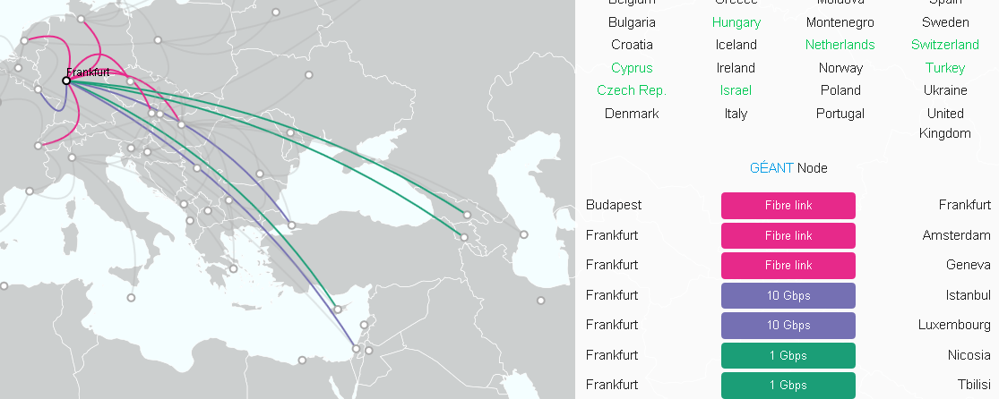
The GÉANT Interactive Map
http://map.geant.org
Regional network maps
Link information (network, speed, end points, funding)
Global connectivity between GÉANT and other world regions
PoP Information
NREN Information and links
Notes:
Solves some of the issues – one location, easy to find, shows global and regional maps.:
Info includes:
Country info: NREN(s) in the country
NREN info (e.g. URL)
Link info (network, speed, end points, funding body)
PoP information
But not perfect for a fully global view – e.g.
shows global connectivity between GÉANT and global partners, so not between say North America and Asia-Pacific.
National maps are shown via link to static map on NREN’s website, so continuity of information is not ensured, and interactive facility is lost at national level.
Data is entered by GÉANT, so dependent on GÉANT engaging on a regular updates from other parties, and entering data on their behalf into database (which requires some syntax to ensure links, etc. appear right).

Slide 4
Global REN Map Proposal – The Why?
Support creation of maps
  Avoid inconsistencies across maps
  Enable organisational, domain specific, or special purpose maps (e.g. GNA)
Useful tool for users:
  Shows (whether/how) they reach counterparts in other parts of the world
  Has the potential to show where global services (e.g. eduroam) are available
Useful marketing tool for stakeholders:
  Shows investors (institutions, public funding bodies) how their investment harnesses a huge global investment in R&E networking infrastructure
  In countries where stakeholders doubt the need for an NRENs, demonstrates concisely that the NREN model is accepted as necessary the world over…

Slide 5
Global REN Map Charter
Initial criteria for the success of a map visualisation:
  Dynamic/interactive map, zoomable with selectable layers & sections, (also printable);
  Ability to show intra- and inter-NREN nodes & connections, including meta information (e.g. link speed);
  Ability to show connected institutions and major science infrastructure & instruments;
  Data to be maintained by individual (N)REN operators & collected automatically in a common format, (reduces update overhead)
  Achieve a critical mass of participation.
Notes:
Critical apsect here is the data model and data exchange
Meta-data tagging is essential, must be well-defined (i.e, capacity, type of link, purpose, conditions of use, …)

Slide 6
Next Steps…
Working group involving CANARIE, GÉANT, Internet2, NORDUnet working on:
  Outline of use cases; to be shared with community; will invite community for further input
  Draft metadata requirements to be included in technical solution to meet initial success criteria
THIS IS A GLOBAL COLLABORATION:
  For Global REN Map to be successful, buy-in of RENs around the global to input data is vital.
  Development will require software development input. NRENs invited to contact members of coordinating team if they might be able to assist.

