Slide 1
Communicating The Roslin Institute: challenges & opportunities
Inês Crespo
Research Communications Officer

Slide 2
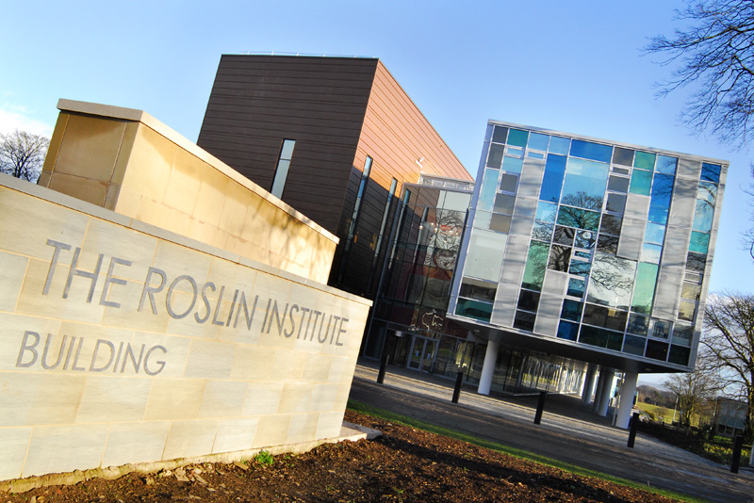
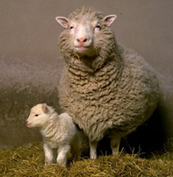

Slide 4
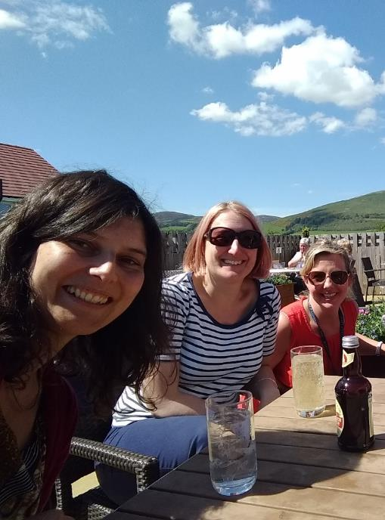
Communications & Public Engagement
Nicola Stock
Public Engagement Officer
Jayne Quoiani
EBSOC Education Officer
Communications Officer
Notes:
And press officer
And campus photographer, digital resources…

Slide 5
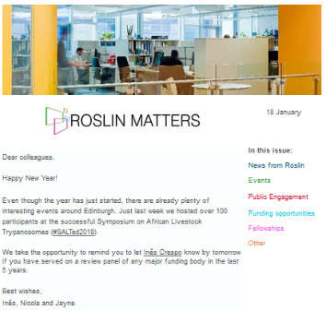
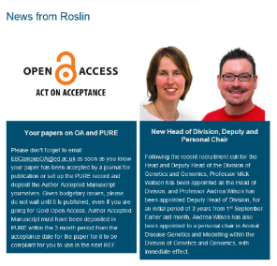
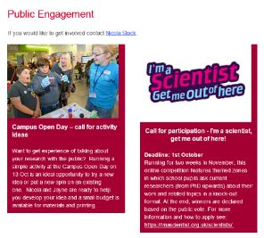
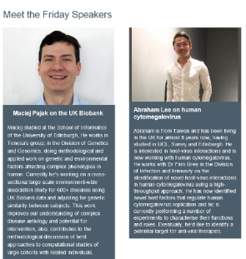
Internal Communications
Screens
Internal newsletter
  “Sense of community”
Challenge:
Still lots of emails…
Notes:
400-500 views
100-200 clicks

Slide 6
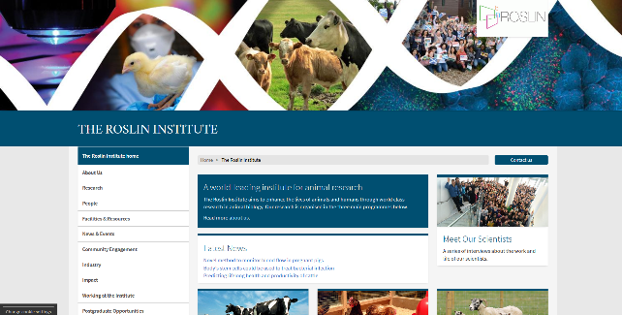



Website & Social media
In less than a year…
Visitors to the website from:
Twitter has tripled
Facebook ~ 10 times more
Followers / likes increased:
39% for Twitter
27% for Facebook
Notes:
In less than a year the number of visitors to our website coming from Twitter has tripled and the number of visitors coming from Facebook is nearly 10 times as much as it was for the old website
The number of Twitter followers since May 2017 has increased 39% to 3,861 [as of 9 March]
Increase of 27% of likes on Facebook since March 2017 to 1,570 [as of 9 March].
13% of visitors to our new website come from social media.

Slide 7
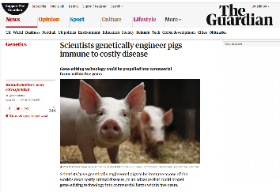
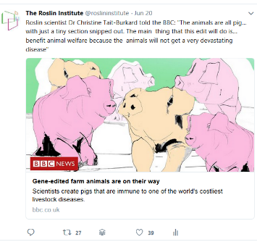
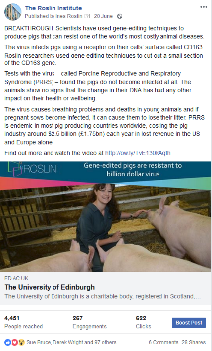
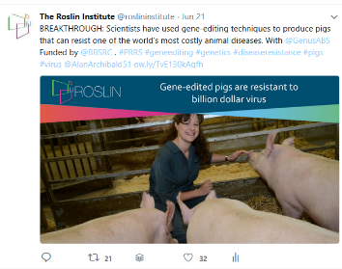
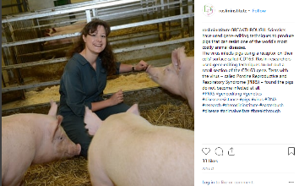

News & coverage
Posted across all channels
Sent to the press
Post media coverage
Covered at public events

Slide 8
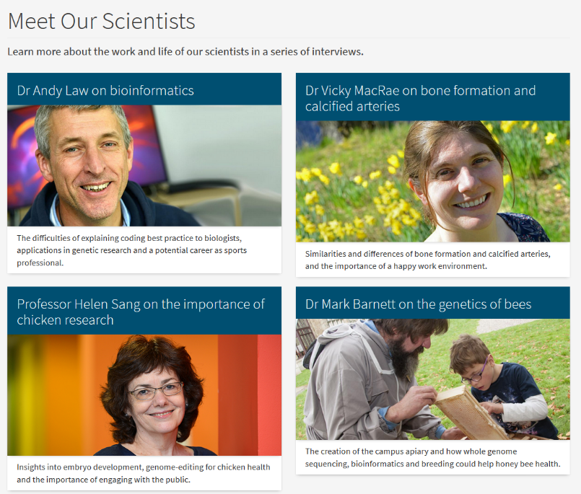
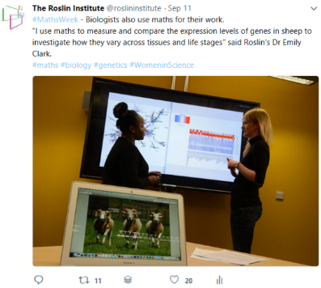
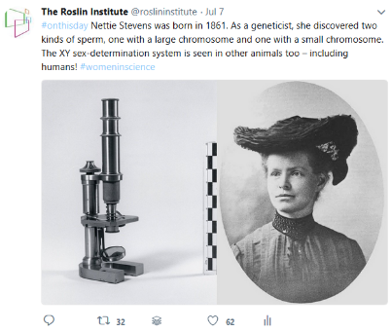
Promoting our science further

Slide 9
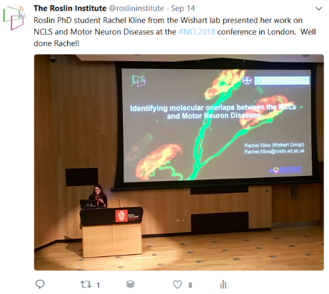


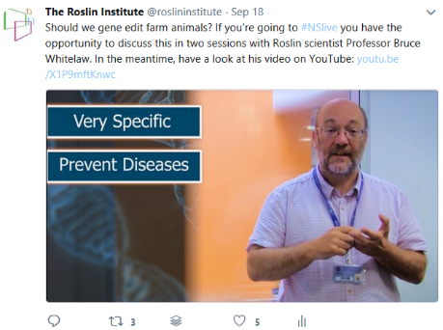
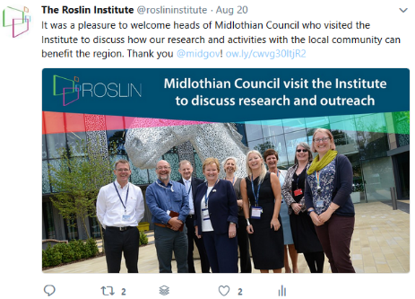
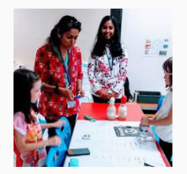
Events
Scientists at events
Our events and visits
Public engagement
Notes:
Opportunities:
Engaging with our scientists – contributing more now
Conferences / events hashtags (incl our own)
Challenge: keeping track of all events
Including public engagement (tag local events)

Slide 10
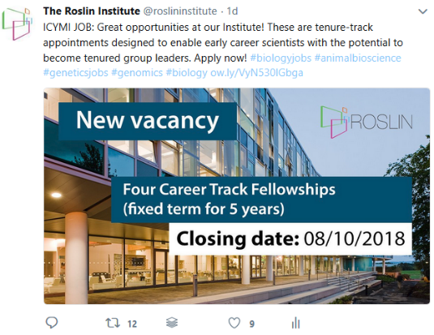
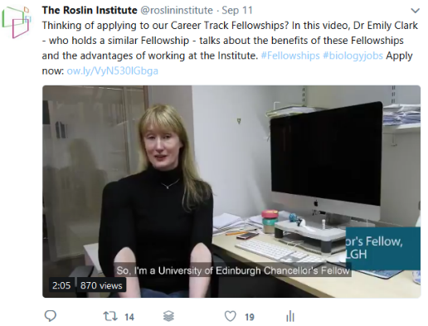
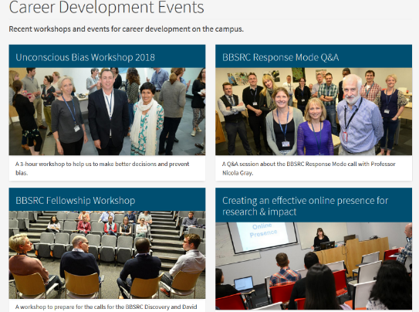

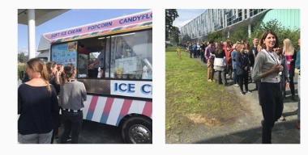
A great place to work

Slide 11
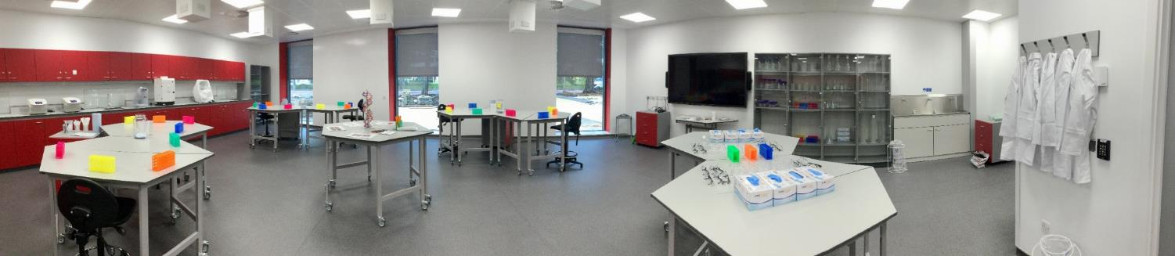


Slide 12
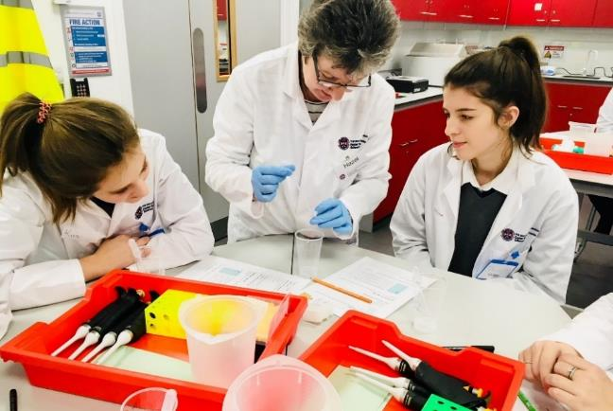
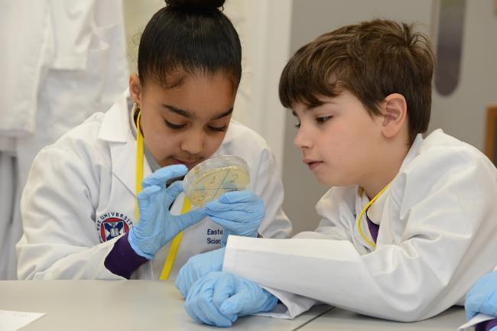
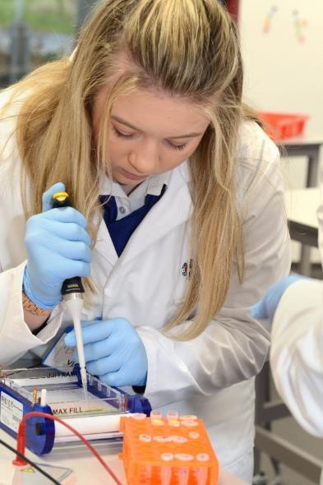
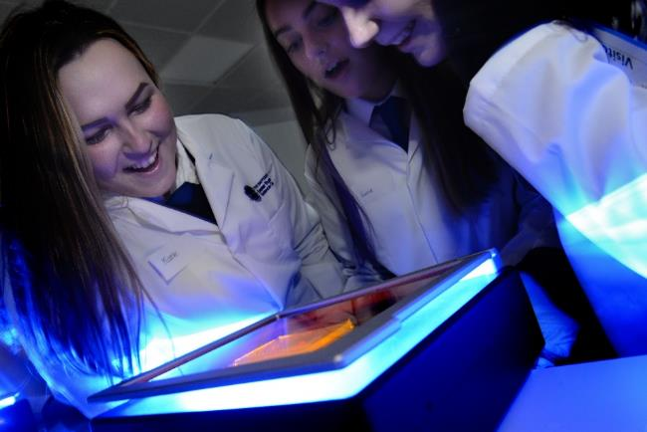
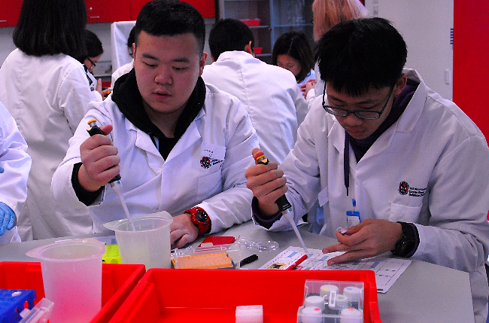
Notes:
What opportunities for computer scientists?

Slide 13


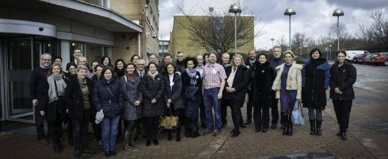




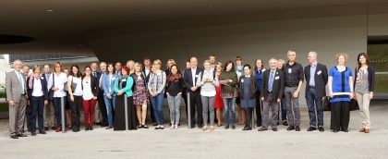
Collaboration
Neutrons and LSF
March 7, 2016
© R. Eriksson, ESS
May 29-30, 2017
RICE
© Claudia Niiranen, MLZ

Slide 14
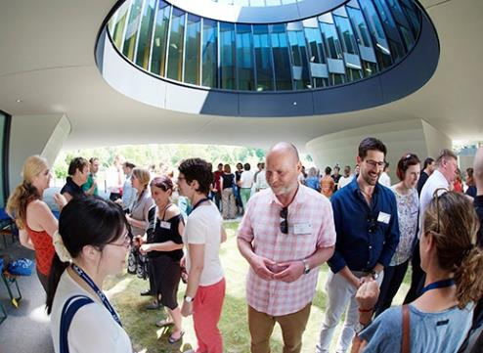
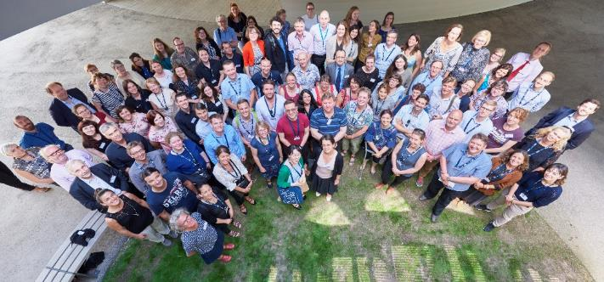
Public Awareness of Research Infrastructures III
8 - 10 April 2019
Building and maintaining public trust
Combatting fake news
Measuring success
Unconventional outreach and new trends
Communicating communications
Finding the next science superstar​​
Risk and issues management
Communicating distributed infrastructures
Equality and diversity
1 October: Abstract submission opens
30 November: Abstract submission closes
www.pari2019.org

Slide 15
Your ideas?
Challenges
Opportunities
More news stories Roslin Reporters
Support our scientists Comms drop-in
Templates Focus Groups
Amount of emails ?

Slide 16
Thank you!
Obrigada!
Inês Crespo
ines.crespo@roslin.ed.ac.uk
@InesSciComm
linkedin.com/in/crespoines

