Slide 1
Developing the GÉANT web presences
As part of ongoing marcomms work and as mentioned in Helsinki, we are looking at developing web presences and simplifying channels. Why?
  To refine messaging to better communicate GÉANT’s offerings
  To provide best communications tools to support outreach
  To demonstrate GÉANT community’s leadership role in key areas
  To demonstrate GÉANT community’s impact on research and education
  To refine communications and channels to reach audiences in most effective and engaging way, that also supports our partners
These objectives are reflected in the GÉANT Communications Plan

Slide 2
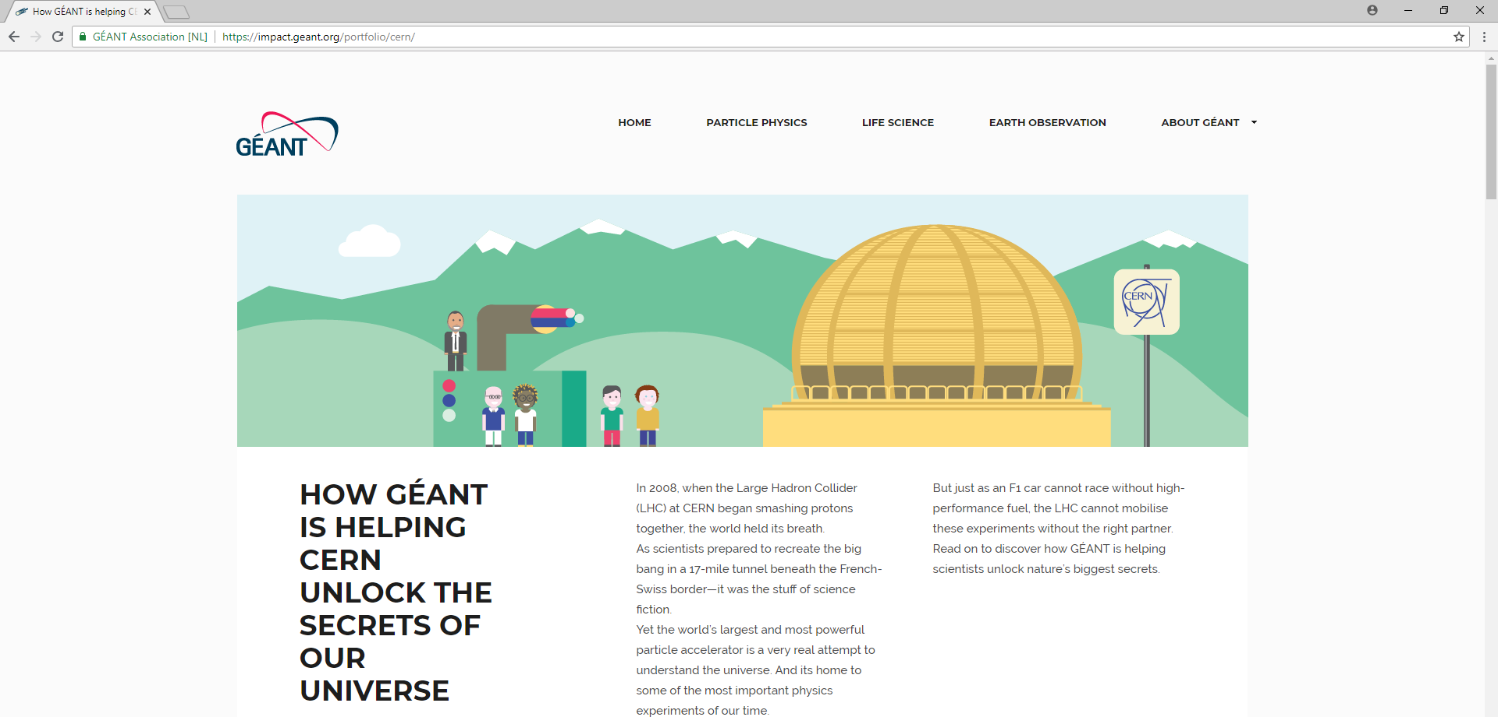
What are we doing?
Provide best communications tools to support outreach
Demonstrate GÉANT’s impact on research and education
Refine communications and channels to reach audiences in most effective and engaging ways, that also supports our partners
OBJECTIVES
  NEW impact.geant.org site aims to quickly and simply highlight the amazing projects supported by GÉANT and our NREN partners – in a very accessible and engaging way, showing the services used and where to learn more. Engagement team can use it at events on a tablet, talking visitors around projects. Content can be shared for digital engagement. Pages can generate infographics and posters.

Slide 3
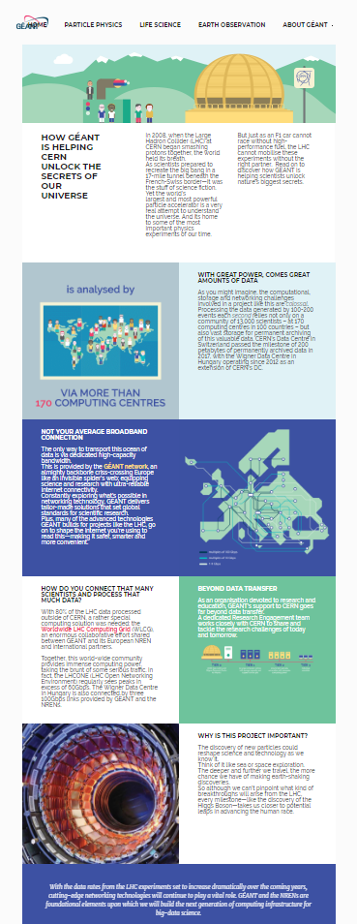
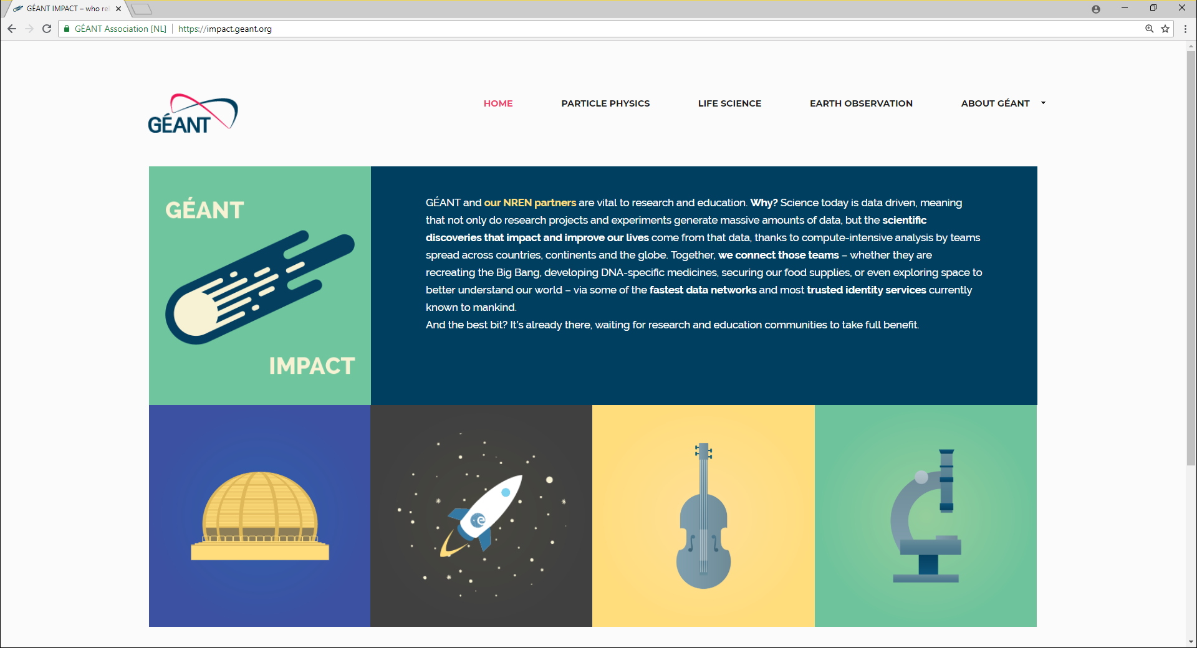
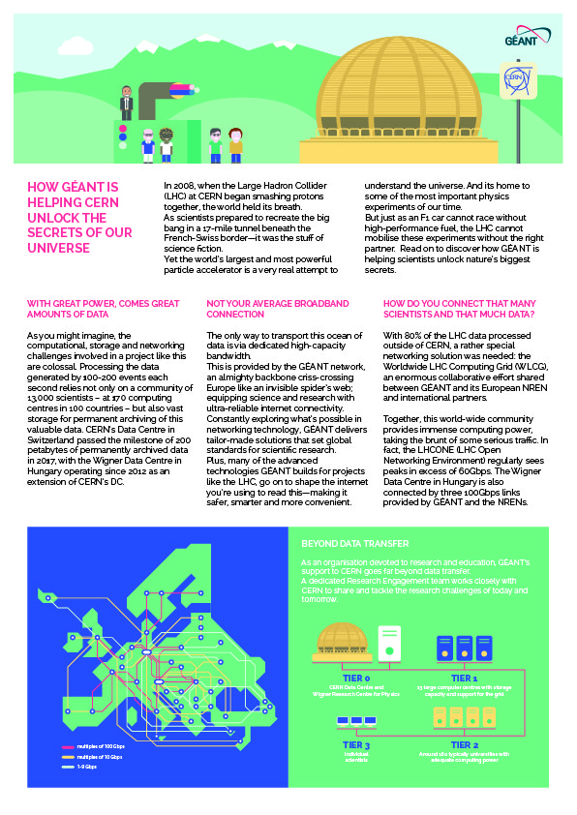
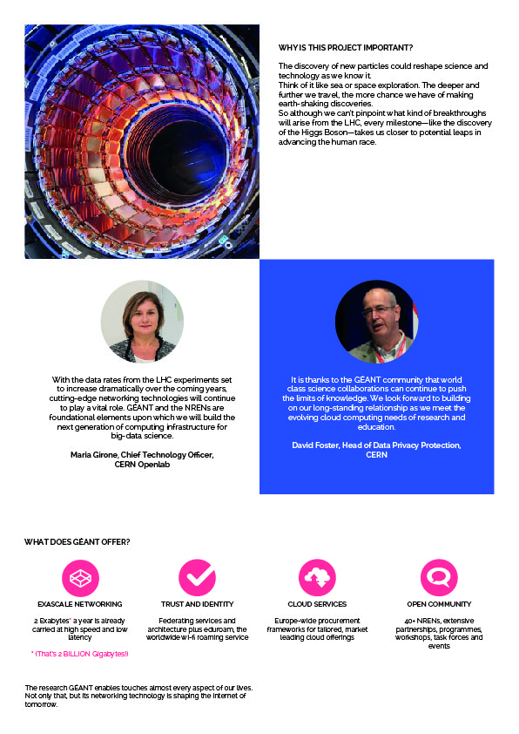
impact.geant.org
WORK IN PROGRESS –
ETA DECEMBER 2018
  Simple, one-click access to project pages
  QR codes lead to PDF versions
  Clear value proposition on each page
… and feeds digital engagement on Twitter, Facebook, Flickr too!

Slide 4
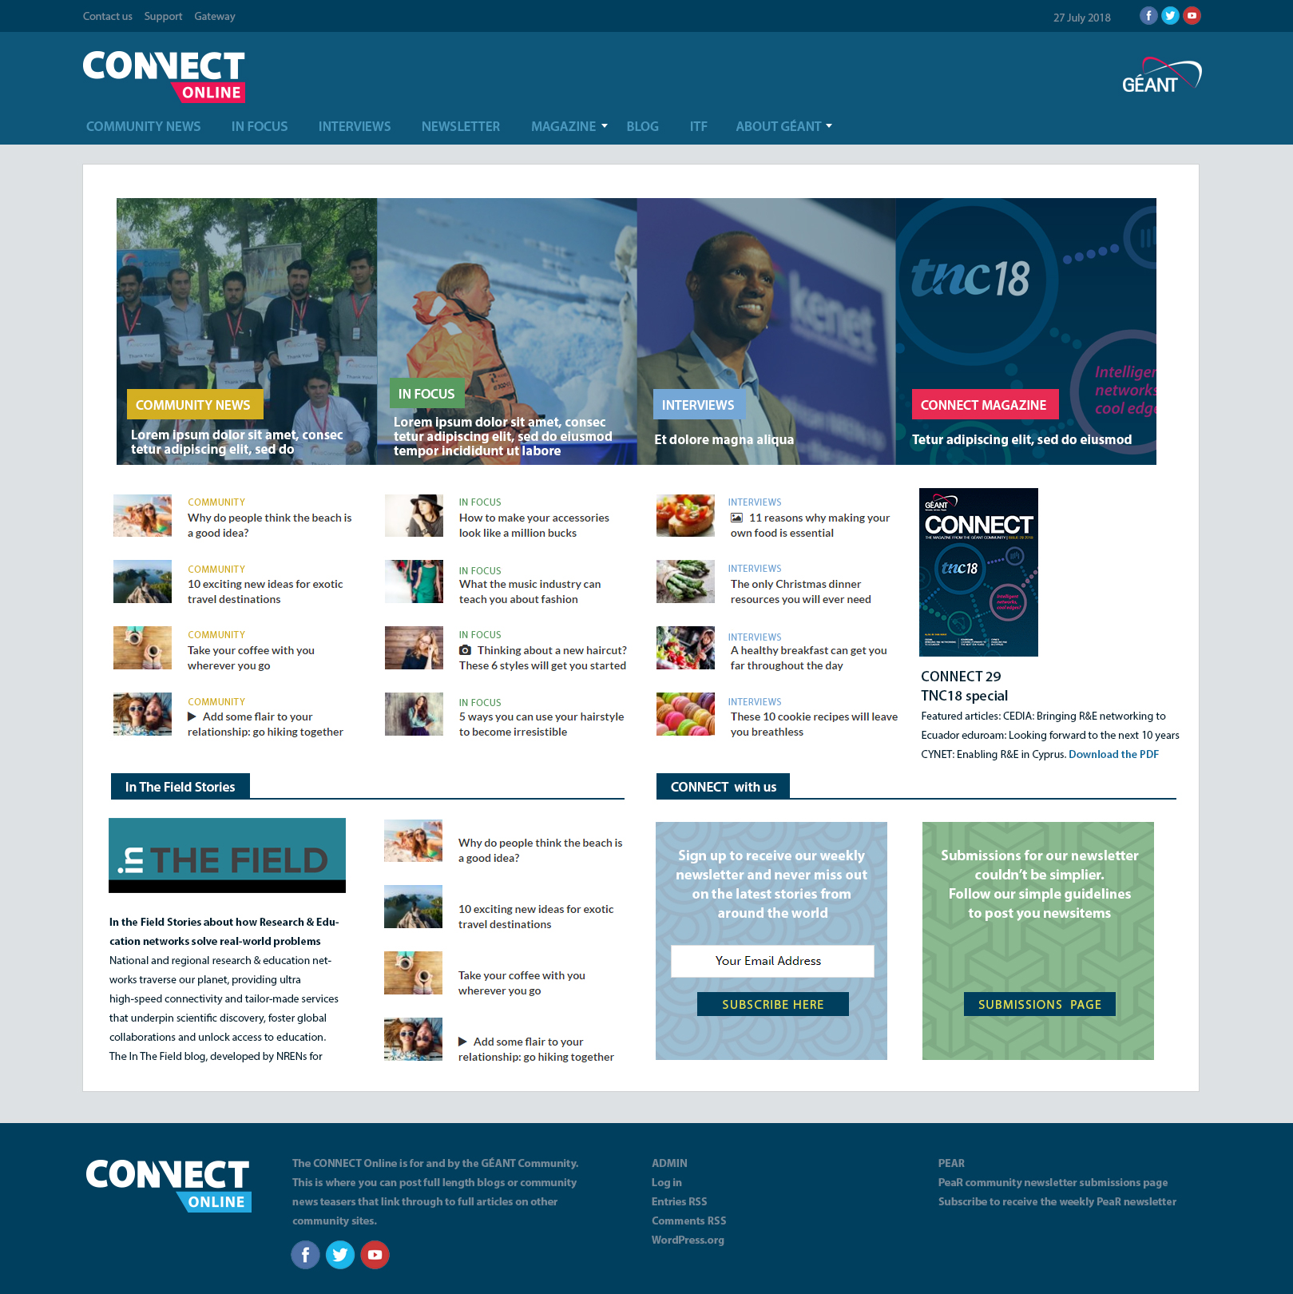
What are we doing?
  Provide best communications tools to support outreach
  Demonstrate GÉANT’s leadership role in key areas
  Refine communications and channels to reach audiences in most effective and engaging way, that also supports our partners
OBJECTIVES
  CONSOLIDATING We have several different communications channels that are not well integrated. Our partners aren’t sure which ones to use, and we are losing impact and consistency.
  We are consolidating under the CONNECT name.
  It will continue as a printed magazine, but will expand to also become a community news site
  and weekly newsletter. All content in ONE PLACE.

Slide 5
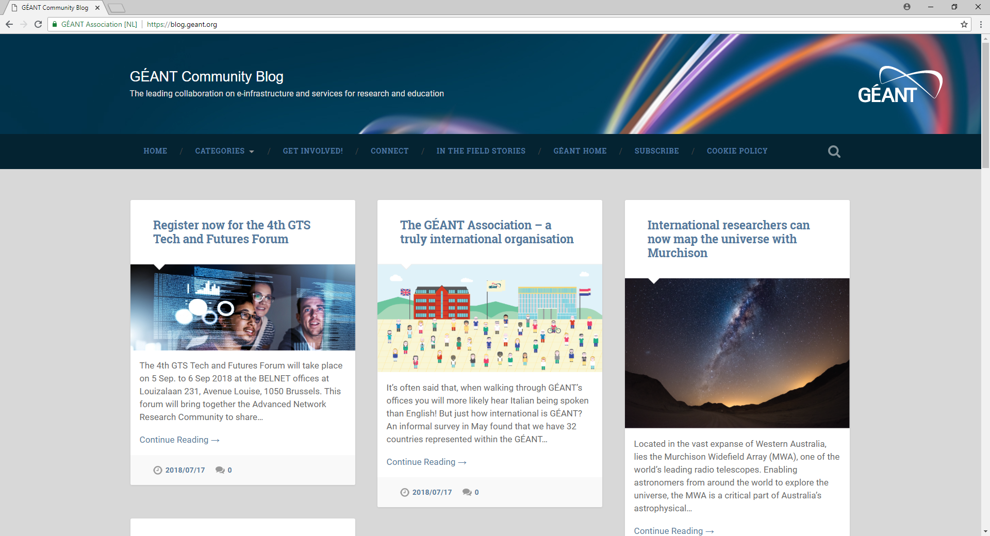
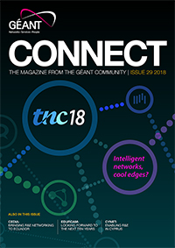
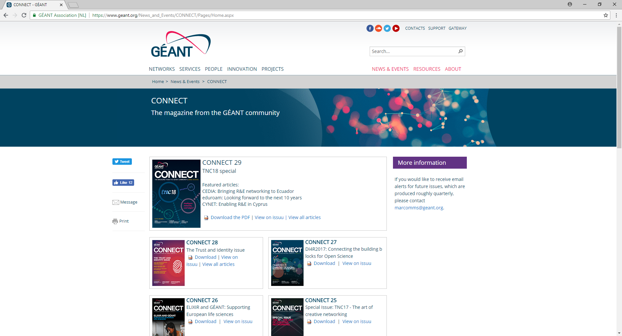
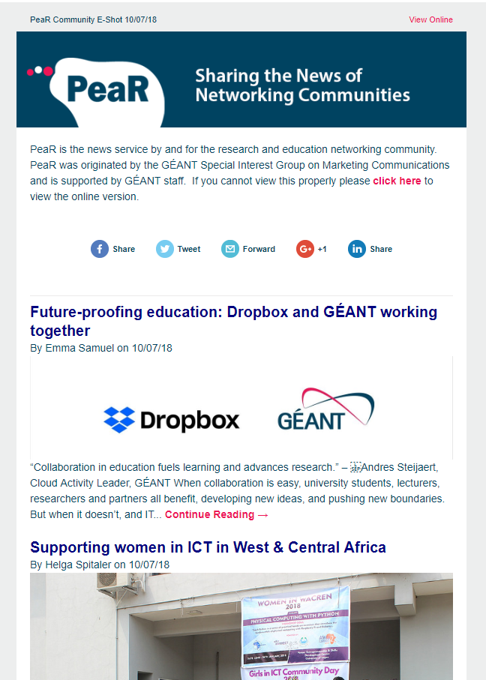
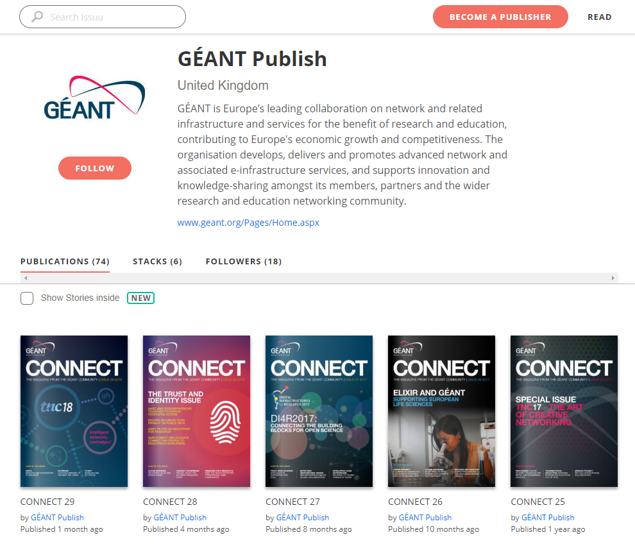
Moving from:
Blog site + PeaR newsletter + CONNECT magazine + ISSUU + CONNECT section of website…

Slide 6
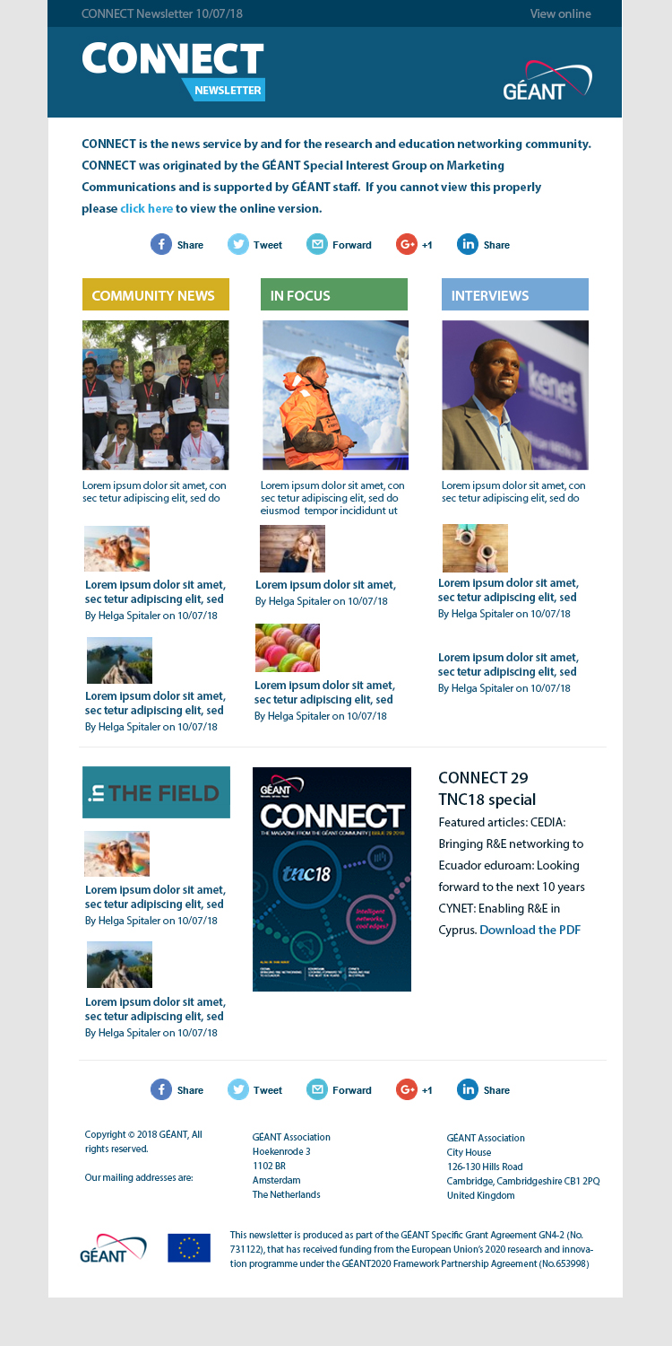
WORK IN PROGRESS – ETA DECEMBER 2018
To: connect.geant.org
A website, newsletter and magazine.
The website will replace blog.geant.org (all existing content will be moved over). Sections reflect those in the magazine. Contributors can upload news items to the Community News section, and we can add features and interviews either from the magazine, or that subsequently go into the magazine. Includes In The Field section, plus a true ‘blogging’ area for future use.
The newsletter is effectively a rebranded and redesigned PeaR to bring consistency and to improve the reader experience – more content but less scrolling.
The magazine continues in its current format, published 3-4 times per year to coincide with events such as TNC and DI4R.
… and content feeds digital engagement on Twitter, Facebook, Flickr too!

Slide 7
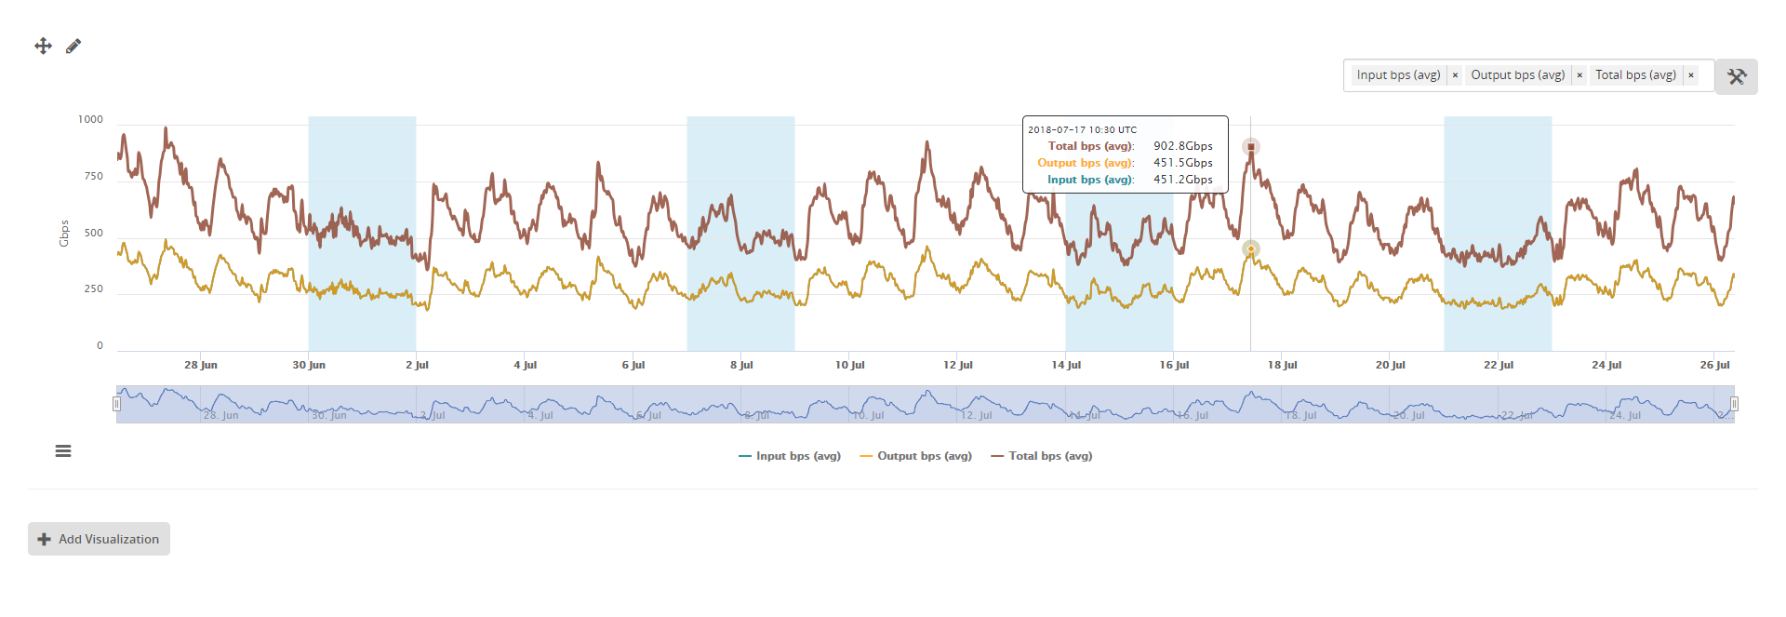
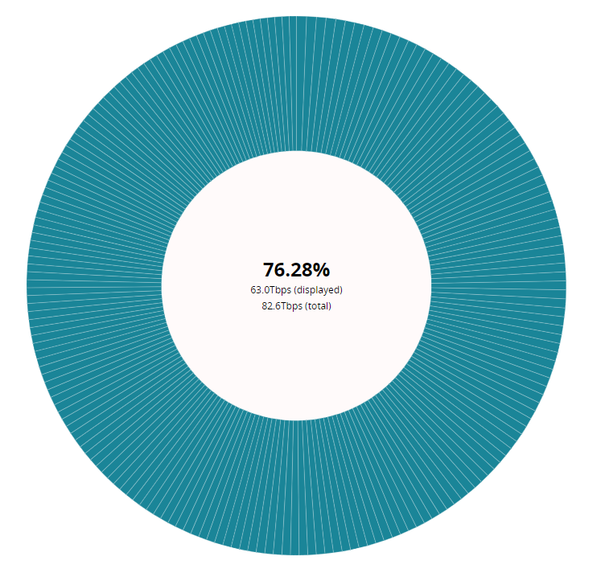
Future plans
We are also working on a network website, network.geant.org
Platform will enable inclusion of near-live data from Operations
  NEW network.geant.org will bring the European network to life, including near-live traffic data to show the enormous amounts of data carried each day/week/month/year; including interesting stats and graphics; engaging ways of explaining the technology etc. Will complement the interactive map and include updated topology maps etc.

Slide 8
Why all the websites?
The geant.org site is trying to cover too much ground meaning it is not easy to find a lot of the content in there.
By bringing out this content and giving key areas their own presence, clearly linked to the geant.org site and to each other, we can streamline the geant.org site, allowing it to become more of an Association website that provides a gateway to the satellite sites e.g. network, clouds, AARC, eduroam, impact, annual report etc.
We have long had satellite sites for services. This approach is intended to bring out information on key areas for specific audiences and ensure the sites work together.

Slide 9
Anything else?
WORK IN PROGRESS – ETA NOVEMBER 2018
We are also working on a GÉANT animation video
If you have input please get in touch – speak to Dimple this week!

