Slide 1


A central community repository
Options and requirements
Daniel Wüstenberg
Communications Research Officer
SIG-Marcomms, Lisbon, 27/09/2018
Public
www.geant.org

Slide 2





Overview
Special Interest Groups and Task Forces current output
A central document repository for SIG/TFs - concept
Options for a central document repository
Additional requirements
Outlook

Slide 3
Special Interest Groups and Task Forces current output
A central document repository for SIG/TFs - concept
Options for a central document repository
Additional requirements
Outlook

Slide 4
Special Interest Groups and Task Forces (SIG/TFs)
Special Interest G​roups and Task Forces (SIG/TFs). Task Forces and Special Interest Groups help GÉANT, NRENs and other R&E bodies to collaborate, share experience and guide future developments of networking services, technology and also a variety of non-technical topics. Secretariat services are provided by GÉANT.
Special Interest Groups
Special Interest Groups enable ​exchanges among representatives within specific organisational functions.​ They are places to network, exchange ideas and organize collaborations.
Task Forces
Task Forces focus on specific projects, have a clearly defined lifespan, deadlines and key performance indicators.
Notes:
The part of the Geant community we are talking about here are the Special Interest groups (like Marcomms) and task forces

Slide 5
Current SIG/TF landscape
SIGs
S​IG-CISS: Cloudy Interoperable Software Stacks
SIG-Greenhouse: Open Source ​Community
SIG-ISM: Information Security Management
SIG-Marcomms: Marketing Communications
SIG-MSP: Management of Serv​​​ice Portfolios
SIG-Multimedia: Multimedia Applications​​
SIG-NOC: Network Operations​ Centres​
SIG-PMV​​: Performance Monitoring and Verification
SIG-SCOPE: Sustainable, Community, Practice Exchange
SIG-TNE: Transnational Education
TFs
TF-DPR: Data Protection Regulation​​
TF-RED: Research Engagement Development​
TF-CSIRT: Computer Security Incident Response Teams

Slide 6
SIG/TF – What is their output?
Meetings
Networking and knowledge exchange
Training events
Training (like a blogging training in 2016)
Documents
Mostly presentations at events
Documented, but mostly intangible, output
Notes:
Meetings like this one
Training events, e.g.

Slide 7
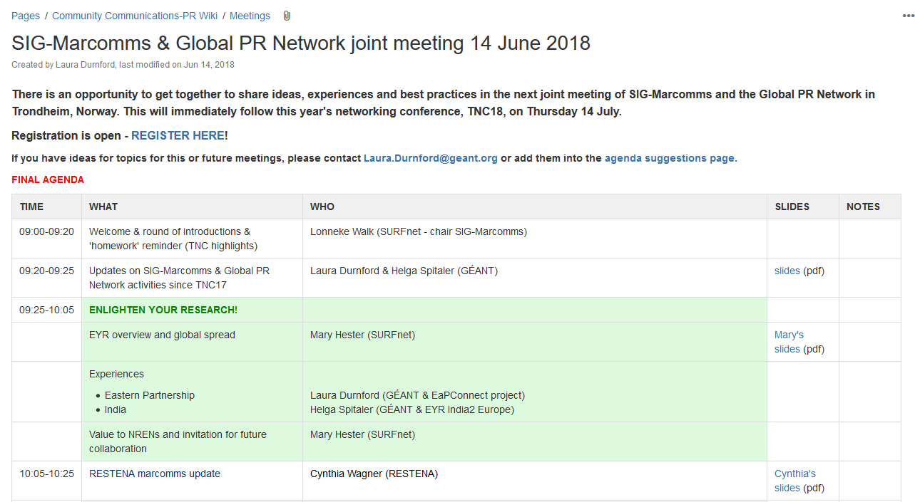
SIG/TF - Wikis
Wikis
Serve as information hubs for each SIG/TF
Run on Confluence
Notes:
This should be a Familiar sight to you - announcing events, programs etc.

Slide 8
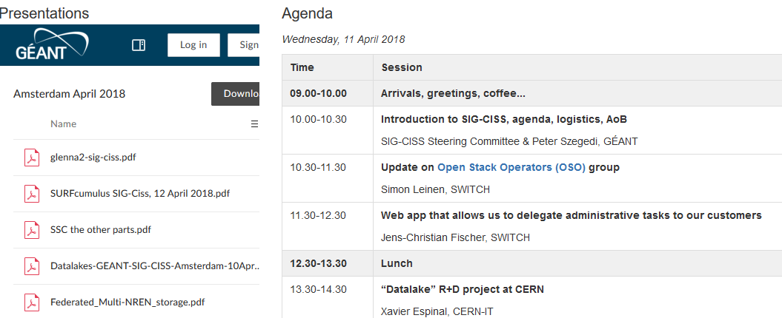
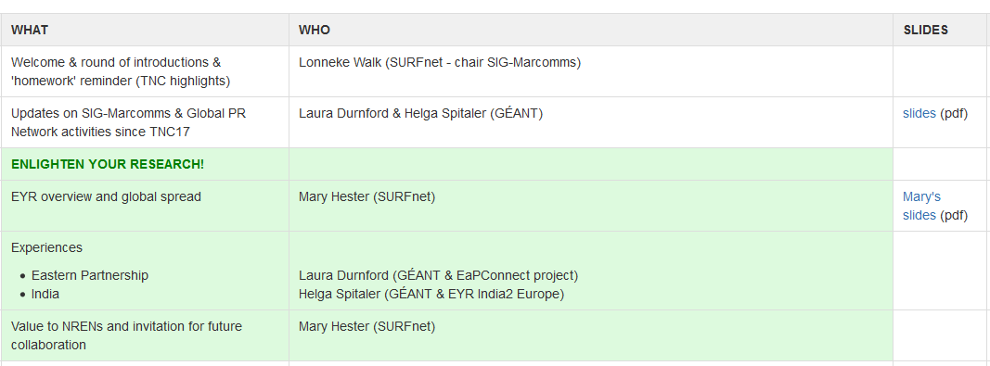
SIG/TF - Presentations
Presentation documents are usually embedded or otherwise attached to the confluence website of each event, with very little metadata available:
As a consequence, these documents are inaccessible for anyone who does not know about this particular meeting

Slide 9
Special Interest Groups and Task Forces current output
A central document repository for SIG/TFs - concept
Options for a central document repository
Additional requirements
Outlook

Slide 10
Central repository
Expectations
Searchable
Systematic access by subject, date, author, etc.
Provides quantifiable metrics
  Downloads and views
  General metric of activity of SIGs/TFs
Contents
New presentations
Legacy presentations
Relatively small number of documents – 100s, rather than 1000s of documents
Questions
What system to use?
What about legacy documents?
  How far back in time do we go?
  How to provide metadata?
What metadata will be needed?
  How to enforce their use?
Challenges
How to provide a simple user interface?

Slide 11
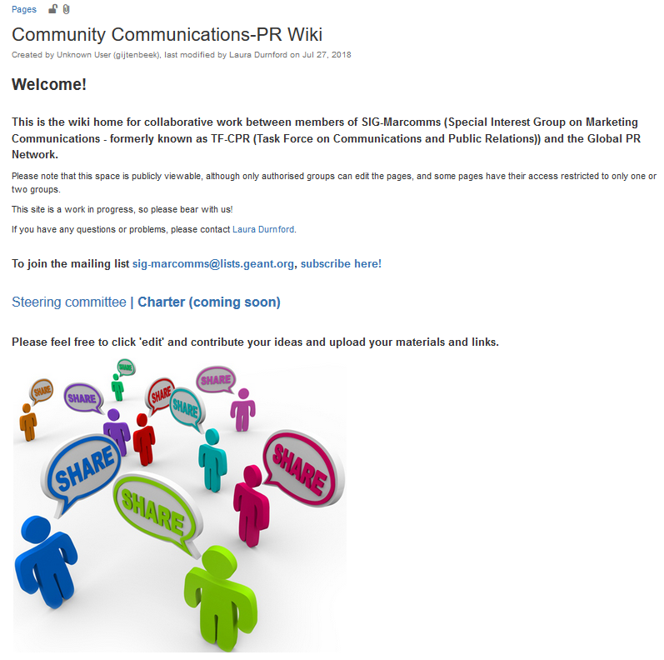

Concept
Change as little as possible
Leave existing Confluence pages untouched
Provide an embedded interface to the document repository within the Confluence page
Frontend: Confluence pages
Interface
Backend: Document repository
Wiki page (with embedded interfaces)
Documents (with metadata tags)
Document upload
Search, download

Slide 12
Interface functionalities
Document upload
Search, download
Upload mask
Provided as a functionality at the SIG/TF site
Offers (and requires) a number of metadata
  Author
  Title
  Date
  Keywords (from a controlled vocabulary)
  Keywords (free text)
  Abstract
Access rights (publicly visible or more restricted)
Search mask
The search mask, will be provided as a functionality at the SIG/TF site
Sets default values that restrict search to a given SIG/TF
Keyword/Title/Author search
In addition, the repository will in principle be open to general internet search

Slide 13
Special Interest Groups and Task Forces current output
A central document repository for SIG/TFs - concept
Options for a central document repository
Additional requirements
Outlook

Slide 14



Backend options
Requirements
Support for metadata
Agnostic of document formats
Access rights management
API to allow access through Confluence (for upload, search and download)
Systems considered as a central repository
Notes:
Analytics: User statistics (views, downloads) but also SIG/TF activity – gives GEANT some metric to document their community support

Slide 15

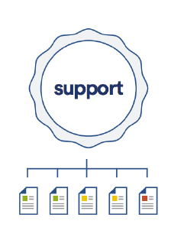
Confluence
What is it?
A collaboration software program developed and published by Atlassian (Jira, Trello, …)
Popular wiki platform in corporate environments
Relevant features
Organized in Spaces that contain Pages
Pages can contain
  Any kind of text
  Any kind of document (jpg, pdf, docx, html …)
Permissions to view or edit Pages can be given at Space or Page level
Macros/plugins can add functionality (like a search mask or metadata fields)
Repository
Space
Pages
Notes:
Pages would serve as

Slide 16
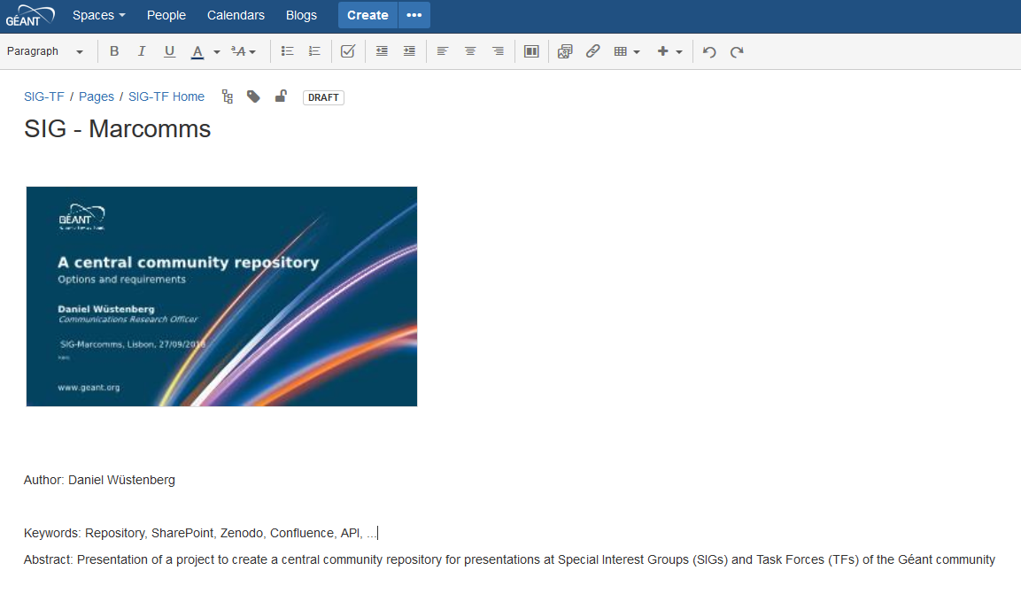

Confluence - metadata
The simplest way to implement metadata would be simply text on the page of each document
Alternatively there are add-ons that allow to add metadata fields to Confluence pages:
Page Fields provides area within each confluence page for common metadata or to attach additional information like status, properties, tokens, strings or other variables.

Slide 17
SharePoint
What is it?
A web-based collaborative platform, is primarily sold as a document management and storage system by Microsoft
Widely used for a variety of purposes
Relevant features
Agnostic to document format
Sophisticated rights management system
Extensive possibilities to provide metadata to documents
API is rich and well documented
Various connectors/interfaces between Confluence and SharePoint exist
Notes:
Those of you who work with it will know that it can a lot more but for our purpose these are the relevant

Slide 18
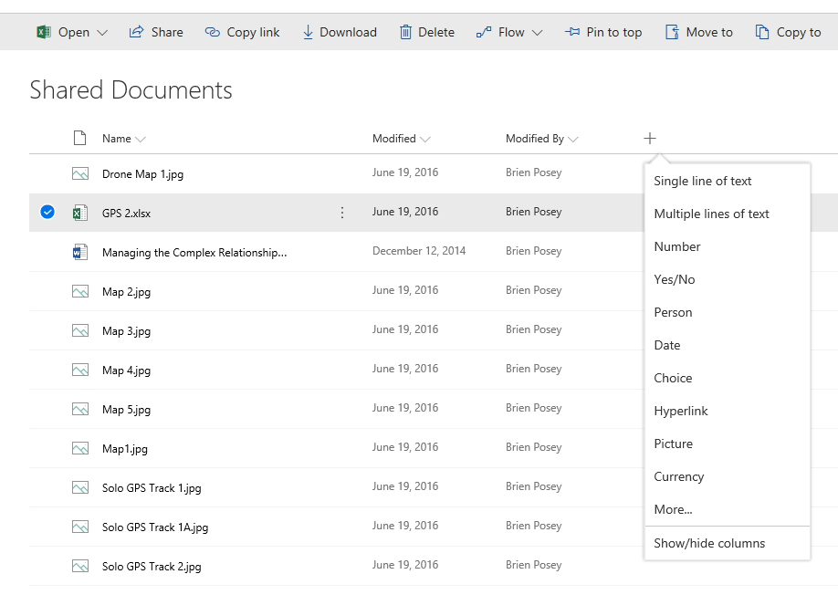
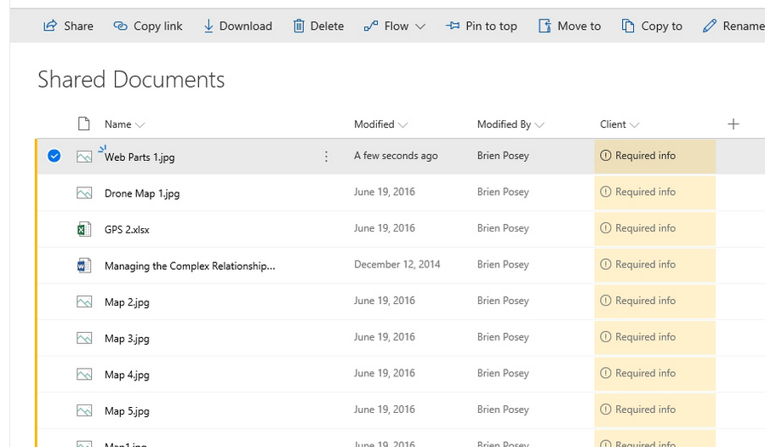
SharePoint - metadata
Arbitrary numbers of metadata fields can be added to documents
Notes:
I stole this screenshots from https://redmondmag.com/articles/2018/04/11/metadata-sharepoint-document-libraries.aspx

Slide 19

Zenodo
What is it?
Zenodo is a general-purpose open access repository, originally intended as research data repository. It was created by OpenAIRE and CERN to provide a place for researchers to deposit datasets and is run by CERN
Relevant features
Zenodo allows any kind of file being uploaded (size limited currently 50 GB)
Anyone can create a Zenodo community and upload data; no curation from Zenodo
When uploading, a large (and configurable) amount of metadata can be added to the file
Access to files can be restricted
API for external access exists but is mostly beta status
Apparently no existing interface to Confluence
Notes:
Zenodo also has a number of other features like version control, that are of less interest in our context

Slide 20
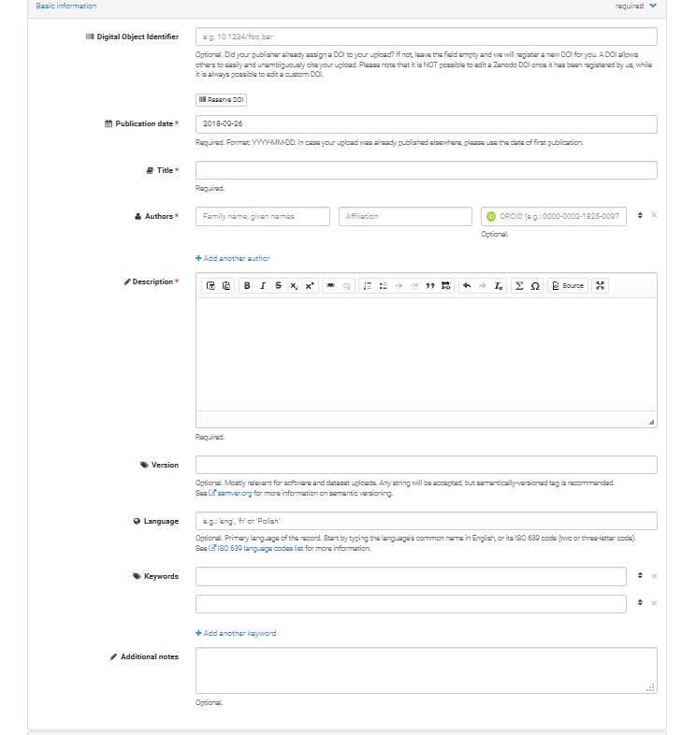
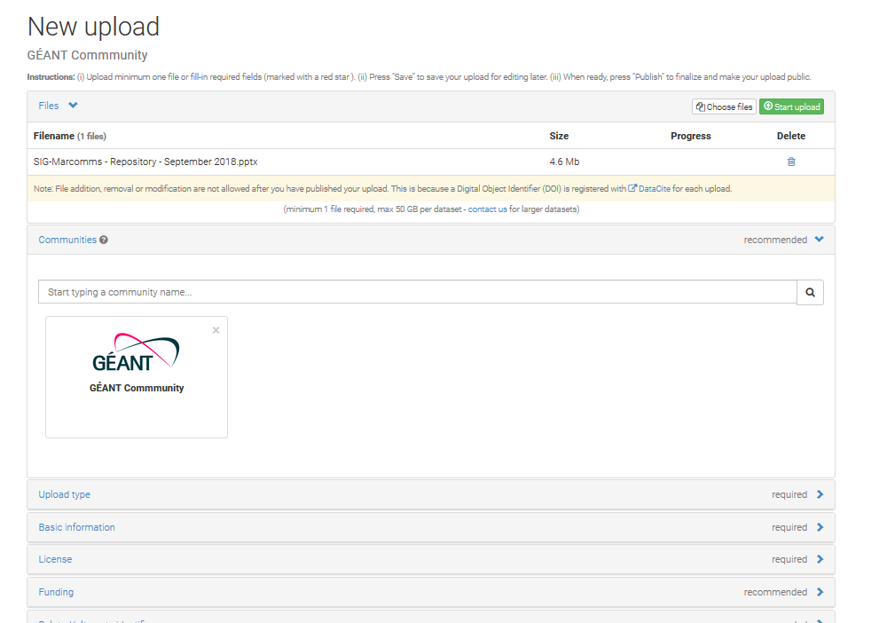

Zenodo - metadata
Metadata options are quite detailed
Notes:
Zenodo also has a number of other features like version control, that are of less interest in our context

Slide 21

Backend options - comparison
Pros | Already in use at GÉANT Same system as used for SIG/TF wikis | Already in use at GÉANT Well established connectors with Confluence Simple and effective metadata system | Designed as a repository system Simple and effective metadata system
Cons | Metadata system might need tweaking for our purposes Interfaces will need to be customized | Interfaces will need to be customized | Currently not used at GÉANT API is mostly in beta state Interfaces will need to be customized

Slide 22
Special Interest Groups and Task Forces current output
A central document repository for SIG/TFs - concept
Options for a central document repository
Additional requirements
Outlook

Slide 23

Upload and search interfaces/macros will be needed
Legacy data
  Can existing presentations be transferred?
    How to add metadata?
    How far back in time?
Maintenance/curation of the repository
  Responsibility of Géant
  Annotation
  Transfer into repository (if so, how far back)
  Keywords:
    Some keyword field could come from a managed vocabulary – this will require input from subject matter experts (i.e. participants of the SIG/TF in question)
User input needed for ….
Especially long-standing SIG/TF participant will be able to advice on the relevancy of older material
Questions
What system to use?
What about legacy documents?
  How far back in time do we go?
  How to provide metadata?
What metadata will be needed?
  How to enforce their use?
Challenges
How to provide a simple user interface?
Especially for a controlled vocabulary, input from SIG/TF participants (i.e. subject matter experts) will be crucial
Some beta-testing will be needed

Slide 24
Requirements on GÉANT’s side
The interface
Who will customize/program the user interfaces?
Running the repository
Marketing/communicating the change
Who will maintain and curate the database
  What kind of curation (if any) be needed?

Slide 25
Special Interest Groups and Task Forces current output
A central document repository for SIG/TFs - concept
Options for a central document repository
Additional requirements
Outlook

Slide 26
Outlook
An action list:
Decisions:
  What backend system to use
  Which legacy data to transfer (and how to annotate them)?
What metadata will be needed – which will be mandatory
  Gather keywords for a controlled vocabulary
Customize and the interface to the repository
Marketing campaign among SIG/TFs – A change is a-coming!

Slide 27

Thank you
Any questions?
www.geant.org
© GÉANT Association on behalf of the GN4 Phase 2 project (GN4-2).
The research leading to these results has received funding from
the European Union’s Horizon 2020 research and innovation programme under Grant Agreement No. 731122 (GN4-2).

