Slide 1
Belnet Update
Sig-MarCom
Lisbon, 26th October 2018

Slide 2

Belnet 1993-2018
Notes:
Important celebration for Belnet.
Action 1 : making a new dedicated logo

Slide 3

Belnet 1993-2018
Notes:
1 articles posted per month. Customer itw, staff itw, how was Belnet in 1993 …

Slide 4

Belnet 1993-2018
Notes:
We also tried to reach a strong press coverage in collaboration with our key customers

Slide 5


Belnet 1993-2018
Notes:
A lot of celebration. Formal with decision makers and influent stakeholder. Less formal with the members of our community we are working with every day

Slide 6

Belnet 1993-2018
Notes:
Last but not least : celebration with colleagues!

Slide 7

Belnet MarCom – Some changes
Notes:
Still doing the same as you all do in Communication and Marketing teams : PR, events, Content writing, annual report. But I want to focus on something else

Slide 8

Belnet MarCom – Some changes
Notes:
Belnet moved towards project mode
PMO
Projects >< recurring tasks

Slide 9
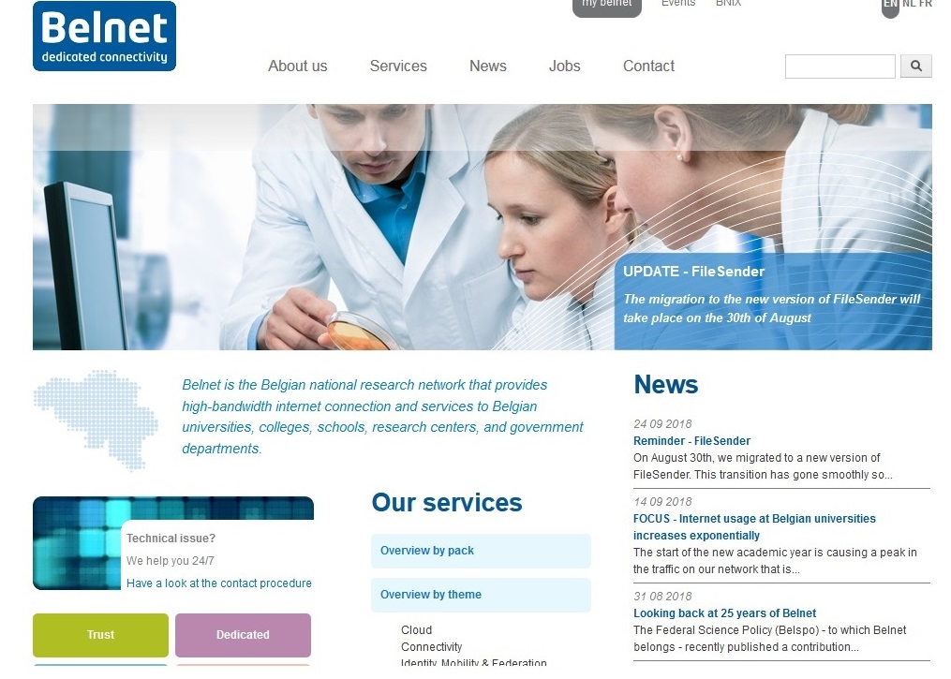
Belnet MarCom – Project #1 : New corporate website
Outdated
Notes:
First project in the new context : renewal of our website.
Total relooking to meet current standards of design and responsivity
New content : no copy-paste, SEO

Slide 10

Belnet MarCom – Project #2 : Crisis communication plan
Notes:
Start en 2016
Many difficulties
Maturity reached
Fully operational plan including new communication tools : dedicated website and sms alert system

Slide 11
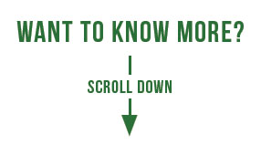

Belnet MarCom – Project #2 : Crisis communication plan
Notes:
Want to know more about our crisis communication plan and crisis management strategy
Join us in November in Malaga for our CLAW event!

Slide 12

More to come in 2019
Notes:
Mandatory changes => marketing team = no employee
Forced us to rethink our strategy
Introduction of product management because problems of ownership of some activities regarding the services

Slide 13

More to come in 2019
Notes:
We are moving to new offices

Slide 14

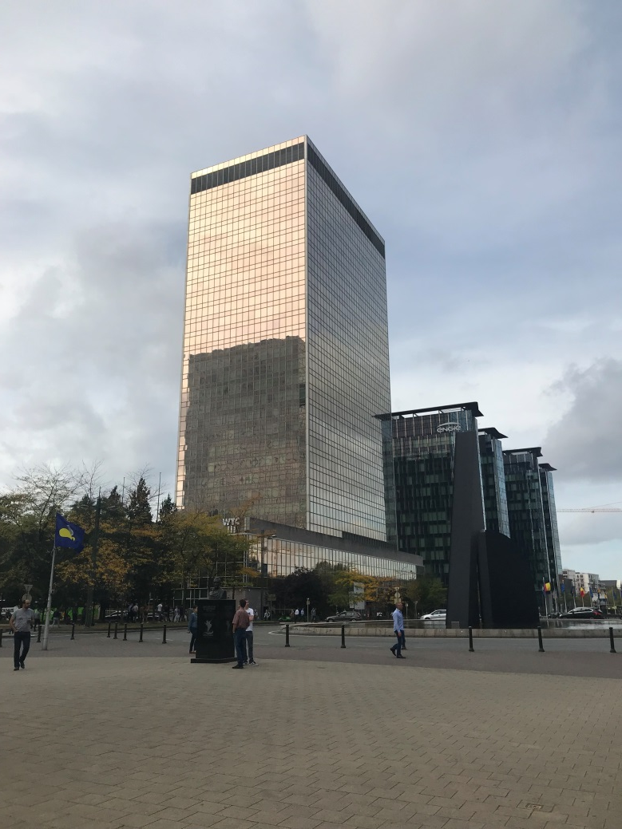
More to come in 2019
Notes:
We are moving to new offices

Slide 15


