Slide 1
ASNET-AM
Academic Scientific Research
Computer Network of Armenia
Institute for Informatics and Automation Problems (IIAP) of the National Academy of Sciences of the Republic of Armenia (NAS RA).
26.09.2018
Lisbon

Slide 2
Basic Data
The Academic Scientific Research Computer Network of Armenia (ASNET-AM) is the National Research and Education Network (NREN) of Armenia.
Created in 1994 - almost 25 years of experience in Networking & IT.
Provides various networking solutions to the Academic, Scientific, Research, Educational, Cultural and other organizations of Armenia, which are engaged in scientific and educational activity.

Slide 3
Basic Data
ASNET-AM functions as a joint structure of several networking centers and departments within the
IIAP NAS RA.
The structure and policy of operation was developed and implemented by the IIAP NAS RA.
ASNET-AM - leading developer of Clustering technologies and Scientific GRID infrastructure in Armenia.
ASNET-AM - supports of Armenia-GÉANT Link

Slide 4
Eastern Partnership Connect
Project
    The Eastern Partnership (EaP) is a joint policy initiative which aims to deepen and strengthen relations between the EU, its Member States and its six European Eastern neighbors.
Stronger economy
Stronger governance
Stronger connectivity
Stronger society

Slide 5
ASNET-AM in Social Media
Facebook – Page created on 23.05.2014
Twitter – Joined Feb 2018

Slide 6

2014-2015

Slide 7
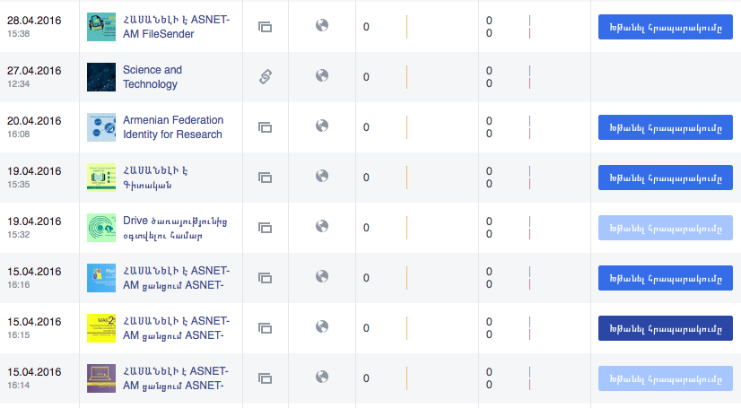
2016

Slide 8
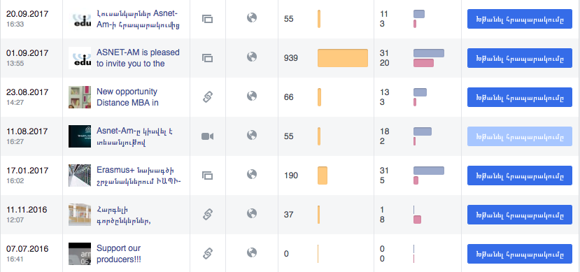
2016-2017

Slide 9
2014-2018
Year | Number of Posts | Number of Reaches
2014 | 2 | 0
2015 | 1 | 0
2016 | 12 | 37
2017 | 5 | 1305
2018 | 25 | 2244

Slide 10

Most viewed Post in 2017

Slide 11
The reason???

Slide 12
More activities
More events
More Services
More Engagement

Slide 13
Challenges?

Slide 14
How can we engage colleagues in social media
There is a need for marketing strategy

Slide 15
THANK YOU

