Slide 1

Internal communication
The Drive for Purpose - engagement
Empower and Support Middle Management
Keep the Brand Promise and Satisfy Your Customers
In a Crisis, Internal Communication Rules
Create a Better Work Environment - engagement
Limit Rumors and Enhance Transparency

Slide 2

Goal of this session
Gather good examples and inspiration
- roundtable on (good) practices
- presentation JISC
Creative collaboration ‘workshop’ on some IC challenges

Slide 3
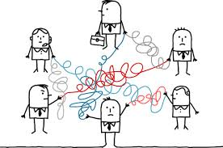
Cases
Make a creative plan to make the management team more visible to staff
Make a creative plan to motivate employees to actively share information
Make a plan how to reach people who work a lot at home

