Slide 1

Personal branding in social media
Some things I heard

Slide 2
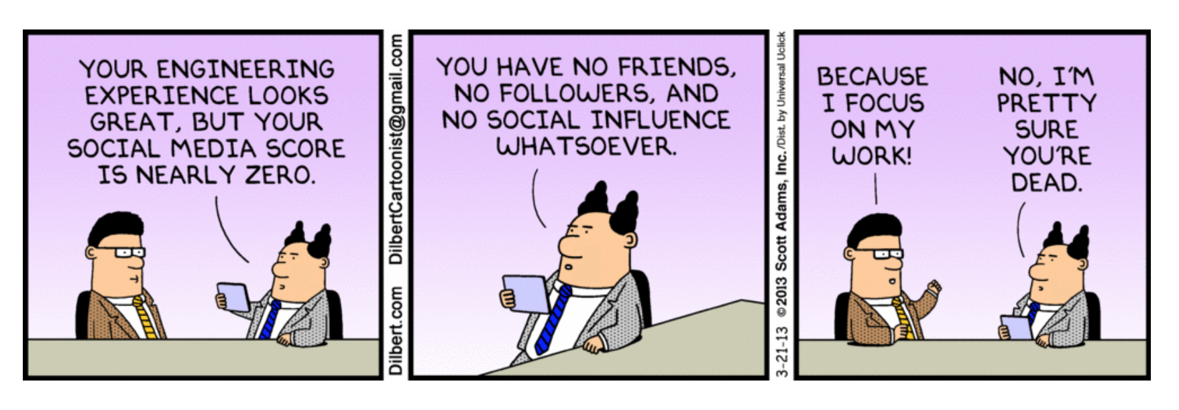

Slide 3

Personal Branding Goals
Become a thought leader in your industry
Be paid to speak at industry conventions
Be known as “the expert” on ……

Slide 4
What makes a strong personal brand?
Authenticity
Your brand values really suites you and other people recognize that.
Cohesion (and synergy)
The different brand values complement and reinforce each other.
Focus
Clearly choose specific brand values and have them come back and propagate everywhere.

Slide 5
How to build your own personal brand
Brand personallity
Knowledge
Education
Experience
Motivation
Personality
Passions
Talents
Appearance
Style
Tangible
Functional
Intangible
Emotional
Motivation
Knowledge
personality
education
Brand
essence
passions
experience
talents
Appearance & style
Presentation and behavior
Expressive
‘Het merk ik’, huub van Zwieten

Slide 6
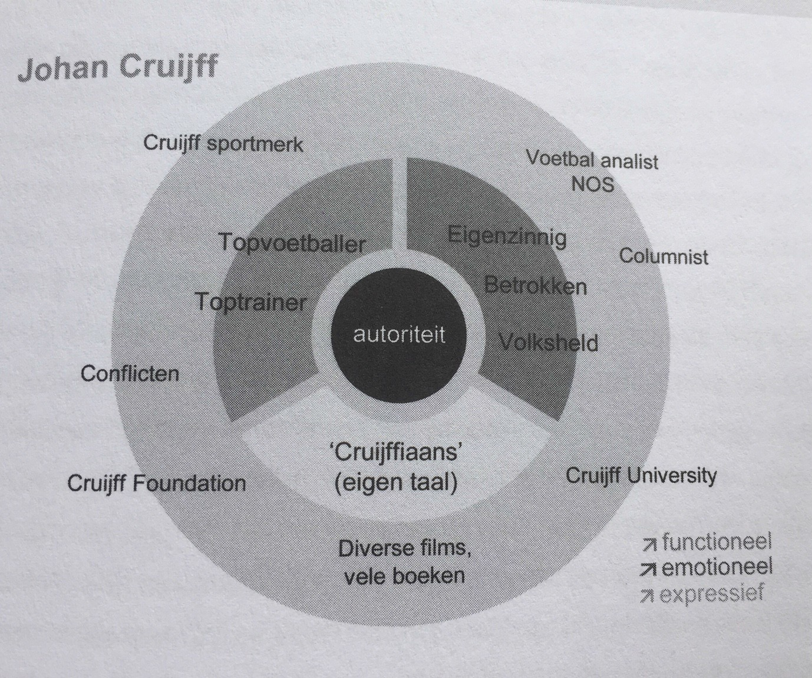
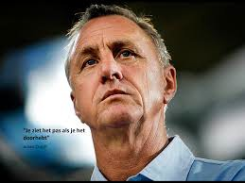
Johan Cruijff
‘Het merk ik’, huub van Zwieten

Slide 7
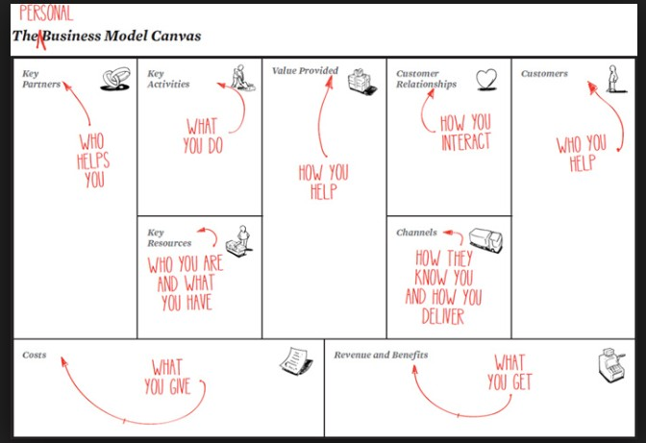
Source: Suzanne van triest

Slide 8

How to make social media work for you
Choose the social network
you want to get started
Step 4
Start dialogue
with network
Step 1
Fill in profile
Step 3
Create content
and share
Step 2
Expand network
Source: Suzanne van triest

Slide 9
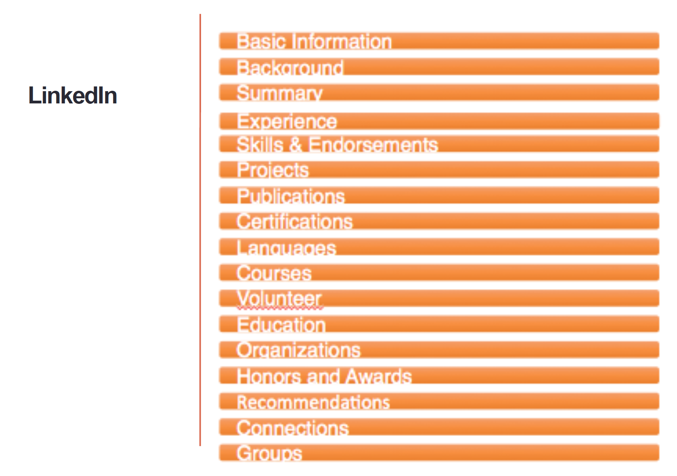
Step 1: fill in profile
Quick wins
Add:
Profile photo
Summary
Contact information
Headline
Work experience
Publications

Slide 10

Step 2: expend network
Add all people you meet on all the social
networks you use. At least on LinkedIn.
Import ‘email- connections’ into LinkedIn

Slide 11
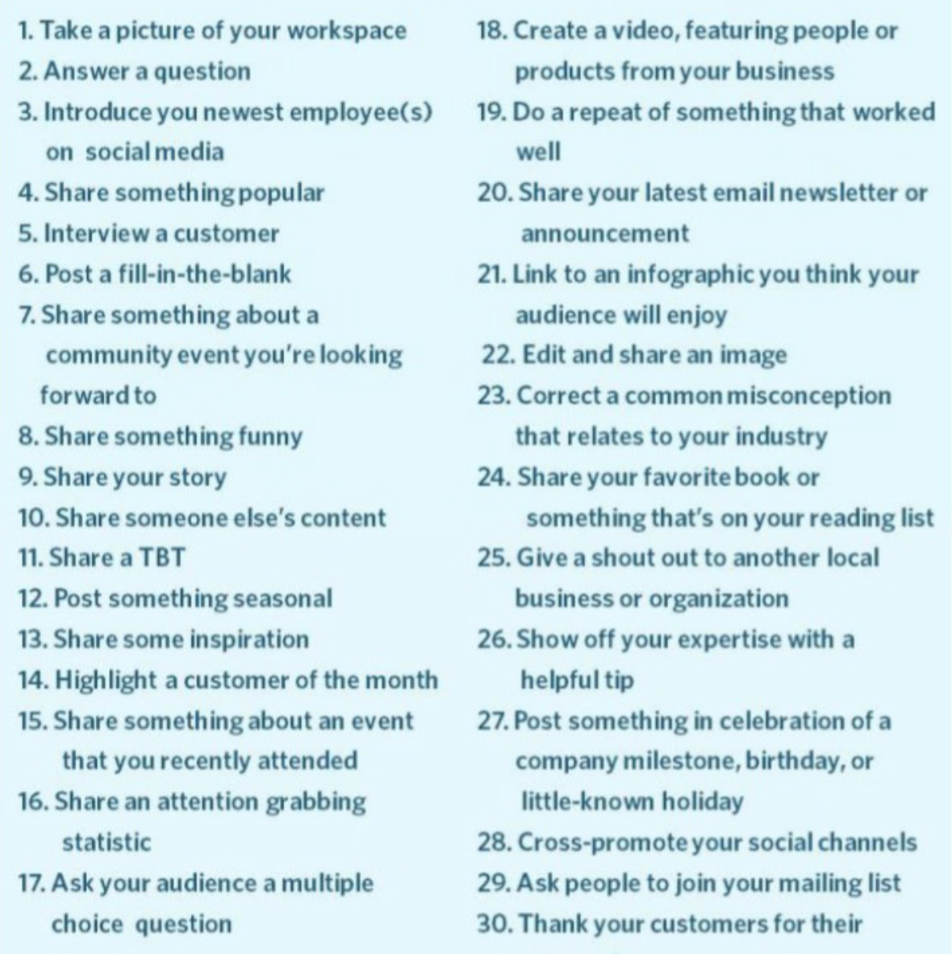
Create content and share
Tip 1
Tag people and Organisations
Tip 2
Use interesting content
Tip 3
Make the message personal

Slide 12
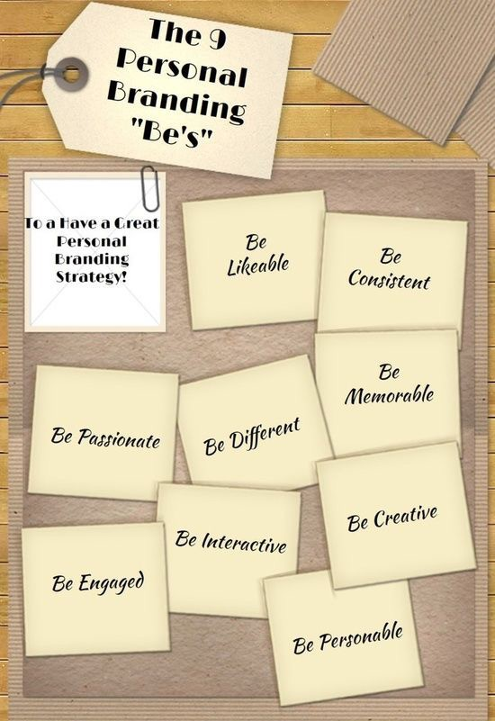
Start dialogue with network
Respond to questions in communities that match your profile.
Respond to your private network if people want to know something about sports, holiday, other countries, schools etc.

