Slide 1
Global PR Meeting
Marketing Metrics
Kathryn Anthonisen| TNC 2019 | June 16, 2019

Slide 2
Over the last fiscal year…
Across all channels, CANARIE had…
758,869
people reading our posts.
CANARIE posted
1,505
times!

Slide 3
Metrics: Website Visitors
(+1,473)
Q4: NREN SIEM press release, RS blog post & CRSC Conference
FY19
Notes:
NOTES: Goals are calculated by the expected trends. Holidays and low points are in December – January, May – August; high points are in January – April, September – November (following school schedule). A growth rate is set for these areas to accommodate for the fluctuating numbers. This may include a negative rate.
Last quarter: NREN SIEM press release, blog post about security research platforms by Manager, Software Development, and Manager, Cybersecurity, CRSC Conference
Total cumulative Website Visitors: 483,735
Total of Q4 FY19 Website Visitors: 19,652

Slide 4
Metrics: Cumulative Video Views on YouTube
(+433)
FY18
FY19
Notes:
NOTES: Combined video views include all 146 YouTube videos on CANARIE Channel
"Views" ex­per­i­enced an er­ror between 19 December 2018 and 20 December 2018 on YouTube Analytics. Data dur­ing this time peri­od may not be ac­cur­ate.
Data error in reporting therefore discrepancy between previous FY19 Q3 total reporting
Total Cumulative Video Views for Q4 FY19: 32,201 (+433)

Slide 5
Metrics: Cumulative Corporate Email Subscribers
(+102)
FY18
FY19
Notes:
NOTES: Moved to Campaigner in Q2 2017. Total includes those who are subscribed, unsubscribed, pending, implicit consent on CANARIE News & Actualités email lists.
Cumulative Total of Subscribers: 3,593
Total Q4 FY19 New Subscribers: 102

Slide 6



Metrics: Social Media Followers
(-14)
(+138)
FY18
FY19
Notes:
NOTES: Twitter & Facebook include ads + organic growth. LinkedIn is organic growth. Goals are calculated by using raw historical data and formulas in excel. For the period before advertising began, an average of the growth was taken and applied to future numbers. Since advertising, we have tried to keep a steady goal and pace. Goals have exceeded our actual when we had paused our follower and page like ad.
LinkedIn and Twitter ads ran for Q4 while Facebook Page Like ads halted.
Total of Organic + Ad Facebook Page Likes Q4 FY19: 5,453 (-14)
Total of Twitter Organic + Ad Followers Q4 FY19: 4,942 (9+138)
Total of LinkedIn Organic +Ad Followers Q4 FY19: 1,298 (+32)

Slide 7
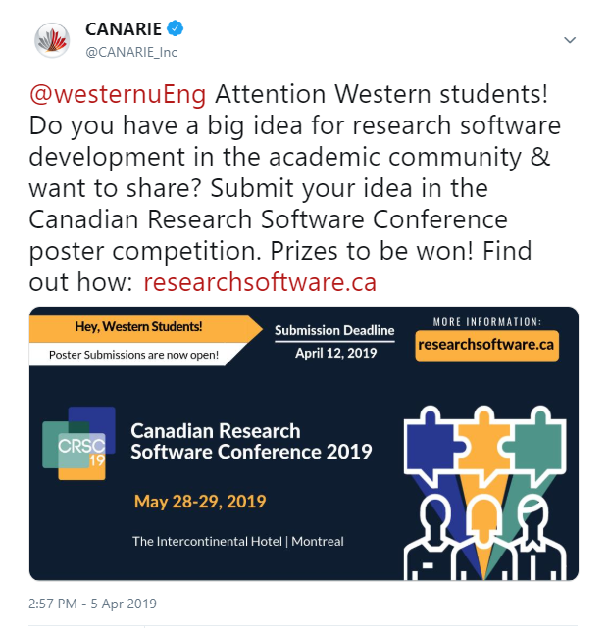
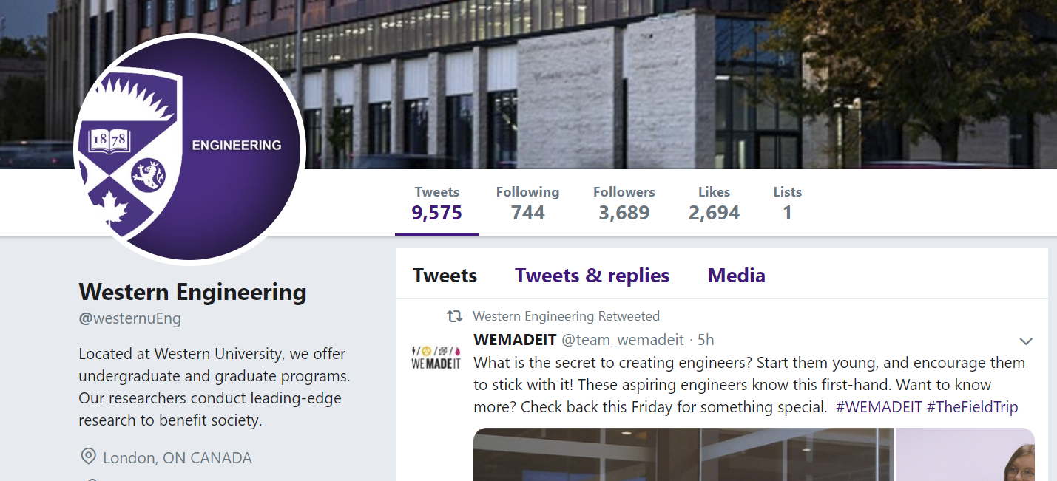
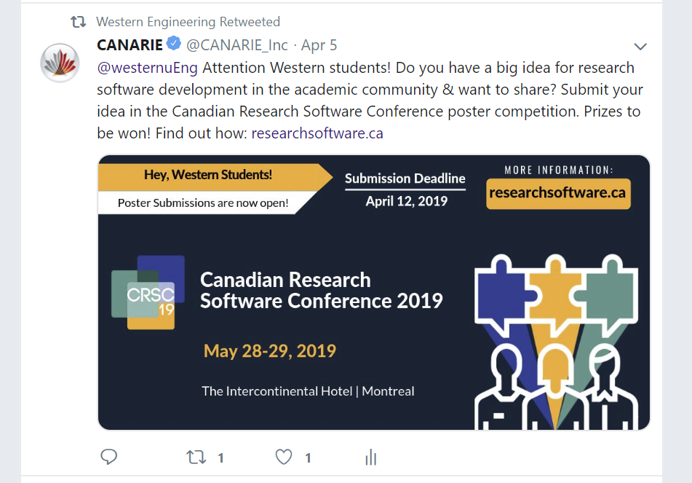
How do we use social media to interact, engage, and notify our followers?
Here, I wanted to show that the custom outreach to individual target accounts resulted in a significant increase in our message being re-tweeted by those accounts.
Customized outreach campaigns:
  Free Splunk training for members
  Software Conference call for speakers
Notes:
These campaigns involved extensive research for what accounts we needed to target for either campaign. For Splunk, we privately messaged institutions that would be interested in signing up so that we could increase uptake.
For the Call outreach, we private messaged and tweeted at several university accounts including their science or engineering depts. So that they could share our message with their followers.
The main idea is that when we need to get our message shared by other accounts – we make it so that all they have to do is click one button. If we had more steps involved in our sharing process, we’d have less of a success rate.

Slide 8
Metrics: Social Media Engagement
Q4 top Facebook posts: Shared articles
Q4 top tweets: NREN SIEM Press Release, Shared articles, eduroam video
Benchmark: 0.96%
FY18
Notes:
NOTES: Organic engagement rate
Q4 FY19 top Facebook posts: January to March saw unusual high engagement with shared articles from various new sources. This quarter was one of the highest engagement rates.
Q4 FY19 top tweets: NREN SIEM press release, shared articles, eduroam video

Slide 9



Observations
Experience has shown us what types of content maximizes engagement on each channel.
Scientific discoveries written in simple terms
News & announcements, particularly related to funding
Corporate news, photos from events, tagging other organizations
Elements that maximize engagement are the most time consuming!
  Customization = maximum results
  Knowing your audience (followers) to target content and ads

