Slide 1
GREN Map Update
TNC Tallinn
Global PR Meeting June 16, 2019

Slide 2
What is the GREN Map?
A dynamic visualization of the Global Research and Education Network
Will allow users to see GREN-connected institutions (network nodes), network links, and NREN- specific information in a zoomable format
For example, a researcher at an institution in Germany can start on the map with a node indicating their institution, then zoom out to see the German NREN map and all connected institutions in Germany, then in Europe, then in North America, etc.

Slide 3
Why have a GREN map?
An easily understood and compelling illustration of the GREN
A powerful tool in communicating:
  How an institution/country/NREN fits into the broader GREN picture
  The global reach of the GREN
  That thousands of institutions/millions of users/hundreds of research instruments are connected to and rely on the GREN to conduct data-intensive, collaborative research

Slide 4
What key messages can be amplified with the GREN map?
The GREN is essential infrastructure supporting global research and education collaboration
Critical data sets and research services are only available through the GREN, not via the commercial Internet
The investments made by institutions/governments in one country’s NREN are leveraged by the investments that other countries/institutions make in their NREN
The evolution of the GREN is managed in a collaborative and cooperative ethos that delivers cost and service efficiencies

Slide 5
What other tools are being developed to help communicate the value of the GREN?
Global Financial Benchmarking Working Group:
  Working to determine the annual global investment in the GREN; data that can be used to illustrate how an institution’s, or a country’s, investment in its NREN is leveraged several-hundredfold by global NREN investment

Slide 6
GREN Map Working Group & TNC Demo
Primary objectives of Map Working Group:
  Develop a data format and schema to support the streamlined sharing of network data, to be used in the creation and maintenance of global maps of the Global Research and Education Network
    Currently, global maps involve long request-response cycles to gather current data, and require a manual effort to filter and harmonize the format
  Encourage wide participation to achieve critical mass adoption of the above format
  Develop tools to help RENs transition/translate to the data format
  (Later): Develop a reference visualization to showcase the use of the data format

Slide 7
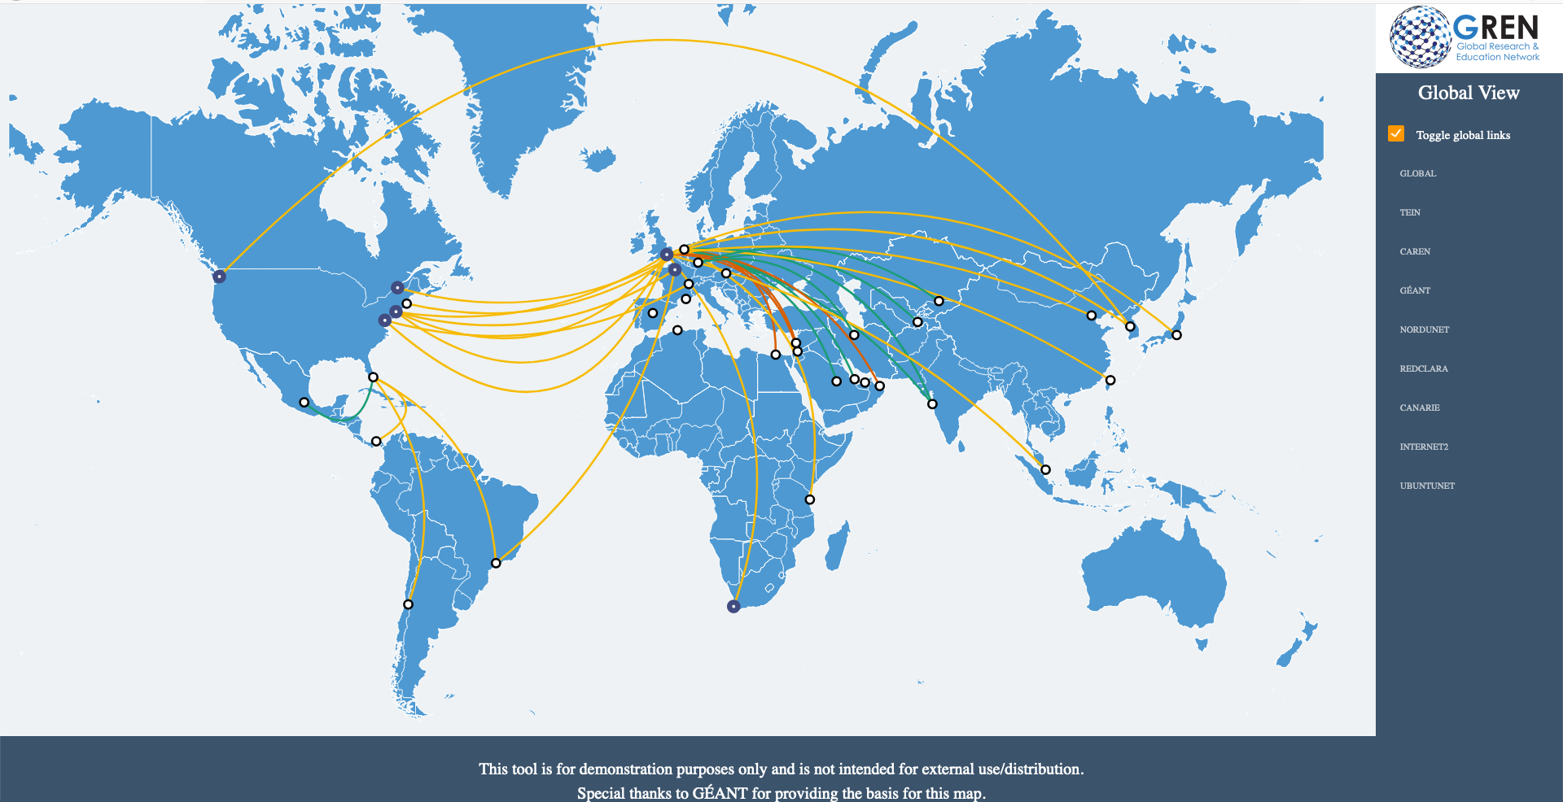

Slide 8
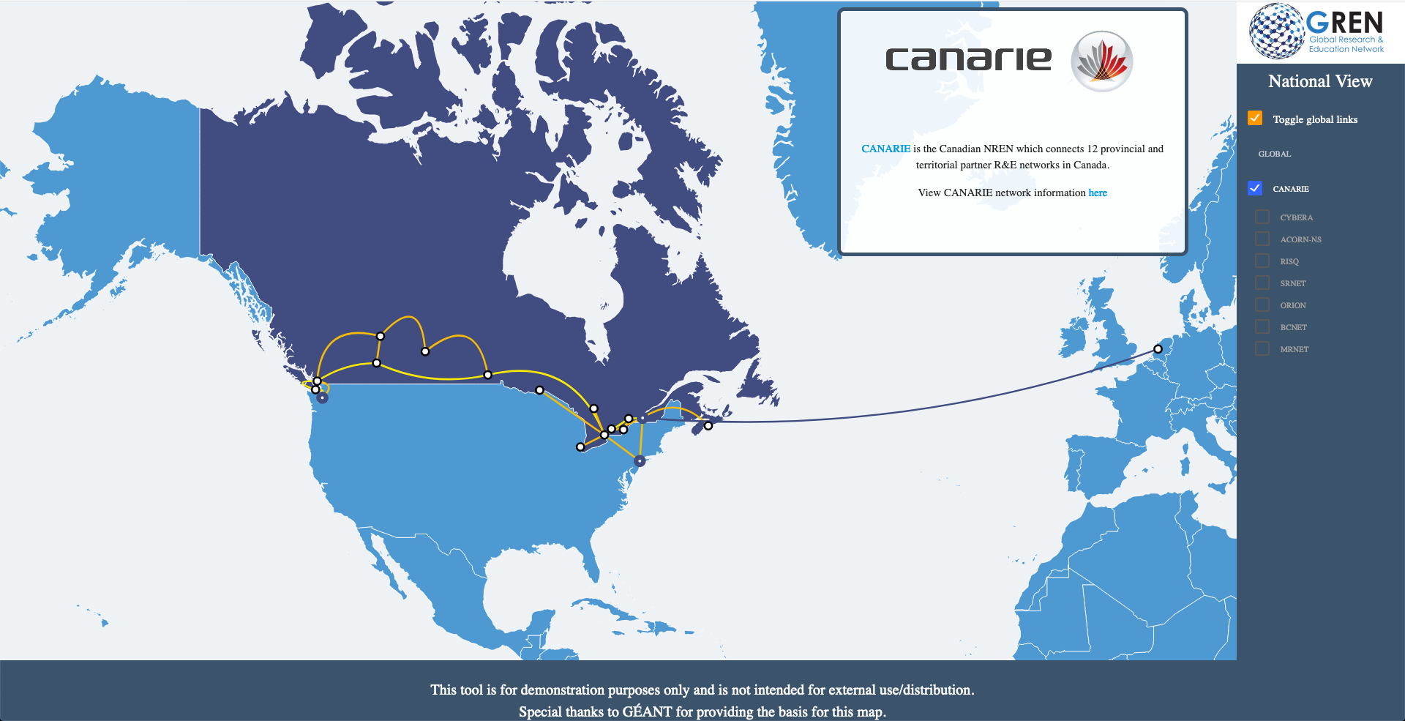

Slide 9
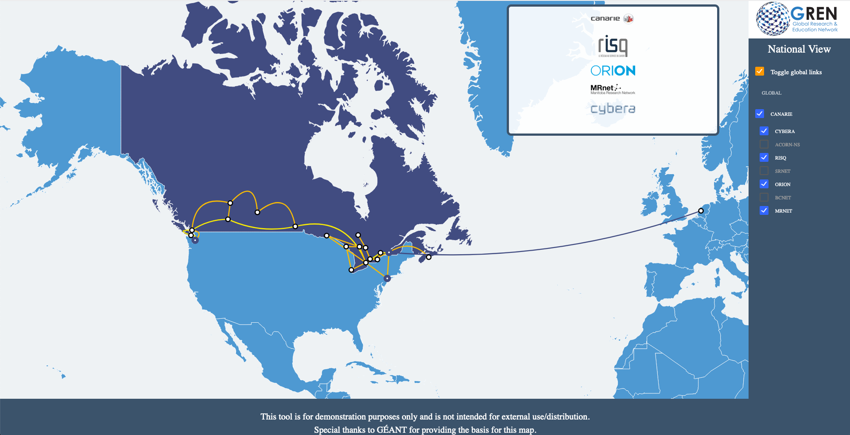

Slide 10
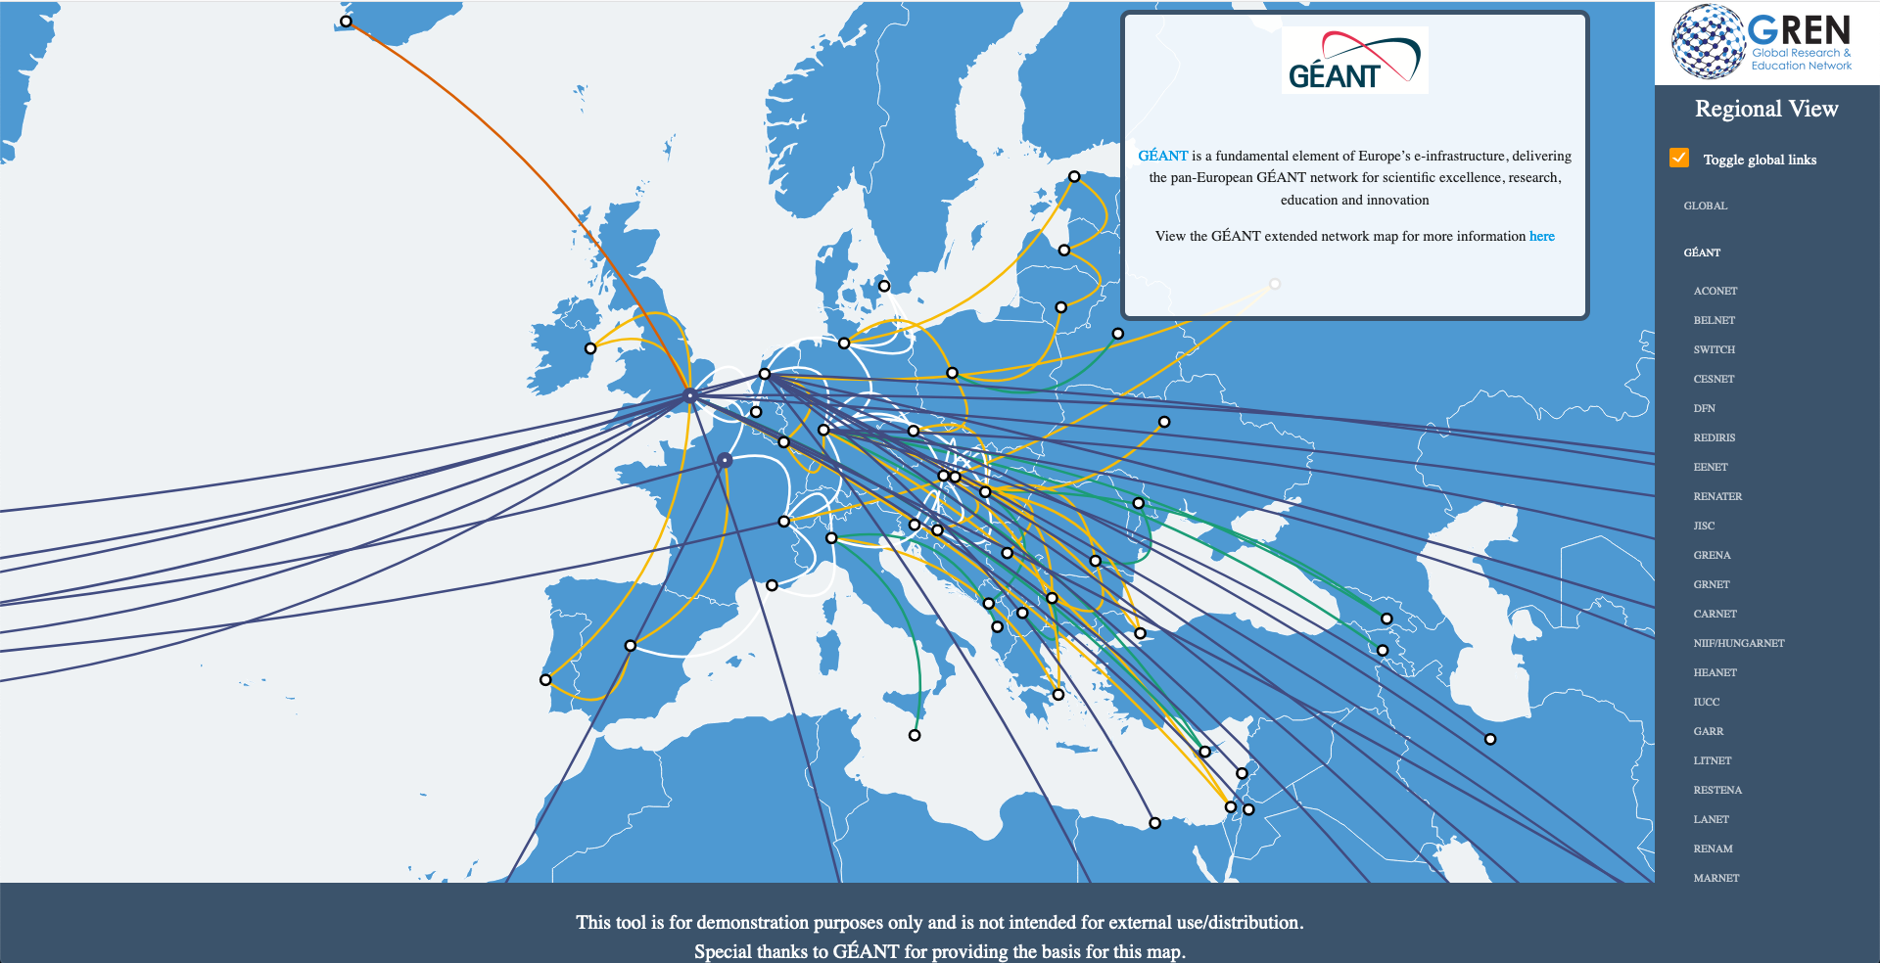

Slide 11
Where to see the demo
GEANT booth
  Formal presentation Monday lunch
  My colleague Ryan Davies will be at booth and can demo map at any time during conference

Slide 12
Next Steps
Incorporate feedback from TNC demo
Continue outreach to community on data format
Begin to construct production map

