Slide 1

#GEANTwomeninSTEM
Campaign results

Slide 2
Total campaign results
Twitter
Impressions: 69,829
Gif views: 629
Link clicks: 201
Engagement: 1,462
LinkedIn
Impressions: 9,203
Gif views: 353
Link clicks: 224
Engagement: 400
Facebook
Reach: 11,273
Gif views: 376
Link clicks: 171
Engagement: 3,242
PeaR
Clicks: 134
Unique clicks: 127
GÉANT Community Blog
Page views: 2,813
Unique clicks: 1,304
Notes:
Average results:
Twitter impressions: 40-45K
Facebook post reach: 5K
LinkedIn impressions: 5K
PeaR: 50-60
GÉANT Community Blog pageviews: 4-5K

Slide 3


1st post: 11 feb - Girls and Women in Science Day
Twitter
Impressions: 5,565
Gif views: 432
Engagements: 89
Facebook
Reach: 704
Gif views: 179
Engagement: 80
LinkedIn
Impressions: 1,172
Gif views: 353
Engagement: 31
PeaR Newsletter
Clicks: 30
Unique clicks: 29
GÉANT Community Blog
Pageviews: 93
Unique pageviews: 45
Average time on page: 24 sec.

Slide 4
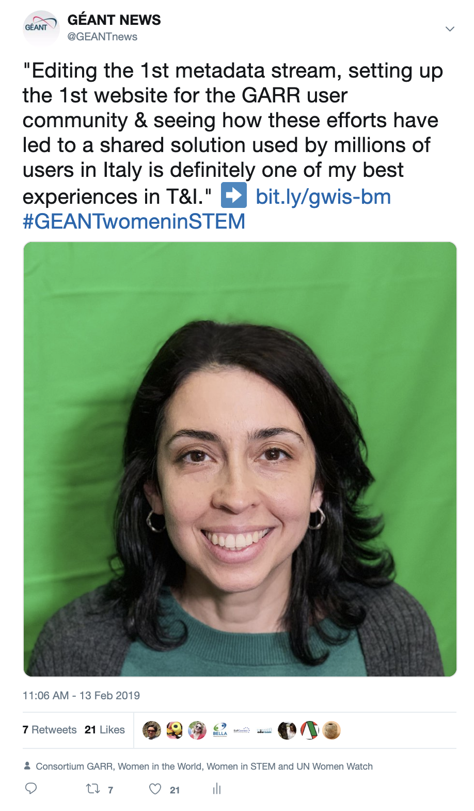
Barbara Monticini
Twitter
Impressions: 3,215
Link clicks: 9
Engagements: 51
Facebook
Reach: 875
Link clicks: 11
Engagement: 91
LinkedIn
Impressions: 474
Link clicks: 8
Engagement: 22
PeaR Newsletter
Clicks: 9
Unique clicks: 5
GÉANT Community Blog
Pageviews: 119
Unique pageviews: 48
Average time on page: 1m3s

Slide 5
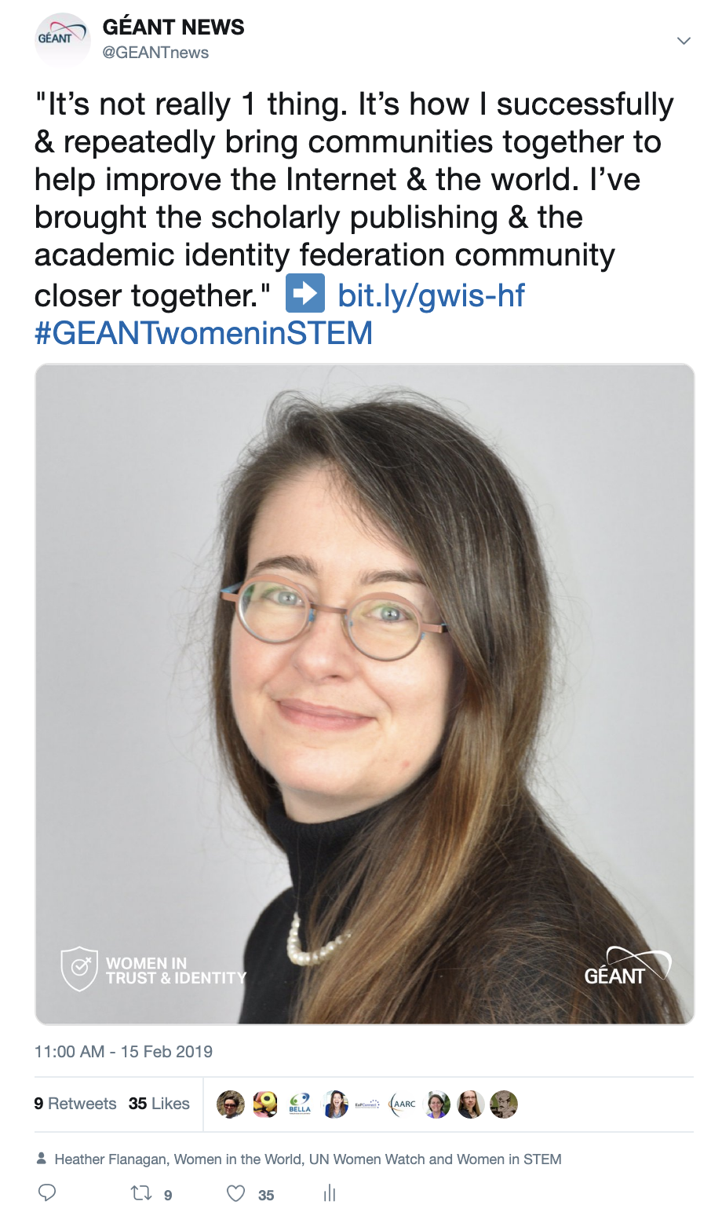
Heather Flanagan
Twitter
Impressions: 4,231
Link clicks: 25
Engagements: 170
Facebook
Reach: 918
Link clicks: 8
Engagement: 230
LinkedIn
Impressions: 420
Link clicks: 6
Engagement: 16
PeaR Newsletter
Clicks: 4
Unique clicks: 4
GÉANT Community Blog
Pageviews: 236
Unique pageviews: 115
Average time on page: 50 sec.

Slide 6
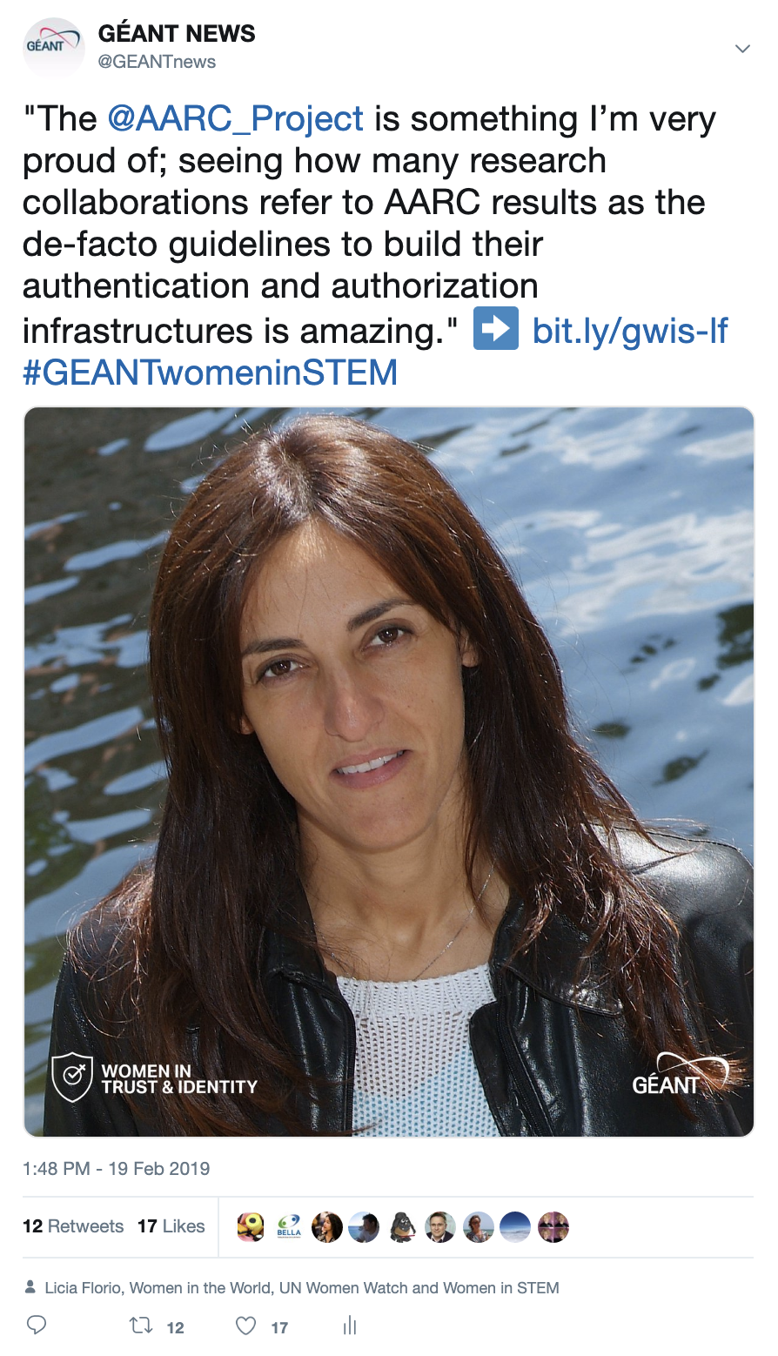
Licia Florio
Twitter
Impressions: 4,073
Link clicks: 7
Engagements: 76
Facebook
Reach: 624
Link clicks: 9
Engagement: 69
LinkedIn
Impressions: 386
Link clicks: 18
Engagement: 26
PeaR Newsletter
Clicks: 10
Unique clicks: 10
GÉANT Community Blog
Pageviews: 104
Unique pageviews: 46
Average time on page: 44 sec.

Slide 7
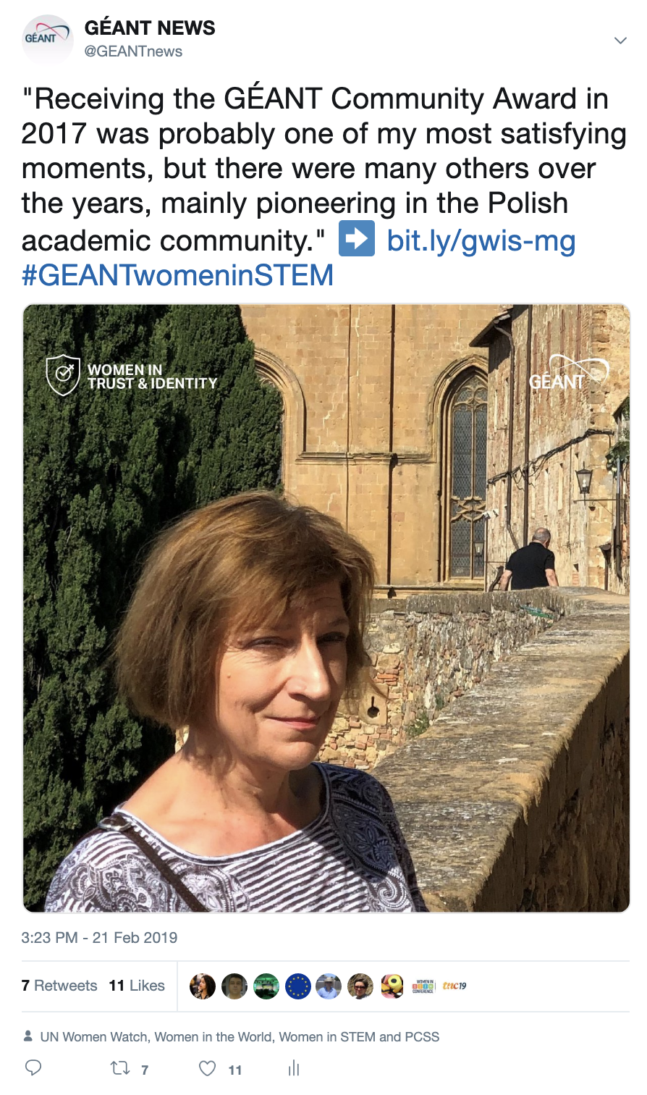
Maja Wolniewicz
Twitter
Impressions: 3,033
Link clicks: 5
Engagements: 49
Facebook
Reach: 483
Link clicks: 5
Engagement: 46
LinkedIn
Impressions: 216
Link clicks: 1
Engagement: 3
PeaR Newsletter
Clicks: 5
Unique clicks: 5
GÉANT Community Blog
Pageviews: 70
Unique pageviews: 37
Average time on page: 18 sec.

Slide 8
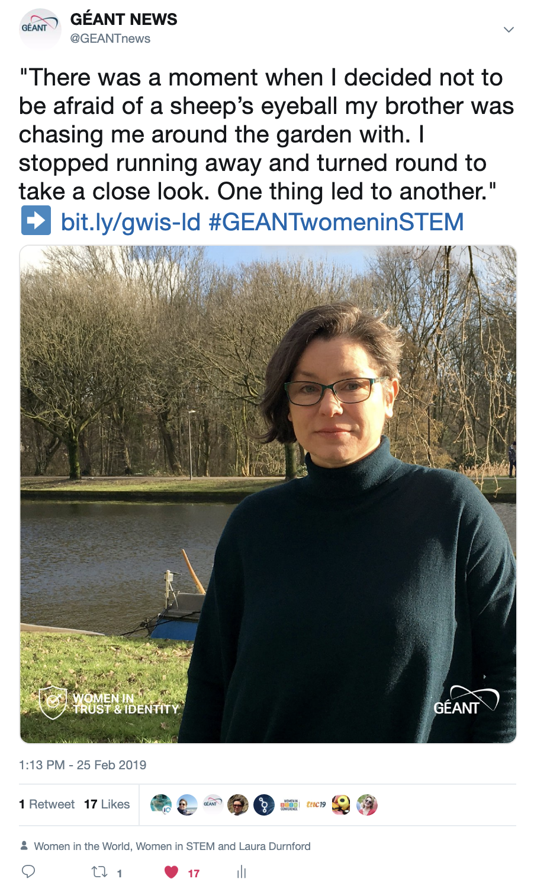
Laura Durnford
Twitter
Impressions: 2,842
Link clicks: 9
Engagements: 49
Facebook
Reach: 638
Link clicks: 47
Engagement: 325
LinkedIn
Impressions: 437
Link clicks: 10
Engagement: 22
PeaR Newsletter
Clicks: 6
Unique clicks: 6
GÉANT Community Blog
Pageviews: 169
Unique pageviews: 83
Average time on page: 14 sec.

Slide 9
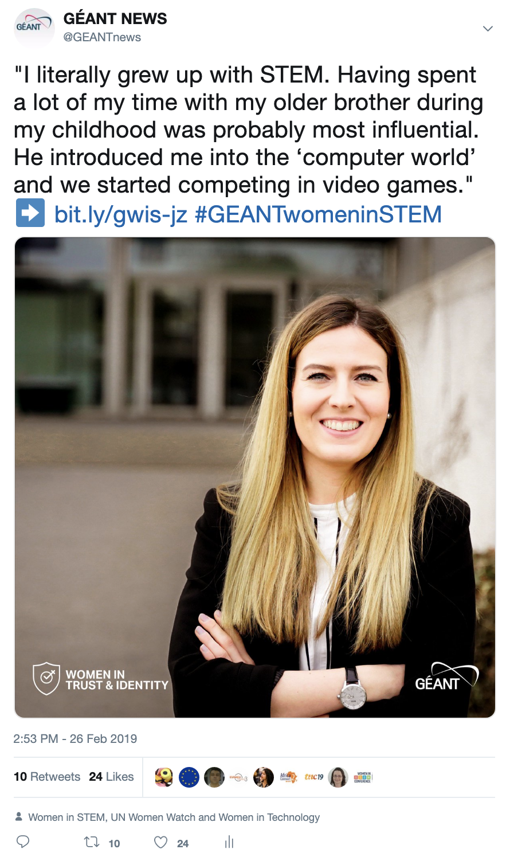
Jule Ziegler
Twitter
Impressions: 4,428
Link clicks: 8
Engagements: 74
Facebook
Reach: 412
Link clicks: 4
Engagement: 34
LinkedIn
Impressions: 270
Link clicks: 6
Engagement: 10
PeaR Newsletter
Clicks: 16
Unique clicks: 14
GÉANT Community Blog
Pageviews: 93
Unique pageviews: 38
Average time on page: 49 sec.

Slide 10
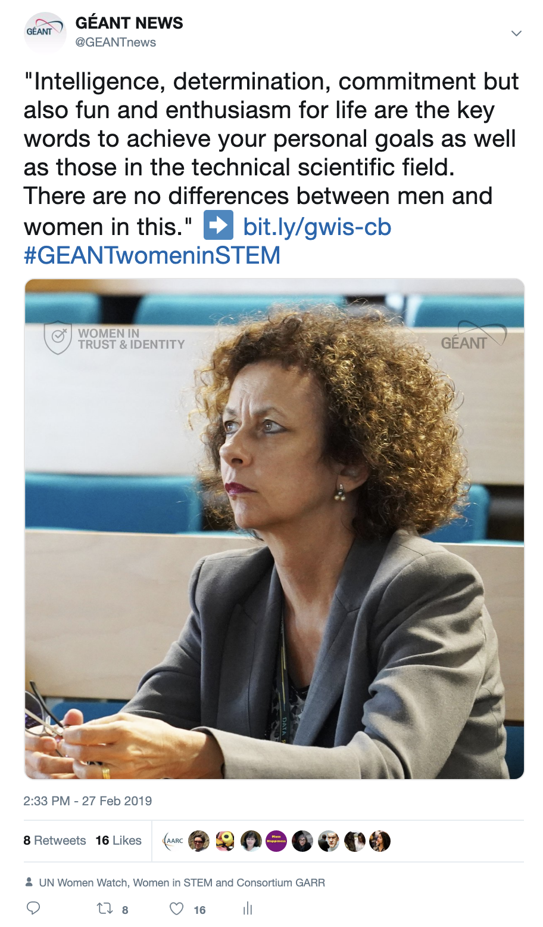
Claudia Battista
Twitter
Impressions: 3,720
Link clicks: 7
Engagements: 42
Facebook
Reach: 823
Link clicks: 2
Engagement: 66
LinkedIn
Impressions: 401
Link clicks: 12
Engagement: 19
PeaR Newsletter
Clicks: 2
Unique clicks: 2
GÉANT Community Blog
Pageviews: 64
Unique pageviews: 33
Average time on page: 24 sec.

Slide 11
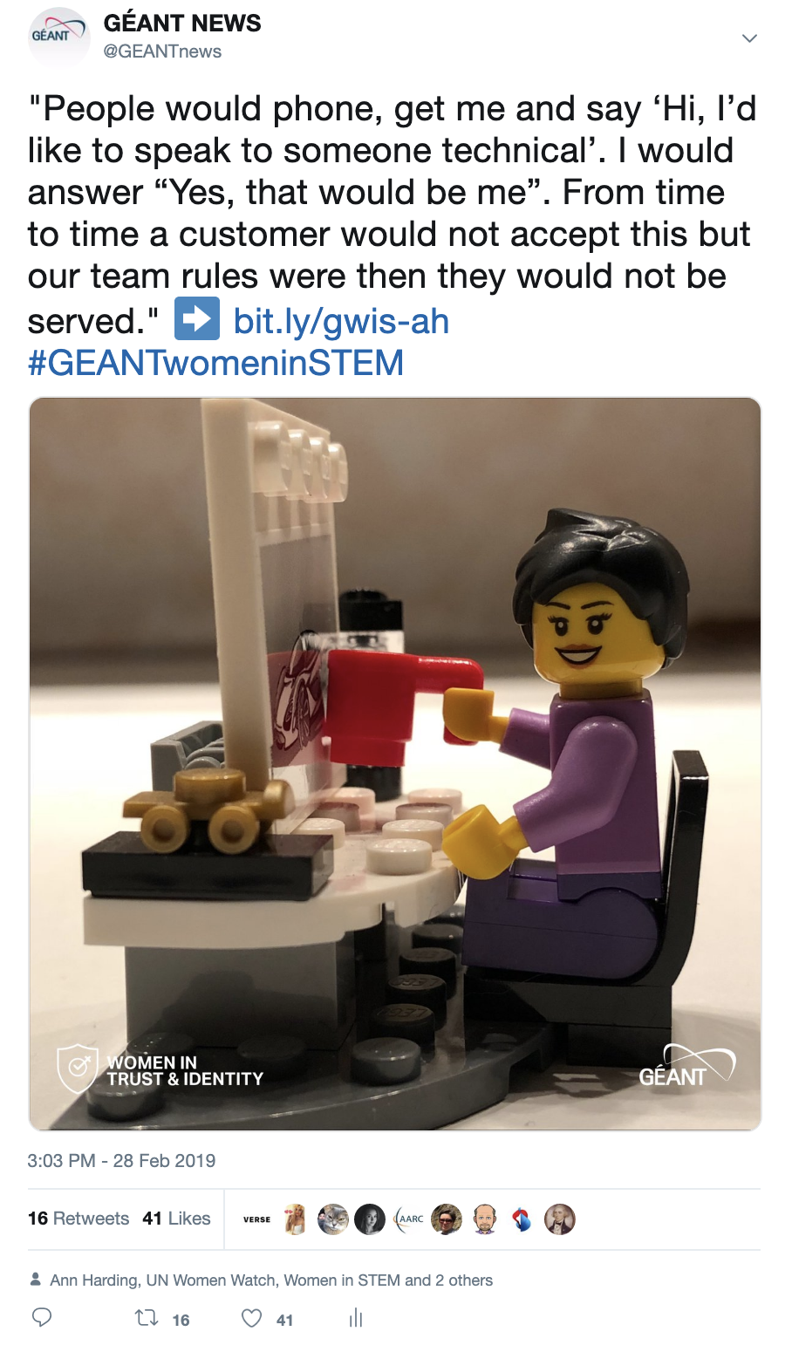
Ann Harding
Twitter
Impressions: 7,008
Link clicks: 44
Engagements: 280
Facebook
Reach: 473
Link clicks: 10
Engagement: 117
LinkedIn
Impressions: 905
Link clicks: 37
Engagement: 52
PeaR Newsletter
Clicks: 8
Unique clicks: 8
GÉANT Community Blog
Pageviews: 83
Unique pageviews: 39
Average time on page: 22 sec.

Slide 12
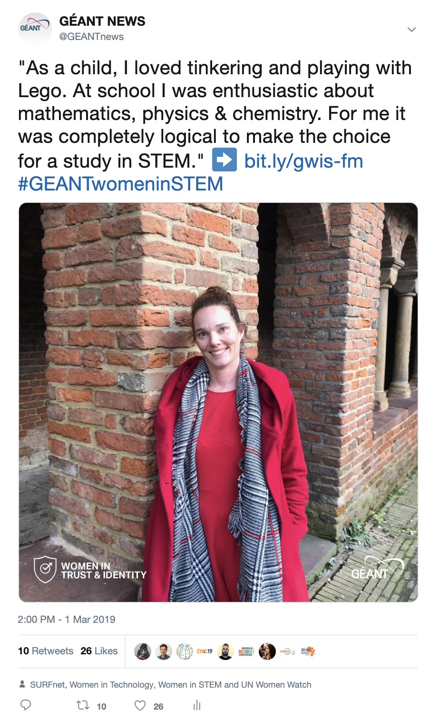
Femke Morsch
Twitter
Impressions: 4,341
Link clicks: 21
Engagements: 96
Facebook
Reach: 292
Link clicks: 2
Engagement: 25
LinkedIn
Impressions: 506
Link clicks: 14
Engagement: 25
PeaR Newsletter
Clicks: 4
Unique clicks: 4
GÉANT Community Blog
Pageviews: 183
Unique pageviews: 86
Average time on page: 38 sec.

Slide 13
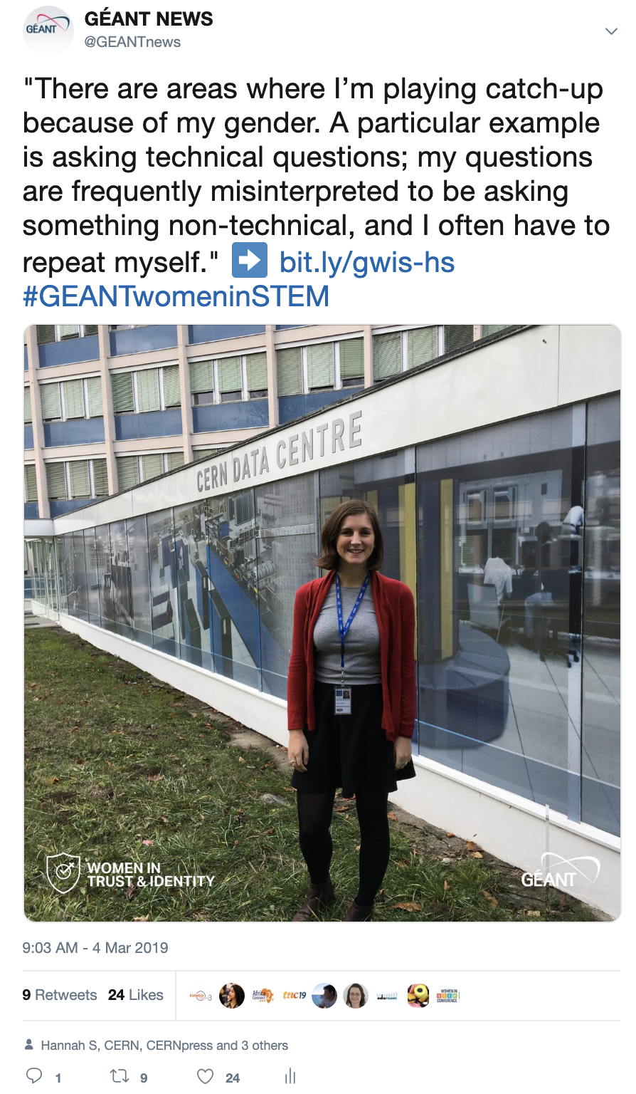
Hannah Short
Twitter
Impressions: 3,414
Link clicks: 17
Engagements: 94
Facebook
Reach: 377
Link clicks: 12
Engagement: 58
LinkedIn
Impressions: 500
Link clicks: 18
Engagement: 24
PeaR Newsletter
Clicks: 7
Unique clicks: 7
GÉANT Community Blog
Pageviews: 152
Unique pageviews: 73
Average time on page: 29 sec.

Slide 14
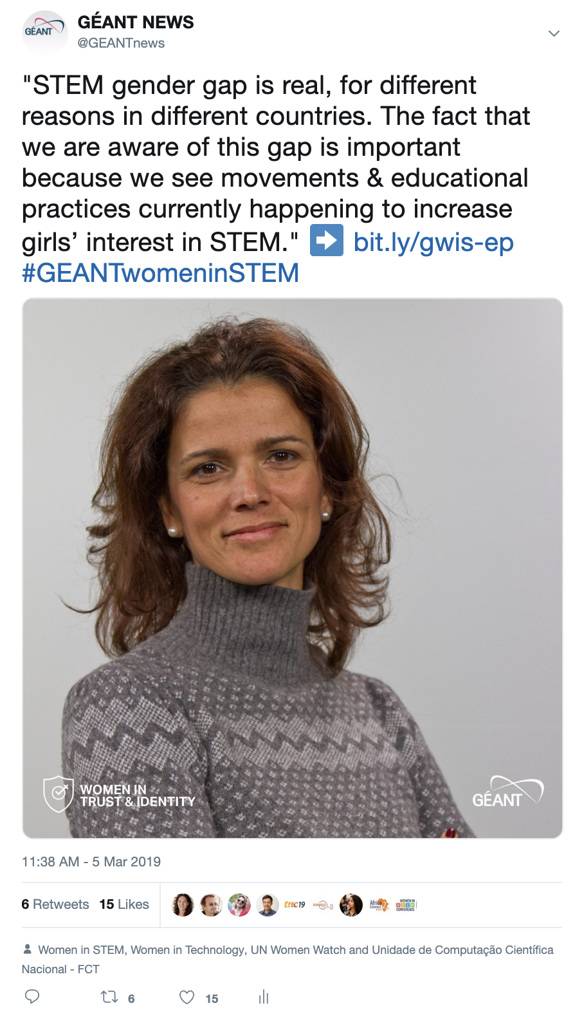
Esmeralda Pires
Twitter
Impressions: 2,623
Link clicks: 8
Engagements: 43
Facebook
Reach: 1,095
Link clicks: 4
Engagement: 1,532
LinkedIn
Impressions: 375
Link clicks: 13
Engagement: 21
PeaR Newsletter
Clicks: 9
Unique clicks: 9
GÉANT Community Blog
Pageviews: 358
Unique pageviews: 162
Average time on page: 32 sec.

Slide 15
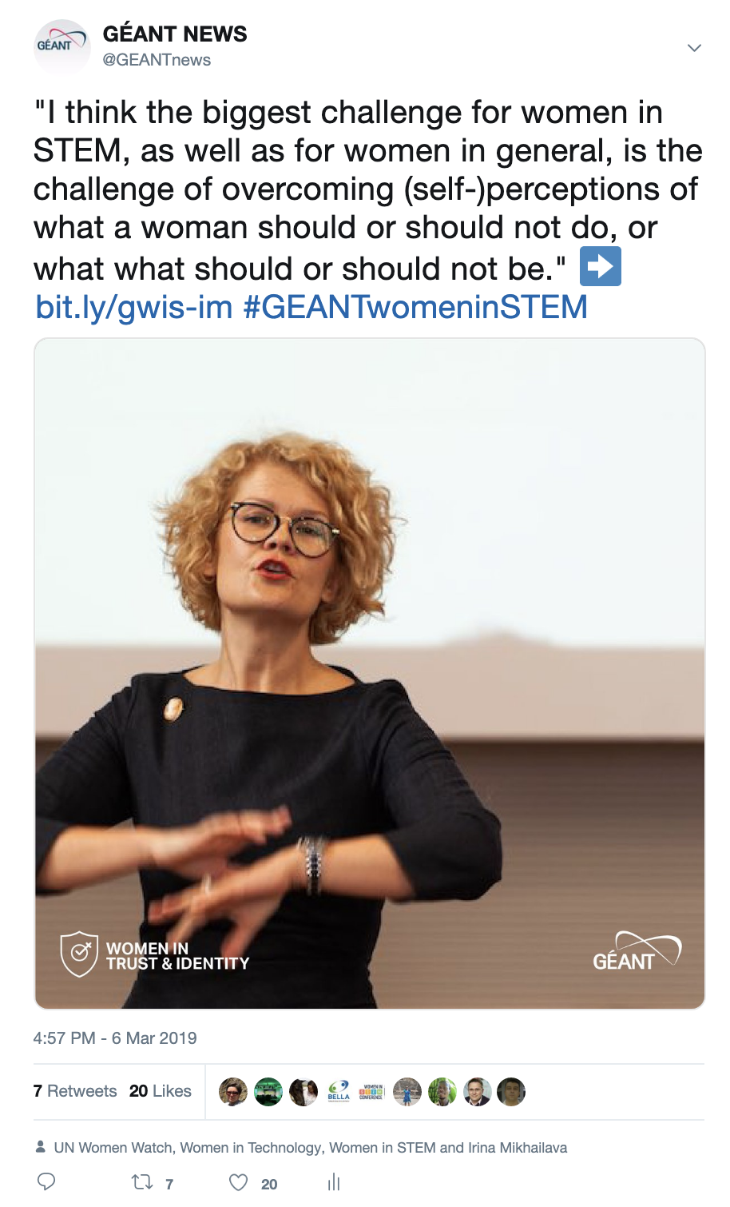
Irina Mikhailava
Twitter
Impressions: 2,427
Link clicks: 6
Engagements: 47
Facebook
Reach: 372
Link clicks: 6
Engagement: 41
LinkedIn
Impressions: 371
Link clicks: 5
Engagement: 11
PeaR Newsletter
Clicks: 3
Unique clicks: 3
GÉANT Community Blog
Pageviews: 212
Unique pageviews: 95
Average time on page: 21 sec.

Slide 16
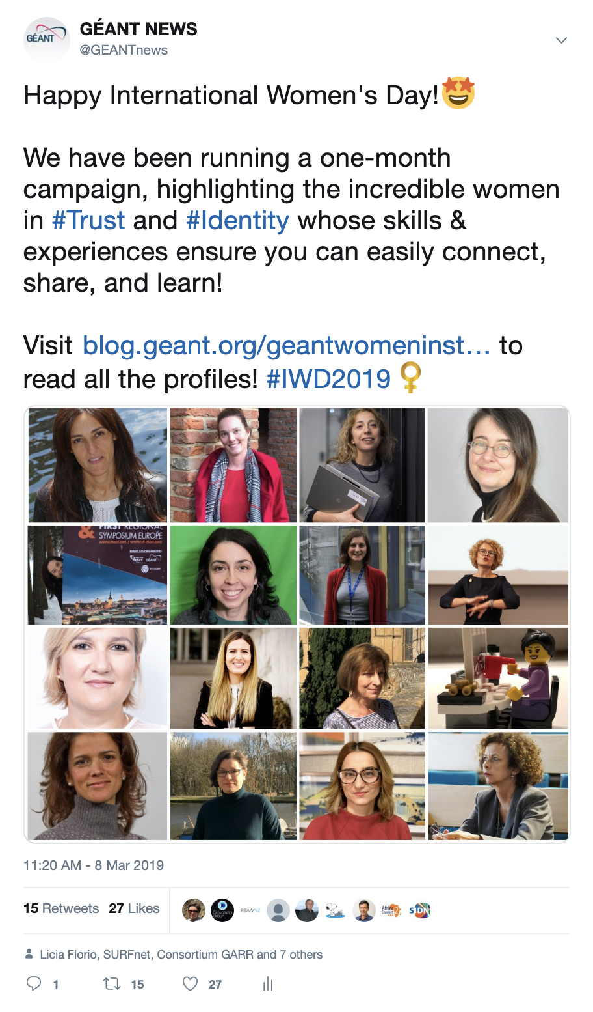
International Women’s Day collage
Twitter
Impressions: 4,837
Link clicks: 14
Engagements: 138
Facebook
Reach: 1,178
Link clicks: 9
Engagement: 290
LinkedIn
Impressions: 1,389
Link clicks: 55
Engagement: 85
PeaR Newsletter
n/a
GÉANT Community Blog
/geantwomeninstem
Pageviews: 144
Unique pageviews: 60
Average time on page: 47 sec.

Slide 17

International Women’s Day gif
Twitter
Impressions: 3,479
Gif views: 197
Engagements: 31
Facebook
n/a
LinkedIn
n/a
PeaR Newsletter
n/a
GÉANT Community Blog
n/a

Slide 18
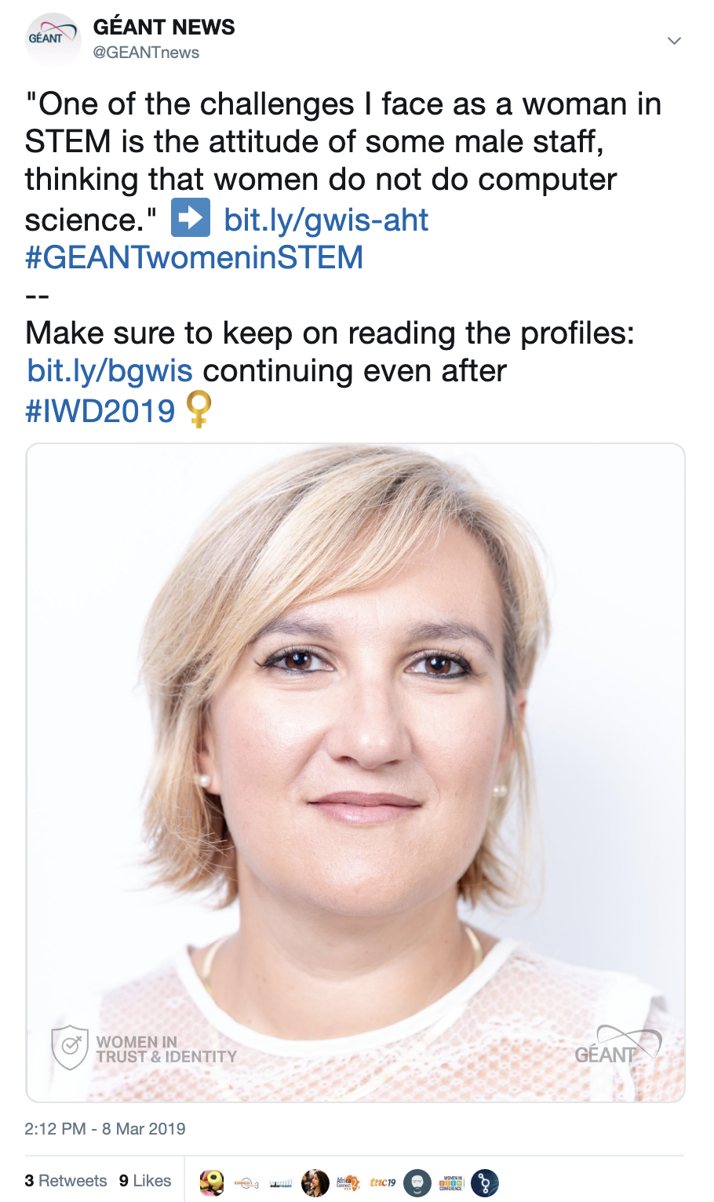
Anne-Hélène Turpin
Twitter
Impressions: 2,383
Link clicks: 6
Engagements: 25
Facebook
Reach: 207
Link clicks: 1
Engagement: 19
LinkedIn
Impressions: 280
Link clicks: 3
Engagement: 7
PeaR Newsletter
Clicks: 2
Unique clicks: 2
GÉANT Community Blog
Pageviews: 232
Unique pageviews: 106
Average time on page: 51 sec.

Slide 19
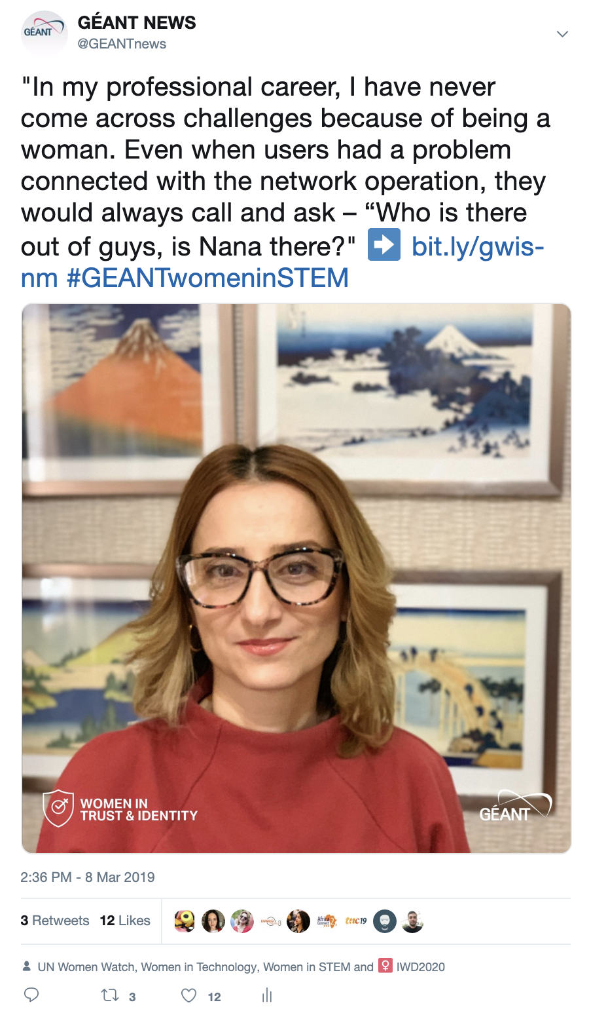
Nana Manukyan
Twitter
Impressions: 2,815
Link clicks: 1
Engagements: 27
Facebook
Reach: 329
Link clicks: 7
Engagement: 38
LinkedIn
Impressions: 377
Link clicks: 8
Engagement: 10
PeaR Newsletter
Clicks: 2
Unique clicks: 2
GÉANT Community Blog
Pageviews: 269
Unique pageviews: 128
Average time on page: 46 sec.

Slide 20
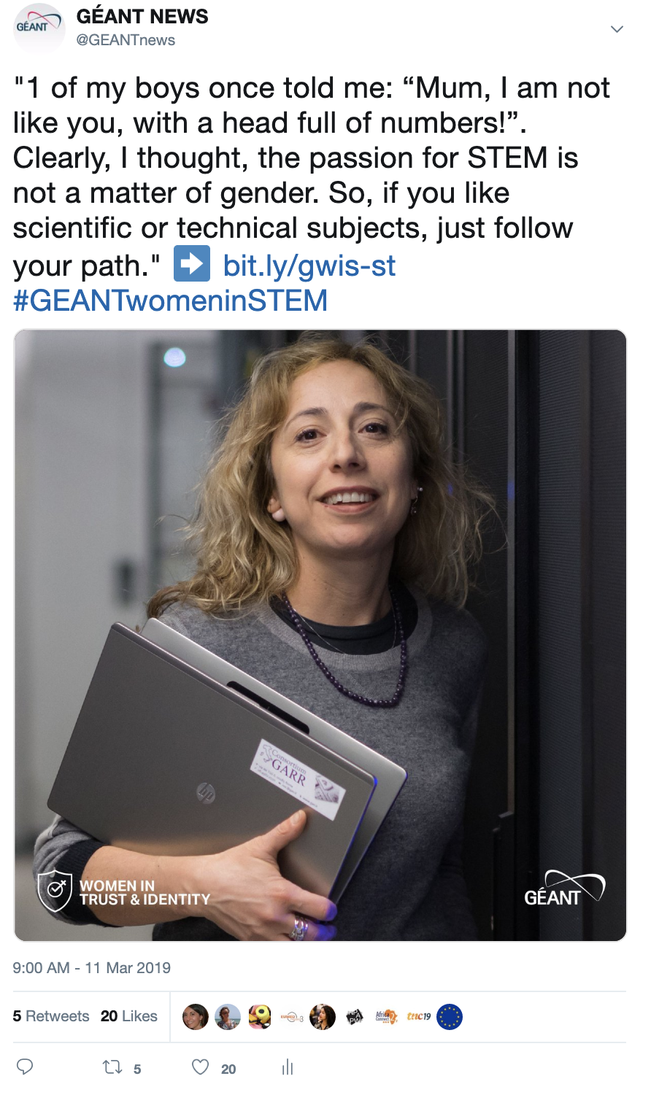
Sabrina Tomassini
Twitter
Impressions: 2,677
Link clicks: 5
Engagements: 47
Facebook
Reach: 1,081
Link clicks: 25
Engagement: 76
LinkedIn
Impressions: 416
Link clicks: 5
Engagement: 10
PeaR Newsletter
Clicks: 4
Unique clicks: 4
GÉANT Community Blog
Pageviews: 141
Unique pageviews: 68
Average time on page: 24 sec.

Slide 21
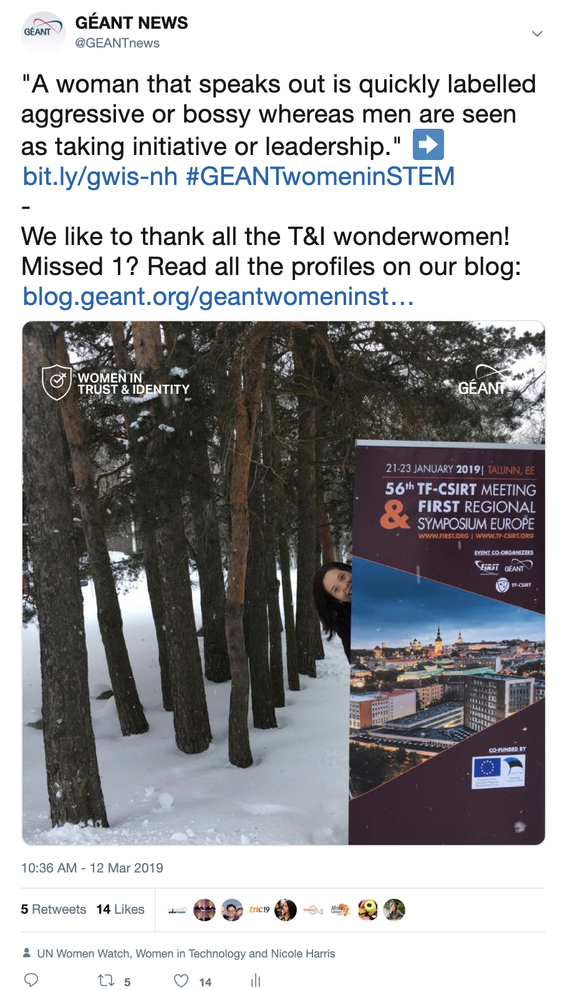
Nicole Harris
Twitter
Impressions: 2,718
Link clicks: 9
Engagements: 34
Facebook
Reach: 392
Link clicks: 9
Engagement: 105
LinkedIn
Impressions: 308
Link clicks: 5
Engagement: 6
PeaR Newsletter
Clicks: 13
Unique clicks: 13
GÉANT Community Blog
Pageviews: 91
Unique pageviews: 42
Average time on page: 1m16s

Slide 22
Lessons learned
Timing: times of the day matter
Relevance: post on day/event
Recognition: posts containing familiar faces or ‘influencers’ even
Provocation: texts containing ‘shocking’ or ‘provoking’ content attract more
Notes:
Average results:
Twitter impressions: 40-45K
Facebook post reach: 5K
LinkedIn impressions: 5K
PeaR: 50-60
GÉANT Community Blog pageviews: 4-5K

