Slide 1

SEO essentials
How to get your content rank high on Search Engine Results Pages (SERPs)

Slide 2
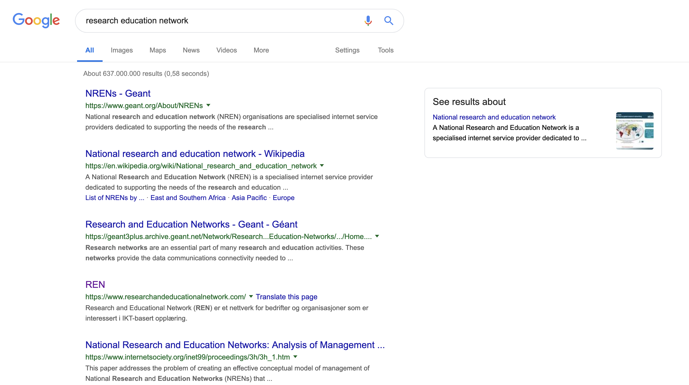
SEO – What is it?
“Search engine optimization (SEO) is the process of affecting the online visibility of a website or a web page in a web search engine’s unpaid results—often referred to as “natural”, “organic”, or “earned” results.
Ranking
Visibility
Relevance
Targeting
Google performance
Business performance
Notes:
Visibility: of items, in the SERP list
Relevance: of items, to query
Targeting: of items, optimal landing page
Google performance: metrics, click-throughs, bounces etc.
Business performance: metrics

Slide 3
Google
Goal: profit – from selling ads by aligning them to web users’ goals
How does Google identify, match and rank?
Unique, quality and accurate content
Easy navigation on the website
Good anchor text
Clear headings and subheadings
Promote honestly
Tip: Read Google’s Optimisation Starter Guide (pdf)

Slide 4
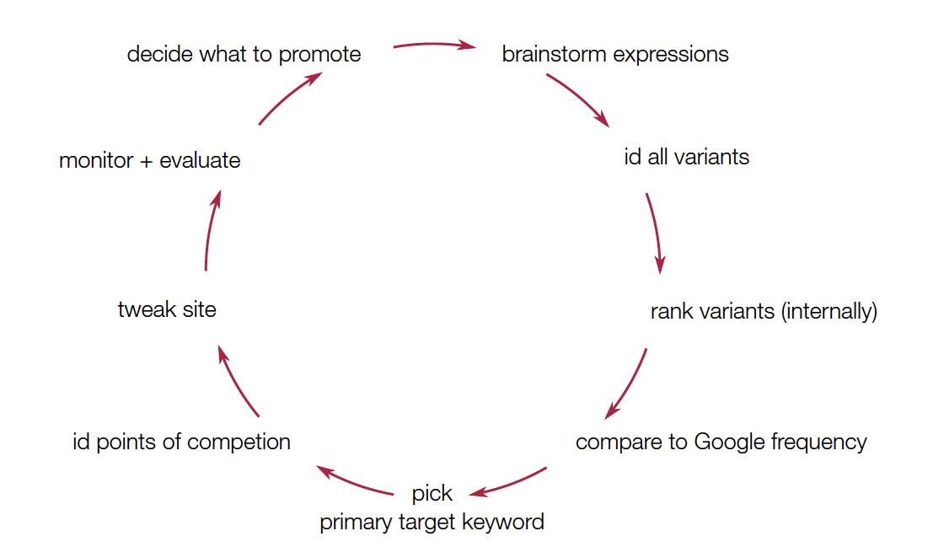
Keywords: understand, evaluate, monitor
Title, headings, first 2 sentences, running text
HTML text encoding – to make text machine-readable
<title>, <h1>, <p> etc.
Metadata: data about data
Google AdWords to see how often your keywords are searched for
Notes:
Google frequency: adwords
All HTML tags are metadata

Slide 5
Links: inbound and outbound
Inbound: links leading to your website
Outbound: links leading to related content on other websites
Links need to be relevant – the web is a ‘pull’ medium
Searchers visit for content, that matches queries

Slide 6
Competition: what is your keyword competition?
Identify top SEO competitors, learn, and measure against them
Make a SWOT analysis
Look for:
number of links
types of source
variety of sources
topical relevance of sources
backlink targets

Slide 7
Try, measure, fix, repeat.
Questions?

