Slide 1

Communication and Visibility of NRENs and Their Impact in the UA Region
By Hastings Ndebvu
Communications Officer
UbuntuNet Alliance
SIG-Marcomms & Global PR Network
16th June 2019
TNC19, Tallinn, Estonia

Slide 2
Presentation Outline
UbuntuNet Alliance
Why Communications and Visibility
UA NRENs and Visibility, baseline
Case Studies – Examples
Challenges, Lessons from Zanzibar
Way forward

Slide 3
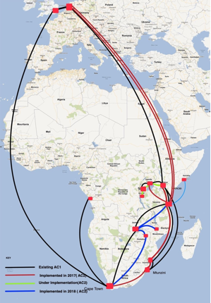
UbuntuNet Alliance
R&E network for Eastern and Southern Africa
Formed in 2015 by 5 emerging Member NRENs
NREN Membership now grown to 16
Aims to provide affordable ICT usage and access for NRENs
Alliance has built its network using the AfricaConnect projects, thanks to EU, GEANT
11 NRENs now connected to the UbuntuNet, 5 not connected, 10 countries not yet members
Apart from network, Alliance providing other Value Adding Services i.e Eduroam, Engineer Capacity Building programme
High potential of NRENs and their impact pose the need for awareness of existence and roles of NRENs

Slide 4
Why Communications and Visibility
To invite intended beneficiaries, students, researchers and other end-users to utilise the network and contribute to social-economic development
To make a case for NRENs by showing impactful stories to convince development partners, governments and other entities to get funding
For the REN to entice countries that do not have NRENs and are not yet part of the REN to come on board
To achieve the objective of making UbuntuNet Alliance the legal and accepted Research and Education networking enabler by all governments in the region and by regional blocks such as the African Union and SADC and to be incorporated in these players agendas as the defacto research and education networking service provider
To make a case for funding and continuity of projects that are currently running i.e. AfricaConnect2

Slide 5
UbuntuNet Alliance NRENs and Visibility, Baseline
NREN | Tool | Comms Dep | Level of Engane with REN | Connection Status
Eb@le | - | - | low | Yes
BERNET | - | - | Medium | Yes
EthERNet | Website | - | Low | -
KENET | Website, Twitter, Facebook, Newsletter, Mailing list | Available | High | Yes
MoRENet | Website, Facebook | Available | High | Yes
MAREN | Website | - | Low | Yes
XNet | - | - | Low | -

Slide 6
NREN | Tool | Coms Department | Engagement with REN | Connection status
SomaliREN | Website, Twitter, Facebook | Available | High | Yes
TENET | Website, Twitter, Facebook | - | Low | Yes
TERNET | Website, Twitter, Facebook | Available | High | Yes
RENU | Website, Twitter, Facebook, Newsletter | Available | High | Yes
ZAMREN | Website | Available | Medium | Yes
ZARNet | Website, Twitter, Facebook | - | Low | Yes

Slide 7
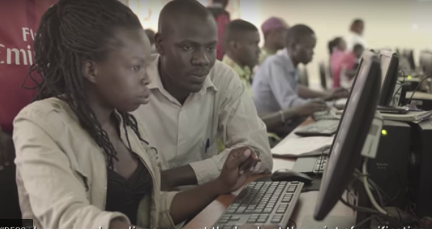
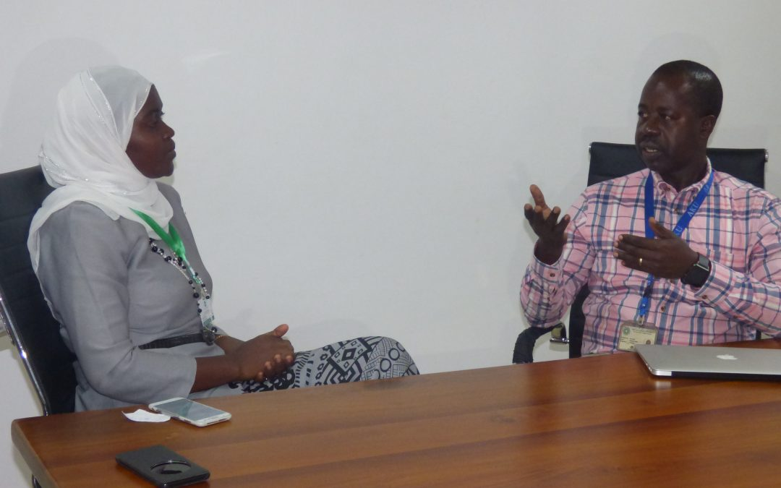
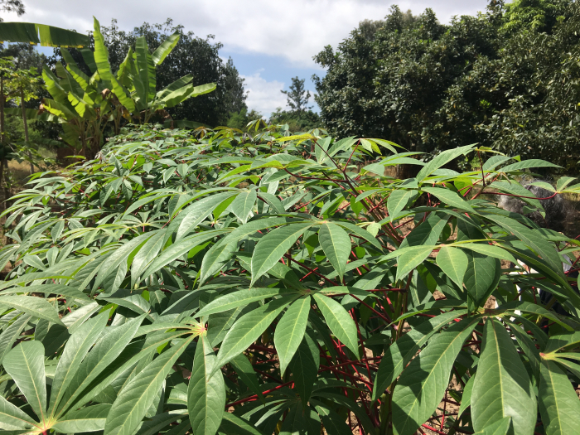
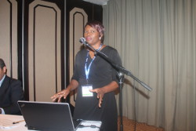
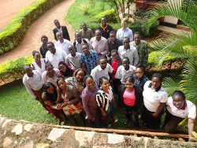
Case Studies
Dr. Lydia Chabala utilises ZAMREN Network for soil study PhD Work

Slide 8
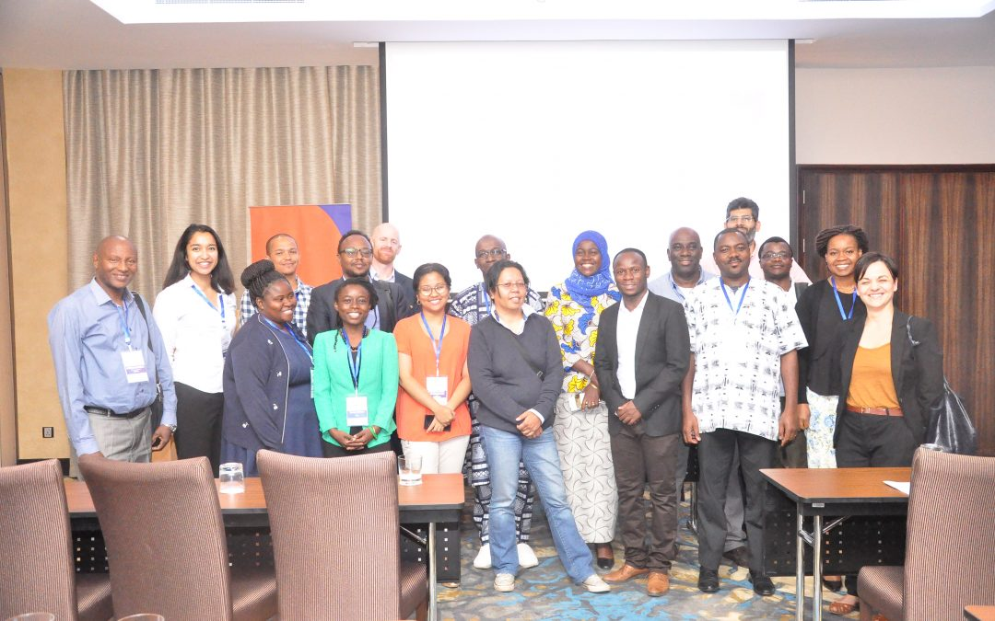
Challenges, lessons from Zanzibar
Even though there is progress, NRENs and RENs are not reaching their full potential in communicating their impacts to the societies they serve
To bridge the gap the UA and other partners including GEANT have been coming up with various interventions
Communications workshop in Zanzibar was one of these interventions. Others include, engagement with NREN CEOs in Project meetings, coordinated communications planning and implementation with partners, establishment of the In The Field Blog

Slide 9
Challenges, lessons from Zanzibar
Workshop attended by representatives from 9 NRENs, from UbuntuNet Alliance Region and 2 from WACREN region, EU DEVCO also represented
Participants outlined challenges with communication and visibility which included
  Lack of resources in NRENs, both financial and human
    NREN CEO left to handle communication
  Lack of coordination between NREN and Universities and Research Centers for NRENs to publicize research activities going on in their communities
  NRENs that are not operating a networking are shy to come out and publish their community activities
  Limited awareness of publishing platforms like In the Field on the part of some NRENs

Slide 10
Recommendations, interventions
Participants agreed on a number of interventions including
  Encouraging NRENs to have dedicated communications personnel – Even engineers who have passion to be contact communications personnel, interns
  Encouraging NRENs to use established communications personnel in their RRENs and other partners i.e GEANT – tips
  Establishment of a PR Mailing list for sharing and following up of news
  Monthly focus on identified NREN to bring out case studies
  Encouraging NRENs that are not connected to still publish news about the activities of their communities.
  GEANT offered to help in mentorship in reporting and measurement of impact of digital communication and visibility initiatives

Slide 11
Evaluation

Slide 12
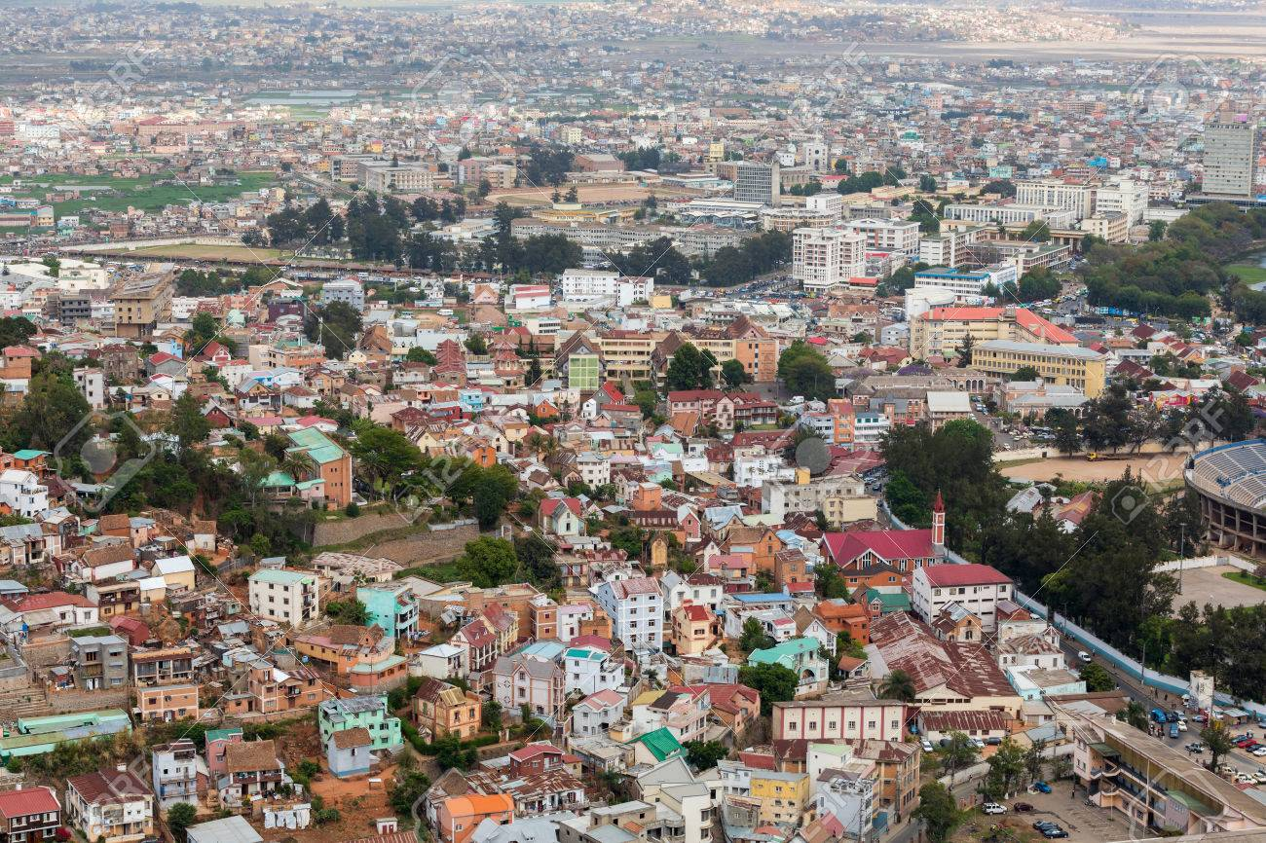
Closing Remarks
UbuntuNet-Connect 2019,
31st October – 1st November 2019, Antananarivo, Madagascar
Call for Abstracts available on UbuntuNet Alliance Website

