Slide 1

Vlogging
A quick introduction

Slide 2
Why vlogging
YouTube second largest search engine
People respond more to visual content
Most engaging form of communication
The personal element is key for the audience to
- identify themselves
- feel attracted
- perceive it as ‘human’ and therefore close to them

Slide 3
Tips and tricks – 1
Light
Selfie stick (and microphone) or a stable hand!
Background
  Not boring or distracting
Camera
  Panorama view
  Speak through/look at the camera
  Position of camera: High or low angle?
act / talk excessively
Notes:
Light: avoid artificial light, try to film near a window.
Light from above or below? Watch out for ’panda’ looks, wrinkels or funny noses.
Camera:
Speak through the camera: as if the viewer is behind your phone/camera
Position of camera:
Low angle shots, where the camera points upwards from below, make people (and things) look bigger, more courageous and more important.
High angle shots from above usually make people or things look weaker and less powerful.
Act / Talk excessively:
If you think you are very enthousiastic…on camera it always looks less

Slide 4


Tips and tricks - 2
Rule of Thirds
Notes:
An image should be imagined as divided into nine equal parts by two equally spaced horizontal lines and two equally spaced vertical lines. The most important elements should be placed along these lines or their intersections.
Bottle: this is an example of rule of thirds because the bottle is the main focus and the sky is only 1/3 of the picture

Slide 5
Checklist Script writing – 1
Step 1: Answer the following questions:
  Who is my targetgroup?
  What is the message I want to make clear – try to invite the viewer to jump into your world, use a storytelling approach
  What is my ‘call to action?’. What do I want the viewer to do at the end?
Step 2: Divide your video into 3 pieces
  1. Introduction.
  2. Core message.
  3. Conclusion / "call to action".

Slide 6
Checklist Script writing – 2
Step 3: Work out the introduction:
  Introduce yourself, who you are and what you do
  Tell what the vlog is about, what can the viewer expect?
Step 4: Work out the core message:
  Write down the core elements and messages you want to cover
  Think about questions you want to be answered,
Step 5: Work out the ‘call to action’
  Think about url / mail address / contact address
Step 6: Visualise your video (storyboard)
  Do you need specific shots? E.g. when you make a vlog about TNC it’s nice to have some impression shots of sessions. Don’t forget to shoot them.

Slide 7
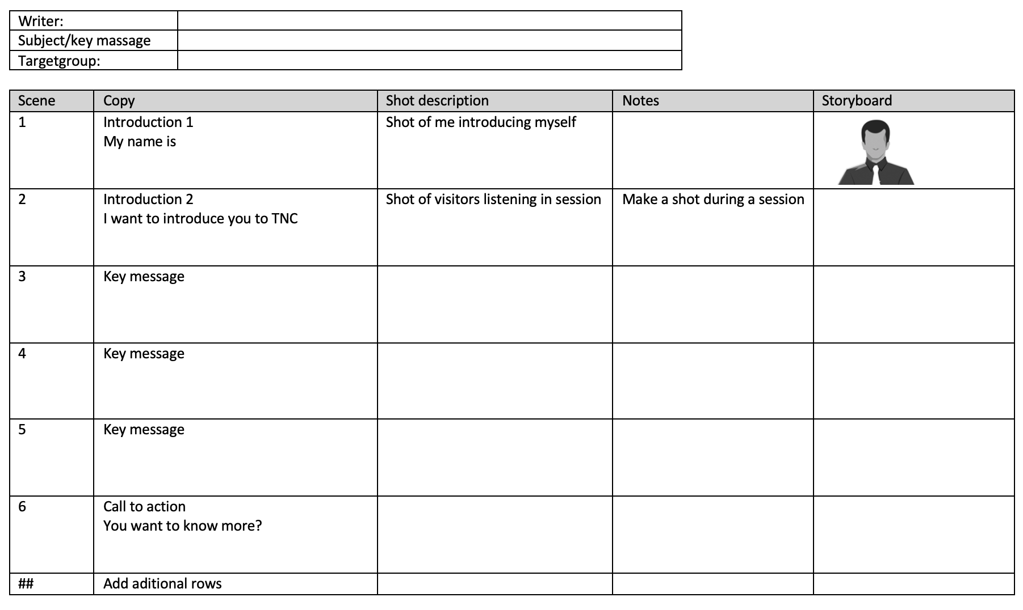

Slide 8
How to edit
For Mac/apple: iMovie
For Windows: Windows Movie Maker
For mobile: Adobe Premiere Clip, Kinemaster, WeVideo, iMovie (iOS only)

Slide 9
Assignment
Form groups and make a script for a short vlog (use template sheet 7)
Make your vlog and edit it

Slide 10
Driving innovation together

