Slide 1


A central community repository
Options and requirements
Daniel Wüstenberg
Community Research Officer
Public
www.geant.org
Notes:
Hi,
My name is Daniel Wüstenberg and I am Communications Research Officer at Géant. I have started this job in August, so most people here will not know me yet.
Today I will present some thoughts on a project to create a central repository for the documents that come out of the Special Interest Groups and Task Forces (SIG/TFs) such as SIG-Marcomms.

Slide 2





Overview
Concept
Interface
Running and Maintenance
Backend options
Summary

Slide 3
Central repository
Expectations
Searchable
Systematic access by subject, date, author, etc.
Provides quantifiable metrics
  Downloads and views
  General metric of activity of SIGs/TFs
Contents
New presentations
Legacy presentations
Relatively small number of documents – 100s, rather than 1000s of documents
Questions
What system to use?
What about legacy documents?
  How far back in time do we go?
  How to provide metadata?
What metadata will be needed?
  How to enforce their use?
Challenges
How to provide a simple user interface?
Notes:
On this slide you’ll find some thoughts about a central repository:
It should be searchable, ideally using relevant metadata
It would also provide quantifiable metrics (number of views but also number or presentations) which would help Géant to support its community efforts
In terms of contents, it would contain, of course all future presentations (the future starting with the roll-out of the new system) but also legacy presentation – all in all the number of documents will be 100s, maybe in the low 1000s but not a huge amount for any document managing system
Still it raises some questions
What systems could be used?
How to handle the question of legacy documents?
More technically:
What metadata will be needed and how will they be acquired?
And how to make the new system so simple that it will be used?

Slide 4
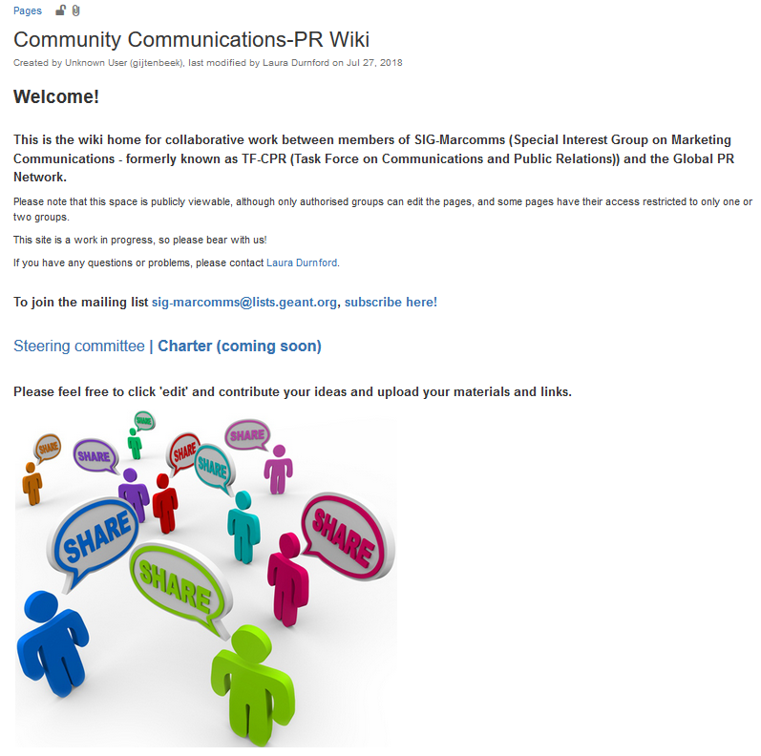

Concept
Continue using the existing Confluence pages (Works for all SIGs, CSIRT has its own website)
Provide an embedded interface to the document repository within the Confluence page
Frontend: Confluence pages
Interface
Backend: Document repository
Wiki page (with embedded interfaces)
Documents (with metadata tags)
Document upload
Search, download
Notes:
High level concept which is based on the premises to change as little as possible of the current system
The Wikis would continue to serve as the face of the SIG and would have the added functionality to allow access to the central repository to upload documents and to search for archived documents (and view/download the latter).
This would give the system 3 parts, the Frontend (i.e. the Wiki), the backend (i.e. the repository) and the interface (or interfaces) between the two

Slide 5
Work areas
Interfaces
An upload interface to the repository
A search interface
Running and maintenance
The repository will need some curation
Optional: Legacy material
Backend
- Which system will be used?

Slide 6
Interface functionalities
Document upload
Search, download
Upload mask
Crucial as the upload will provide the metadata SIG/TF site
Offers (and requires) a number of redefined metadata, e.g.
  Author, Title, Date, Event
  Keywords (from a controlled vocabulary)
  Keywords (free text)
  Abstract
Access rights (publicly visible or more restricted)
Search mask
More of a convenience as the repository will be open to general internet search
That said, it could provide a much more refined search mask
  Prefilled fields (e.g. the SIG/TF from which site the search is started)
  Defined fields, e.g.
    Keywords (from a controlled vocabulary)
    Author, date, etc.
Notes:
Crucial for such a system will be the interfaces as they need to provide the functionalities provided here
The search function is pretty clear (though this can certainly be embellished with a search mask) but the upload function will be very important as the upload is the moment where the all-important meta-data are added to the document
Current thinking is presented here – in addition to title, SIG/TF and date, keywords should be added and possibly and abstract. Not all of these metadata need to be mandatory, of course. As the metadata (especially keywords) will be SIG specific, this will require feedback from users

Slide 7
Upload Interface - suggestions
 | Mandatory | Optional | Comment
Bibliographic data
Title | +
Author | +
Author affiliation | +
SIG/TF | + |  | Could be prefilled
Event or presentation | + |  | Possibly prefilled
Date (of the presentation/event) | +
Content information
Controlled keywords | + |  | SIG/TF specific; at least 2
Free-text keywords |  | +
Abstract |  | +
Access
Confidentiality level | + |  | Pre-set to public
Notes:
Problem here:
Until now, upload procedures were up to the SIG/TF (in some, the secretary asks for the presentation and then uploads it, in others an upload link is provided)
The upload interface would require the presenters to provide as the very least keywords as this is not something a secretary could do

Slide 8
Interface work packages
Metadata
Implementation
Metadata inventory
What metadata will be required?
Which will be mandatory?
Controlled vocabulary
To come up with a list of relevant keywords for each SIG/TF, the participants will need to contribute their expertise
The vocabulary is likely to change over time
Graphical design
How should it look and where should it be found on the SIG/TF site
Software implementation
A connector between Confluence (i.e. the SIG/TF wiki pages and the repository needs to be written
  Either based on existing interfaces or from scratch

Slide 9
13 SIG/TFs to collect keywords from
SIGs
S​IG-CISS: Cloudy Interoperable Software Stacks
SIG-Greenhouse: Open Source ​Community
SIG-ISM: Information Security Management
SIG-Marcomms: Marketing Communications
SIG-MSP: Management of Serv​​​ice Portfolios
SIG-Multimedia: Multimedia Applications​​
SIG-NOC: Network Operations​ Centres​
SIG-PMV​​: Performance Monitoring and Verification
SIG-SCOPE: Sustainable, Community, Practice Exchange
SIG-TNE: Transnational Education
TFs
TF-DPR: Data Protection Regulation​​
TF-RED: Research Engagement Development​
TF-CSIRT: Computer Security Incident Response Teams
Notes:
Quick overview over the landscape of currently active SIGs and TFs (10 SIGs and 3 TFs)

Slide 10
Running and maintenance
Controlled vocabulary
Keyword collections will need to be refreshed regularly
Interface
Customized interfaces might run into compatibility issues when the frontend and backend software is developing (not likely to happen often)
Upload procedure
Currently, the upload procedure is not standardized, in some cases the secretary does it, in others the presenters
The need for keywords means that the presenter needs to be involved in the upload procedure
Legacy presentations
Marketing/communicating the change
Who will maintain and curate the repository
  What kind of curation (if any) be needed?
Notes:
Some practical problems to be solved
- Gathering and maintaining the controlled vocabulary
– The programming or customization of the user interfaces will require some time and expertise which needs to be allocated
- Procedures for the upload to assure that the metadata will be available

Slide 11
Requirements on GÉANT’s side
The interface
Who will customize/program the user interfaces?
Running the repository
Marketing/communicating the change
Who will maintain and curate the repository
  What kind of curation (if any) will be needed?
Notes:
On Géant’s side there will also be some practical problems to be solved – the programming or customization of the user interfaces will require some time and expertise which needs to be allocated
The change, if it goes ahead will need to be communicated, and finally the there will be the need to look after the repository – certainly not a full-time position but still a responsibility to be taken care of

Slide 12
Legacy material
Metadata
Pre-repository material will only have limited metadata available
  Title, Author, Author affiliation, Event, Event date, SIG/TF
In addition, the metadata are only available as context information on the Confluence wiki, i.e. they need to be harvested and converted into the right format
Even the information on the wiki is not standardized across the SIG/TFs - there might be manual work needed to extract it (see next slide for an example)
Keywords could meaningfully only be added when the original authors would provide them
Quantity
There are probably several hundred presentations on the Confluence pages
  Though a lot, it might be possible to transfer these presentations (semi-) manually
Notes:
Transferring the legacy material is optional – it would, of course, give the repository quite a head start in terms of usability but even if the repository started with zero content it would grow useful over time.

Slide 13
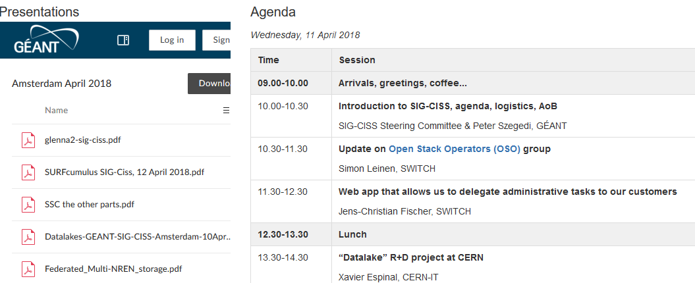
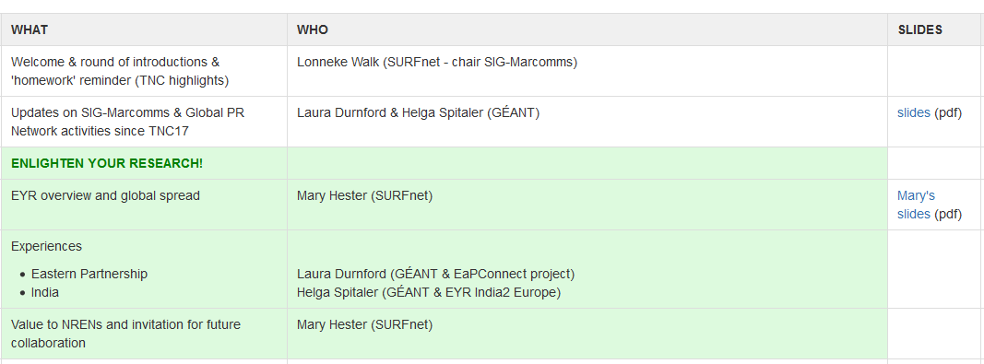
Legacy material - problems
Presentation documents are usually embedded or otherwise attached to the confluence website of each event, but not in a standardized way:
Notes:
The presentation slides are embedded on these sites ….
This is also where you will currently find any presentations – they are mostly simply added to the meeting at which each presentation has been held SIG-CISS to the left and Marcomms to the right).
This will make an automated import difficult as they are not even attached in the same way.

Slide 14




Backend options
Requirements
Support for metadata
Agnostic to document formats
Access rights management
API to allow access through Confluence (for upload, search and download)
Systems considered as a central repository
Notes:
Based on the concept presented at the beginning of the presentation, we put down certain requirements
Which are: support for metadata
The possibility of arbitrary document formats
Access rights management to be able to regulate access to the documents
An API that allows to implement the interfaces explained in the previous section
and looked at what would be easily available – this has yielded three possible options: Confluence, SharePoint and Zenodo which I will present briefly over the next few slides:
Analytics: User statistics (views, downloads) but also SIG/TF activity – gives GEANT some metric to document their community support

Slide 15

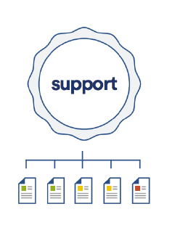
Confluence
What is it?
A collaboration software program developed and published by Atlassian (Jira, Trello, …)
Popular wiki platform in corporate environments
Relevant features
Organized in Spaces that contain Pages
Pages can contain
  Any kind of text
  Any kind of document (jpg, pdf, docx, html …)
Permissions to view or edit Pages can be given at Space or Page level
Macros/plugins can add functionality (like a search mask or metadata fields)
Repository
Space
Pages
Notes:
Confluence is a collaboration software which is (as already mentioned) used to run the SIG/TF wiki. It is organized in spaces and each space can contain any number of pages; the pages can contain any type of document which makes them suitable as containers for the presentations – they can also contain any kind of text which could provide the metadata
Functionality like search or upload interfaces can be implemented through macros or plugins and there are numerous of these available which might be adaptable to our purposes

Slide 16
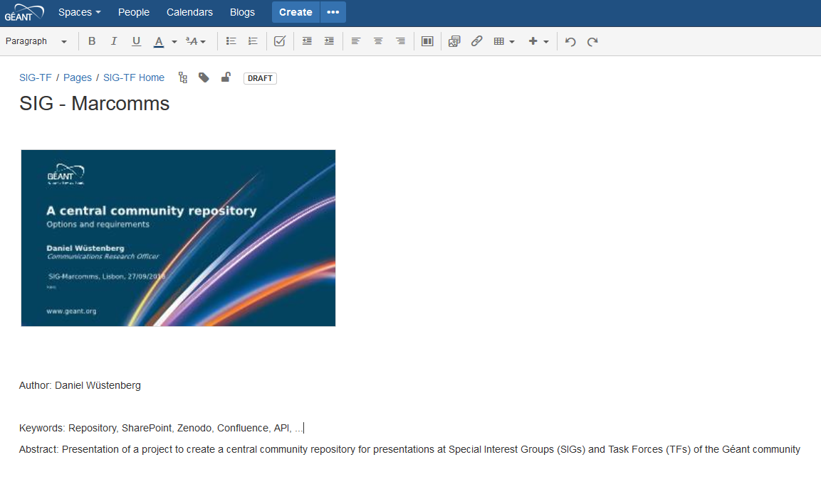

Confluence - metadata
The simplest way to implement metadata would be simply text on the page of each document
Alternatively there are add-ons that allow to add metadata fields to Confluence pages:
Page Fields provides area within each confluence page for common metadata or to attach additional information like status, properties, tokens, strings or other variables.
Notes:
Here simple idea how metadata could be added when confluence is used (I won’t ask you to read the small print)
Either just as text on the page of the the presentation or by use of specialized plugins

Slide 17
SharePoint
What is it?
A web-based collaborative platform, is primarily sold as a document management and storage system by Microsoft
Widely used for a variety of purposes
Relevant features
Agnostic to document format
Sophisticated rights management system
Extensive possibilities to provide metadata to documents
API is rich and well documented
Various connectors/interfaces between Confluence and SharePoint exist
Notes:
SharePoint is also a collaboration software but more focused on document management. It fulfils the criteria laid out beforehand and might be a bit better in terms of metadata features as it has an elaborate system of different types of tags

Slide 18
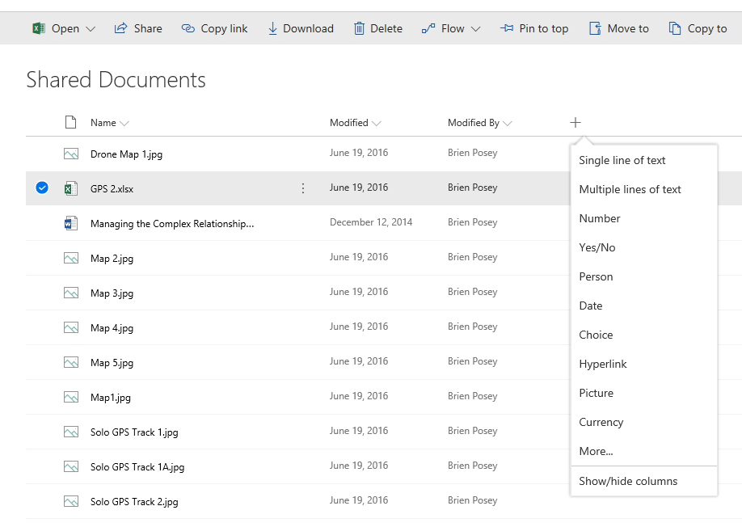
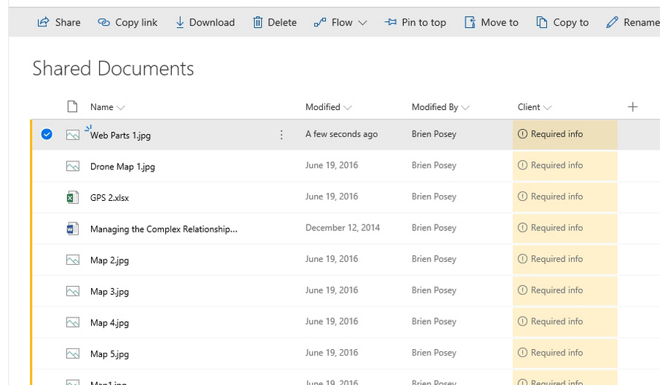
SharePoint - metadata
Arbitrary numbers of metadata fields can be added to documents
Notes:
It allows to add arbitrary numbers of metadata fields of different types and allows to make them mandatory or not. Functionality like this would have to be implemented in the interface if Confluence was used.
I stole this screenshots from https://redmondmag.com/articles/2018/04/11/metadata-sharepoint-document-libraries.aspx

Slide 19

Zenodo
What is it?
Zenodo is a general-purpose open access repository, originally intended as research data repository. It was created by OpenAIRE and CERN to provide a place for researchers to deposit datasets and is run by CERN
Relevant features
Zenodo allows any kind of file being uploaded (size limited currently 50 GB)
Anyone can create a Zenodo community and upload data; no curation from Zenodo
When uploading, a large (and configurable) amount of metadata can be added to the file
Access to files can be restricted
API for external access exists but is mostly beta status
Apparently no existing interface to Confluence
Notes:
The third option is Zenodo, a data repository developed and run by CERN. As the other systems, it can take any type of files and like SharePoint it has an elaborate metadata system.
Currently a disadvantage is the status of the API which is under development and most elements are still in beta.
(Zenodo also has a number of other features like version control, that are of less interest in our context)

Slide 20
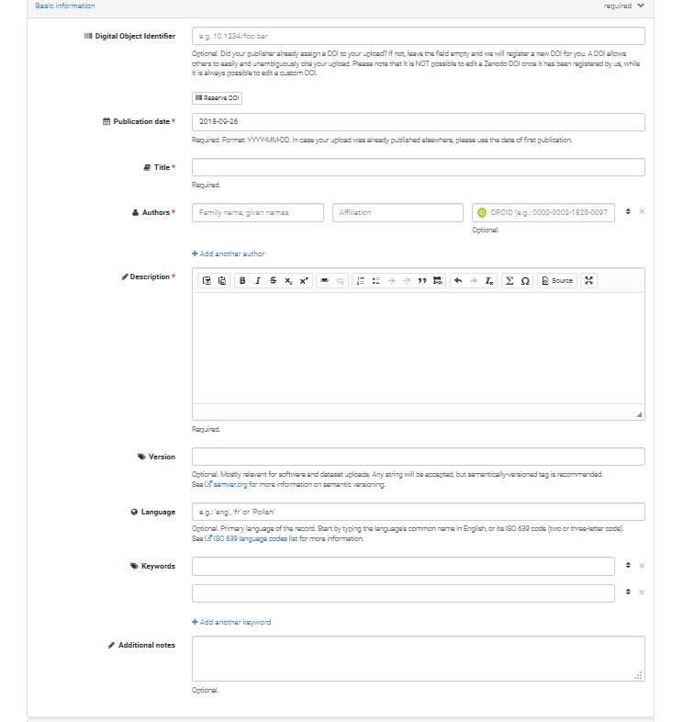
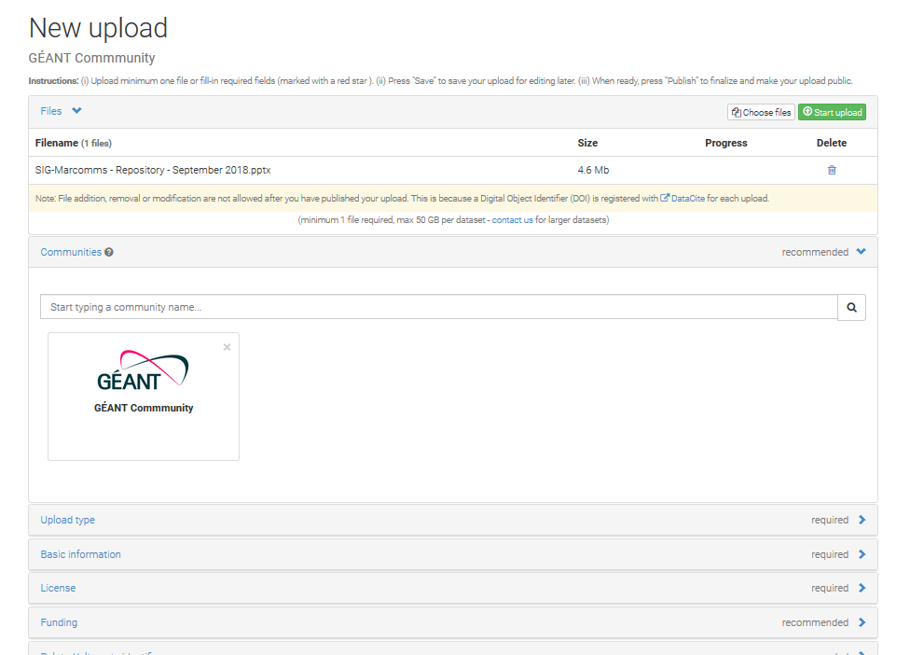

Zenodo - metadata
Metadata options are quite detailed
Notes:
Here are some screen shots showing various options to add metadata to uploaded data – this is of course the original interface of zenodo which would have to be fed through the planned interface embedded in the wiki.
Zenodo also has a number of other features like version control, that are of less interest in our context

Slide 21

Backend options - comparison
Pros | Already in use at GÉANT Same system as used for SIG/TF wikis | Already in use at GÉANT Well established connectors with Confluence Simple and effective metadata system | Designed as a repository system Simple and effective metadata system
Cons | Metadata system might need tweaking for our purposes Interfaces will need to be customized | Interfaces will need to be customized | Currently not used at GÉANT API is mostly in beta state Interfaces will need to be customized Currently only OrcID and GitHub sign in Servers in Switzerland
Notes:
This slide provides a quick head to head comparison of the three systems in terms of Pros and Cons – Factors considered here are the experience with each system a Géant, the metadata system and how easy it will be to implement the interface.
This table is quite preliminary but there seems to be maybe a slight advantage for SharePoint at this point in time

Slide 22
Summary
An action list:
Decisions:
  What backend system to use (I think any of the three will work so this is not a huge stumbling block)
  Which legacy data to transfer (and how to annotate them) (this is optional, though it would be hugely convenient to have)?
What metadata will be needed – which will be mandatory
  Gather keywords for a controlled vocabulary
Customize an interface to the repository
Communication of the change among SIG/TF
Notes:
I will end this presentation with a brief action list of things to be done (all of which have been mentioned in the last 20 minutes)
A backends system needs to be picked
A metadata system needs to be designed
The interface functionality needs to be implemented (and tested)
A roll-out needs to be preceded by a communication offensive.

Slide 23

Thank you
Any questions?
www.geant.org
© GÉANT Association on behalf of the GN4 Phase 2 project (GN4-2).
The research leading to these results has received funding from
the European Union’s Horizon 2020 research and innovation programme under Grant Agreement No. 731122 (GN4-2).
Notes:
Thanks for listening and I am happy to take any questions now.

