Slide 1
WP7. Pilot coordination and continuous risk assessment
Michał Zimniewicz
Poznan Supercomputing and Networking Center
Up2U Update Webinar
15th November 2018

Slide 2
Work Package 7
Pilot Coordination
  Coordination of Technology + Quality Assurance
  Administrative coordination
Continuous service improvements
Risk management
Notes:
Preparation, management, administrative and technical coordination of the pilots

Slide 3
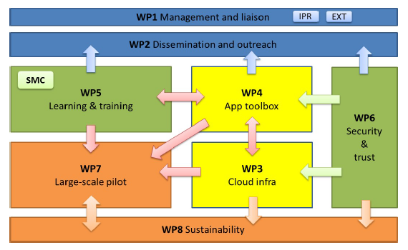
Interactions between WPs
Notes:
base on outcomes of WP3 and WP4
monitor pedagogy input coming from WP5

Slide 4
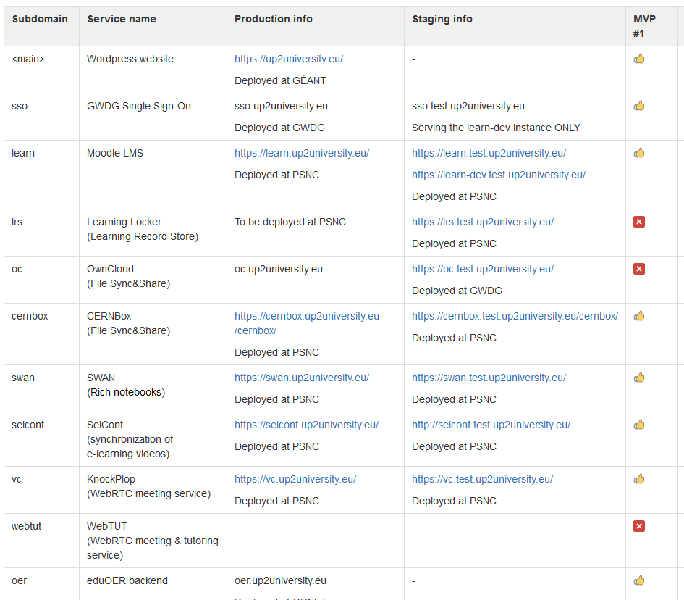
Coordination of Technology
Deployments of tools and services for pilots
  See wiki page on available tools and services

Slide 5
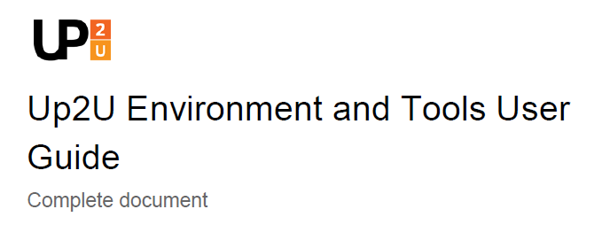
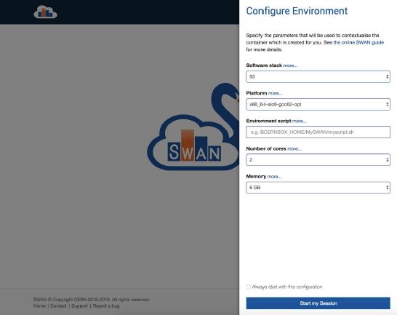
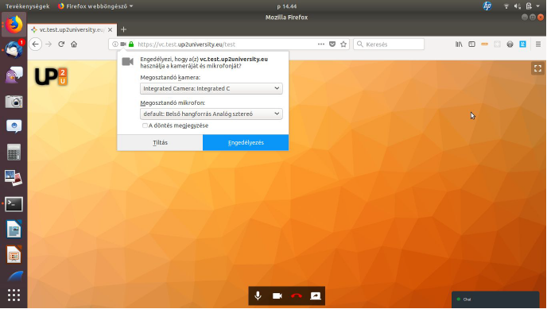
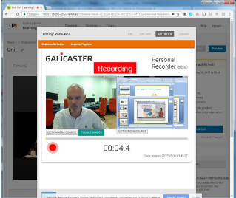
Coordination of Technology
User guide and video tutorials
  up2university.eu/tutorials

Slide 6


QA – Tracking Issues
9 main GitHub repositories
Ca. 130 issues reported
Details – see wiki page

Slide 7
Administrative Coordination
Per-country pilot coordination teams
  See wiki page
Pilot school overview
Schedules of pilot activities

Slide 8
Pilot Countries
Country | Teacher training (CPD Module 1) | Numbers of schools / teachers | Students engaged so far | Start of pilots (CPD Module 2)
Greece | Mar – May 2018 | 8 / 80 |  | Jan – Feb 2019
Italy | Apr – May 2018 | 5 / 11 |  | Feb – May 2019
Poland | Jun – Oct 2018 | 15 / 30 |  | Awaiting JCA
Hungary | Aug – Sep 2018 | 8 / 12 |  | Early 2019
Lithuania | Nov 2018 | - / 15 | 7k users, 60 schools | Ongoing
Portugal | Nov 2018 |  |  | 2019
Germany | Dec 2018 |  |  | 2019
Spain | Dec 2018 | - / 7 |  | Early 2019
CERN | --- | --- | A full class | Ongoing

Slide 9
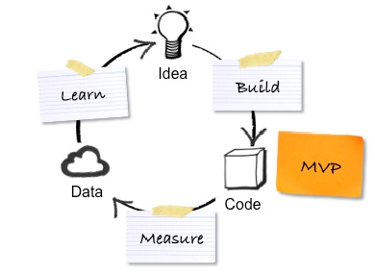
Minimum Viable Product
x3
Notes:
MVP approach: build-measure-learn feedback loop is designed to ensure that the project outcome continuously improves

Slide 10
Milestones
Jun 2017 – Initial pilot setup
Aug 2017 – Initial pilot schools confirm their participation
Dec 2017 – First release of the Application Toolbox
Oct 2018 – First MVP feedback is available here
Dec 2018 – Toolbox v.2.0, report on improvements
Jun 2019 – D4.3 on 2nd set of improvements
Dec 2019 – D7.4 on 3rd set of improvements

Slide 11
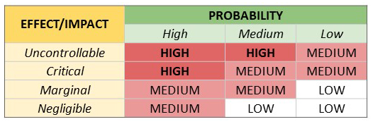
Risk Management – Methodology
Continuously assess what could go wrong
Implement strategies to deal with the risks
See our risk record
Notes:
Identify – by tasks
assess probability and possible impact on the project -> risk exposure
Preventing actions vs response actions
Avoid, reduce, postpone
Continuously

Slide 12
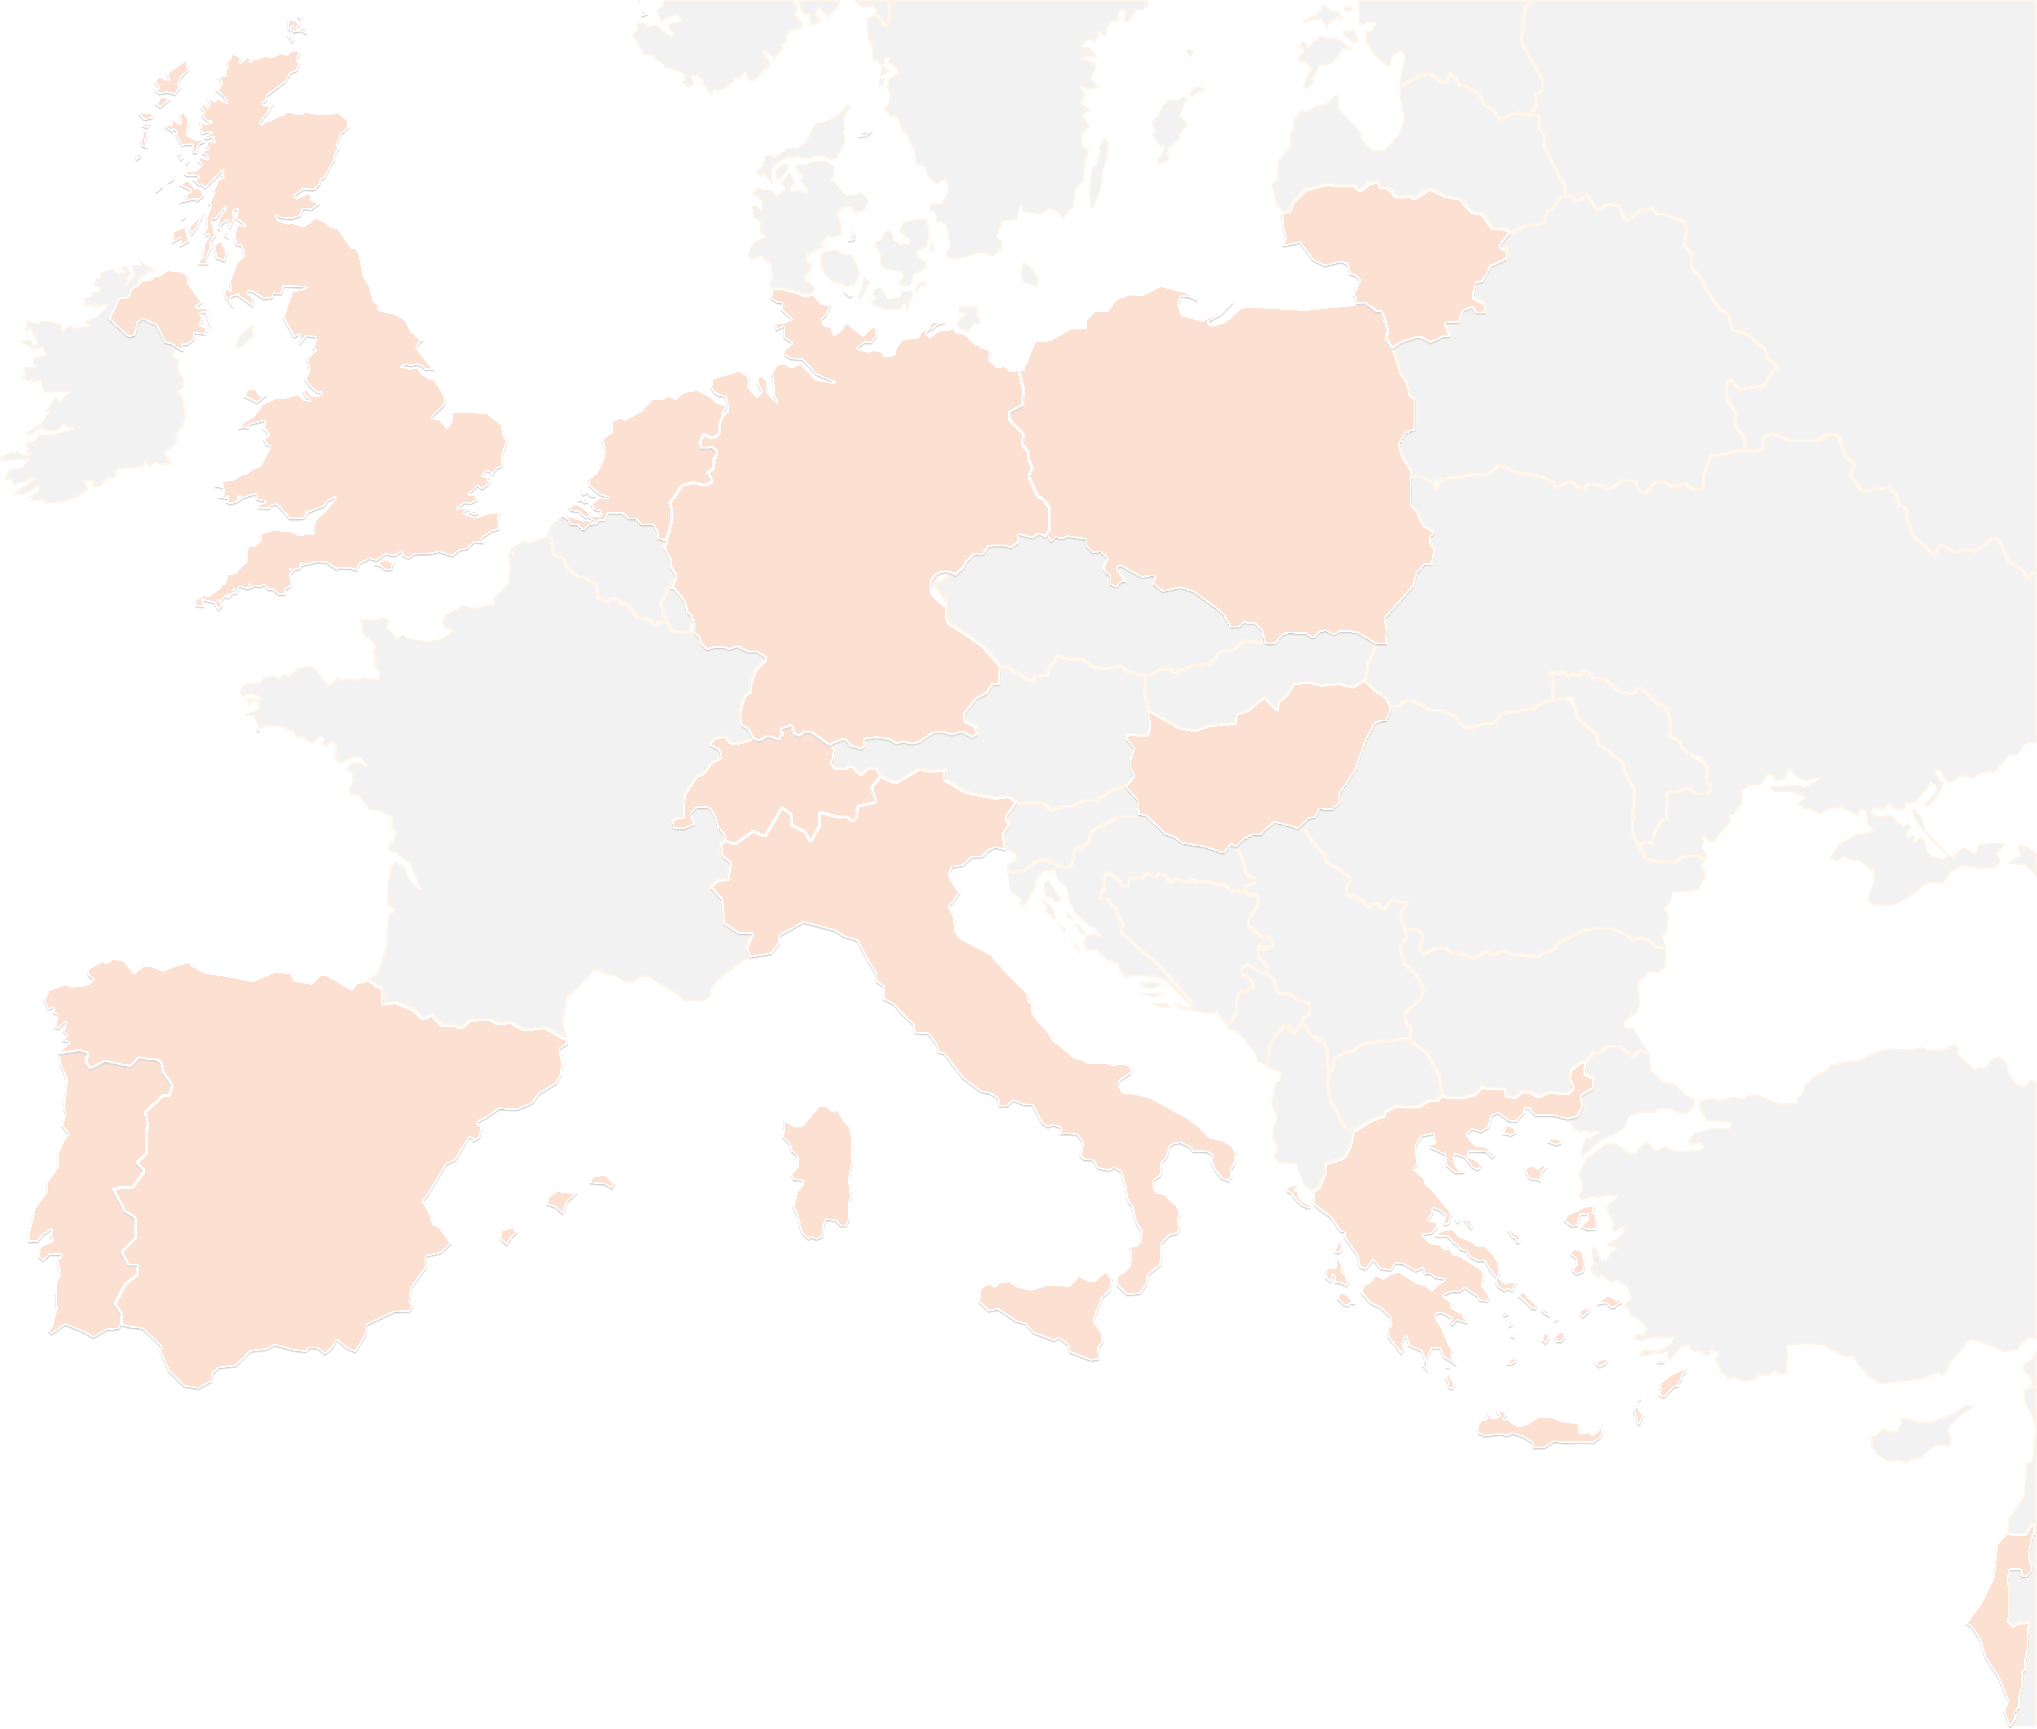
THANK YOU FOR YOUR ATTENTION!

