Slide 1
UP2U WP8
Sustainability and Exploitation of Results

Slide 2
Status of Deliverables
Deliverables | Topic | Status
D8.1 | Analysis of Up2U Ecosystem and Existing Business Models | Accepted
D8.2 | Draft Plan for Sustainability and Exploitation | Accepted
D8.3 | Up2U Business Models | Under Preparation
D8.4 | Final Report on Up2U Sustainability and Exploitation | 30.06.2019
M2.6
M3.5

Slide 3
Status of D8.3
OBJ | Subject | Status
O1 | Identification of Business Models | 6 Business Models were identified
O2 | Evaluation of Business Models | All business models have been evaluated based on cost/benefit analysis and independent use-case for each BMs
O3 | Sustainability and Exploitation Plan | The sustainability and exploitation plan has been updated according to the reviewers’ comments. Relationships between BMs and plans have been designed.
O4 | Country-Specific Plans and Results | Our sustainability plan and identified business models have been evaluated in different associated countries.

Slide 4
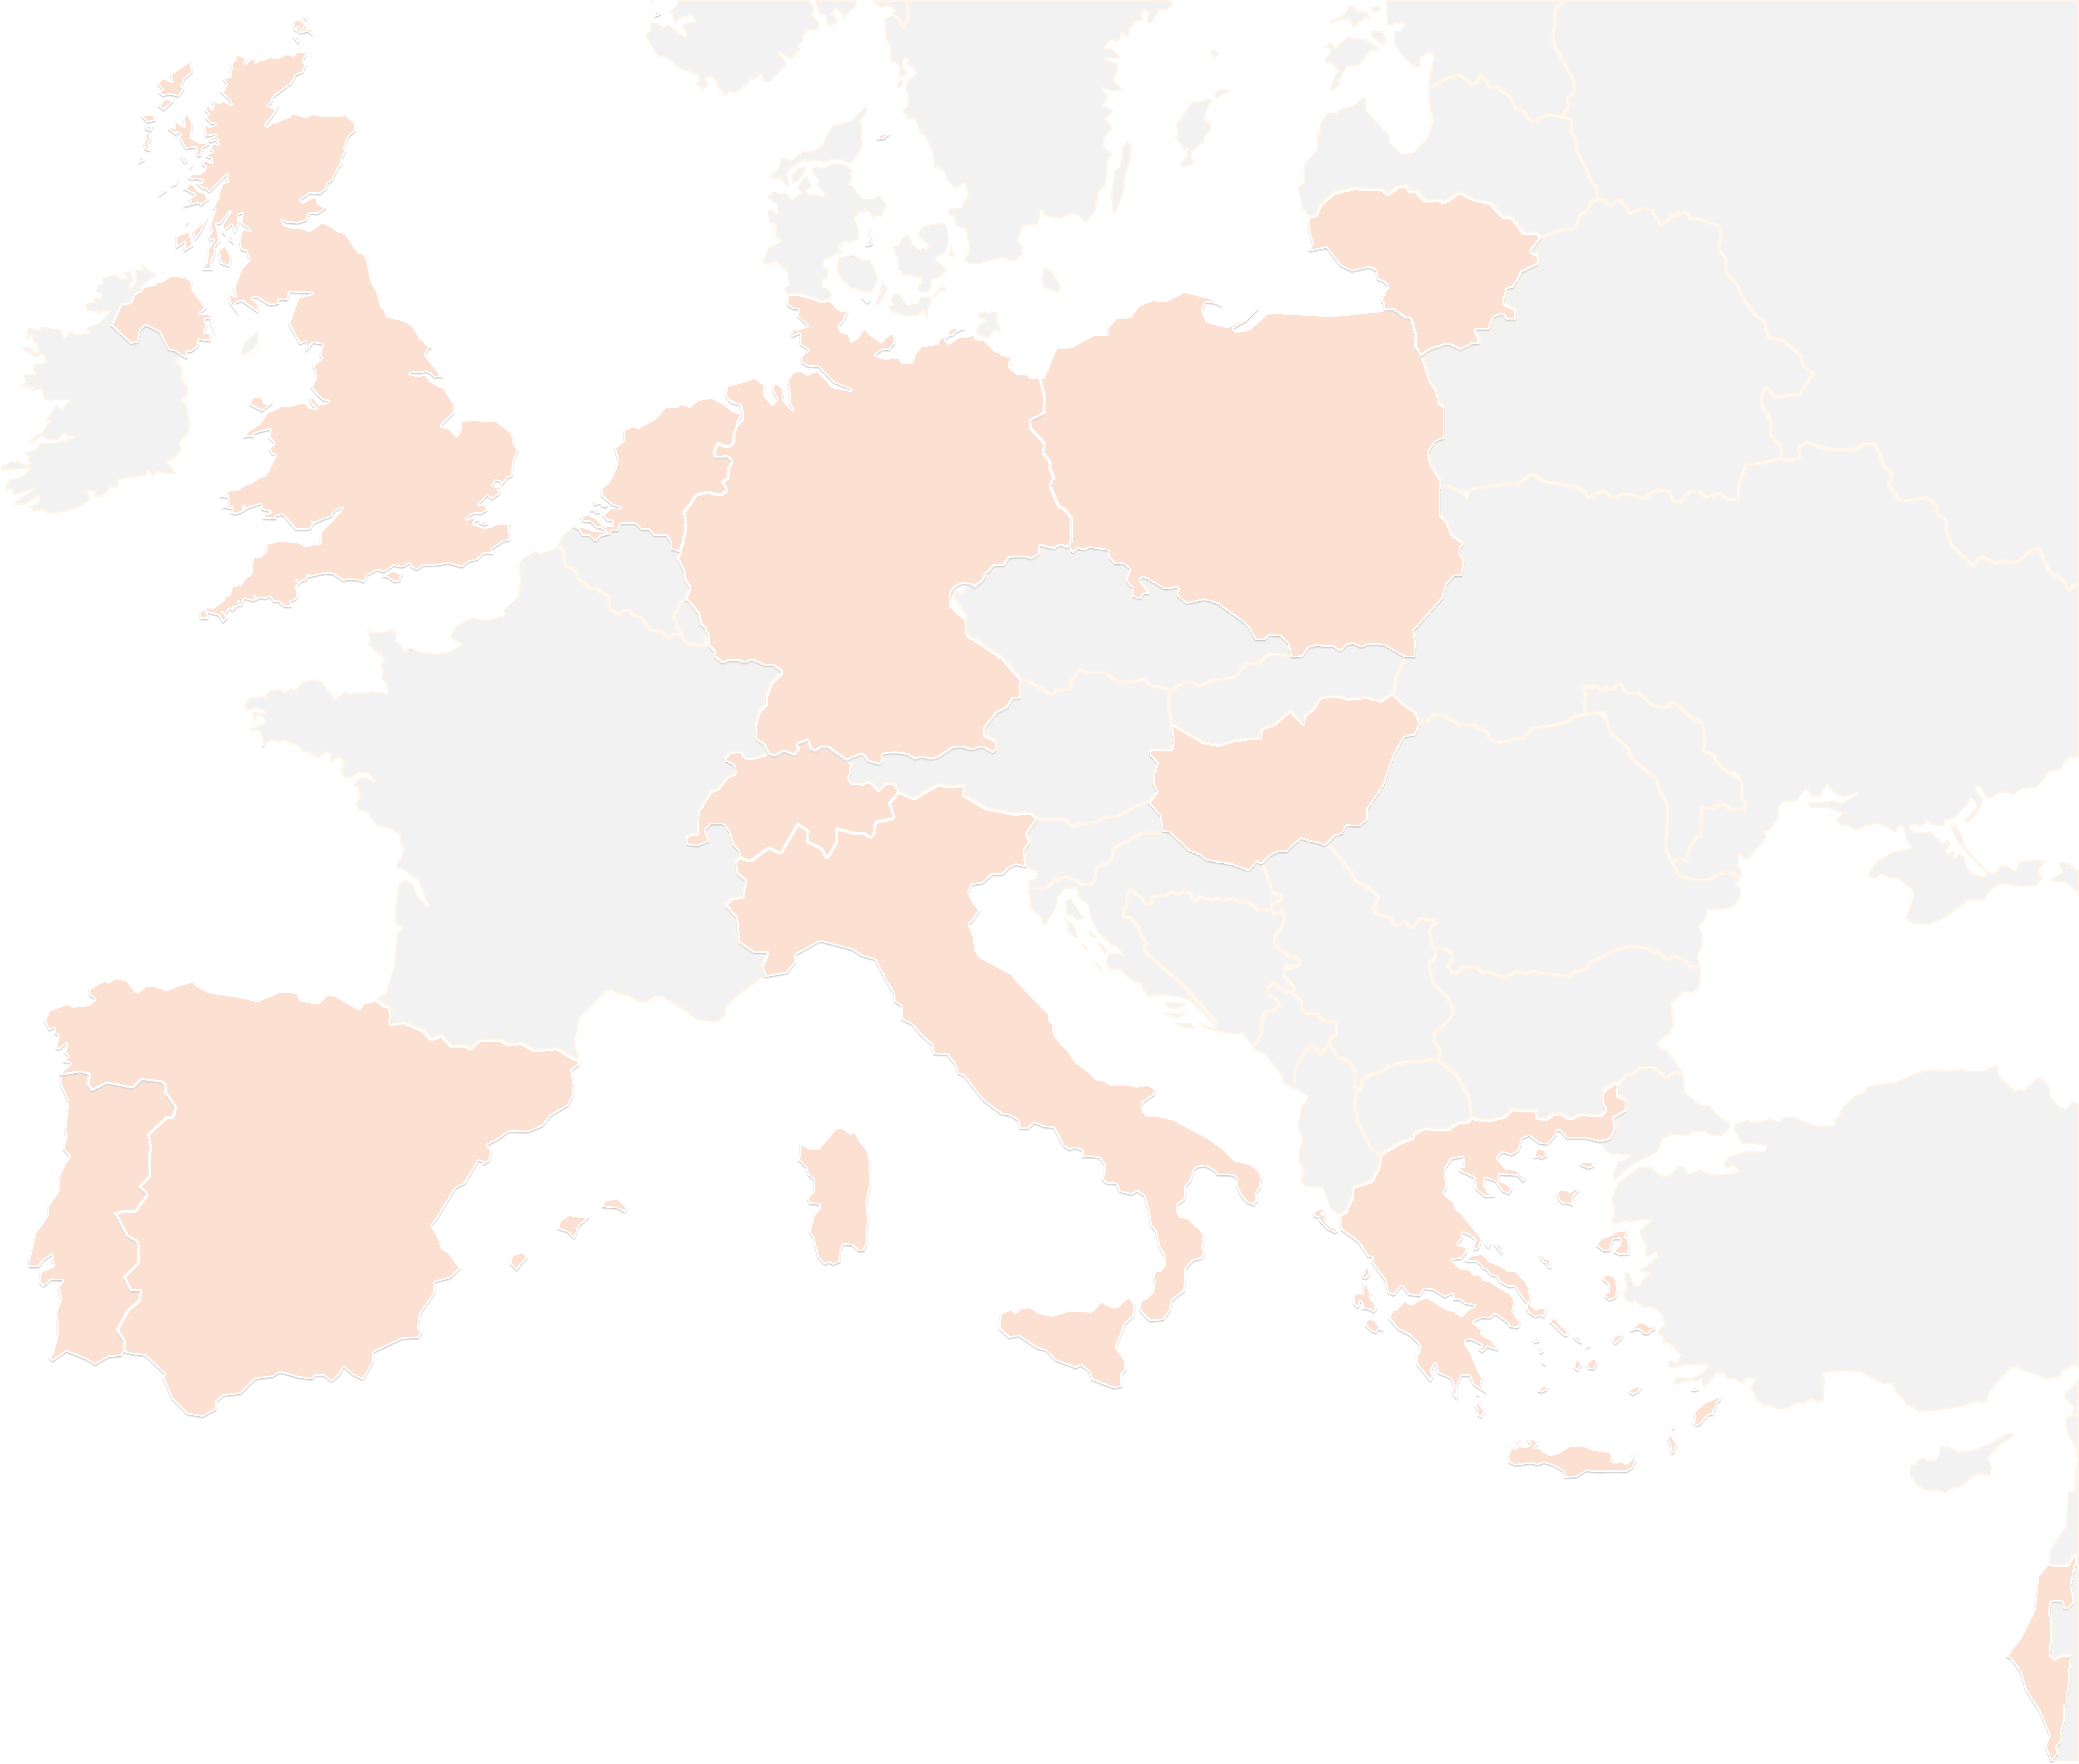
THANK YOU FOR YOUR ATTENTION!
contact@lists.up2university.eu
#up2universe

