Slide 1
Up2U Webinar #1
WP1: Date: 15/11/2018
Deliverables
GA Update
Task Forces

Slide 2
UP2U Deliverable status

Slide 3
UP2U GA Update
Deliverables
Process of peer reviewing:
Internal communication
On the GA decided to have a monthly project Webinar to inform project participant about ongoing activities
Deliverable # | File name | Date received by peer reviewer | Include recommendations by peer-reviewer |  | Date received by Technical Authors | From TA-Up2U Internal status | Uploaded to the EC portal
DX.X | Report 1 | 07/10/2018 (WPX) | 12/10/18 |  | 17/10/18 | 30/10/18 Review TA Comments | 08/11/18

Slide 4
UP2U Task Forces
  Taskforce decided on the GA
Uniformed Content & Pilot Activities. Led by: Antonio Castro (ISEP).
Platform Improvement. Led by: Vicente Goyanes (TELTEK).
Engaging Community. Led by: Eli Shmueli (IUCC)
GDPR. Led by: Ana Alves (GÉANT), Michal Zimniewicz (PSNC), Giorgio Valente (GARR), Philpp Wieder (GWDG).
  Timeline for Task Forces:
9 November: Task Force leaders to define the scope and goals of the Task Force.
Skills.9 November: Task Force leaders to identify skills needed to reach the goals of the Task Force.
People.30 November: Task Force leaders + Consortium to identify members of the Task Forces (4 – 5 per TF).

Slide 5
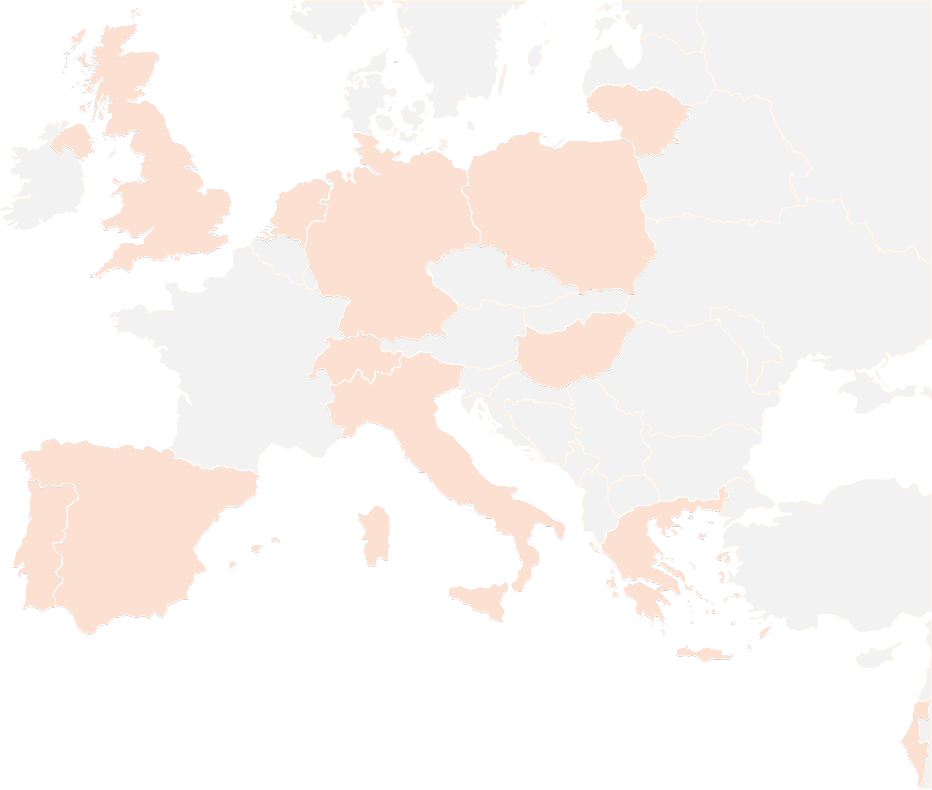
THANK YOU FOR YOUR ATTENTION!
contact@lists.up2university.eu
#up2universe

