Slide 1
WP4 Webinar Update
Up2U Update

Slide 2
Platform status
New production release based on current pedagogy platform
  Currently bugfixing and testing
Learning scenario(s) from WP5 being implemented as demonstration courses for production
  Reviewers will be given access via enrolment codes
Country categories and management structure

Slide 3
Deliverables
D4.2 Enhanced application tool box and technical specifications has been resubmitted to include mapping learning scenarios from WP5 onto technology requirements
D4.3 Tool integration report due M30
  Due date (EC portal submission): 30.06.2019
  Submission for TA: 31.05.2019
  First draft: 17.05.2019

Slide 4
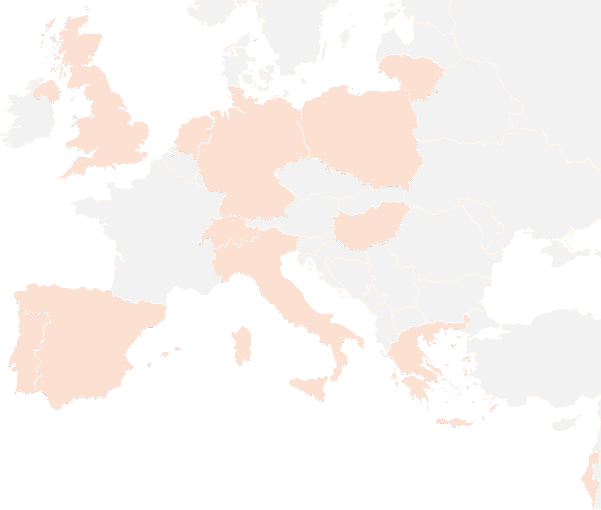
THANK YOU FOR YOUR ATTENTION!
wp4@lists.up2university.eu
#up2universe

