Slide 1
WP4 Webinar Update
Up2U Update

Slide 2
Platform status
Active development/bugfixing
  Critical issues for pilots
  Feedback for MVP#2
  User experience improvements
New tool: Multiparty Meeting
  Possible replacement for Knockplop
  Designed to handle more users
  Test instance deployed, integration testing soon
Notes:
Issues are categorised on Github in terms of criticalilty; major progress in last month on fixes – currently in merging/testing phase.
UX improvements: e.g., H5P library installation. Currently admin needs to pre-install libraries manually before less privileged users can see them – working on automating this.
Knockplop doesn’t scale to more users well, due to peer-to-peer connectivity. Multiparty meeting instead uses a central server to aggregate many users’ connections.

Slide 3
Next steps
Deploy critical fixes ASAP
Deploy updated production version ideally this year
  i.e., also ASAP
Formalise structure/process for new tools
Notes:
Possibly combine critical and production deployments: currently working out process so as not to interfere with platform usage.
Addition/integration of new tools should be pedagogically-led, with clear use cases, or, rarely, technically-led (tool “replacements” only, e.g., motivation for Multiparty Meeting to improve Knockplop)

Slide 4
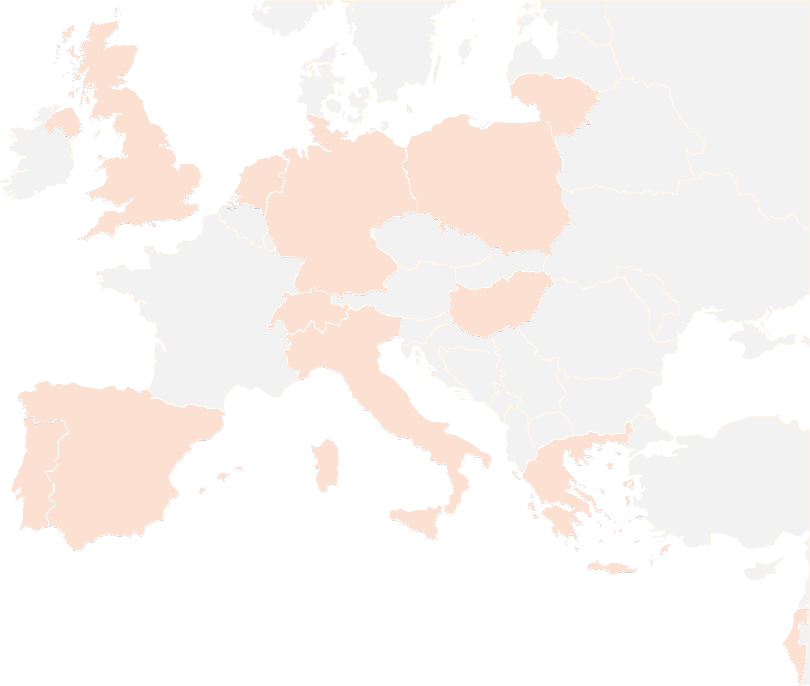
THANK YOU FOR YOUR ATTENTION!
wp4@lists.up2university.eu
#up2universe

