Slide 1
UP2U WP8
Sustainability and Exploitation of Results
Dr. Philipp Wieder, Dr. Faraz Fatemi Moghaddam
GWDG (Gesellschaft für wissenschaftliche Datenverarbeitung mbH Göttingen)

Slide 2
Status of Deliverables
Deliverables | Topic | Status
D8.1 | Analysis of Up2U Ecosystem and Existing Business Models | Accepted
D8.2 | Draft Plan for Sustainability and Exploitation | Accepted
D8.3 | Up2U Business Models | Under Preparation
D8.4 | Final Report on Up2U Sustainability and Exploitation | 30.06.2019
M2.6
M3.5

Slide 3
Status of KPIs
KPI | Topic | End of Year 2
KPI1 | Business models Identified, Tested and Evaluated | At Least 5
KPI2 | Business Actors willing to Engage with Up2U on a Commercial Basis | At Least 2

Slide 4
Business Models
Hosted UP2U Tools
New Schools Integration
Third-Party Tool Integration
Business Models
Autonomous Use
Course Delivery
Technical Exploitations
One-Off Events

Slide 5
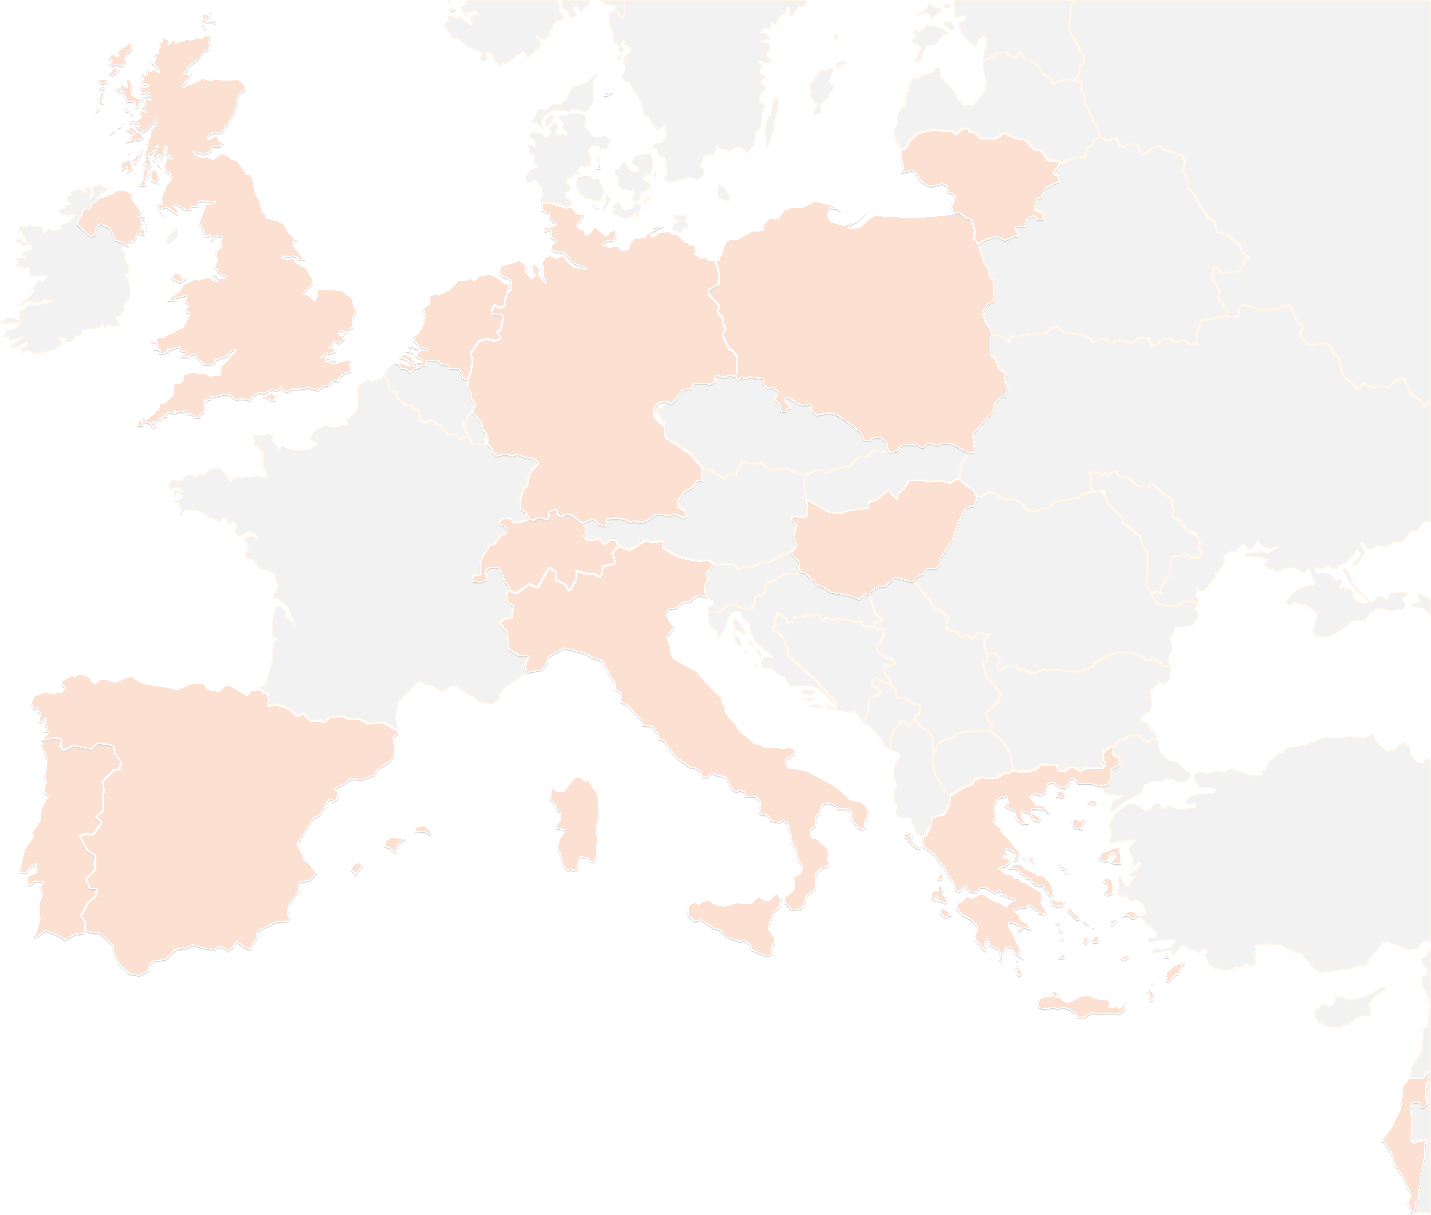
THANK YOU FOR YOUR ATTENTION!
contact@lists.up2university.eu
#up2universe

