Slide 1
Up2U Update Webinar #2

Slide 2
Up2U monthly webinar
WP1
Erik Kikkenborg

Slide 3
Work done November
  Organized Board meeting
  Created a Deliverables Roadmap
  for future deliverables
  Ongoing work on GDPR
Notes:
Board meeting:
- Good discussions and outcomes
- Minutes are currently being reviewed and will go public on the Wiki after revision.

Slide 4
Planned/Ongoing Actions
  Arrange F2F review in February & March
  Arrange VC Board meeting January
  Oversee deliverable submission process.

Slide 5
Up2U monthly webinar
WP2
Barbara Tóth
KIFÜ

Slide 6
Ongoing tasks
  D2.3 : A number of inputs are still missing, please provide your input ASAP! The deadline for internal submission is today!
  Motion graphics video: Nelson is creating the animations in the upcoming weeks. The video needs to be ready by early January.

Slide 7
Next Steps
  Don’t forget to share information about your local and international events:
  https://docs.google.com/spreadsheets/d/1sbdofqggjqn2uyM_1a1ZmchNXCLjW3rAq3UNK3mW0XE/edit?usp=sharing
  Social media activity needs to be more active volunteers welcome!

Slide 8
Up2U monthly webinar
WP3
Ilias Hatzakis
GRNET

Slide 9
TASK 3.3: OER
  Finalization and submission of D3.4 (Open Educational Resource Aggregation and Exposure Platform Enhancements)
  Improvements on the Moodle eduOER user experience
  Improvements on the eduOER platform, SAML integration, soon a login button, voluntary paradata
  NEW REPOS: NASA, Yale, MIT, MIT K12, Open UK, ArtsEdge, TDC.
  Next big think: KHAN Academy
  Soon, announcement of one new repo every week on social media

Slide 10
TASK 3.2
  OCM tests between GWDG and KTU
  Next tests:
    testing between Uvigo and KIFU [OC] -> [NC]
    2. testing between [CERNBox] -> [OC] on CERN
  Full report of OCM testing at the CS3 2019 -- end of January: http://cs3.infn.it

Slide 11
WP4 Webinar Update
Up2U Update

Slide 12
Platform status
Active development/bugfixing
  Critical issues for pilots
  Feedback for MVP#2
  User experience improvements
New tool: Multiparty Meeting
  Possible replacement for Knockplop
  Designed to handle more users
  Test instance deployed, integration testing soon
Notes:
Issues are categorised on Github in terms of criticalilty; major progress in last month on fixes – currently in merging/testing phase.
UX improvements: e.g., H5P library installation. Currently admin needs to pre-install libraries manually before less privileged users can see them – working on automating this.
Knockplop doesn’t scale to more users well, due to peer-to-peer connectivity. Multiparty meeting instead uses a central server to aggregate many users’ connections.

Slide 13
Next steps
Deploy critical fixes ASAP
Deploy updated production version ideally this year
  i.e., also ASAP
Formalise structure/process for new tools
Notes:
Possibly combine critical and production deployments: currently working out process so as not to interfere with platform usage.
Addition/integration of new tools should be pedagogically-led, with clear use cases, or, rarely, technically-led (tool “replacements” only, e.g., motivation for Multiparty Meeting to improve Knockplop)

Slide 14
Up2U monthly webinar 20/12/18
WP5
Stefano Lariccia
UROMA

Slide 15
MONTH 23, November 2018
Contribution to D7.3 and D8.3
Pilots planning
Learning Units preparation
  Unit 1: New pedagogic paradigm. An introduction to Trialogic learning methods (COMPLETED)
  Unit 2: Language Processing. How to manage words on the web. (COMPLETED)
  Unit 3: Language analysis and Critical Thinking. How to increase you ability to produce texts and videoclips (drafted, in progress)

Slide 16
RIGHT NOW, MONTH 24
Supporting Pilots from a pedagogical point of view
  WP5 Sub-WorkGroup setup
  Greek Pilots
  Lithuanian pilots collaboration and supporting activity to be started)
  Monitoring Task 5.4 (Portuguese pilots?)
Providing models to collect and analyse data
  Starting activity on evaluation models based on data collection; exploring LRS query methods and potential
  Exploring how Jupyter Notebooks can be supportive for tracking Informal Learning activities

Slide 17
RIGHT NOW, MONTH 24
CommonSpaces into Up2U ecosystem
  “Light” integration of existing Jupyter notebook; translation; adaptation of selected Notebooks
  Italian University as a Hub will provide “flipped” courses for Italian secondary schools based on CommonSpaces. This will start on February, in parallel with GARR coordinated Pilot. We expect an high innovation rate and a reduced number of schools

Slide 18
Up2U monthly webinar
SMC
Mary Grammatikou
NTUA

Slide 19
SMC Status
  A meeting with SMC members took place in November
  SMC members decided to add new external members in the Committee
  Some proposals have already arrived
    this will close in January
  Discussions on how the national SMCs will be contacted for supporting the pilots

Slide 20
Next Steps
  Suggestions will be given to pilot countries for Module 2 preparation
  User scenarios to be approved for Module 2
  Proposed videos to be discussed for the training
  How MOOCs could support Up2U training

Slide 21
WP6
Update Dec. 18
Gabriella Paolini
GARR

Slide 22
GDPR
Towards the final step
Signature of the Joint Controllers Agreements from each partner

Slide 23
Guidelines for Users
In collaboration with WP2: a useful and attractive version of WP6 guidelines
  Annexes in D6.2
Presentation to the Mozambique NREN

Slide 24
WP7. Pilot coordination and continuous risk assessment
Michał Zimniewicz
Poznan Supercomputing and Networking Center
Up2U Update Webinar
20th December 2018

Slide 25
Pilot Progress
Country | CPD Module 1 | Numbers of schools / teachers | Pilots (CPD Module 2) | Targeted schools
Germany | Q2 2019 |  | Q2 2019 | Private teachers
Greece | Mar – May 2018 | 8 / 80 | Jan – Feb 2019 | 8
Hungary | Aug – Sep 2018 | 8 / 12 | Early 2019 | 8
Italy | Apr – May 2018 | 5 / 11 | Feb – May 2019
Lithuania | Nov – Dec 2018 | 10 / 15 | Nov – ongoing | 76
Poland | Jun – Oct 2018 | 15 / 30 | Jan – March 2019 | 15
Portugal | Fall 2018, Jan 2019 | 1 school, more in 2019 | 2019
Spain | Nov – Dec 2018 | 7 / 7 | 2019
CERN | --- | --- | Ongoing, no updates | 1 class
Notes:
CPD trainings have already started in most of the pilot countries.
Pilots involving students are scheduled in most cases.
Concrete actions for reaching new schools are scheduled in particular pilot countries and reported in D7.3.
Detailed monthly pilot updates are submitted to EC – first in November, another one just now.

Slide 26
D7.3:
Report on the large-scale pilot services, essential features and their improvements
Led by KTU.
Finalised. To be submitted to GEANT today.
The scope:
  Updates on pilot countries and their plans
  Updates on pilot infrastructures
  First MVP suggestions and first improvements
  Risk management update
  Project and pilot evaluation

Slide 27
Future MVP Improvements
Dec 2018
  Application Toolbox v.2.0
  1st set of improvements implemented
  D7.3 reports on the improvements
Q1-Q2 2019
  Collecting new suggestions from students ASAP
  Some improvements to be reported at the project review in spring
  D4.3 to report on 2nd set of improvements
Q3-Q4 2019
  Collecting new suggestions, implementing improvements
  D7.4 to report on 3rd set of improvements

Slide 28
UP2U WP8
Sustainability and Exploitation of Results

Slide 29
Status of Deliverables
Deliverables | Topic | Status
D8.1 | Analysis of Up2U Ecosystem and Existing Business Models | Accepted
D8.2 | Draft Plan for Sustainability and Exploitation | Accepted
D8.3 | Up2U Business Models | Under Preparation
D8.4 | Final Report on Up2U Sustainability and Exploitation | 30.06.2019
M2.6
M3.5

Slide 30
Status of D8.3
OBJ | Subject | Status
O1 | Identification of Business Models | 6 Business Models were identified
O2 | Evaluation of Business Models | All business models have been evaluated based on cost/benefit analysis and independent use-case for each BMs
O3 | Sustainability and Exploitation Plan | The sustainability and exploitation plan has been updated according to the reviewers’ comments. Relationships between BMs and plans have been designed.
O4 | Country-Specific Plans and Results | Our sustainability plan and identified business models have been evaluated in different associated countries.

Slide 31
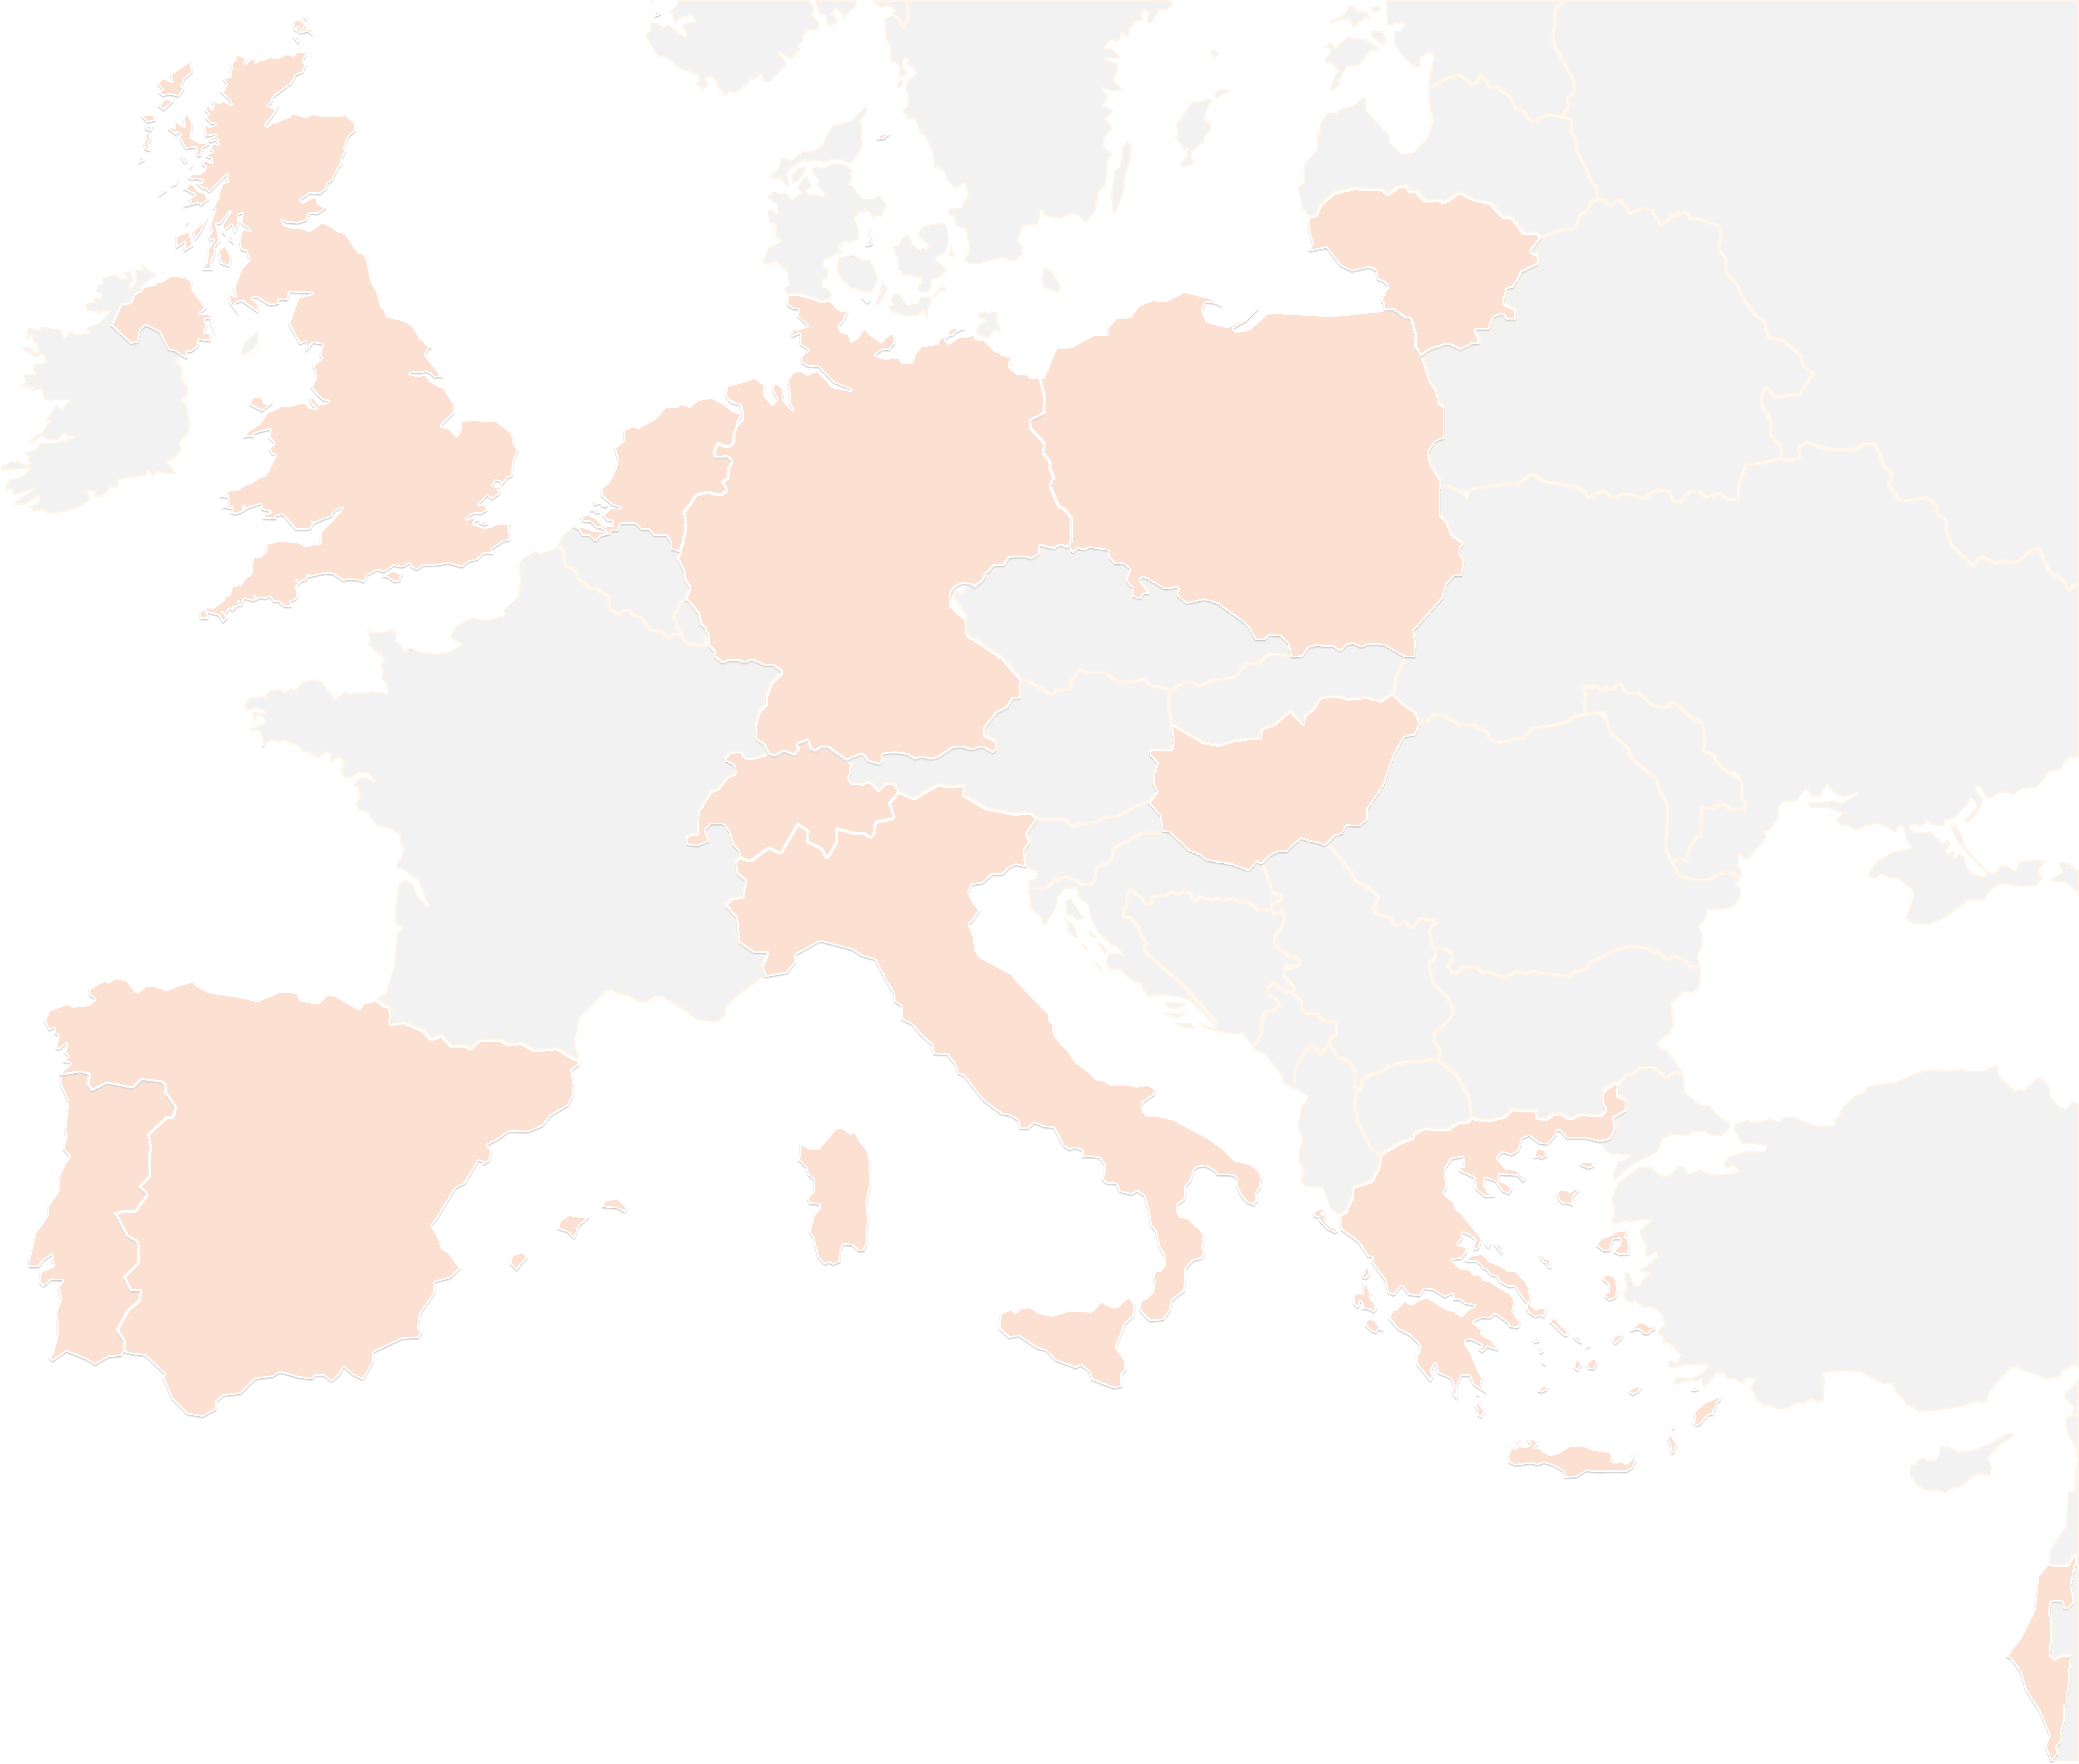
THANK YOU FOR YOUR ATTENTION!
contact@lists.up2university.eu
#up2universe

