Slide 1

BECOME INTERNATIONAL WITH EDUGAIN:
Towards a scalable and safe users attribute release
Maria Laura Mantovani, Simona Venuti, Marco Malavolti
NA2, AARC
GARR
TNC16, Prague
16 June 2016

Slide 2
Agenda
9:00-10:30
Introduction to new federated technologies
  eduGAIN needs IdP collaboration to work
  The attribute release problem
Entity categories as a solution
  Research & Scholarship EC
  GÉANT Data Protection Code of Conduct EC
---------------
10:30-11:00 BREAK
---------------
11:00-12:30
Legal ground for ECs
Attribute release process, easy IdP configuration if supported by federation
  Fill missing values
  Easy configuration for entity category support
  Federation registry: a valid helper in attribute release configuration
---------------
12:30-14:00 LUNCH BREAK
---------------
14:00-16:00
Workgroups
  Technical issues in order to support R&S and DP_CoCo ECs
  Legal issues in order to support R&S and DP_CoCo ECs
  New ECs for the Federation and for eduGAIN
---------------
16:00-16:30 BREAK
---------------
16:30-17:30
Reports from the groups
Debriefing & Summary

Slide 4
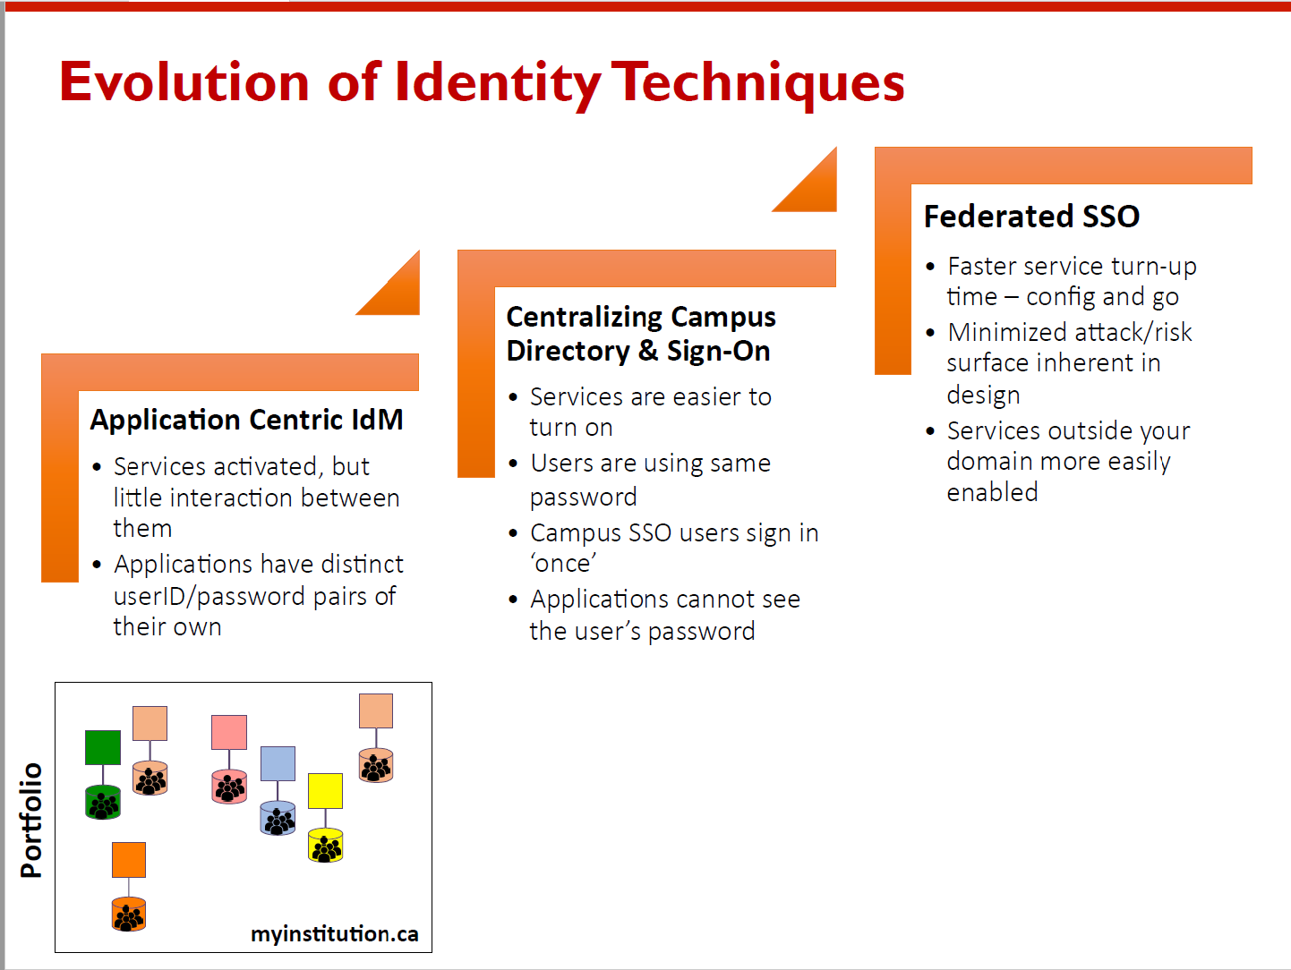

Slide 5
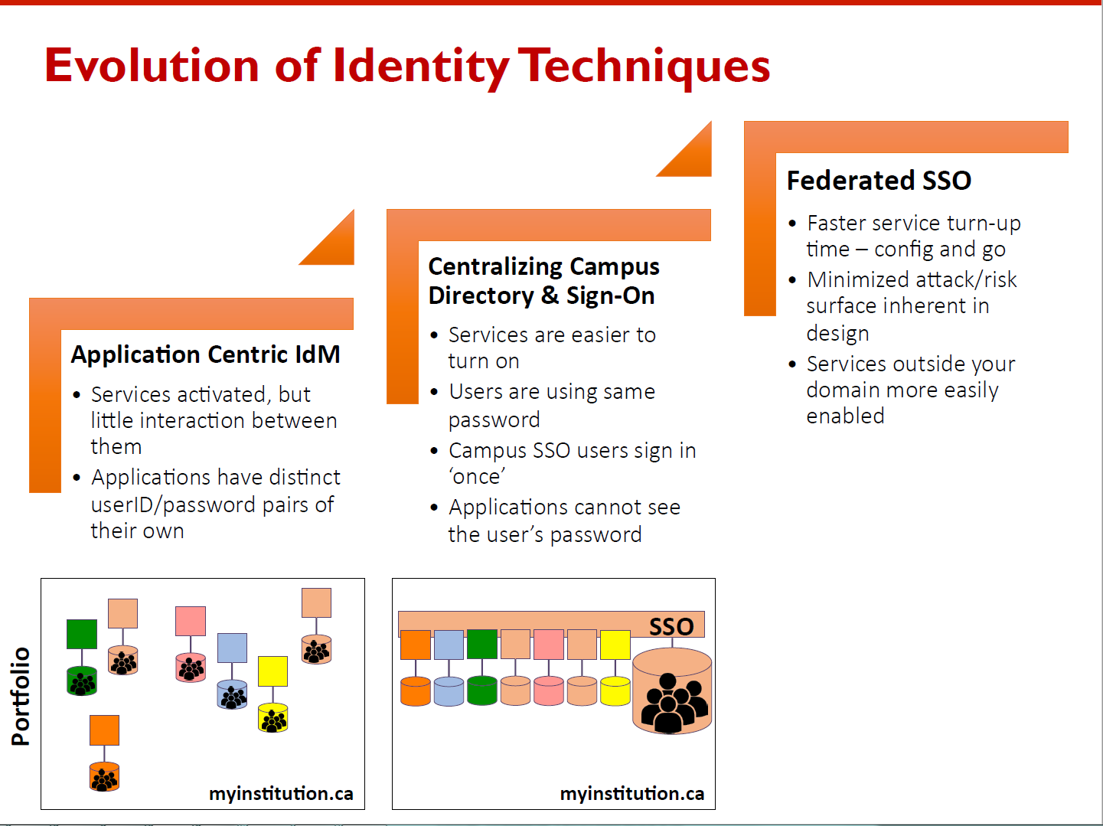

Slide 7
Campaigns for “eduGAIN works”
100% of the federations
Does it talk with “friends”?
Is the entity in eduGAIN?
Matches security practices?
CoCo and R&S
Does it release attributes?

Slide 8
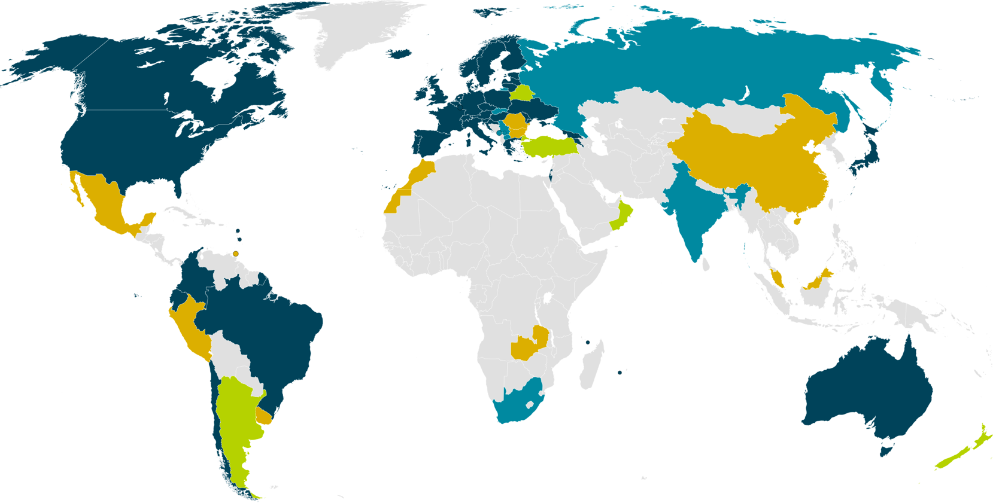
eduGAIN & Federation Status
24/06/2013
38 eduGAIN Members
5 Joining eduGAIN
8 Candidate Federations
10 Known Federations
March 2016
Notes:
Big growth in new federations – many have aspirations to join eduGAIN and interfederate.
IDEM joined in eduGAIN on 24/06/2013

Slide 9
Campaigns for “eduGAIN works”
100% of the federations
Does it talk with “friends”?
Is the entity in eduGAIN?
Matches security practices?
CoCo and R&S
Does it release attributes?

Slide 10
eduGAIN vs the World!
Federations: 63%
+ joining: 70%
Entities: 27% (ALL)
IdPs: 57%
SPs: 14%

Slide 11
eduGAIN & Federation Status (% of entities)
20%
54%
100%
100%
60%?
100%
2%
38 eduGAIN Members
5 Joining eduGAIN
8 Candidate Federations
10 Known Federations
March 2016
Notes:
Only IdP
Australia: 1/51=
Brazil: 127/135=78%
USA: 405/746=8.4%
UK: 3131
Germany 44/217

Slide 12
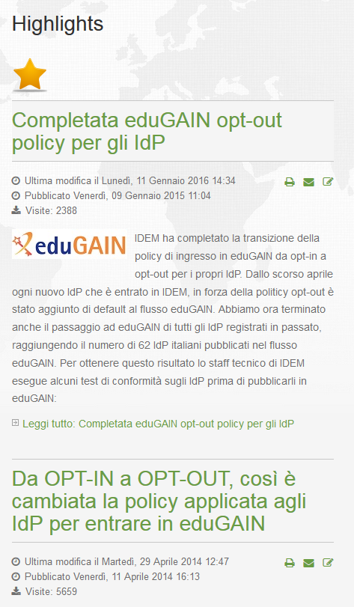
Is the entity in eduGAIN?
YES, Thanks to Opt-Out policy for Idps
11/01/2015

Slide 13
Campaigns for “eduGAIN works”
100% of the federations
Does it talk with “friends”?
Is the entity in eduGAIN?
Matches security practices?
CoCo and R&S
Does it release attributes?

Slide 14
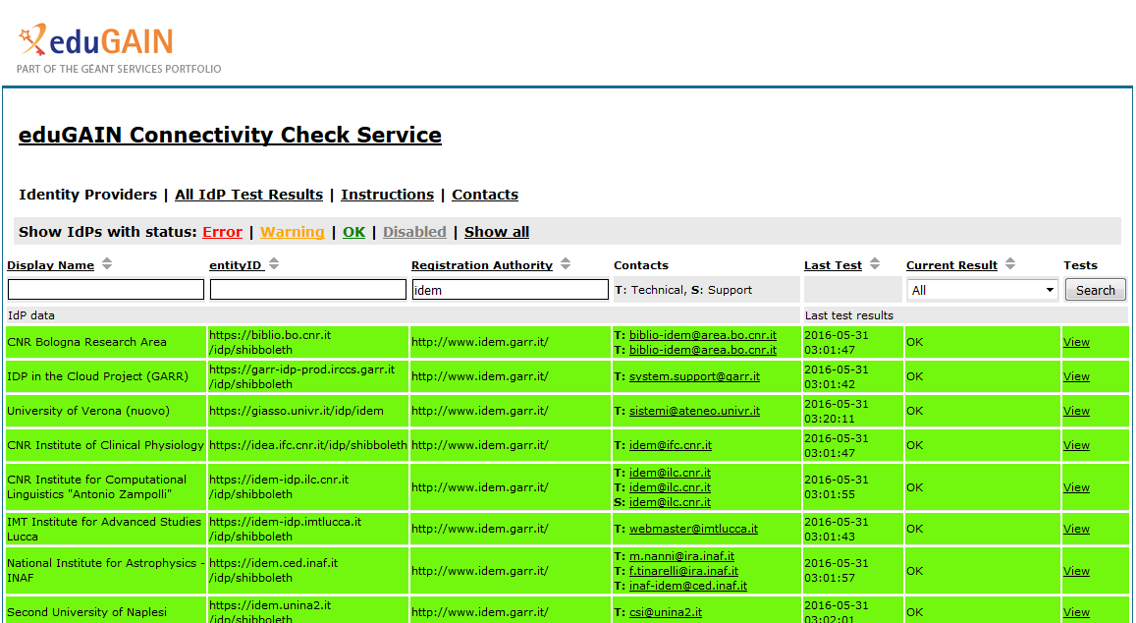
Does it talk with “friends”? https://technical.edugain.org/eccs/
https://technical.edugain.org/eccs/

Slide 15
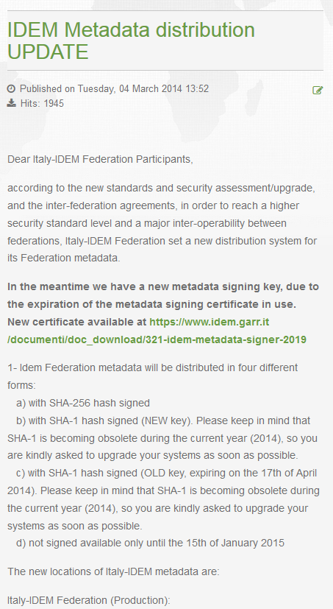
Does it talk with “friends”?
YES, Thanks to the new metadata distribution
04/03/2014

Slide 16
Campaigns for “eduGAIN works”
100% of the federations
Does it talk with “friends”?
Is the entity in eduGAIN?
Matches security practices?
CoCo and R&S
Does it release attributes?

Slide 17
We have experienced a severe problem
07/04/2014
A very serious bug in OpenSSL 1.0.1 was announced this afternoon:
http://heartbleed.com/
The actual direct impact on the Shibboleth software packages is relatively minimal in comparison with the fallout from this. The only distribution of OpenSSL included with any Shibboleth software is the Windows SP.
I'm not waiting to produce an actual advisory on this before saying something because this is a major, major bug and it's public.
I am working to prepare a patch for this (I had no advance warning) and it will be done as soon as I can produce it. It will *only* apply to the supported SP version, which is 2.5.3. Anything older than 2.5.0 didn't include an affected OpenSSL version, but any 2.5.x version will need to be updated to 2.5.3 and then patched.
Any other SP version is still vulnerable if used with OpenSSL 1.0.1, but I don't control the process of obtaining an update, so that will depend on your OS or local build.
On the IdP side, this is really a matter for deployment considerations. We don't provide the actual web server and TLS implementation for the IdP, so you would need to evaluate your choices there and determine whether OpenSSL 1.0.1 is implicated. Obviously pure Java solutions hosting the IdP are not, though some Java containers can be configured to use OpenSSL as a TLS stack for performance reasons.
As to the implications, this is a very severe bug, and has apparently been shown to leak the private key used on the server or client. In the case of an IdP, that usually means the potential exposure of *the* signing key because that key usually doubles as a server key for SOAP traffic on a second port.
In the case of the SP, there is, I think, somewhat less risk because the SP doesn't generally contact arbitrary servers that might be used to attack it, but that doesn't guarantee safety.
In the security parlance, keys at risk are basically considered compromised and the official advice would have to be to revoke and replace them. I would imagine that federations will be moving on this to help people understand and react to this, but I felt an obligation to say something in the interim, given the gravity of the bug.
-- Scott Cantor
Shibboleth Project/Consortium

Slide 18
Matches security practices?
IDEM help desk performs this audit every 2 months
https://www.ssllabs.com/ssltest/
Survey:
https://goo.gl/6prNMg
Answers:
https://goo.gl/5Oi8Hq
Notes:
https://docs.google.com/forms/d/1jsMQiBswLt8mtGicNpZ3z7yPqy6bluS3s2no1JHtpqw/viewanalytics?usp=form_confirm

Slide 19
Campaigns for “eduGAIN works”
100% of the federations
Does it talk with “friends”?
Is the entity in eduGAIN?
Matches security practices?
CoCo and R&S
Does it release attributes?

Slide 20


Trust and Identity today
Classic Identity Federations interoperating via eduGAIN
  Identity Provider (IdP) asserts authentication and information about users.
  Service Providers (SP) check and consume this information for authorization and make it available to an application
A group of organizations running IdPs and SPs that agree on a common set of rules and standards that build trust
Notes:
Typical use cases – journals, e-learning, contracts happen out of band. Simple 1:many models.

Slide 21
eduGAIN interfederation
https://technical.edugain.org/status
https://technical.edugain.org/entities
Many SPs in eduGAIN want to collaborate with our users

Slide 22
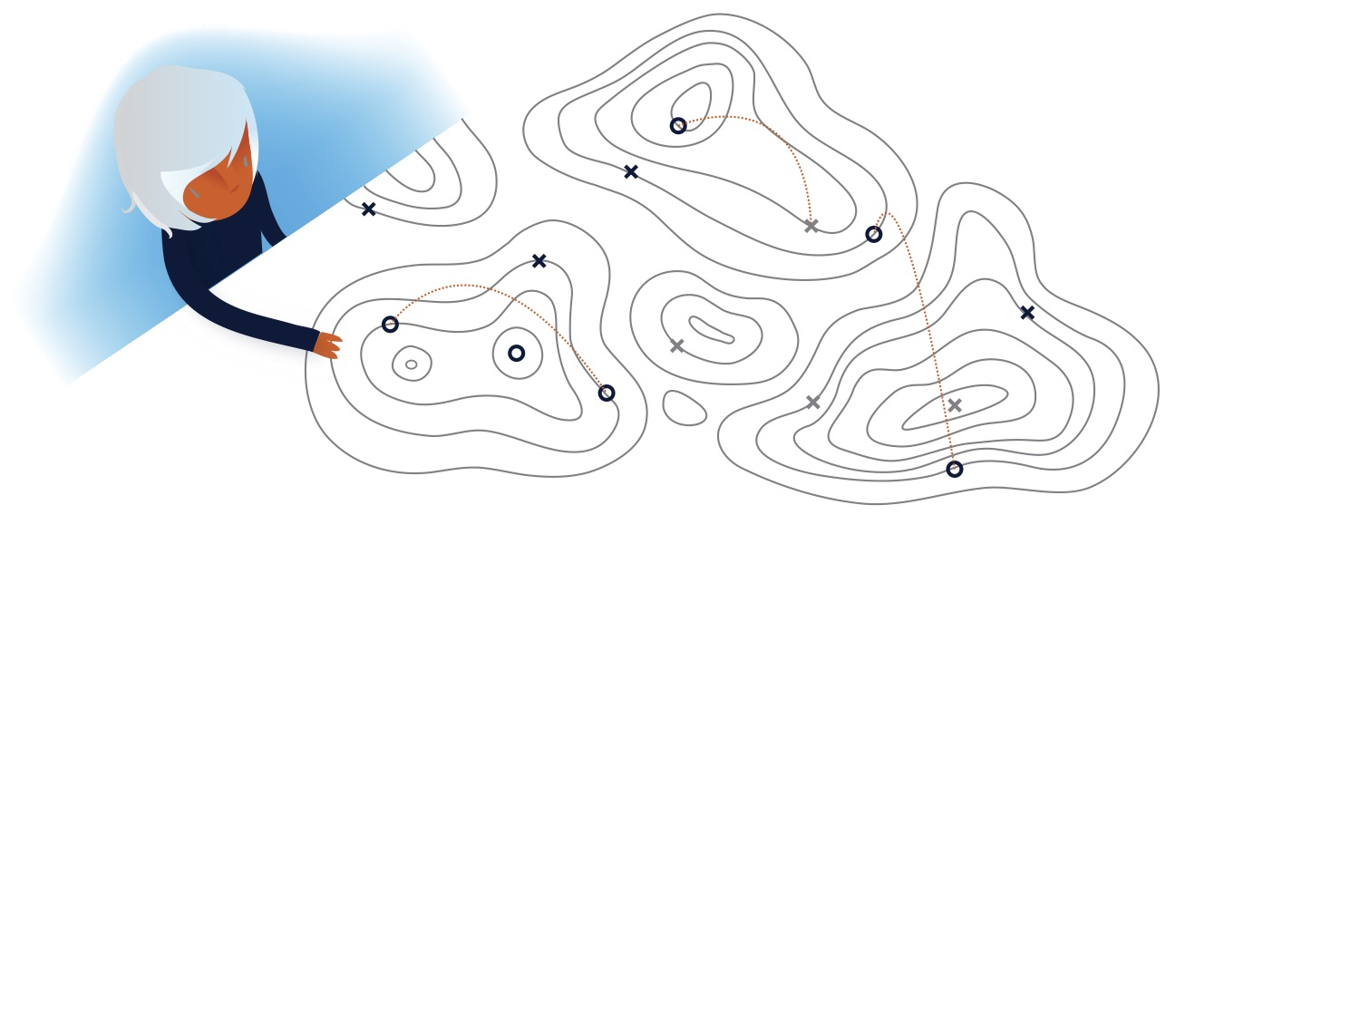
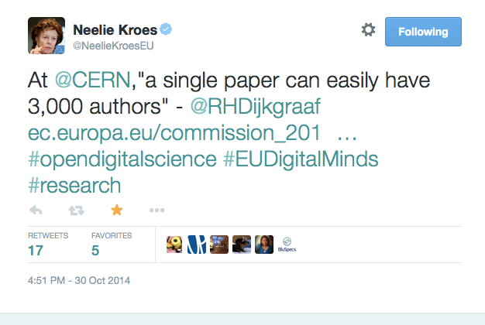
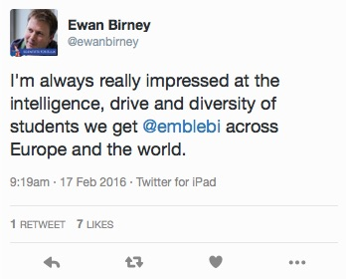
No researcher works in isolation
Source: LIGO/Caltech
Notes:
Borderless research
LIGO: Total members: 1006 Total institutions: 83 Countries represented.
Horizon 2020 “excellent Science” programme
United Kingdom (1161) (Germany next biggest c700).

Slide 23




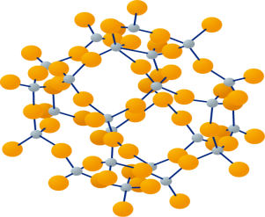
e-Research Trust and Identity Infrastructures
GENERIC
SPECIFIC
Campus
Federation
eduGAIN
General and Specific e-Research Infrastructures
Individual Experiments
Hundreds of thousands of users
Tens of thousands of services
Thousands of services
Hundreds of services
Tens to hundreds of individuals *
Notes:
39 federations providing statistics to REFEDS Feb 29 2016
3493 IdP 7893 SPs
– inc. centralised IdPs
Numbers for eduGAIN Feb 2016–
Federations 38
IdPs: 1999
SPs: 1119
21 ESFRI Projects with a high degree of maturity - including 6 new Projects - and 29 ESFRI Landmarks

Slide 24
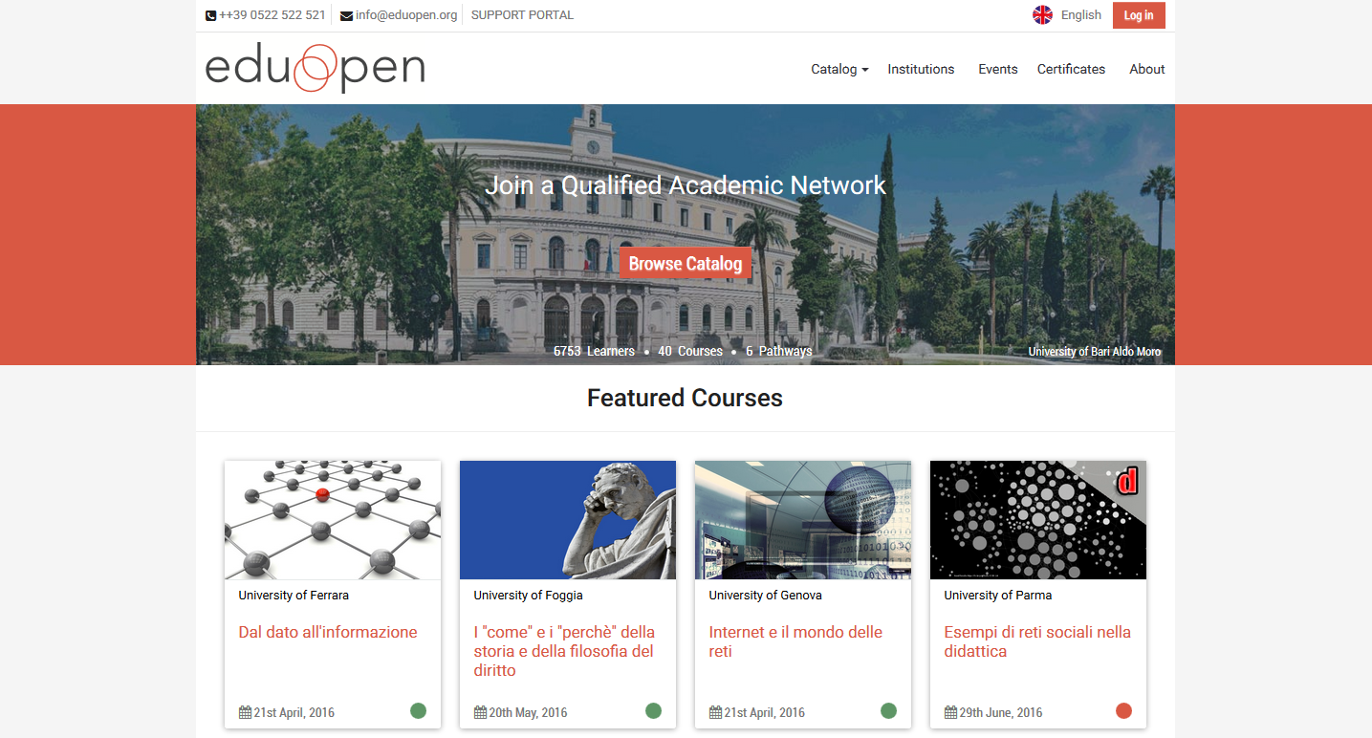
Understand how hard for a SP to be happy in the interfederation
EduOpen Example - https://learn.eduopen.org
Try to
Log in
Survey: https://goo.gl/G1Ywbf
Answers: https://goo.gl/8ntpZ3
Notes:
Answers: https://docs.google.com/forms/d/1UcR-4UOZFTTES3AFmSBZLIMjJyrCfz5v6oRCpD0s97Y/viewanalytics?usp=form_confirm

Slide 26
Does your IdP works with LIGO?
LIGO Example
Survey: https://goo.gl/2zPqvl
Answers: https://goo.gl/cwKCel
Notes:
https://gracedb.ligo.org/
And now the results:
https://docs.google.com/forms/d/1UcR-4UOZFTTES3AFmSBZLIMjJyrCfz5v6oRCpD0s97Y/viewanalytics?usp=form_confirm
https://docs.google.com/forms/d/10kl6_PDuL76_7ebrUgX2YUK48CE6Ljz_0BYBqPxJ5W0/viewanalytics?usp=form_confirm
With wiki.ligo.org the approach is to offer all IdPs and then show the user an "error page" if the IdP does not assert eppn.
We use the same technique recently discussed on the REFEDs list and leverage the Shibboleth SP ability to run a "hook"
that checks for attributes and redirects on missing attributes.
With gracedb.ligo.org (and others) we take a different approach. There we filter on the REFEDs R&S entity category,
but also whitelist IdPs that we find that do release eppn.
a set of SPs expected to be used somewhat regularly by external astronomers. gracedb.ligo.org is in that category, along with a few others.
For this second category LIGO management decided we would only show SPs known to federate (assert eppn) in order to minimize errors users would see. So if users cannot find their campus IdP in the discovery service they are directed to enroll with
an IdP of last resort (for now LIGO Guest or Google).

Slide 27

LIGO needs to collaborate with you
Italian Login Providers (IdPs)
These Italian login providers (identity providers or IdPs) are of particular interest to the gravitational-wave community since there are groups of astronomers from those institutions that need to collaborate with LIGO.
This is not a static list and is expected to evolve. If you have suggestions or changes for the list please send email to the LIGO IdP project.
Federated IdPs
Dipartimento di Fisica, Università di Siena (entityID https://shibboleth.unisi.it/idp/shibboleth)
INAF - National Institute for Astrophysics (entityID https://idem.ced.inaf.it/idp/shibboleth)
University of Milano Bicocca (entityID https://idp.unimib.it/idp/shibboleth)
Università di Padova (entityID https://shibidp.cca.unipd.it/idp/shibboleth)
University of Perugia (entityID https://idp.unipg.it/idp/shibboleth)
Universita di Pisa (entityID https://idp.unipi.it/idp/shibboleth)
INFN (all institutes) (entityID https://idp.infn.it/saml2/idp/metadata.php)
Not federated at this time
ASDC - ASI Science Data Center
Brera Observatory Milan
Istituto Universitario di Studi Superiori of Pavia
Università dell'Insubria
Università di Udine
https://wiki.ligo.org/AuthProject/EMFollowUpOrganizationsForIdMItaly
https://wiki.ligo.org/AuthProject/EMFollowUpOrganizationsForIdM

Slide 28

What we can do
Now can LIGO have some attributes please?
We have many more years of gravitational-wave astronomy
discoveries to come and realizing the full science potential
will require close collaboration with astronomers and
astrophysicists from around the world. eduGAIN and your
national federations can help make that happen.
- Scott Koranda, lead architect for the Laser Interferometer Gravitational-Wave Observatory Identity and Access Management
Read more about releasing attributes for Science https://refeds.org/a/1154

Slide 29






The real world of interfederation
ORG
R&S
ERROR
SP1
Is it possible to prevent this error?
Release Attributes?
IdP
  username|password
authenticated
Notes:
What is the real world of interfederation
A new SP appears suddenly in the eduGAIN metadata aggregate. The SP has done a lot of work to be part of eduGAIN. The SP require attributes. Likely the SP comply with R&S and/or CoCo and has done a lot of work for this compliance. Now the SP expects that all works as desired with logins coming from 1 thousands of IdPs. But the real world is that all the effort spent in making the SP able to work in the interfedaration is vain, because nothing works automatically as expected.

Slide 30
ERROR AFTER SUCCESSFUL LOGIN: Frustration of user
The user doesn’t understand the error
The user doesn’t know to whom complain
User feels that things must work

Slide 31
ERROR AFTER SUCCESSFUL LOGIN: Frustration of the SP
SP has done a lot of work to domesticate the application.
SP has done a lot of work to join and be compliant with national federation’s rules and policies.
SP has done a lot of work to join and be compliant with eduGAIN.
The SP require attributes.
Likely the SP comply with R&S and/or DP CoCo and has done a lot of work for this compliance.
Now the SP expects that all works as desired with logins coming from 1 thousands of IdPs.
But the real world makes all the effort spent by a SP to be able to work in the interfederation a vain effort, because nothing works automatically as expected.
It’s hard for the SP to get in touch with the IdP and, in any case, is too late.

Slide 32
ERROR AFTER SUCCESSFUL LOGIN: doesn’t the IdP care?
Seems that IdP operators don’t care about this until they receive complains from the user

Slide 33
The desired world of interfederation
ORG
R&S
OK
SP1
R&S
Release Attributes?
IdP
  username|password
authenticated
Notes:
What is the desired world of interfederation
When a new SP appears suddenly in the eduGAIN metadata aggregate the IdP dynamically and automatically configure the attribute-filter (ARP: attribute release policy) in the way requested by the SP and in compliance with the policy of the IdP home organisation.

Slide 34
What is the desired world of interfederation
When a new SP appears suddenly in the eduGAIN metadata aggregate
the IdP dynamically and automatically configure the attribute-filter (ARP: attribute release policy)
  in the way requested by the SP and
  in compliance with the policy of the IdP home organisation.

Slide 35
ERROR AFTER SUCCESSFUL LOGIN: doesn’t the FedOp care?
The role of the Federator operator SHOULD BE proactive or passive? (in order to help to reach the desired world)
Here follows our proposal, as Federation Operator, to help in solving the issue

Slide 36
Campaigns for “eduGAIN works”
100% of the federations
Does it talk with “friends”?
Is the entity in eduGAIN?
Matches security practices?
CoCo and R&S
Does it release attributes?
?

Slide 37
Attribute Release Problems
Everytime a new SP joins a federation, the IdP manager has to
Edit and modify the attribute release policy (attribute-filter.xml or module_attributepolicy_prod.php file)
Add the new entityID
Add the list of the RequestedAttributes (if they are compliant with the Organization policy)
For a Shibboleth IdP - Restart the IdP services!

Slide 38
… And problems
As we all know, manually editing files is a big time consuming activity...
... And stressing activity....
... And it is very easy to make mistakes
Everytime it is
Easy to make mistakes
Easy to forget
Difficult to implement if there are many SPs

Slide 39
… And more problems….
In a inter-federated enviroment it could be even more difficult:
The IdP manager often is not aware of new SPs joining for example eduGAIN and for this reason
He will never add the new SP to his configuration file
He will never release the correct attributes to make them work
The new SP will never work with his IdP until one or more users complain about a SP that is not working

Slide 40
Desiderata
IdP managers need something is:
Simple to configure
Simple to implement
Automatic!! (or at least semi-automatic)
Compliant with the Organization privacy policy for the users

Slide 41
A possible approach
There is one thing that could help the IdP managers to solve many of the problems discussed
the EntityCategory feature
The produced simplification consists in a federation service categorization of homogeneous services
The scope of EntityCategory is that the attribute release policy will not be configured for each SP but only once for the whole category
Each category will contain a set of homogeneous entities (in our case a set of SPs) that meet the requirements of the category itself
IdPs can configure a rule for the category. The rules will remains unchanged (scalable) even if further SPs subscribe that category in the future.

Slide 42
How Entity Category works
A federation agrees with its members to
Introduce one or more category for its federated IdP and SP
Define a set of criteria to belong to the category
Establish procedures, both for SPs and IdPs, to be member
Membership to a category is written in the single entity metadata

Slide 43
The Entity Category trust circle
  Since the SP must satisfy a set of requirements
  Since the Federation Operator has to control that those requirement are compliant and satisfied
  Once the Federation or the Registration Authority accepted the SP in a category
  The IdP can trust every SP in that category, and be sure that all the requirements are satisfied and certified by the Registration Authority, or by the Federation

Slide 44
Entity Category attribute
To obtain the entity category attribute a SP MUST satisfy the requirements for the category and ASK for the certification to the Registrar.
To certify that a SP is member of a category the Registrar (after any necessary control) adds this fragment to the SP entity metadata
<mdattr:EntityAttributes>
<saml:Attribute Name="http://macedir.org/entity-category" NameFormat="urn:oasis:names:tc:SAML:2.0:attrname-format:uri">
<saml:AttributeValue>
http://refeds.org/category/research-and-scholarship
</saml:AttributeValue>
<saml:AttributeValue>
http://www.geant.net/uri/dataprotection-code-of-conduct/v1
</saml:AttributeValue>
</saml:Attribute>
</mdattr:EntityAttributes>

Slide 45
The Entity Category support attribute
A categorised SP needs to know the supporter IdPs of the category, in order to work easier.
IdPs are asked to claim explicitly that they are supporting the category, by inserting a proper tag in the IdP metadata
<mdattr:EntityAttributes>
<saml:Attribute Name="http://macedir.org/entity-category-support" NameFormat="urn:oasis:names:tc:SAML:2.0:attrname-format:uri">
<saml:AttributeValue>
http://refeds.org/category/research-and-scholarship
</saml:AttributeValue>
<saml:AttributeValue>
http://www.geant.net/uri/dataprotection-code-of-conduct/v1
</saml:AttributeValue>
</saml:Attribute>
</mdattr:EntityAttributes>

Slide 46
Research & Scholarship Entity Category
The Research & Scholarship (R&S) EntityCategory is a category that applies only to SP and IdP that are operated for the purpose of supporting research and scholarship interaction, collaboration or management
Examples:
Wiki
Blog
Collaborative tools
Learning management system
Research collaborations (LIGO, ELIXIR, CLARIN, etc)
Not any licensed content like e-journals

Slide 47
Research & Scholarship attribute
An SP part of R&S category has to
Claim that it will not use attributes for purpose that fall outside of the service definition
Request a minimal subset of R&S attributes that represent only those attributes that the SP requires to operate its service
R&S relies on the legitimate interest approach
Metadata example for an R&S SP
<mdattr:EntityAttributes>
<saml:Attribute Name="http://macedir.org/entity-category" NameFormat="urn:oasis:names:tc:SAML:2.0:attrname-format:uri">
<saml:AttributeValue>
http://refeds.org/category/research-and-scholarship
</saml:AttributeValue>
</saml:Attribute>
</mdattr:EntityAttributes>

Slide 48
Research & Scholarship (V2) IdP support attribute
An IdP that support R&S entity category MUST release the following attributes to the SPs in this category
  eduPersonPrincipalName
  eduPersonTargetedID
  displayName
  givenName
  sn
  mail
Populate the user directory with the attributes to release
An IdP that support R&S entity category is STRONGLY ENCOURAGED to release:
  eduPersonScopedAffiliation
Notes:
MUST is provided by the new implementation of REFEDS R&S Entity Category
Link new R&S: https://wiki.refeds.org/pages/viewpage.action?pageId=10944524

Slide 49
Research & Scholarship IdP metadata
After the IdP configured its attribute-filter file for R&S it has to explicitly claim its support to the category, by inserting this fragment in its metadata:
<mdattr:EntityAttributes>
<saml:Attribute Name="http://macedir.org/entity-category-support" NameFormat="urn:oasis:names:tc:SAML:2.0:attrname-format:uri">
<saml:AttributeValue>
http://refeds.org/category/research-and-scholarship
</saml:AttributeValue>
</saml:Attribute>
</mdattr:EntityAttributes>

Slide 50
Research & Scholarship IdP filter
Example of attribute-filter.xml file for a IdP supporting R&S
<AttributeFilterPolicy id="releaseDynamicSubsetRandSAttributeBundle">
<PolicyRequirementRule xsi:type="EntityAttributeExactMatch"
attributeName="http://macedir.org/entity-category"
attributeValue="http://refeds.org/category/research-and-scholarship"/>
<AttributeRule attributeID="eduPersonPrincipalName">
<PermitValueRule xsi:type="basic:ANY"/>
</AttributeRule>
<AttributeRule attributeID="email">
<PermitValueRule xsi:type="basic:ANY"/>
</AttributeRule>
[…]
</AttributeFilterPolicy>
Notes:
NON È COMPLETO!!!

Slide 51
GÉANT Data Protection Code of Conduct Entity Category
GÉANT Data Protection Code of Conduct (DP_CoCo)
Created to meet the requirements of the EU Data Protection Directive in federated identity management
It’s a formal agreement about how user data will be treated in order to respect user privacy
It is expected that Home Organisations are more willing to release attributes to Service Providers who manifest conformance to the Data protection Code of Conduct.
Notes:
Dato che hai messo l’abbreviazione DP_CoCo, riportala su tutte le slide

Slide 52
DP_CoCo attribute
To be member of DP_CoCo entity category a SP has to
Be located in EU/EEA and obey to EU laws
  It is not allowed to send the user data to third parties
  It must ask only for the minimal set of required attributes
Ask its necessary attributes in its RequestedAttribute statement as «isRequired="true"»
Inform the user about the processing his personal data in a PrivacyPolicy page linked to its primary service page

Slide 53
DP_CoCo SP metadata
The SP is member of DP_CoCo category if the Registrar certifies it (after any necessary control) by adding this fragment to the SP entity metadata
<mdattr:EntityAttributes>
<saml:Attribute Name="http://macedir.org/entity-category" NameFormat="urn:oasis:names:tc:SAML:2.0:attrname-format:uri">
<saml:AttributeValue>
http://www.geant.net/uri/dataprotection-code-of-conduct/v1
</saml:AttributeValue>
</saml:Attribute>
</mdattr:EntityAttributes>

Slide 54
DP_CoCo IdP support attribute
To support DP_CoCo entity category an IdP has to
Release only the requested attributes with the «isRequired="true"» value
If the SP requires a particular value for multivalue attribute the IdP has to release only that value
Inform the user about the treatment for every single attribute in its PrivacyStatementURL
To support DP_CoCo EntityCategory the IdP has to explicitly claim it in its metadata by adding:
<mdattr:EntityAttributes>
<saml:Attribute Name="http://macedir.org/entity-category-support" NameFormat="urn:oasis:names:tc:SAML:2.0:attrname-format:uri">
<saml:AttributeValue>
http://www.geant.net/uri/dataprotection-code-of-conduct/v1
</saml:AttributeValue>
</saml:Attribute>
</mdattr:EntityAttributes>

Slide 55
DP_CoCo IdP – attribute-filter.xml
<AttributeFilterPolicy id="releaseToCoCo">
<PolicyRequirementRule xsi:type="EntityAttributeExactMatch"
attributeName="http://macedir.org/entity-category"
attributeValue="http://www.geant.net/uri/dataprotection-code-of-conduct/v1"/>
<AttributeRule attributeID="sn">
<PermitValueRule xsi:type="AttributeInMetadata" onlyIfRequired="true"/>
</AttributeRule>
<AttributeRule attributeID="givenName">
<PermitValueRule xsi:type="AttributeInMetadata" onlyIfRequired="false"/>
</AttributeRule>
[…]
</AttributeFilterPolicy>

Slide 56
DP_CoCo: Notes for IdP Managers
Release only Attributes that are adequate, relevant and not excessive for the Service Provider flagged as requested in SAML metadata (see SAML 2 Profile for the Code of Conduct for details on how this is done)
If the Service Provider requests only a particular Attribute value, release only that value and no other values for instance, if the Service Provider requests only eduPersonAffiliation="member", do not release eduPersonAffiliation="faculty"
Inform the end user on the Attribute
  for each Attribute, the Attribute name, description and value an easily understood label can be displayed instead of displaying several closely related Attributes (eg the various name Attributes)
If use the data controller's legitimate interests as the legal grounds for attribute release, release only attributes that are flagged as NECESSARY

Slide 57

BREAK

Slide 58
eduGAIN Identity Providers
2079
DP_CoCo (support)
R&S (support)
57
70
105
eduGAIN IdPs
May 2016

Slide 59
Personally identifiable information (PII)
and
Legal Ground

Slide 60
informed
YES 91%

Slide 61
consent
YES 77%

Slide 62

Unlocking Attributes
I am not a lawyer…
Most of eduGAIN is under EU Data protection directive or equivalent
The objective of the directive is to protect a person’s fundamental rights while guaranteeing the free flow of personal data between member states
Member States shall provide that the controller must implement appropriate technical and organizational measures to protect personal data against accidental or unlawful destruction or accidental loss, alteration, unauthorized disclosure or access, in particular where the processing involves the transmission of data over a network, and against all other unlawful forms of processing.
Notes:
The standard approach to achieving minimum risk under the EU Data protection directive would expect contracts between a Home Organisation and the entities responsible for every Service Provider accessed by every member of its community.
very few Home Organisations would be able to assess every potential Service Provider.

Slide 63

Balancing Risk
https://wiki.refeds.org/display/ENT/Guidance+on+justification+for+attribute+release
Notes:
Note balance between user freedom from and freedom to.
Note balance between regulatory risk and ‘commercial business purpose’ risk for campus.
Note R&E tends to do more for privacy than industry for whom legislation is normally designed.
Reminder of project engagement in pan Euro research has worth.
Processing is necessary for the purposes of the legitimate interests pursued by the controller or by the third party or parties to whom the data are disclosed.

Slide 64
In Focus - Attribute Release
Tools to automate risk-analysis-based support of e-Research
Entity Categories group federation entities that share common criteria.
Facilitate IdP decisions to release a defined set of attributes to SPs without the need for detailed local review for each SP
Research and Scholarship Entity Category relies on the legitimate interest approach
Safeguards of data minimisation, privacy enhancing tech
Limits the types of services that are allowed to claim this category and focusing on low-risk, high benefit services that have a clearly identifiable need for personal information
Each SP is considered on a case-by-case basis by the federation in question and reviewed annually.
GÉANT Code of Conduct approach aims to minimise the risk that arises from depending on each other.
Legitimate interest is also fundamental
Signals that the Home Organisation and Service Provider are aware of the legal requirements
Based on Directive 95/46/EC 1995
Check with your Federation Operator for advice on which best suits your needs

Slide 65
PROBLEM
Federated Users can’t access to the Federated Resources because their federated IdP doesn’t release all the needed attributes
Notes:
With the hat of a Federation Operator we ask to ourself why the attribute release is a problem…

Slide 66
Attribute Release Process
Institutional Directory
(LDAP/AD)
Stores institutional user in compliance with the directory schemas. Attributes values are not always populated.
IDP Attribute Definition
Maps user info provided by the Institutional Directory on specific Attributes
IDP Attribute Filter
Decide to whom release the attributes
Notes:
We find that the problem may come from 3 different places:
Institutional Directory: where the user info are stored after the identification
IdP Attribute Definition: where the user info provided by the institutional directory are mapped on the SAML Attributes.
IdP Attribute Filter: where the SAML attributes defined are managed for the release to the federated resources

Slide 67
Attribute Schema: eduPerson and SCHAC
Importance of using international defined schemas
  We need to share international schemas in order to be able to exchange attributes in an international context (eduGAIN)
Private/national schemas are irrelevant in the international context (SP should be aware they cannot pretend to obtain private/national defined attributes).
  Could be taken in consideration at national level.
Notes:
The usage of international defined schema is essential, custom schemas can produce problems on the international context.
With a simple survey you can collect some useful datas on the attributes managed by the IdPs, analize the results and discover how much your community is compliant with eduGAIN practices and recommendations.

Slide 68
Does your IdP manage these attributes?
https://goo.gl/rOMQiP
Notes:
From the results received we are able to say that our IdPs support totally the email attribute, but not completely the others… So, this can be a problem for the federation and interfederation usage…

Slide 69
attribute management
FriendlyName | OID | Count
email, mail, rfc822Mailbox | urn:oid:0.9.2342.19200300.100.1.3 | 282
eduPersonPrincipalName, eppn | urn:oid:1.3.6.1.4.1.5923.1.1.1.6 | 277
displayName | urn:oid:2.16.840.1.113730.3.1.241 | 148
eduPersonTargetedID | urn:oid:1.3.6.1.4.1.5923.1.1.1.10 | 144
givenName, gn, FirstName | urn:oid:2.5.4.42 | 144
sn, surname, LastName | urn:oid:2.5.4.4 | 141
eduPersonScopedAffiliation | urn:oid:1.3.6.1.4.1.5923.1.1.1.9 | 126
cn, commonName | urn:oid:2.5.4.3 | 85
eduPersonScopedAffiliation, eduPersonAffiliation | urn:oid:1.3.6.1.4.1.5923.1.1.1.1 | 62
schacHomeOrganization, shacHomeOrganization | urn:oid:1.3.6.1.4.1.25178.1.2.9 | 35
eduPersonEntitlement | urn:oid:1.3.6.1.4.1.5923.1.1.1.7 | 33
o, organizationName | urn:oid:2.5.4.10 | 32
schacHomeOrganizationType | urn:oid:1.3.6.1.4.1.25178.1.2.10 | 22
preferredLanguage | urn:oid:2.16.840.1.113730.3.1.39 | 17
uid | urn:oid:0.9.2342.19200300.100.1.1 | 15
eduPersonPrimaryAffiliation | urn:oid:1.3.6.1.4.1.5923.1.1.1.5 | 13
eduPersonOrgDN | urn:oid:1.3.6.1.4.1.5923.1.1.1.3 | 10
ou | urn:oid:2.5.4.11 | 8
title | urn:oid:2.5.4.12 | 7
telephoneNumber | urn:oid:2.5.4.20 | 7
mobile | urn:oid:0.9.2342.19200300.100.1.41 | 6
eduPersonNickname, Nickname | urn:oid:1.3.6.1.4.1.5923.1.1.1.2 | 6
eduPersonOrgUnitDN | urn:oid:1.3.6.1.4.1.5923.1.1.1.4 | 6
eduPersonAssurance | urn:oid:1.3.6.1.4.1.5923.1.1.1.11 | 5
eduPersonPrimaryOrgUnitDN | urn:oid:1.3.6.1.4.1.5923.1.1.1.8 | 5
postalAddress | urn:oid:2.5.4.16 | 5
l, localityName | urn:oid:2.5.4.7 | 5
Which are the attributes that my IdP is able to manage?
  Complete your list
Which are the attributes that SPs require?
Most requested attributes from SPs in eduGAIN
Are the two lists compatible? Overlapping?
Is my IdP able to release the attributes that could be requested?
At the end:
  If I want/need, am I in the position to be able to release attributes requested?
Notes:
You can find here a simple table with the most requested attributes from the SPs in eduGAIN that you can use to stimulate your IdPs on how many SPs they can satisfy with the attributes released by them.
Are your IdP Managers in the position to be able to release the attributes requested?

Slide 70
Attributes are missing in the Directory (openLDAP/AD)
SOLUTION: Define dynamically the missing attributes on the IdP side
  Fast solution
  Simply like a JavaScript script
  Directory Manager independent
  Used only if the attribute is not already present on the directory
Notes:
If you need an attribute that your directory doesn’t give you… What do you do?
Simple! Generate it with a script! The Federation provides some examples to help you on the generation of the missing attributes.
Yes, we can’t give you a solution for all attribute you want, but once you have learnt the mechanism, you can create your custom scripts for all your needs!
Take a look to the next table.

Slide 71
What the IdP Operator needs to do

Slide 72
Fill values missing in the directory
Dynamic Attributes Definitions Examples
Attribute Name | IDEM Attribute Value composed by | IDEM Implementation for IdP with Java 7 (Rhino) | IDEM Implementation for IdP with Java 8 (Nashorn)
schacHomeOrganization | domain.org | schacHomeOrganization | schacHomeOrganization
organizationName | schacHomeOrganization | organizationName | organizationName
organizationalUnit | organizationName | organizationalUnit | organizationalUnit
eduPersonOrgDN | organizationName + schacHomeOrganization | eduPersonOrgDN | eduPersonOrgDN
eduPersonOrgUnitDN | eduPersonOrgDN | eduPersonOrgUnitDN | eduPersonOrgUnitDN
displayName | commonName OR givenName + surname OR givenName OR surname | displayName | displayName
Notes:
You can find here some examples that a Federation can give to their IDP Managers (shibboleth v3 compliant only), to solve problem of the missing attributes on their LDAP or Active Directory. (Yes, they work also if you connect a database to your IdP, but we try to cover the majority of institutional behaviours.)

Slide 73
Attributes Filters are misconfigured
WHY:
IdP Manager is not always focused on the IdP problems.
IdP Manager doesn’t have enough technical knowledge.
IdP Manager doesn’t want to change those things that seems working.
The person who installed the IdP software has left the institution without passing all the needed knowledge.
Notes:
If the problem reside on the attribute filter of the IDP…

Slide 74
Attributes Filters are misconfigured
SOLUTION:
Federation Operator supports IdP Manager on the definition of the needed attribute release policy.

Slide 75
Attribute Release Policy (ARP)
How to address the attribute release to the federated resources
ARP Entity Category(EC) based:
attribute release policy based on static rules that don’t require changes once created to satisfy the attribute requests coming from old and new federated resources.
ARP Registry based:
attribute release policy based on rules built dynamically through easy-to-use tools (like a registry) that allow to an IDP Manager to change them easily and satisfy the attribute requests coming from the federated resources.

Slide 76
ARP EC based VS ARP Registry based
PRO & CONS
EC ARP |  | REGISTRY ARP
PRO | CONS | PRO | CONS
Scalable (it needs less or no changes in the long time period) | Low number of IdP compliant with the existing Entity Categories | It can satisfy all federated resources without limit. The IdP Manager can change the rules as he want. | Scalable (but only with the right conditions)
Simple and fast to apply on IdP (download and use it) | The current Entity Categories are not sufficient | Simple and fast to apply on IdP (download and use it)
 |  | A simple GUI replaces heavy manual operations (metadata management, ARP, know all resources available, …)
Notes:
The Federation offer a ready-to-use attribute release policy that the IdPs can use or not if the ADVANTAGES and DISADVANTAGES are acceptable and valid enough.
Approfondire/leggere i pro e i contro

Slide 77
eduGAIN Service Providers
1197
DP CoCo
R&S
41
91
83
eduGAIN SPs
May 2016
Notes:
We show the number of SPs we need to satisfy with our solution and how many SPs are entity categories compliant.

Slide 78
Proposal Federation choice: EC ARP + Registry ARP
IDEM GARR AAI has chosen to use both, plus its Default ARP:
Default ARP:
  Default Federation ARP: attribute filter that releases a very small set of attributes to all resources and allows to use only few essential federation resources.
EC ARP:
  R&S EC ARP: attribute filter that implement the rules established for all resources compliant with Research and Scholarship entity category.
  CoCo EC ARP: attribute filter that implement the rules established for all resources compliant with Code Of Conduct entity category.
Registry ARP:
  Custom IdP ARP: An IdP Manager maintains the decisional power to release or not the attributes to the SPs by building his attribute filter with the help of IDEM Entity Registry. This ARP is useful to reach also SPs that didn’t join yet to R&S and/or CoCo entity categories.
Notes:
As Operator of Mesh Federations we can only propose to apply our solution on the IdP of our institutions, but we have to leave them free to decide to follow other rules… (and, perhaps, meet much more errors)
As IDEM Federation we propose to adopt 3 different type of Attribute Release Policy:
A Default ARP that implements the rules for the mandatory attributes requested by the federation.
An EC ARP (R&S and CoCo) that implements the rules for the releasing of those attributes that are needed to be a member of the R&S and CoCo community.
A Custom IdP ARP generated with the help of Jagger that implements the rules for those resources that didn’t join yet in the R&S and/or CoCo community.

Slide 79
General Steps to apply a new Attribute Filter on a Shibboleth IdP
Create or Retrieve the attribute filter
Add it to «services.xml»
Reload the attribute filter service (or entire Tomcat if it fails)

Slide 80
IDEM Default ARP + R&S + CoCo

Slide 81
HOW TO Retrieve and Use IDEM Default and EC ARPs
Download the IDEM ARPs:
  cd /opt/shibboleth-idp/conf
  wget http://www.garr.it/idem-conf/attribute-filter-v3-idem.xml
  wget http://www.garr.it/idem-conf/attribute-filter-v3-rs.xml
  wget http://www.garr.it/idem-conf/attribute-filter-v3-coco.xml
Modify the «services.xml» file:
  vim /opt/shibboleth-idp/conf/services.xml
      <util:list id ="shibboleth.AttributeFilterResources">
      <value>%{idp.home}/conf/attribute-filter-v3-idem.xml</value>
      <value>%{idp.home}/conf/attribute-filter-v3-rs.xml</value>
      <value>%{idp.home}/conf/attribute-filter-v3-coco.xml</value>
      </util:list>
Restart the Attribute Filter Service of the Shibboleth IdP:
  cd /opt/shibboleth-idp/bin
  ./reload-service.sh –id shibboleth.AttributeFilterService
Notes:
To sustain better our proposal, we prepare all needed files and tutorials to drive the IdP Managers in the application of the proposal so that they can’t think «it is too difficult for me, I don’t want change the behaviour of my IDP»

Slide 82
IDEM Registry ARP
Notes:
The Entity Category is a beautiful way to make easier the attribute release management, but, at the moment, seems that there are a lot of resources that didn’t apply the Entity Category R&S or CoCo… We need a solution for all of them, we need a simple solution for the IdP Managers… We need a tool, like Jagger Registry, to manage the ARP for such resources. ☺

Slide 83
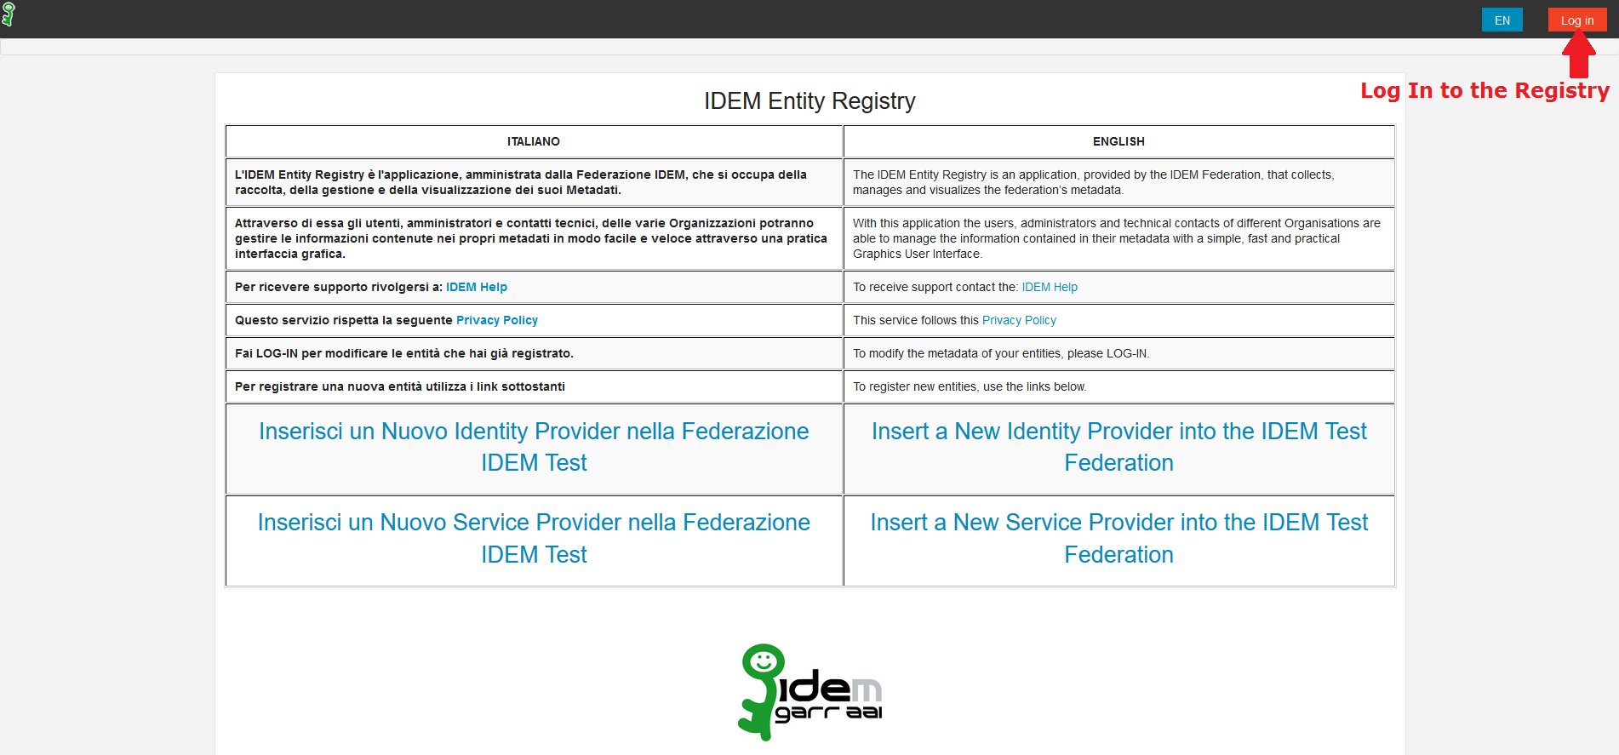
HOW TO Use the IDEM Entity Registry for creating custom ARP
STEP 1 - Log in via federated identity to the IDEM Entity Registry: https://registry.idem.garr.it

Slide 84
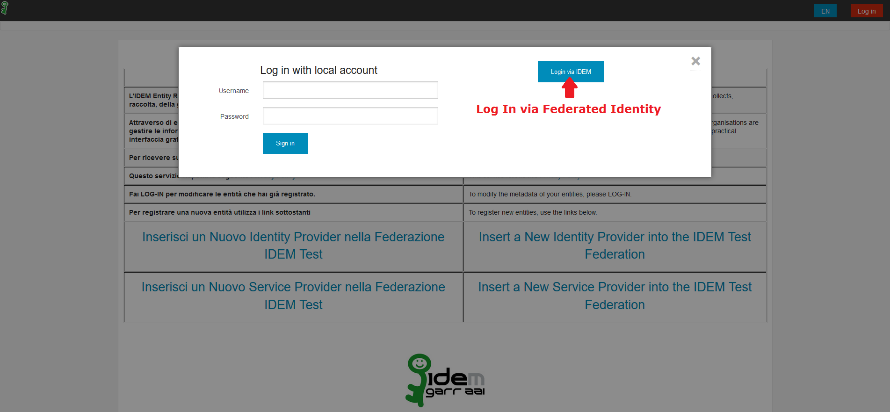
HOW TO Use the IDEM Entity Registry for creating custom ARP
STEP 1 - Log in via federated identity to the IDEM Entity Registry

Slide 85
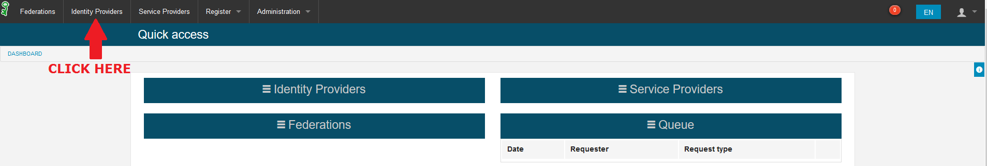
HOW TO Use the IDEM Entity Registry for creating custom ARP
STEP 1 - Log in via federated identity to the IDEM Entity Registry

Slide 86
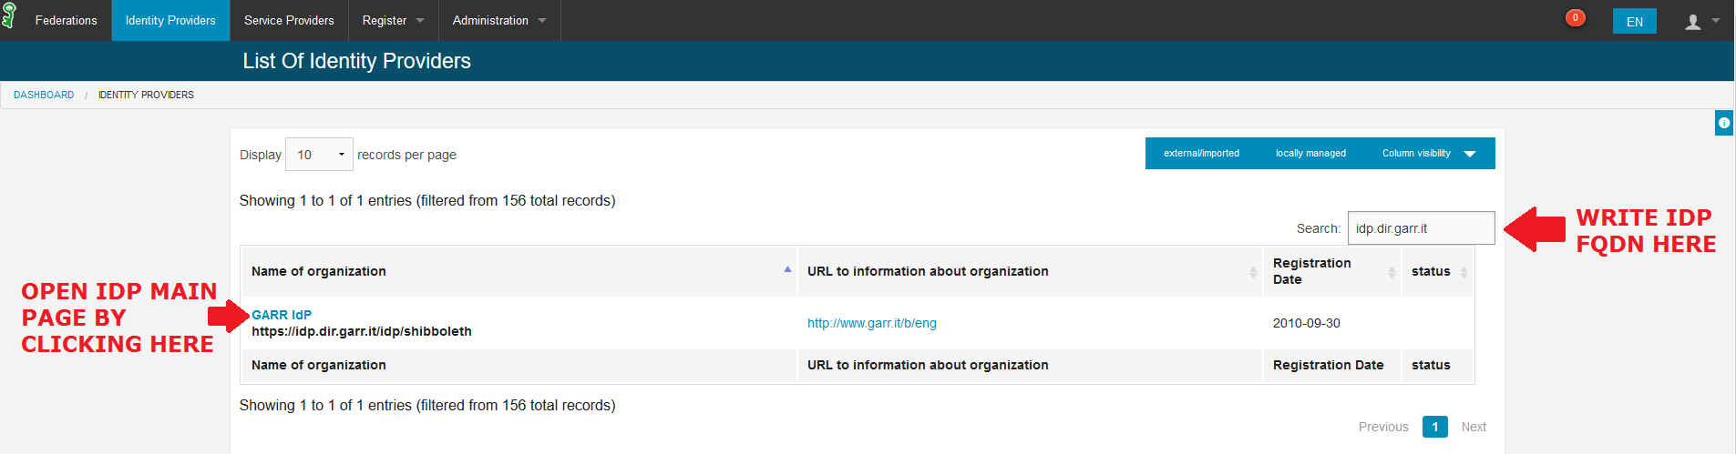
HOW TO Use the IDEM Entity Registry for creating custom ARP
STEP 2 – Declare which attributes are supported by the IdP

Slide 87
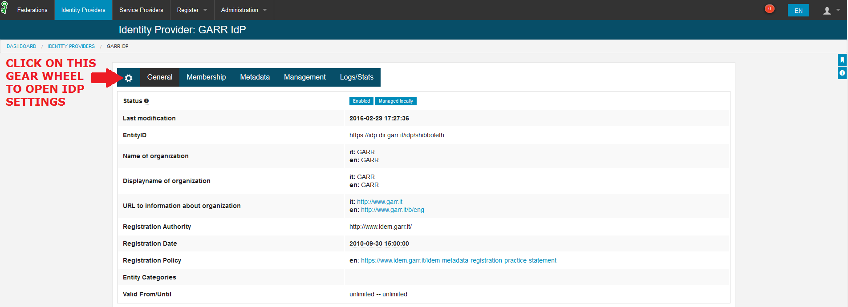
HOW TO Use the IDEM Entity Registry for creating custom ARP
STEP 2 – Declare which Entity Category will be supported by the IdP

Slide 88
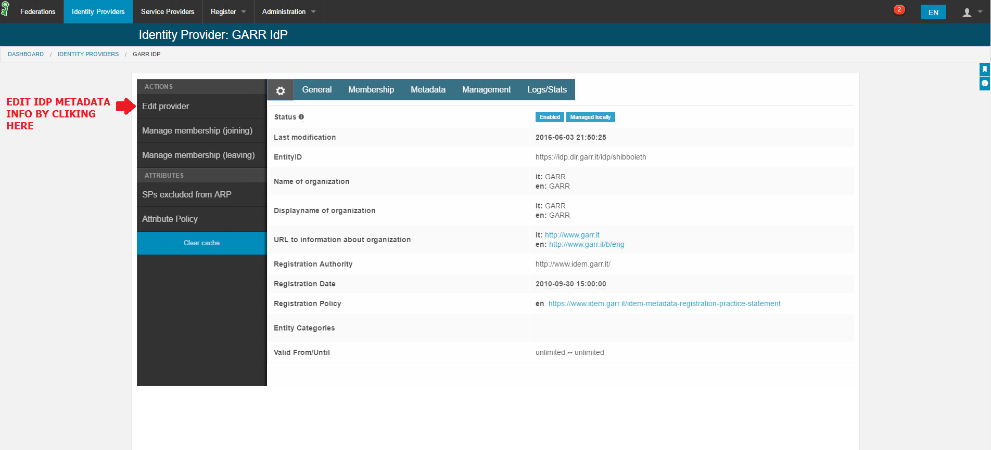
HOW TO Use the IDEM Entity Registry for creating custom ARP
STEP 2 – Declare which Entity Category will be supported by the IdP

Slide 89
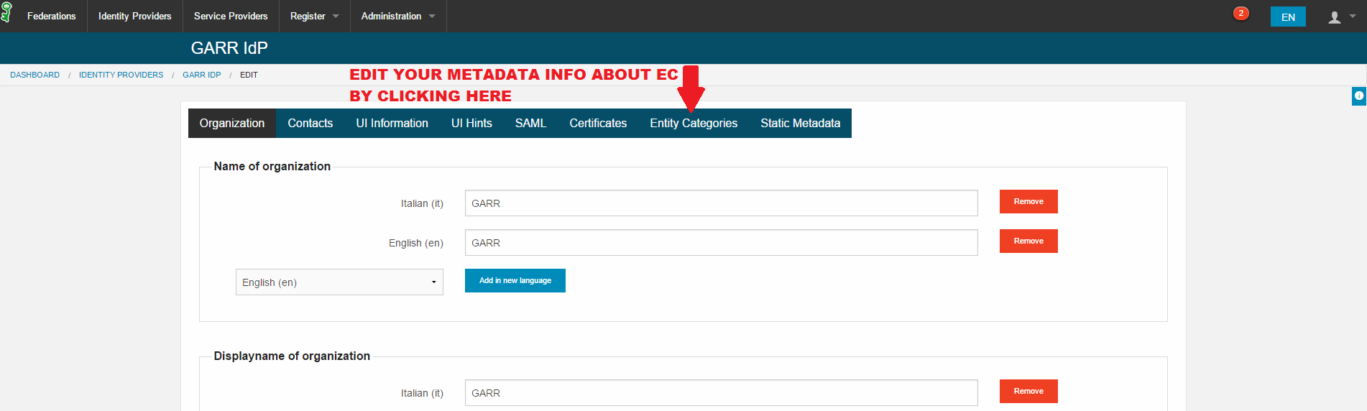
HOW TO Use the IDEM Entity Registry for creating custom ARP
STEP 2 – Declare which Entity Category will be supported by the IdP

Slide 90
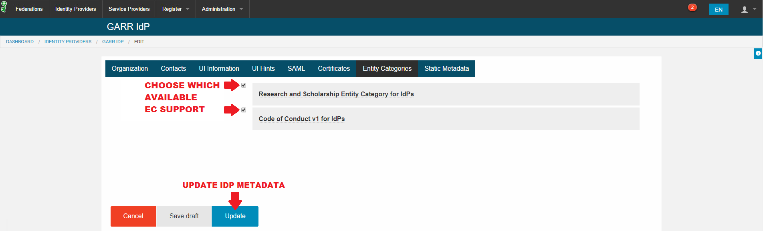
HOW TO Use the IDEM Entity Registry for creating custom ARP
STEP 2 – Declare which Entity Category will be supported by the IdP
Notes:
With the Jagger Registry you can request to support the Entity Category in a very simple way…

Slide 91
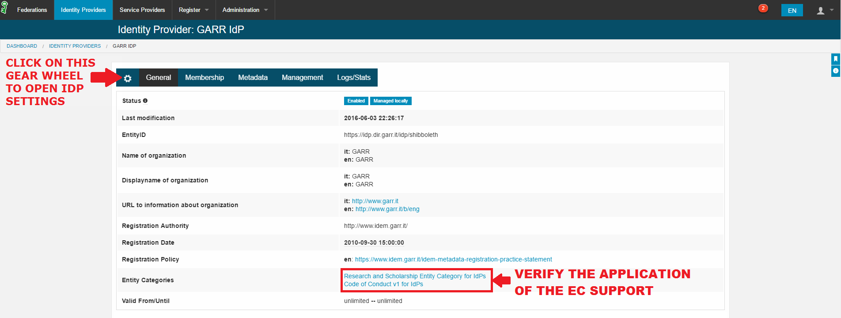
HOW TO Use the IDEM Entity Registry for creating custom ARP
STEP 2 – Declare which Entity Category will be supported by the IdP

Slide 92
eduGAIN Service Providers
1197
DP CoCo
R&S
41
91
83
eduGAIN SPs
May 2016
Notes:
We show the number of SPs we need to satisfy with our solution and how many SPs are entity categories compliant.

Slide 93
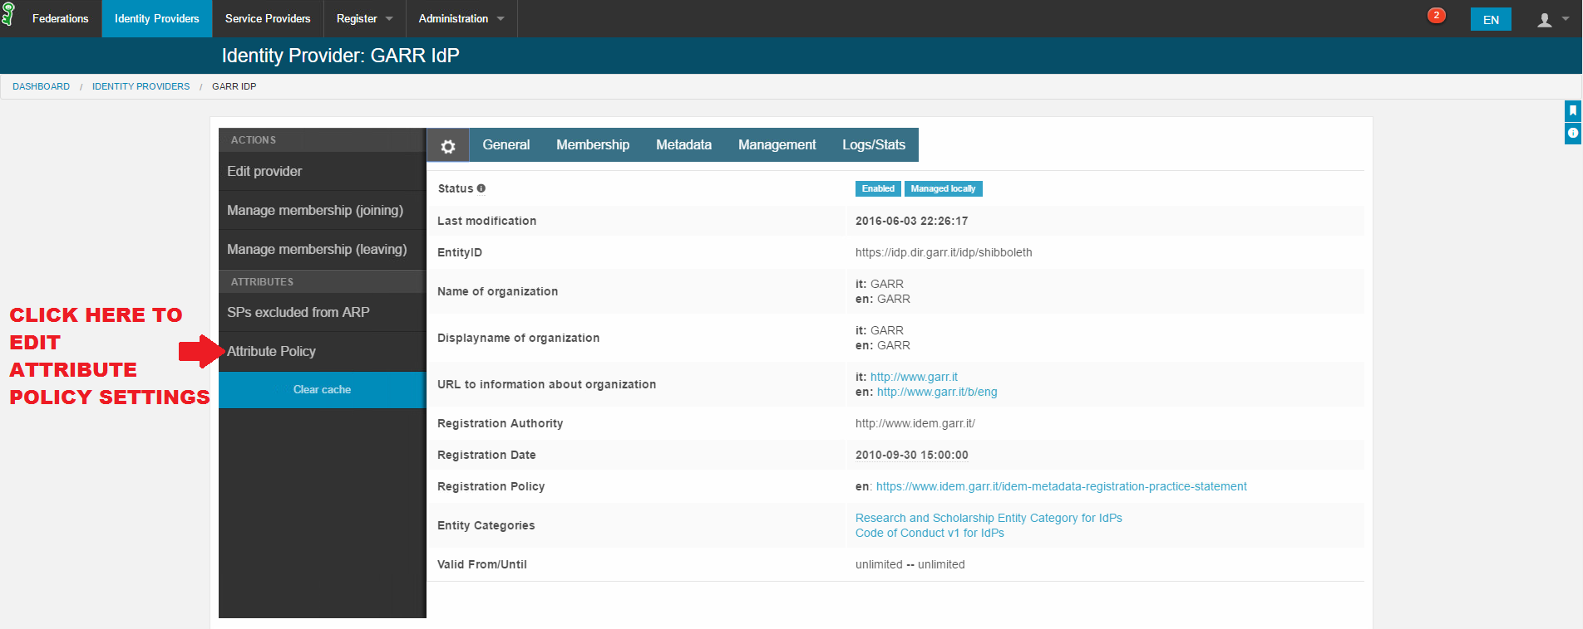
HOW TO Use the IDEM Entity Registry for creating custom ARP
STEP 3 – Declare which attributes are supported by the IdP

Slide 94
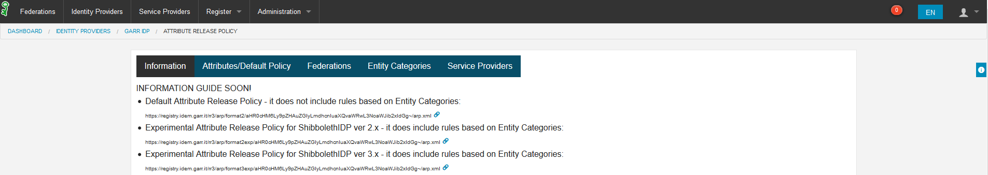
HOW TO Use the IDEM Entity Registry for creating custom ARP
STEP 3 – Declare which attributes are supported by the IdP

Slide 95
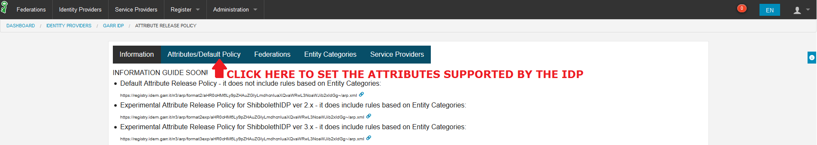
HOW TO Use the IDEM Entity Registry for creating custom ARP
STEP 3 – Declare which attributes are supported by the IdP

Slide 96
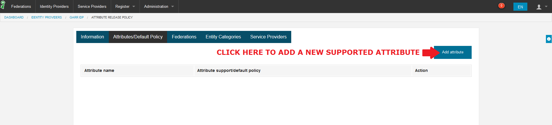
HOW TO Use the IDEM Entity Registry for creating custom ARP
STEP 3 – Declare which attributes are supported by the IdP

Slide 97
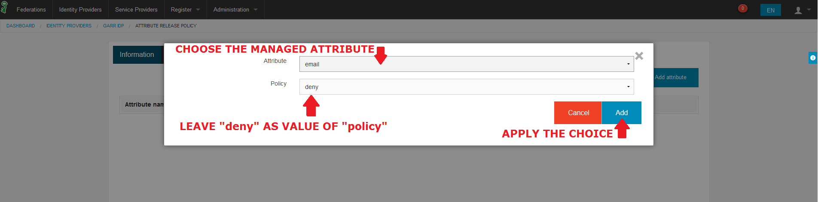
HOW TO Use the IDEM Entity Registry for creating custom ARP
STEP 3 – Declare which attributes are supported by the IdP
Notes:
… decide which attributes your IdP can manage…

Slide 98
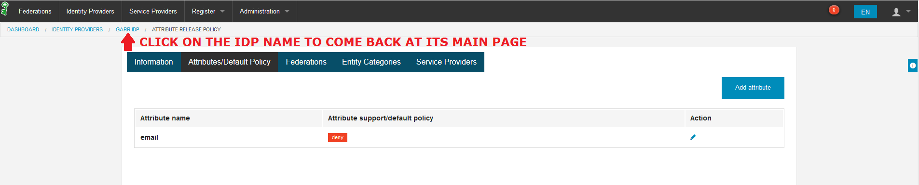
HOW TO Use the IDEM Entity Registry for creating custom ARP
STEP 4 – Set the Attribute Release Policy for SPs

Slide 99
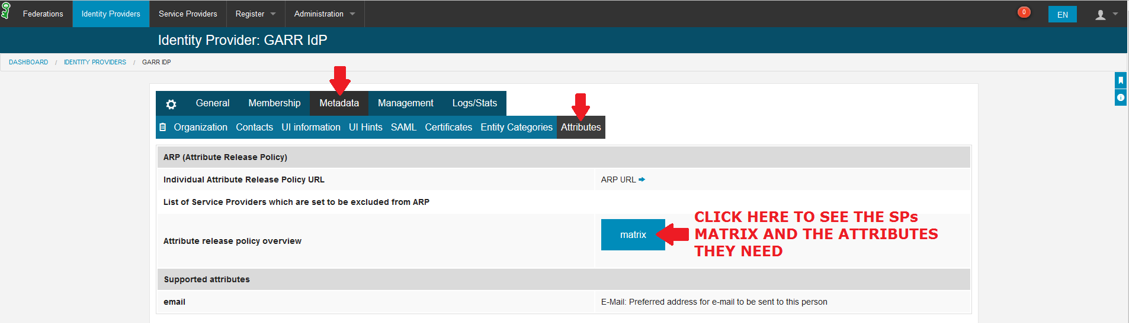
HOW TO Use the IDEM Entity Registry for creating custom ARP
STEP 4 – Set the Attribute Release Policy for SPs

Slide 100
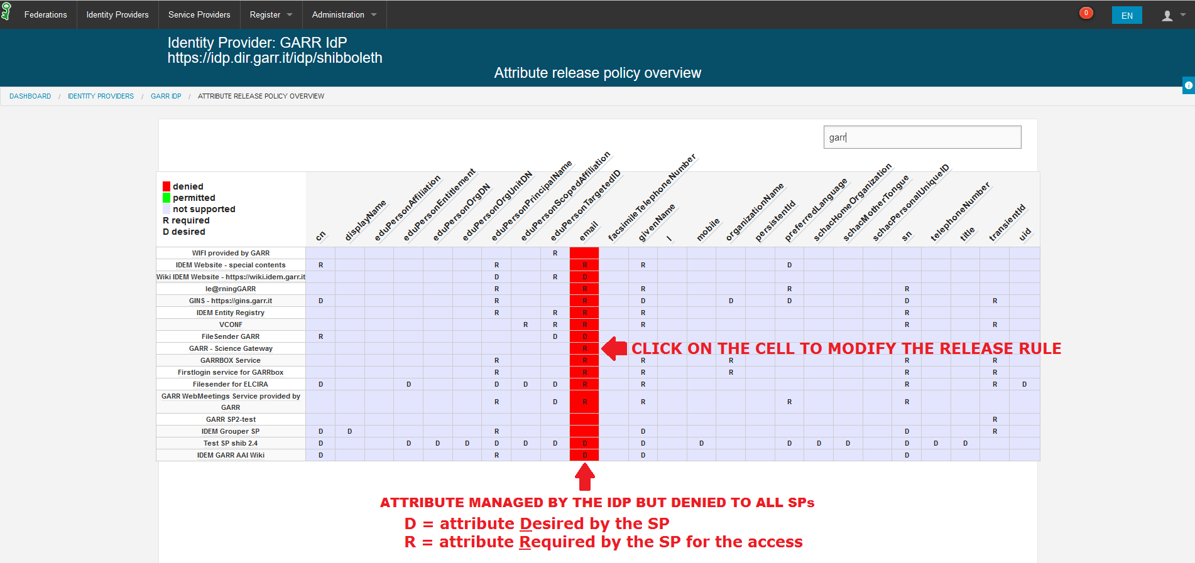
HOW TO Use the IDEM Entity Registry for creating custom ARP
STEP 4 – Set the Attribute Release Policy for SPs
Notes:
…release them to a specific resource…

Slide 101
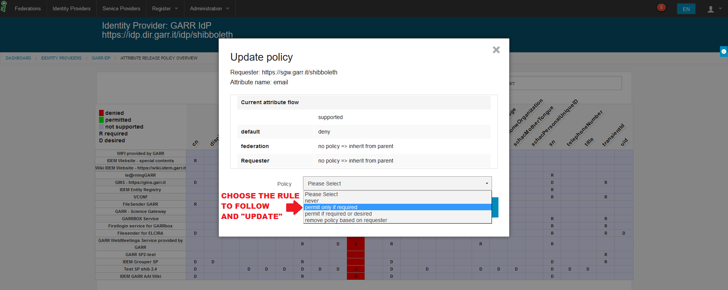
HOW TO Use the IDEM Entity Registry for creating custom ARP
STEP 4 – Set the Attribute Release Policy for SPs

Slide 102
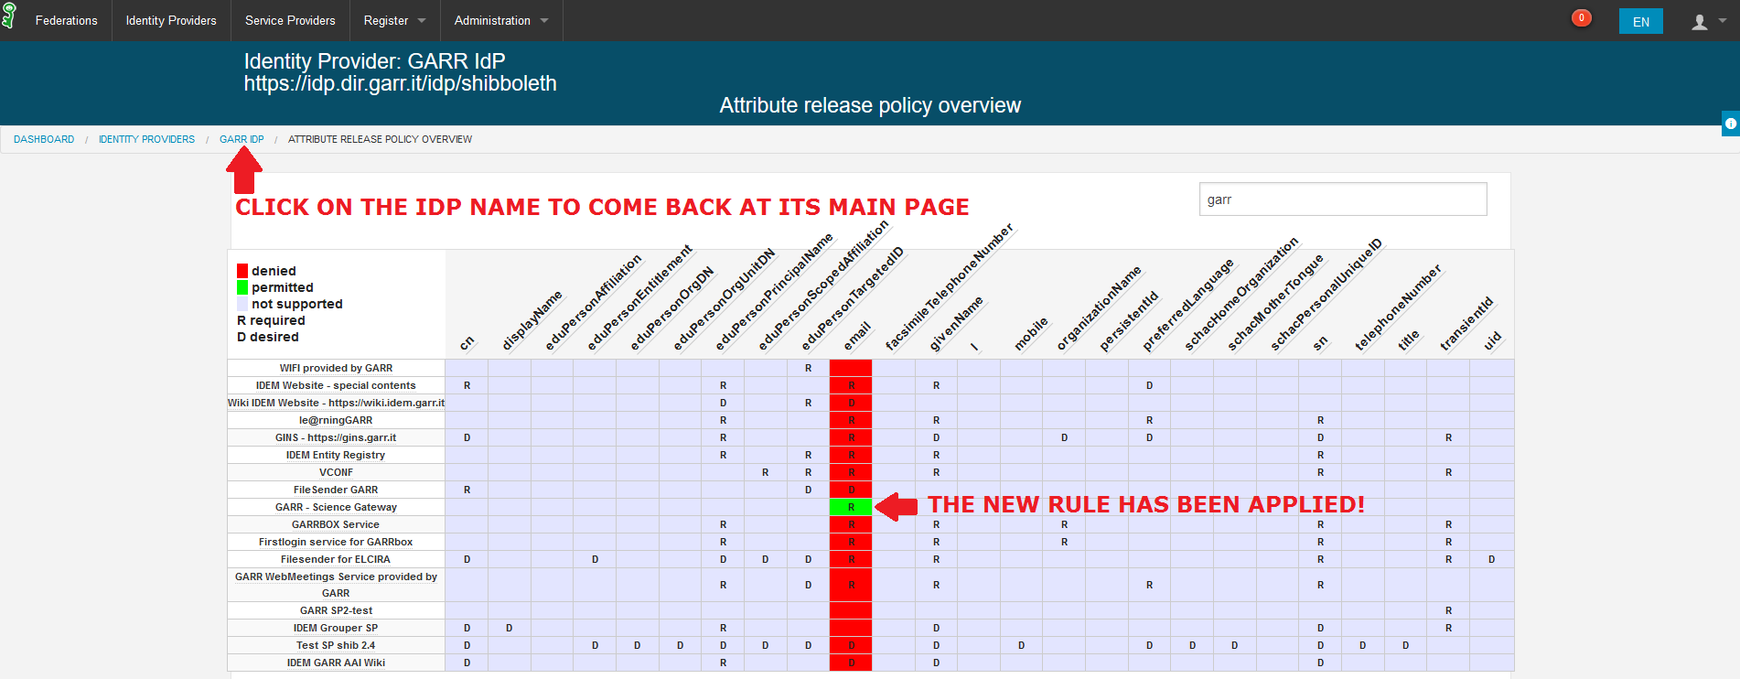
HOW TO Use the IDEM Entity Registry for creating custom ARP
STEP 4 – Set the Attribute Release Policy for SPs

Slide 103
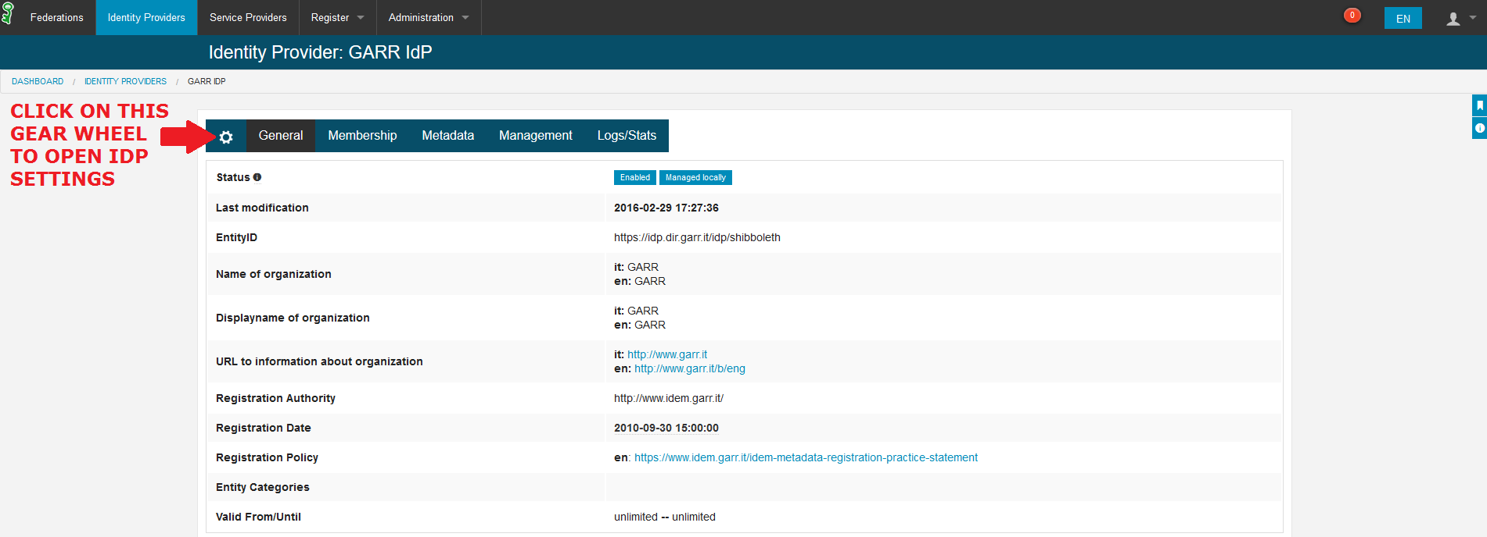
HOW TO Use the IDEM Entity Registry for creating custom ARP
STEP 5 – Retrieve the new attribute policy release by URL

Slide 104
HOW TO Use the IDEM Entity Registry for creating custom ARP
STEP 5 – Retrieve the new attribute policy release by URL

Slide 105
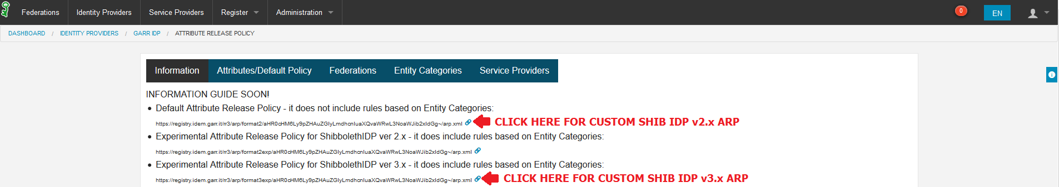
HOW TO Use the IDEM Entity Registry for creating custom ARP
STEP 5 – Retrieve and Use the new custom attribute release policy
Notes:
…and, finally, Jagger registry provides to you a ready-to-use ARP for your Shibboleth IDP!

Slide 106
HOW TO Use the IDEM Entity Registry for creating custom ARP
STEP 5 – Retrieve and Use the new custom attribute release policy
Add the following bean to the «services.xml» :
  vim /opt/shibboleth-idp/conf/services.xml
  <bean id="FileBackedIdemJaggerAttributeFilter" class="net.shibboleth.ext.spring.resource.FileBackedHTTPResource"
  c:client-ref="shibboleth.FileCachingHttpClient"
  c:url="### IDEM JAGGER ARP URL ###"
  c:backingFile="%{idp.home}/conf/attribute-filter-custom.xml"/>
  ...
  <util:list id ="shibboleth.AttributeFilterResources">
  ...
  <ref bean="FileBackedIdemJaggerAttributeFilter"/>
  </util:list>
Restart the Attribute Filter Service of the Shibboleth IdP:
  cd /opt/shibboleth-idp/bin
  ./reload-service.sh –id shibboleth.AttributeFilterService
  (as indicate on “conf/services.properties” the refresh time for attribute filter service is set to 15 minutes)
Notes:
We take care of our IDP Managers by providing them detailed instructions and configurations to put them in the condition to avoid any other manual operation on the IdP ARP files.
By adopting this instructions an IdP will be able to manage its ARP with a comfortable GUI and leave the IdP ARP configuration file unchanged.
The new rules provided by Jagger will be retrieved every 15 minutes as indicated from shibboleth framework as default value.

Slide 107
Conclusion
By using attribute release policy with rules based on the Entity Categories defined before, it is possible to answer correctly and quickly to the attribute requests coming from the federated resources without change the configurations on your own IdP.
By using a tool like Jagger to create a custom attribute release policy, it is possible to answer correctly and quickly to the attribute requests coming from the federated resources not yet R&S or CoCo compliant without changing the configurations on your own IdP, but only acting on the GUI provided by Jagger. (90% of eduGAIN SPs)
By using a tool like Jagger to create a custom attribute release policy, the IDP Manager, and hence the institution, maintains the authoritative role on the release of the attributes to those resources that are not yet R&S or CoCo compliant.
Using a tool like Jagger becomes more difficult meet syntax mistakes when you create a custom ARP and its GUI makes all easier.
Using a tool like Jagger becomes easy the research and the discovery of the new available resources.
Notes:
We have found some considerations about the solution proposed to convince our IdP Managers on the adoption and to make easier their life and the life of their helpdesks.

Slide 108
Credits
Chris Phillips (CANARIE)
Brook Schofield (GÉANT)
Ann Harding (SWITCH)
Uros Stevanovic (KIT)

Slide 109
marialaura.mantovani@garr.it
simona.venuti@garr.it
marco.malavolti@garr.it

