Slide 1
Workshop: AARC Training:
Defining a training module for scalable attribute release in federation and interfederation
Maria Laura Mantovani, Simona Venuti, Marco Malavolti,
Irina Mikhailava
NA2, AARC
GARR, GÉANT
TNC2016, Prague
16 June 2016

Slide 2
Introduction & Goals
I love federated access.
  Federated access is an essential mechanism for efficient, safe and secure access to shared resources and services.
  Can others (IdPs, SPs, users, research collaborations, e-infrastructures) say the same?
Federations look after federated access
  Identity federations ensure that federated access runs smoothly and seamlessly for the user.
  Federations have not completed their job (Does someone remember Brook’s eduGAIN KPI?)
Notes:
Today here in majority we are federation operators. For this reason, in an homogeneous group, we often see primarily the positive and common aspects, the positive things that we share, what we have in common. So we all love federated access because we all know that federated access delivers a lot of benefits. And we are all aware of these benefits.
For us, federation operators, Federated access is an essential mechanism for efficient, safe and secure access to shared resources and services.
But can others say the same? Can users say that they love federated access? Can SPs, research collaborations, e-infrastructures love federated access?
We, as federation operators, need to change the point of view. Are we able to dress the clothes of other subjects in order to better understand their situations? And for IdPs, are we able to dress the clothes of IdPs and understand which are all the reasons that make them not perfectly working in the eduGAIN space?
Federations look after federated access. This statement for now is a wish. Is a wish that Identity federations ensure that federated access runs smoothly and seamlessly for the user.
We know that Federations have not completed their job that consist in easing the user experience with federated access.
Users sometimes don’t find their IdP or sometimes face unexpected errors.
SPs would like to reach all their users but they find that many of them are homeless. In other cases SPs experience an insufficient care in charge of IdPs. Does someone remember Brook’s presentation at the last GÉANT symposium about Key Performance Indicator of eduGAIN?
These KPI are…

Slide 3

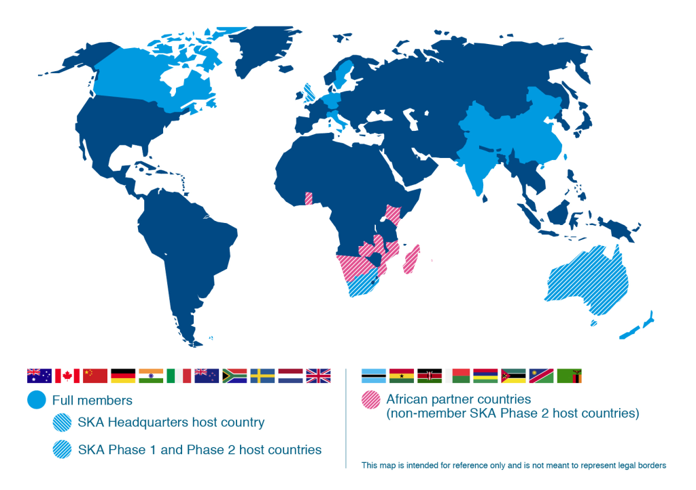

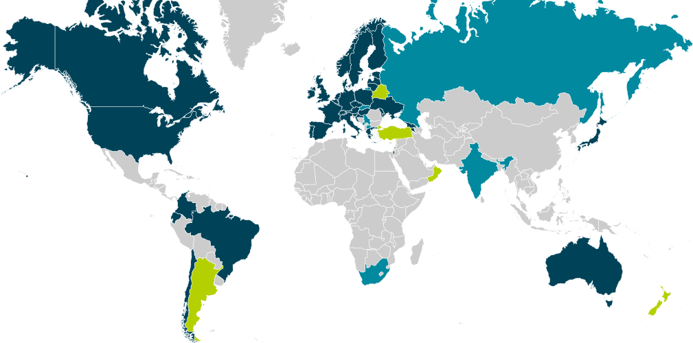

Slide 4
Campaigns for “eduGAIN works”
100% of the federations
Does it talk with “friends”?
Is the entity in eduGAIN?
Matches security practices?
CoCo and R&S
Does it release attributes?
0.3
0.5
0.7
1
Notes:
The KPI are:
We need all the nations in eduGAIN. 38/196 = 20% ; 61/196 = 31%
well if your federation is in eduGAIN we suppose that the weight of the federation is 1
We need all the entity in eduGAIN. Does your Federation register in eduGAIN as IdPs all the relevant institutions? If not your federation don’t count for 1, but for less.
If some of the IdPs of a federation, registered in eduGAIN, don’t exchange metadata with friends in the correct way, the weight of your federation fall down again.
The same if IdPs don’t match security practeces.
Lastly your federation loose further weight if your IdPs don’t release attributes and dont support CoCo and R&S
So weight of federations in eduGAIN today is still very low.

Slide 5
Introduction & Goals
I love federated access.
  Federated access is an essential mechanism for efficient, safe and secure access to shared resources and services.
  Can others (IdPs, SPs, users, research collaborations, e-infrastructures) say the same?
Federations look after federated access
  Identity federations ensure that federated access runs smoothly and seamlessly for the user.
  Federations have not completed their job (Does someone remember Brook’s eduGAIN KPI?)
The main issue currently perceived is:
  Service providers and research collaborations experience a poor/insufficient attribute release that could deny access to federated resources.
All this may lead to a belief: eduGAIN doesn’t work
Notes:
The main issue currently perceived by SPs, research collabborations, e-infrastructures is a poor/insufficient attribute release that could deny access to federated resources.
If we really believe that Federations must look after federated access, we, as federation operators, are called to do something to fix the problem. We think that we cannot stay waiting that our users, our SPs, our IdPs come to us and tell us their problems, we need to do something to prevent their problems, their issues.

Slide 6
Introduction & Goals
Encourage federation operators (not only people present here) to be more pro-active toward the identity providers registered in their federation
  Pro-active means: provide configurations, tools, trainings, audits, support, raise the level of requirements.
  In the specific:
    Encourage the use of a Federation Registry in order to help setting up Entity Category support
    Encourage the use of a Federation Registry in order to ease the ARP definition for the IdP Manager
Notes:
These are the Goals of this day and the goal of the material of the training that we will present in a while.
We are encouraging a proactive behavior of the federation operator. A fed op that takes the initiative, that makes the first step.
This encouragement is addressed to you that are present here, so you can think at you, at your federation, if this proactive behavior is feasible.
In the same time we are asking you also to think to other federations that are not present here, maybe we ask you to think to those federations that need help increase the level of their performance.
The pro-active behavior is meant toward identity providers. We need more IdPs in eduGAIN to reach more users, we need IdPs well configured, we need IdP that release attribues.
So be proactive for a federation operator means provide configurations, tools, trainings, audits, support, raise the level of requirements to join the federation.
In the specific, for the attribute release issue, we
Encourage the use of a Federation Registry in order to help setting up the Entity Category support
Encourage the use of a Federation Registry in order to ease the ARP definition for the IdP operator for SPs outside the ECs, that are the 90% of SPs in eduGAIN.
Today we will propose you a training package that you, as federation operator, could use to deliver a training to your identity providers. We are seeking for feedback on the usefulness of this training for you, for your federation, and for federations in general, especially the ones that are not present here.
And the last thing that we will ask you is to give us suggestions and comments in order to improve this training. We will collect the comments here today and in the next days via email.
The active role of the federation operator
Usefulness of the material for the federations
Feedback about the material

Slide 7
eduGAIN Service Providers
1197
DP CoCo
R&S
41
91
83
eduGAIN SPs
May 2016
Notes:
We show the number of SPs we need to satisfy with our solution and how many SPs are entity categories compliant.

Slide 8
Introduction & Goals
Encourage federation operators (not only people present here) to be more pro-active toward the identity providers registered in their federation
  Pro-active means: provide configurations, tools, trainings, audits, support, raise the level of requirements.
  In the specific:
    Encourage the use of a Federation Registry in order to help setting up Entity Category support
    Encourage the use of a Federation Registry in order to ease the ARP definition for the IdP Manager
seek feedback on usefulness for Federations in general (not only for you, also for less skilled federations) of the proposed training package to support Identity Providers in the attribute release process
Seek feedback for improvements of the proposed training package (will be collected here and in the future via email)
Notes:
These are the Goals of this day and the goal of the material of the training that we will present in a while.
We are encouraging a proactive behavior of the federation operator. A fed op that takes the initiative, that makes the first step.
This encouragement is addressed to you that are present here, so you can think at you, at your federation, if this proactive behavior is feasible.
In the same time we are asking you also to think to other federations that are not present here, maybe we ask you to think to those federations that need help increase the level of their performance.
The pro-active behavior is meant toward identity providers. We need more IdPs in eduGAIN to reach more users, we need IdPs well configured, we need IdP that release attribues.
So be proactive for a federation operator means provide configurations, tools, trainings, audits, support, raise the level of requirements to join the federation.
In the specific, for the attribute release issue, we
Encourage the use of a Federation Registry in order to help setting up the Entity Category support
Encourage the use of a Federation Registry in order to ease the ARP definition for the IdP operator for SPs outside the ECs, that are the 90% of SPs in eduGAIN.
Today we will propose you a training package that you, as federation operator, could use to deliver a training to your identity providers. We are seeking for feedback on the usefulness of this training for you, for your federation, and for federations in general, especially the ones that are not present here.
And the last thing that we will ask you is to give us suggestions and comments in order to improve this training. We will collect the comments here today and in the next days via email.
The active role of the federation operator
Usefulness of the material for the federations
Feedback about the material

Slide 9
THE FEDERATION OPERATOR’S ROLE

Slide 10
The IDEM use case
IDEM also has done nothing until May 2016 to push entity category support for IdPs
and the result was that 0 IdPs support R&S and 0 IdPs support DP_CoCo
On the other hand we have begun to promote EC towards SPs and the result is that 7 SPs support R&S and 12 SPs support DP_CoCo
FedOps involvement care!

Slide 11
FedOps involvement care!
https://technical.edugain.org/entities
SWITCHaai and InCommon have done a lot
IdP CoCo-support from Switch = 33 (100% !!!)
IdP R&S-support from Switch = 33 (100% !!!)
IdP R&S-support from InCommon = 39 (9%)
  Why InCommon IdPs don’t support DP_CoCo?
All the rest of eduGAIN, not su much
IdP DP_CoCo-support from eduGAIN-Switch = 41 (2%)
IdP R&S-support from eduGAIN-Switch-InCommon = 36 (1,7%)
  (from only 9 federations. 4-5 per federation on average)
Of 38 federations in eduGAIN, 27 of them don’t have IdPs that support R&S and CoCo EC (73%)
Notes:
Seems that 2 Federations have done a lot of work with their IdPs. The situation about the 2 EC (R&S and CoCo) federation per federation can be monitored on the site https://technical.edugain.org/entities

Slide 12
How the FedOps can take care of their IdPs?
=> An active role of Federation Operators is needed in order IdPs support R&S and CoCo EC
IDEM delivered the training to their IdPs on the 7th of June
  40 people attended in presence + 70 via streaming
IDEM wants to measure inside the Federation, after pushing and helping for support the 2 categories, which will be the result after 1 year.

Slide 13
Differences between Mesh and H&S federations with respect to the attribute release
Mesh
H&S (easier issues)
In the following for H&S only some hints will be provided
eduGAIN Federations (38, 7 without enough information)
Hub & Spoke Federations (5) | Mesh Federations (26)
 | Mainly Shibboleth (22) | Mainly SimpleSAMLphp (4)
SURFconext(The Netherlands) - SIR!(Spain) - TAAT(Estonia) - WAYF(Denmark) - AAI@EduHr(Croatia) | AFIRE(Armenia) - AAF(Australia) - ACOnet(Austria) - Belnet(Belgium) - CaFe!(Brazil) - Canadian Access Federation(Canada) - COFRe(Chile) - eduID.cz(Czech Republic) - HAKA!(Finland) - Fédération Éducation-Recherche(France) - DFN AAI(Germany) - GRNET(Greece) - eduId.hu(Hungary) - Edugate(Ireland) - IDEM(Italy) - GakuNin(Japan) - PIONIER.Id(Poland) - RCTSaai(Portugal) - SWAMID(Sweden) - SWITCHaai(Switzerland) - InCommon(U.S.) - UK federation(United Kingdom) | LAIFE(Latvia) - LITNET FEDI(Lithuania) - eduID Luxembourg(Luxembourg) - ArnesAAI Slovenska izobraževalno raziskovalna federacija(Slovenia)
Notes:
This trining is targeted to federations where the main deployment type of IdPs is based on the Shibboleth framework
In Mesh Federation

Slide 14
A Proactive Federation Operator
Provide Home Organisations with a value proposition and trainings about R&S and DP_CoCo support in order to clarify which are the benefits of releasing attributes and move out of fear about legal implications.
Setup the federation registry (Jagger)
Define the workflow to be adopted in order to add the ECs-support to IdPs and advertise IdPs of this procedure (will see in the training)
If necessary, provide with paperwork and/or registry functions in order to make IdPs able to declare to support Entity Category
Notes:
Provide to o provide with si può dire in entrambi i modi. Io preferisco with.

Slide 15
A Proactive Federation Operator
Help the IdPs by providing a correct set of configuration file for attribute releasing
Define a Default Attribute Release Policy that an IdP have to follow for releasing the minimal set of mandatory attributes decided by the federation and provide the IdPs with a skel or working example or template
Provide a working configuration for releasing the correct attributes for R&S and CoCo SPs in eduGAIN
Train the IdPs on the registry usage in order to create any other specific Attribute Release Policy

Slide 16
Proposal for Federations: central distribution of filters and registry usage
Federation can choose to use:
Default ARP:
  Default Federation ARP: attribute filter that releases a very small set of attributes to all resources and allows to use only few essential federation resources.
EC ARP:
  R&S EC ARP: attribute filter that implement the rules established for all resources compliant with Research and Scholarship entity category.
  CoCo EC ARP: attribute filter that implement the rules established for all resources compliant with Code Of Conduct entity category.
Registry ARP:
  Custom IdP ARP: An IdP Manager maintains the decisional power to release or not the attributes to the SPs by building his attribute filter with the help of IDEM Entity Registry.
Notes:
Finally we drive the IdP on the implementation of the federation solution studied that was based on:
A Default ARP that implement the rules for the mandatory attribute requested by the federation to be called «member»
The R&S and CoCo EC ARP that implement the rules for the attribute needed to support to be a member of the R&S and CoCo community.
A Custom IdP ARP generated with the help of Jagger that implements the rules for those resources that didn’t join in the R&S and/or CoCo community.

Slide 17
marialaura.mantovani@garr.it
simona.venuti@garr.it
marco.malavolti@garr.it

