Slide 1
What will the Sirtfi trust framework change for FIM4R?
Hannah Short, hannah.short@cern.ch

Slide 2
Background
A Security Incident Response Trust Framework for Federated Identity
Need for common trust framework
  Enable coordination of security incident response
  Vector of attack grows more inviting as magnitude of federated networks increases
Self assertion
  Practical compromise
  Possible extension to peer assessment

Slide 3
What will Sirtfi change?
Impact on FIM4R Communities
Trust
Support
Responsibility
Self Audit
We need partners within FIM4R to pilot this framework!

Slide 4

Federated incidents
Compromised account from Identity Provider (IdP) accesses external Service Providers (SPs)
Could be intra-federation, or inter-federation
Malicious actor is able to penetrate the network and take advantage of the lack of coordinated incident response
SP
IdP
IdP
IdP
SP
SP
Compromised
IdP
SP
SP

Slide 5
It all seems like common sense…
SP
IdP
SP notices suspicious jobs executed by a handful of users from an IdP
Notifies IdP
IdP identifies over 1000 compromised accounts
IdP identifies all SPs accessed
Notifies SPs
SP
SP
SP

Slide 6
But without Sirtfi…
Small IdP may not have capability to block users, or trace their usage
!
SP
IdP
SP notices suspicious jobs executed by a handful of users from an IdP
Notifies IdP
X
IdP identifies over 1000 compromised accounts
IdP identifies all SPs accessed
!
Large SP does not share details of compromise, for fear of damage to reputation
X
X
Notifies SPs
X
SPs are not bound to abide by confidentiality protocol and disclose sensitive information
SP
SP
No security contact details!
!
!
SP

Slide 7



Trust
There will be a higher level of trust for Sirtfi-compliant organisations. These participants will be more likely to grant and be granted access to shared resources.
Before Sirtfi
After Sirtfi
eduGAIN Token
SP
Access restricted to critical SPs
SP
SP
SP
User from non Sirtfi’d IdP
eduGAIN Token
SP
SP
May be granted to some basic SPs
eduGAIN Token
User from Sirtfi’d IdP

Slide 8
Support
Sirtfi-compliant organisations will be able to draw on support from each other in the event of an incident. Bridging federations and identifying required expertise will be facilitated.
Before Sirtfi
After Sirtfi
Can we get accurate logs to track the incident within our community?
IdP
Who can we trust with sensitive information?
Sirtfi-compliant IdP
<ContactPerson contactType=“security”>
<EmailAddress>security@myidp.org</EmailAddress>
</ContactPerson>
<SirtfiCompliance status=“asserted” />
Who should we notify?
Can we count on a response for urgent incidents?

Slide 9

Responsibility
Sirtfi-compliant organisations must be able to comply with support obligations in the event of a security incident. Individuals should be identified at each participating organisation and be aware of expectations.
Before Sirtfi
After Sirtfi
To: security@myidp.org
From: panic_stations@mysp.org
Urgent! User found submitting malicious jobs – please investigate!
To: security@myidp.org
From: panic_stations@mysp.org
**TLP AMBER – Limited distribution allowed **
Urgent! User found submitting malicious jobs – please investigate! Details below…
To: panic_stations@mysp.org
Cc: security@myidp.org
From: hero@myidp.org
**TLP AMBER – Limited distribution allowed **
Absolutely– I’m on rota this week, account blocked and we are investigating. Attaching relevant logs and will keep you updated.

Slide 10


Self Audit
Sirtfi-compliant organisations will be required to complete periodic self assessments to analyse their incident response capability. Security contact information must be accurately represented in metadata and be verified during staffing and business reorganisation.
Before Sirtfi
Has anyone thought about security?
After Sirtfi
Logs
Contact Point
AUP
Staffing change?

Slide 11
What’s next?
Potentially RFC
LoA requirements
Finalisation of metadata elements
  Security contact elementhttp://www.slideshare.net/jbasney/saml-security-contacts
  Sirtfi compliance element
Tool for assessing/managing Sirtfi compliance attribute
Sirtfi v 2.0
  Requirement to notify Sirtfi partners
  Alerting mechanism

Slide 12
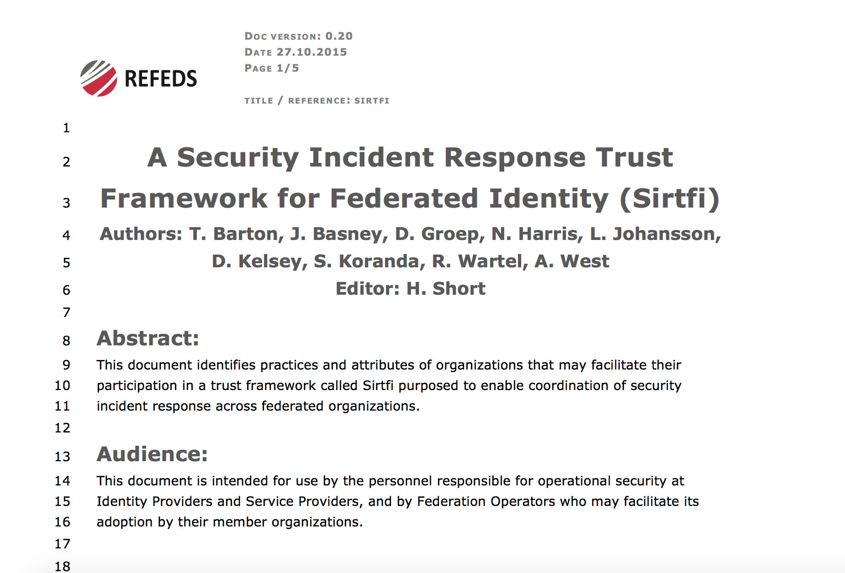
Sirtfi status
Consultation closes on December 8th
https://wiki.refeds.org/display/CON/SIRTFI+Consultation%3A+Framework
Comments welcome!

Slide 13
Appendix: Sirtfi assertions

Slide 14
Operational security
[OS1] Security patches in operating system and application software are applied in a timely manner.
[OS2] A process is used to manage vulnerabilities in software operated by the organisation.
[OS3] Mechanisms are deployed to detect possible intrusions and protect information systems from significant and immediate threats
[OS4] A user’s access rights can be suspended, modified or terminated in a timely manner.
[OS5] Users and Service Owners (as defined by ITIL [ITIL]) within the organisation can be contacted.
[OS6] A security incident response capability exists within the organisation with sufficient authority to mitigate, contain the spread of, and remediate the effects of a security incident.

Slide 15
Incident response
[IR1] Provide security incident response contact information as may be requested by an R&E federation to which your organization belongs.
[IR2] Respond to requests for assistance with a security incident from other organisations participating in the Sirtfi trust framework in a timely manner.
[IR3] Be able and willing to collaborate in the management of a security incident with affected organisations that participate in the Sirtfi trust framework.
[IR4] Follow security incident response procedures established for the organisation.
[IR5] Respect user privacy as determined by the organisations policies or legal counsel.
[IR6] Respect and use the Traffic Light Protocol [TLP] information disclosure policy.

Slide 16
Traceability
[TR1] Relevant system generated information, including accurate timestamps and identifiers of system components and actors, are retained and available for use in security incident response procedures.
[TR2] Information attested to in [TR1] is retained in conformance with the organisation’s security incident response policy or practices.

Slide 17
Participant responsibilities
[PR1] The participant has an Acceptable Use Policy (AUP).
[PR2] There is a process to ensure that all users are aware of and accept the requirement to abide by the AUP, for example during a registration or renewal process.

Slide 18
Questions?
hannah.short@cern.ch

