Slide 1
2019: The New PRACE Website
Marjolein Oorsprong
PRACE aisbl

Slide 2
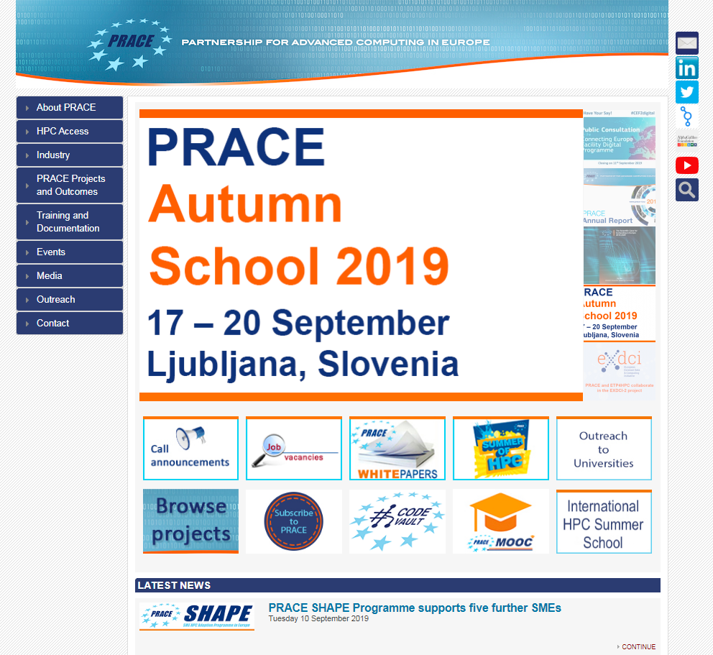
Comprehensive Re-design & Development of www.prace-ri.eu
Grown organically from a project-focussed website
“I want it all and I want it now”
Several attempts at improvement already (back-end, front-end)
Notes:
www.prace-project.eu
Back-end > from SPIP to WordPress
Front-end > Menu structure & homepage
More balanced publication process > not just those who shout the loudest get the exposure

Slide 3
Comprehensive Re-design & Development of www.prace-ri.eu
Supplier found via a simplified tendering process
It all took a very long time…
Notes:
Start PRACE-5IP January 2017, end April 2019…
Working with Insight Media Group from UK
Unclear as to which process PRACE should follow
No previous experience in PRACE (aisbl) to handle such a tender
Difficulty to outline technical requirements (no time for pre-discussions with potential suppliers)

Slide 4

Comprehensive Re-design & Development of www.prace-ri.eu
Live, but hidden, work in progress: https://prolinktrials.co.uk/prace/
The new website is planned to go live on 1 October 2019
Notes:
Delayed from 2 September 2019

Slide 5
Comprehensive Re-design & Development of www.prace-ri.eu
The new website will clearly present:
  What PRACE is and does
  Information on accessing HPC
  Useful resources for PRACE users – documents, guides, training materials, etc.
  Getting involved with PRACE – events

Slide 6
Comprehensive Re-design & Development of www.prace-ri.eu
The website will be based on a more user-friendly menu structure
Two examples:
  “Resources” page will be renamed “HPC Systems”
  New menu item for “Infrastructure Support”
Notes:
Visitor-focussed instead of project-structure as leading principle

Slide 7
Comprehensive Re-design & Development of www.prace-ri.eu
The scope of this task encompasses www.prace-ri.eu with specific attention to the connection with other portals and websites, such as the PRACE Training Portal, and the HPC in Europe Portal.
The PRACE corporate branding is maintained (colours, logo)

Slide 8
Comprehensive Re-design & Development of www.prace-ri.eu
Manual migration of content, scrubbing all HTML and recompiling pages
“Easter eggs” in the current back-end
Re-writing, merging, and creation of content
Executive decisions that go beyond the website and into the PRACE Communication Strategy, Style Guide
Notes:
Delayed from 2 September 2019
Style Guide:
Aims to harmonise PRACE texts, and making proofreading easier, by providing standards such as how to write numbers (thousands, decimals), dates, brand-own names and acronyms
Together with the brand elements (logo, colours) it helps to keep the PRACE image consistent

Slide 9
HPC in Europe portal
www.hpc-in-europe.eu
http://www.infineasy.com/HPCinEU/
Conceived after the EC request for a “one-stop shop” for European HPC, and to avoid the PRACE website to become overcrowded
Notes:
One-stop-shop:
Training
Calls / Access
CoEs > Applications
FET HPC projects
Events

Slide 10
Connect | Networks & Groups
Public Awareness of Research Infrastructures (PARI)
  www.isis.stfc.ac.uk/Pages/PARI2019.aspx (most recent event)
Women in HPC
  womeninhpc.org/

Slide 11
Connect | Sign-up
PRACE mailing lists
  Info Bulletin (general PRACE News & Announcements)
  Training Bulletin
  Outreach to Universities
PRACE SIG Mailing Lists
  sig-operation@prace-ri.eu
  sig-new-tech@prace-ri.eu
  sig-industry@prace-ri.eu
  sig-application-enabling@prace-ri.eu
  sig-marcomms@prace-ri.eu
  sig-training@prace-ri.eu
Notes:
Operational-Services
New-technologies
Links-with-industry
Application-enabling-at-exascale
Training collaboration
Dissemination

Slide 12
THANK YOU FOR YOUR ATTENTION
Marjolein Oorsprong
Communications Officer
M.Oorsprong@staff.prace-ri.eu
www.prace-ri.eu
Twitter: @PRACE_RI
LinkedIn: www.linkedin.com/company/prace

