Slide 1
Jisc digital vision
Robert Haymon-Collins – Jisc executive director marketing and communications
September 2019
Notes:
The world is going digital and we must lead by example

Slide 2
Contents
Objectives, benefits and scope
Progress to date
Planned outcomes

Slide 3
Objectives, benefits and scope

Slide 4



Jisc digital vision objectives
Creating the optimum, future experience / interface for our membership and customers to interact with us
Delivering a platform to allow Jisc to expand to its future customer needs, demonstrating innovation and best practice for automation and efficiency
Delivering continual cost improvement across the business based on evidential efficiencies
Notes:
We have know our members experience a much richer, more intuitive and more sophisticated environment.
We fear the gap is growing between their experience of our offering & that of commercial providers.
We've heard loud & clear from members (surveys and voice) that they want more clearly defined offering which is tailored for their own needs.
We have a range of distributed experts offering a large number of digital interfaces across Jisc.

Slide 5
Jisc Digital Vision – Why?
For our Membership and customers:
An exceptional customer experience
A more intimate, intuitive and customisable experience with Jisc
A trusted partner for advice and best of breed services
A secure and safe partner yet flexible and accommodating
A balance between online (digital) and human contact
Feeling part of a community working towards shared goals
Service catalogue Automated billing and ordering
Predictive push technology for additional services (as per Amazon)
Service level agreements
A rich data analytics capability

Slide 6
Jisc Digital Vision – Why?
For Jisc:
A closer more intimate relationship with our membership and customers
Building a platform for Jisc to expand to it’s customer needs
A showcase of innovation and best practice in the industry
Visibility of all member contracts and products and services
More and easier opportunities for cross and upselling our services
Predictive analytics for cross and upsell opportunities
A wide source of data for analytics purposes (to sell / offer to our customers)
A scientific approach to cost saving and efficiency (demonstrating 6% return)

Slide 7
Core user journeys and themes
Themes
Personalisation
Automation
Look and feel
Subscription to and provision of services
User Journeys
Service information and management
Advice and guidance
Opinion and involvement
Notes:
Four core user journeys have been identified which will be provided online.
By structuring our work according to journeys (describing the way users access our offering), we're able to ensure we focus fully on their needs … rather then sustain a siloed experience.
For instance 'advice and guidance' has historically been separate from any purchase opportunities, we're looking at ways we a offer help, but incorporate the widest experience of our offering.
Work is guided by three themes … none of which are easy!
Introducing personalisation is not easy, but we think it will be hugely beneficial to Jisc as much as members.
Automation is tough, we're beginning to explore introducing BOTS to handle basic queries.
Look and feel … we've worked hard to cohere our corporate digital spaces, but now there's work to do to ensure we're making it easy for users to navigate.

Slide 8
Progress to date

Slide 9
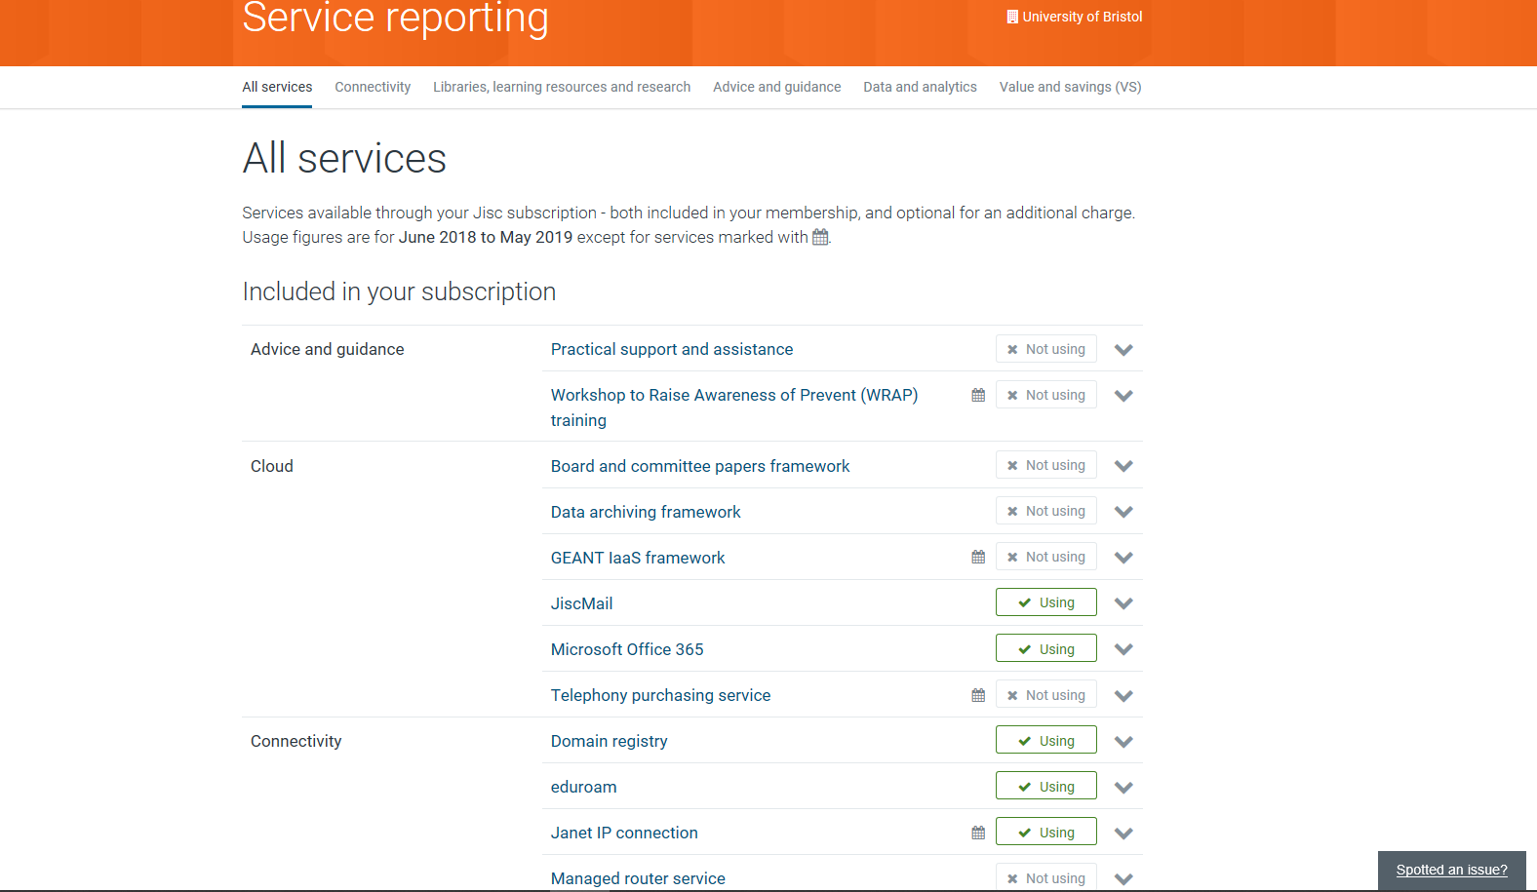
Service Readiness
Notes:
Key reports currently available on My Jisc
‘All services’ report shows the usage status of all Jisc services, both included in the relevant subscription, or optional
For services that they are not using, there are calls to action, such as, ‘start using’ or ‘subscribe to optional service’
So what?
Well this means we can have much easier conversations with members about what's on offer & what's available.
Our members like that we've made it clear what is avaialble.
We want them to appreciate that we're working in partnership to make sure they're gaining maximum value from the subsidised Jisc offering.

Slide 10
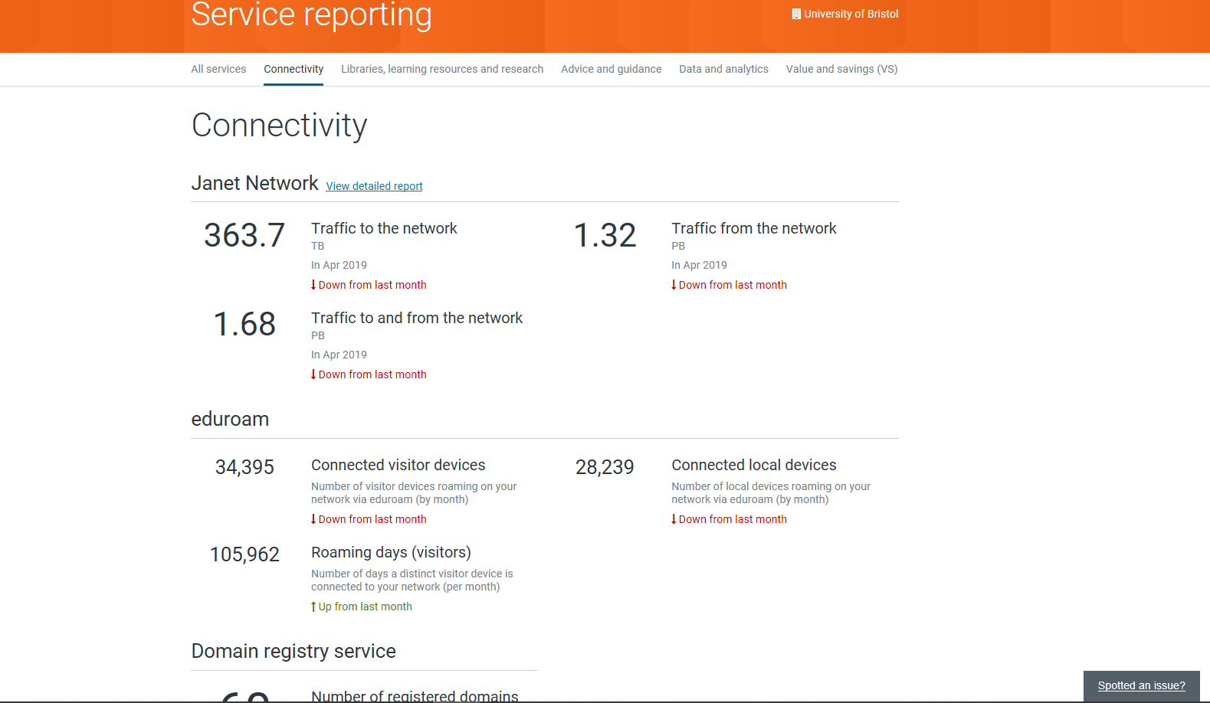
Service Readiness
Notes:
New product family usage reports, released this month
Shows headline scale usage metrics for services within our product families, such as connectivity here
Provides the next level of detail down from the All Services report – plus we also have detailed service usage reports for Janet, Jisc Collections and Ebooks for FE (Janet linked here)
We currently have 4 out of 7 product family reports
So what?
Worth nothing that technical (network & libraries) have extensive access to data behind these dashboards. For instance the cyber security portal holds live data on cyber situation.
But these views are for those leaders who manage the Jisc relationship.
In the past our members reflected that they only had a partial view to account information.
We've recently releaed functionality which enables them to download data for their own purposes … making it much easier for our members to 'make th case' for Jisc membership … something which can be challenging for some … because typically no single leader has a clear view of the significance & value of Jisc's offering.

Slide 11
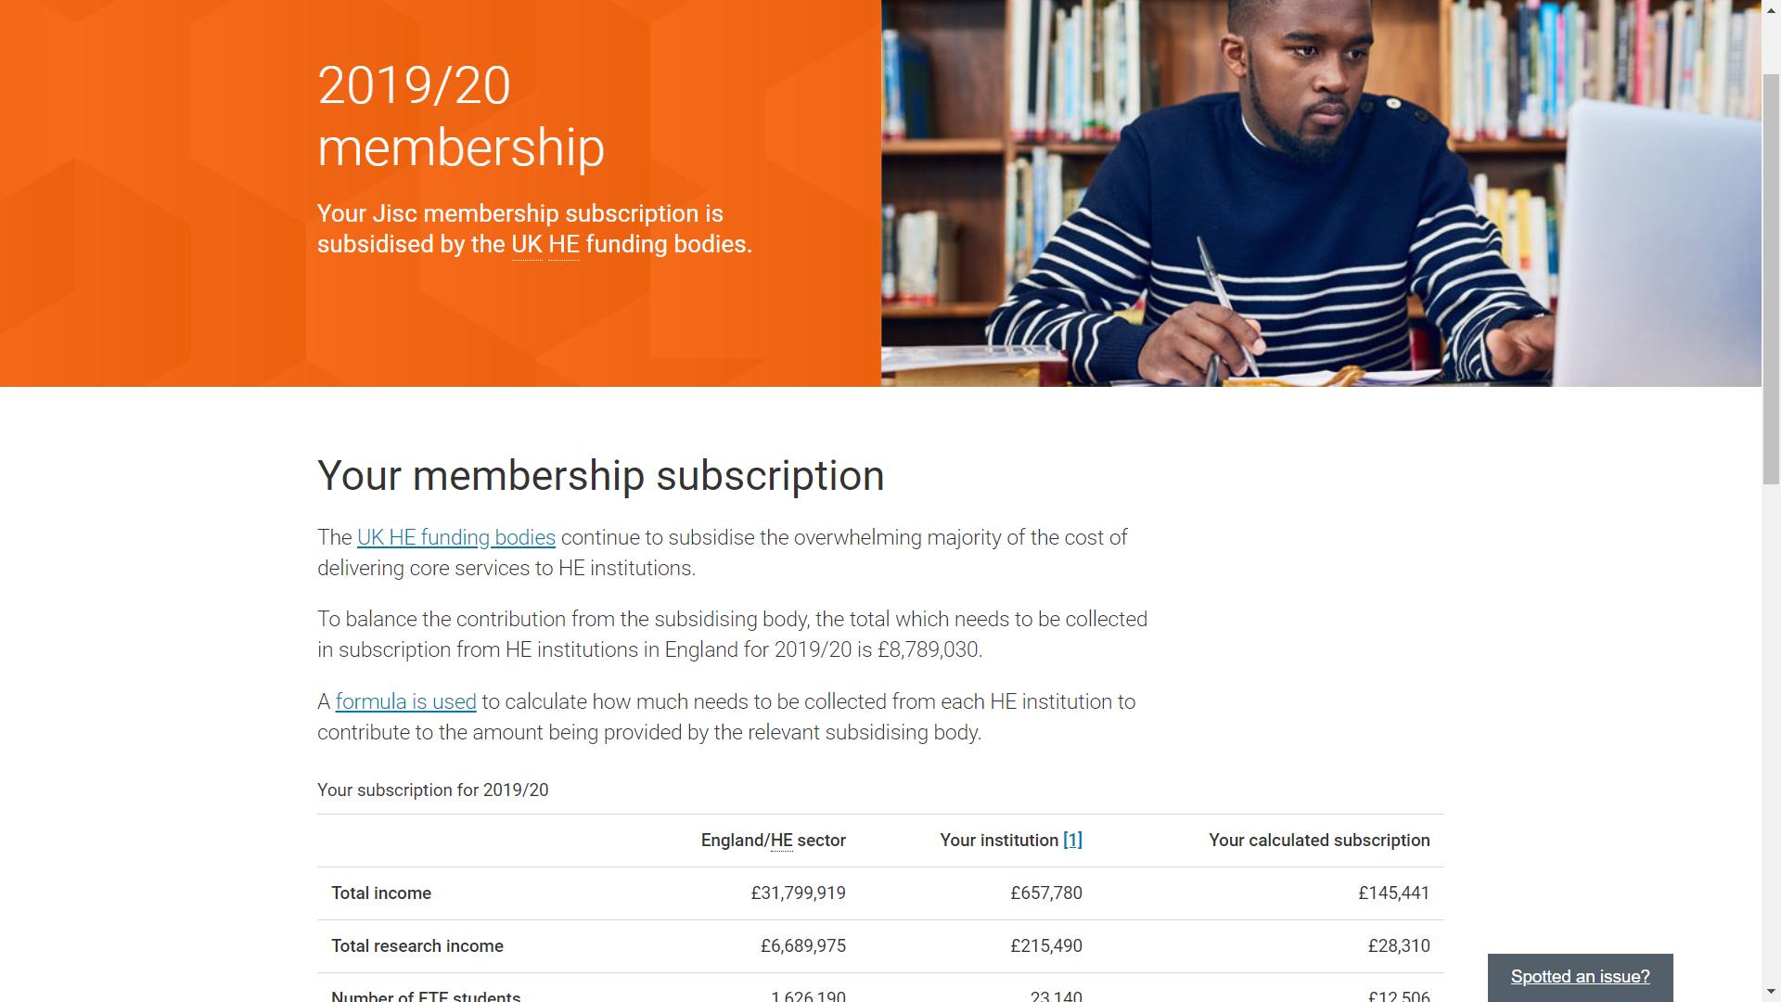
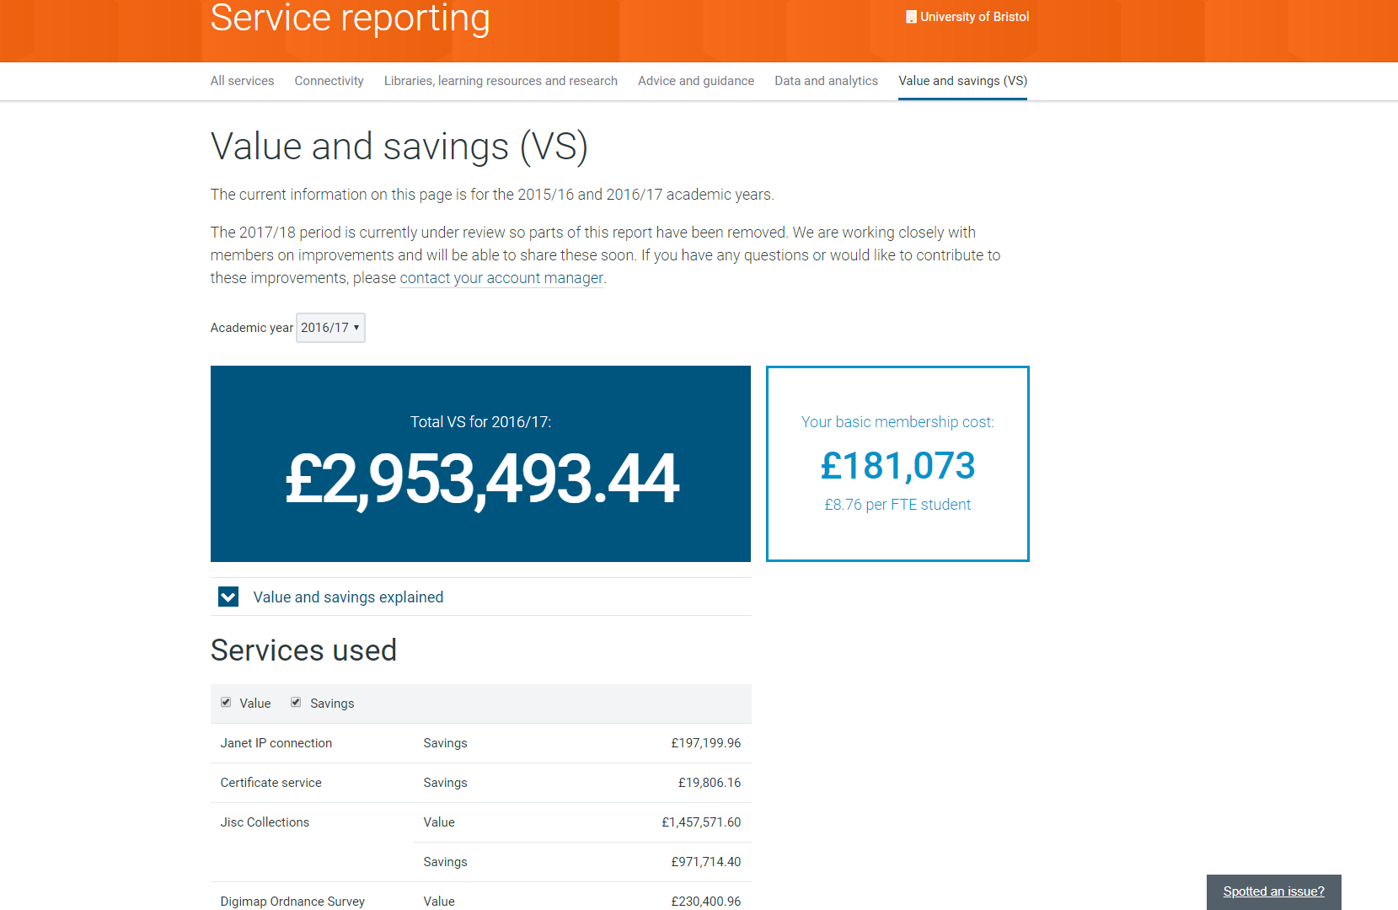
Service Readiness
Notes:
Information about their membership subscription contribution and how it is calculated.
We secured some fantastic voice from this in the last few weeks:
University of Kings College London (Not always an enthusiastic supporter of Jisc): As I say, this (HE subs letter) is the best one I have ever had from Jisc

Slide 12
Planned outcomes

Slide 13
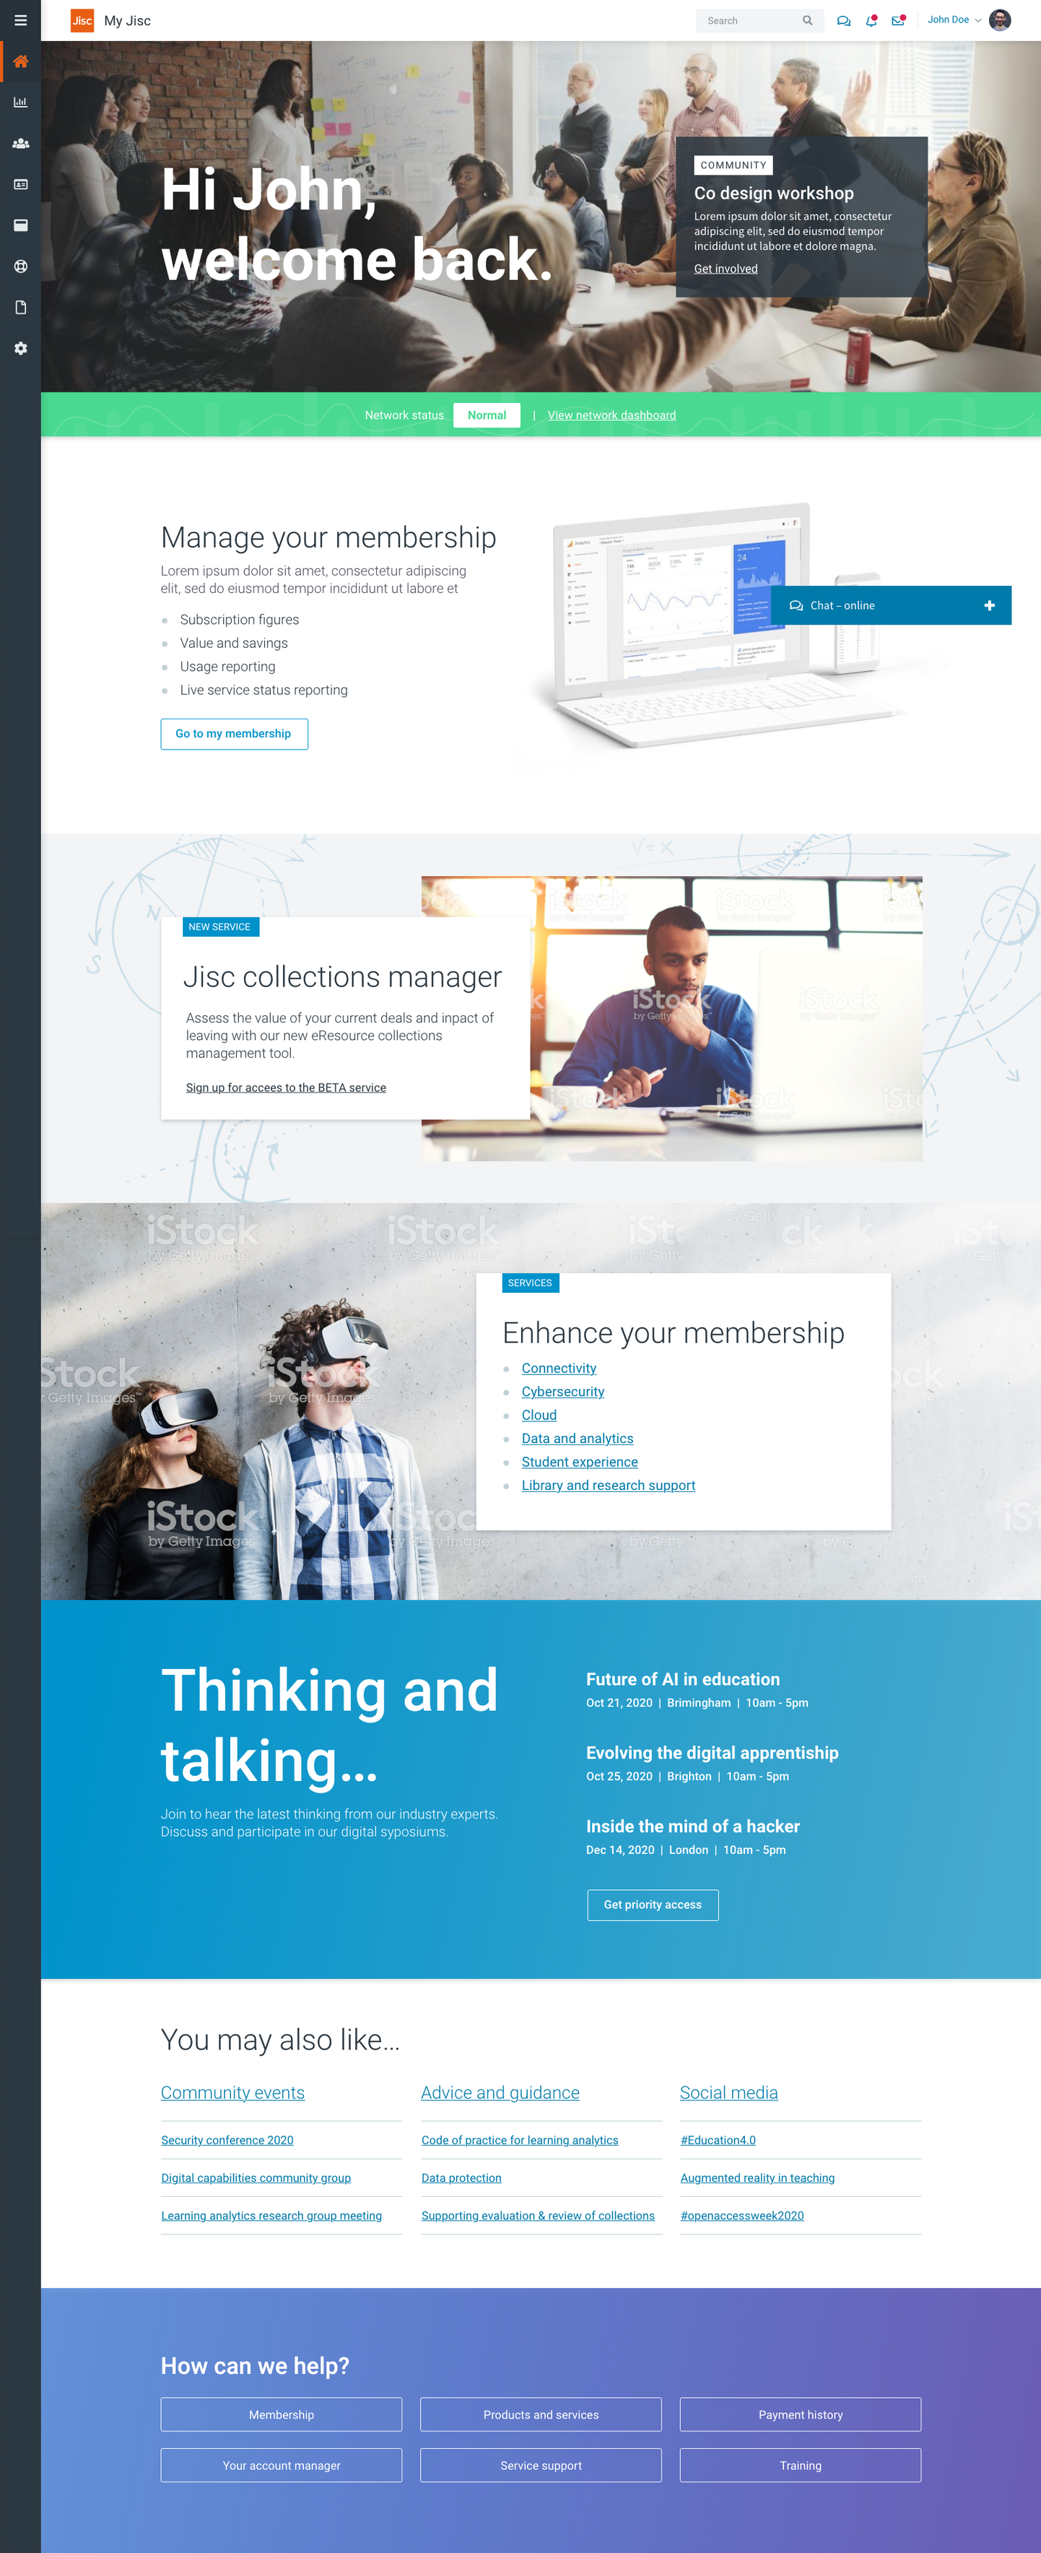
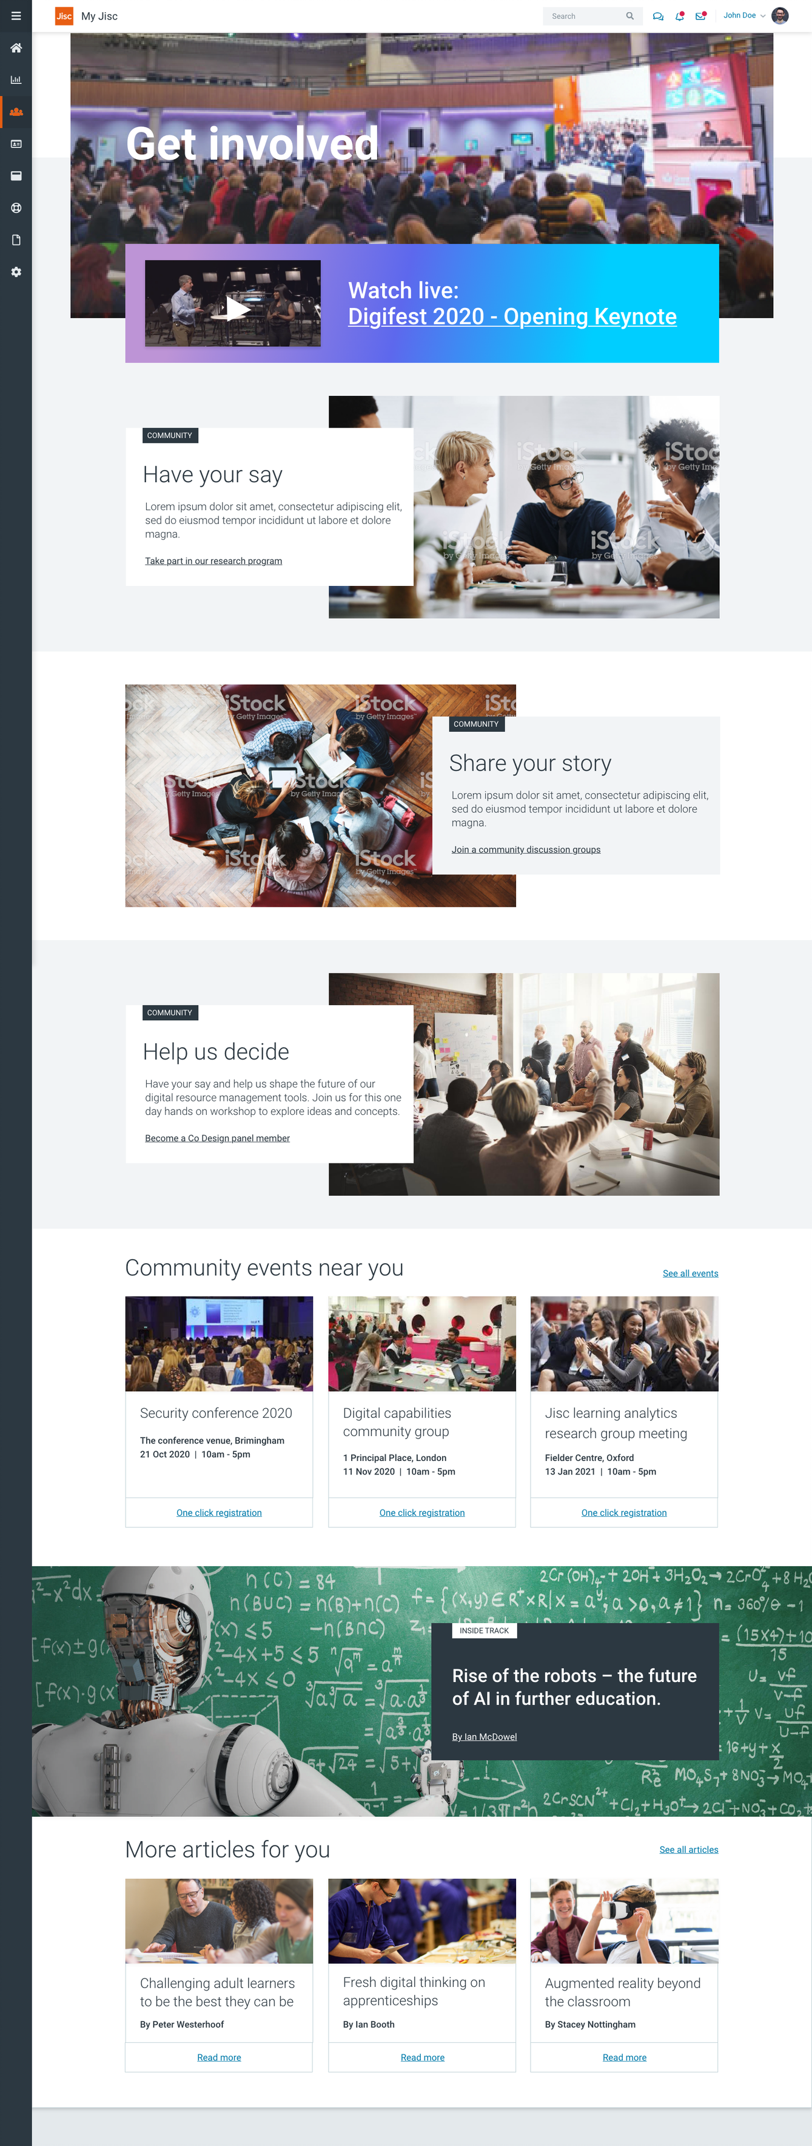
Notes:
Personalised splash page showing a relevant community event, network status and inviting them to manage their membership.
We feel the real 'added value' of Jisc membership is the facilitating role we play in the community.
We hope to bring this much more into focus for members.

Slide 14
Notes:
The community page with a Jisc Digifest exposé and invitation to get involved and provide you opinion.

Slide 15
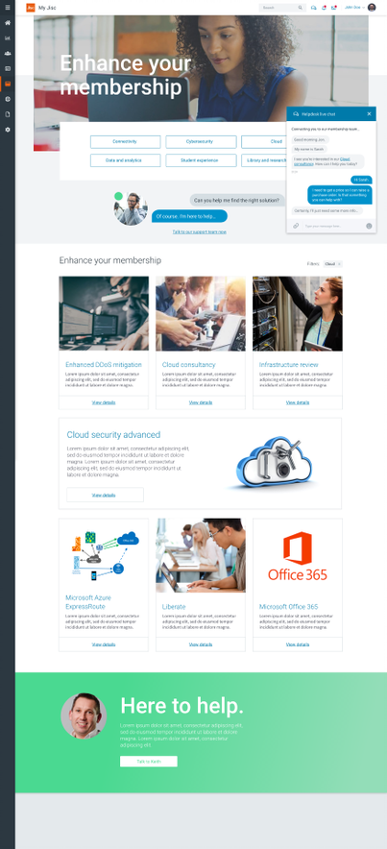

Notes:
A space to enhance your membership by finding information about the services that would benefit you with the option to utilise chat with a bot or account manager.

Slide 16
The challenges
Reliable, accurate data (especially for services)
Open/closed, free/charged for information
Personalisation that feels authentic
Cultural
  giving the member or customer what they need not what we want to
  teams working together at the same pace
  aligning with the best in the commercial sector

Slide 17
Robert Haymon-Collins
Executive director
Marketing and Communications
+ 44 7725 830007

