Slide 1
Marcomm Activities at GRENA
Tamara Gvenetadze, Marketing Manager at Grena
Tamara@grena.ge
Montpellier, France
September 17th , 2019

Slide 2
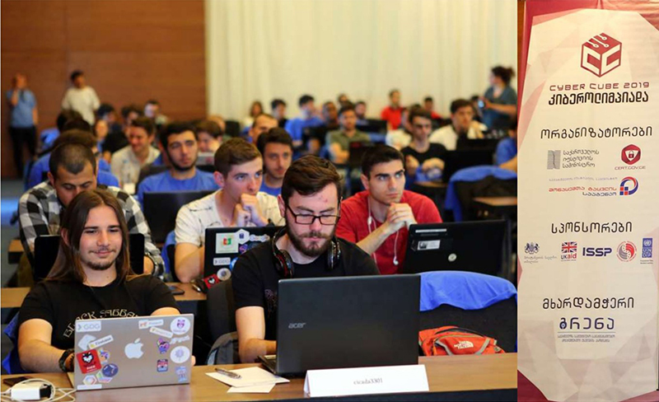
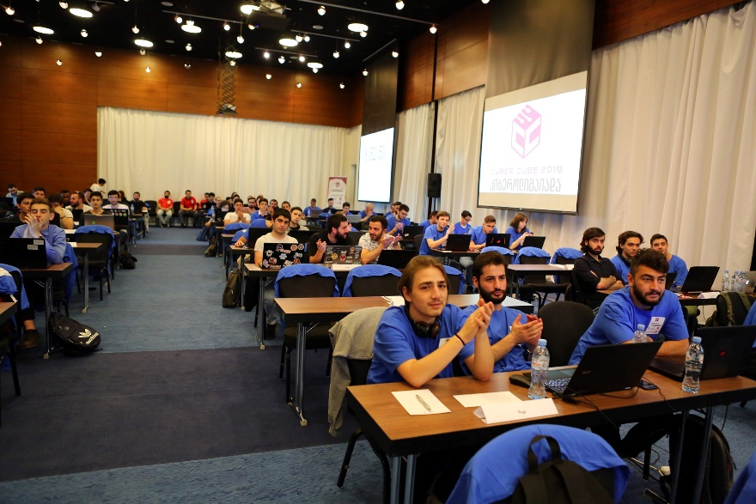
Cyber Olympiad 2019
GRENA participated in organizing of the fourth Cyber Olympiad- Cyber Cube 2019. The event was organized by the Governmental Computer Emergency Response Team CERT.GOV.GE of the Data Exchange Agency of the Ministry of Justice of Georgia. GRENA was responsible for installation and reliable operation of network and online platform.

Slide 3

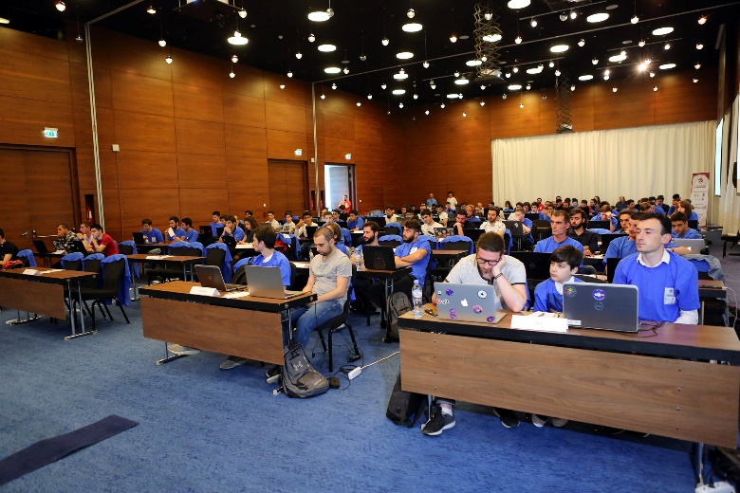
Cyber Cube 2019
Goals of Cyber Olympiad
Increase awareness of cyber security
Testing and motivating students and pupils
Discovering new talents
First Cyber exercise in Caucasus region
Using established contacts during emergency situations
Sharing knowledge during emergency situations
Implementation of unique platform

Slide 4
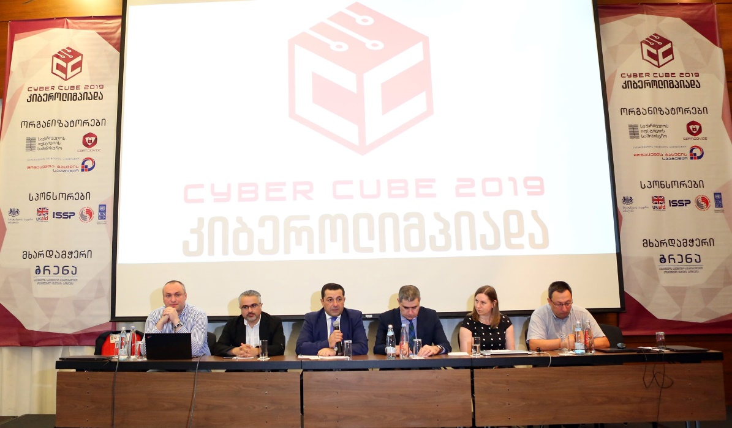

Cyber Olympiad 2019

Slide 5
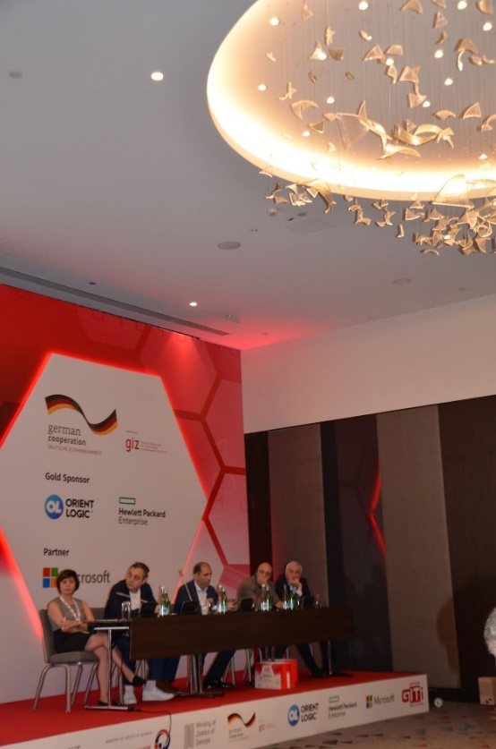
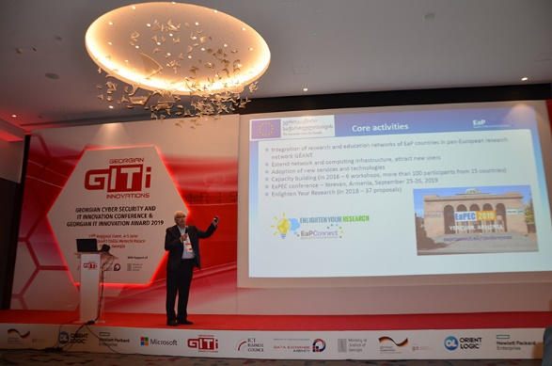
Georgian IT Innovations
Event 2019
11th Georgian IT Innovations event GITI 2019 took place in Tbilisi, Georgia. The purpose of the GITI conference is to describe the significance of information technology in terms of creating an engine of growth for socio-economic development of the region. Ramaz Kvatadze made a presentation “European Commission EaPConnect project“ at the conference.

Slide 6

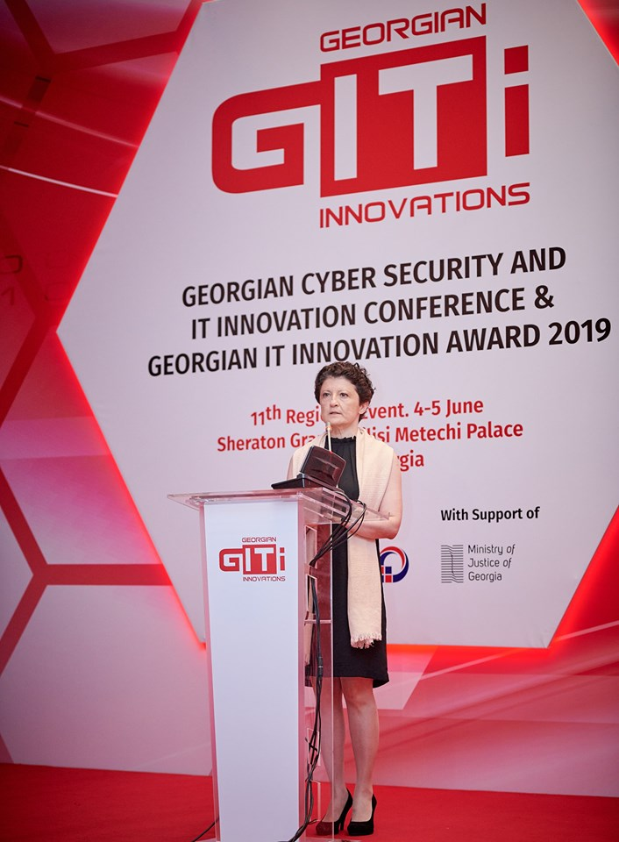
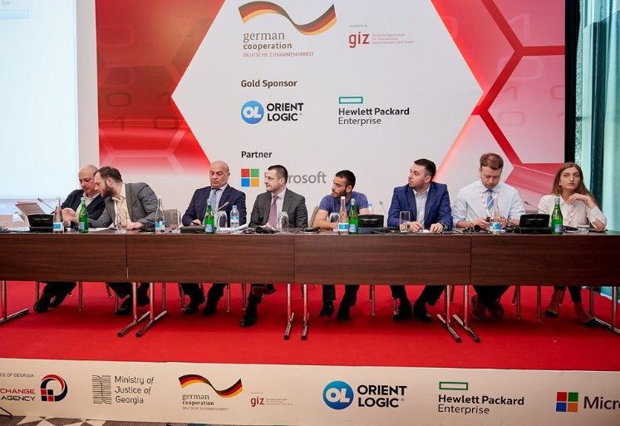
GITI 2019

Slide 7
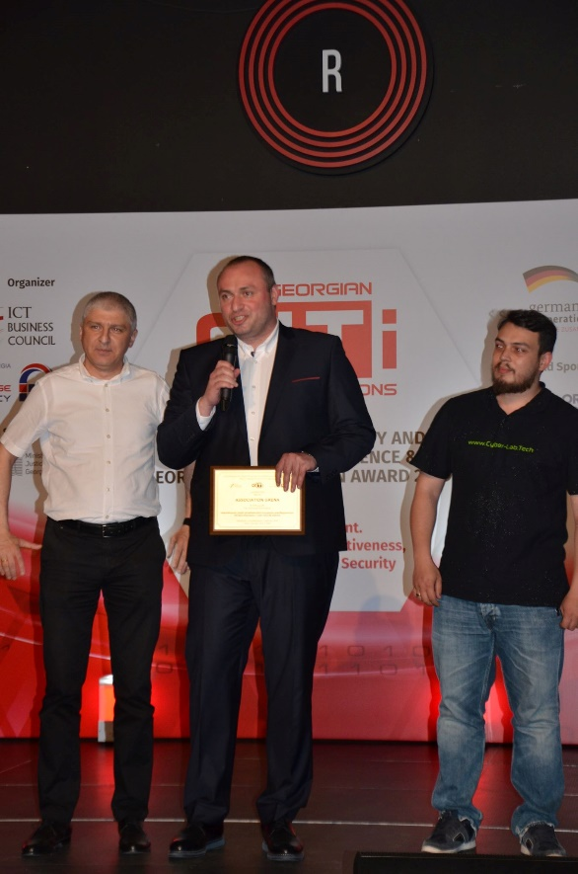
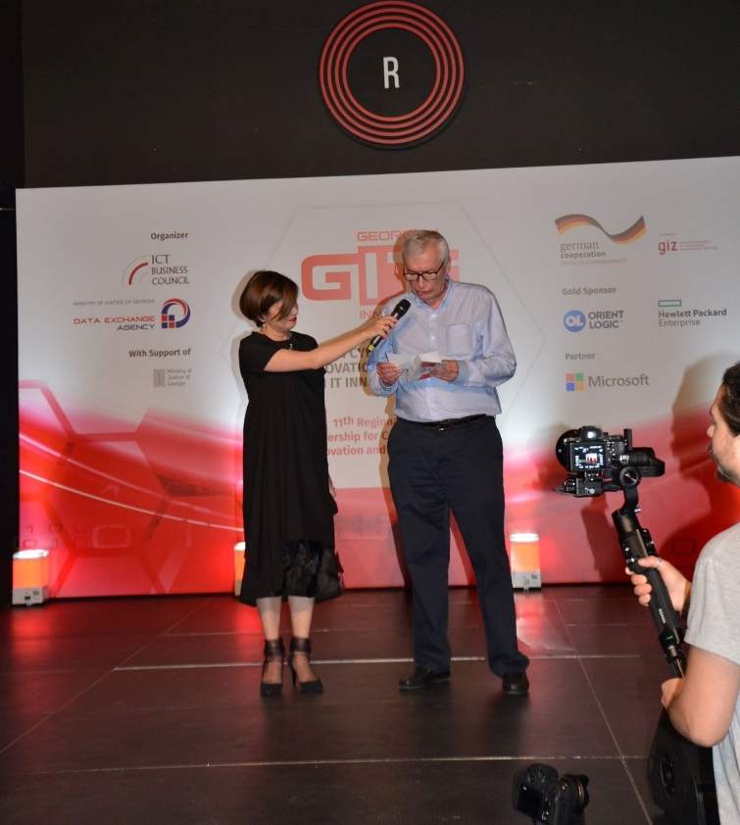
Georgian IT Innovation Award
GRENA together with the Governmental Computer Emergency Response Team CERT.GOV.GE was given Georgian IT Innovation Award in the nomination of „The Best Information/ Cyber Security Solution“ for the Cyber-Lab Tech portal https://cyber-lab.tech/ supported by the EaPConnect project.

Slide 8

Cyber Lab Tech
In cooperation with the CERT.GOV.GE Governmental Computer Emergency Response Team of the Data Exchange Agency under the Ministry of Justice of Georgia and GRENA have developed cyber exercises portal https://cyber-lab.tech/. Portal is mainly intended for Georgian IT students in order to deepen their practical skills in detecting and reacting to cyber incidents. The portal is also useful for IT professionals working in public and private sectors.

Slide 9
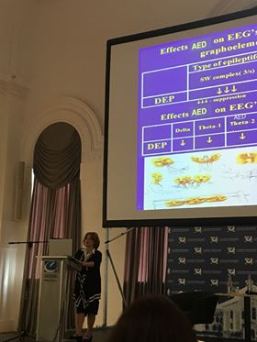
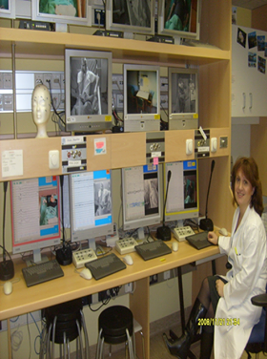
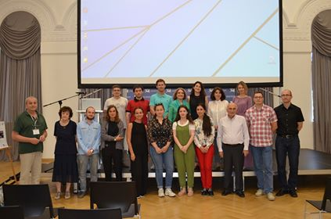
International Symposium on Neurocomputing
Advances in Brain Research
Irma Khachidze winner of the European Commission EaPConnect project Enlighten Your Research EYR@EaP2018 programme organized an International Symposium on Neurocomputing Advances in Brain Research. Association GRENA supported this research by providing technical assistance and computing resources for the establishment of an EEG online database portal EEGHUB.GE.

Slide 10
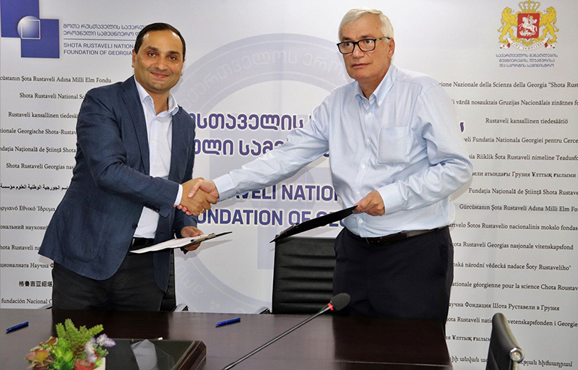
Memorandum of Understanding
Memorandum of Understanding was signed between the Shota Rustaveli National Science Foundation of Georgia and the Georgian Research and Educational Networking Association GRENA. According to the memorandum GRENA will provide the grant holders of the foundation who require high performance calculations computing and storage resources and technical support in porting their applications in Cloud infrastructure.

Slide 11
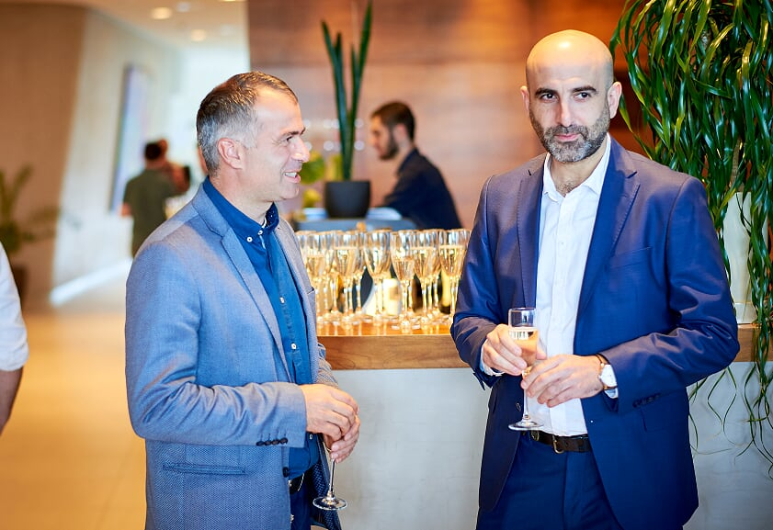
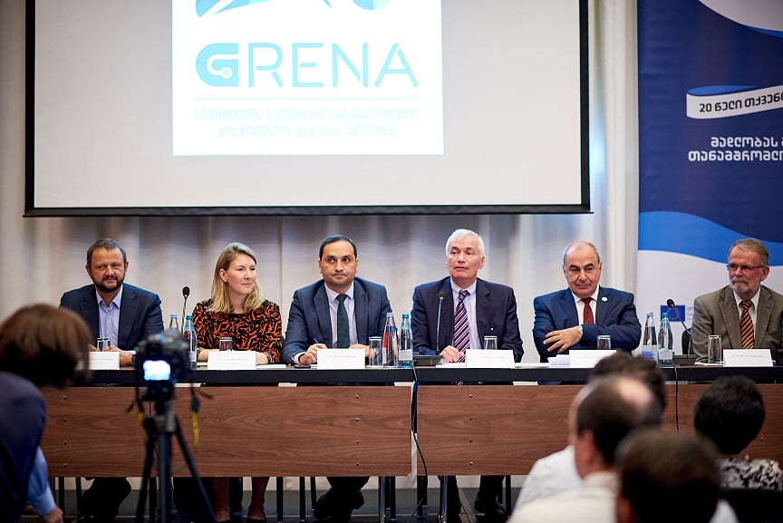
GRENA 20th Anniversary
20th anniversary of GRENA took place on September 12, 2019 and was attended by international and local research, educational and IT community members and governmental representatives.

Slide 12
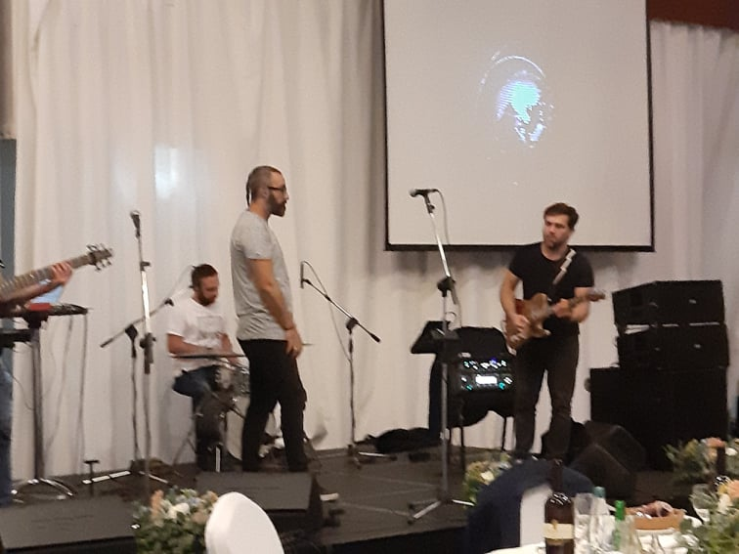
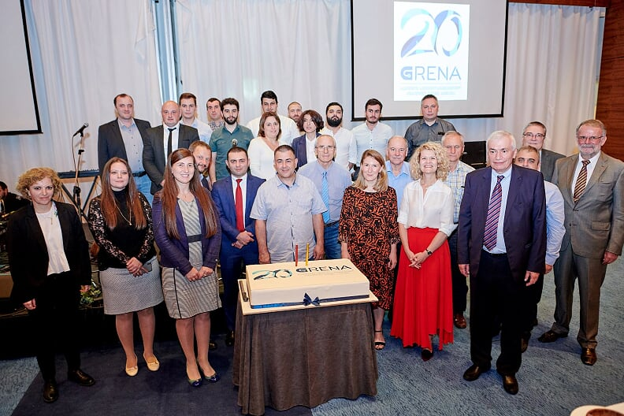
GRENA 20th Anniversary

Slide 13

Thank You For Your Attention!
Tamara@grena.ge
Montpellier, France
September, 2019

