Slide 1
RENATER’s new agile method to develop end users services
18 September 2019
Joint meeting Sig Marcomms & Sig MSP – Montpellier
Alice Thorel
Notes:
Bonjour à tous,
Merci d’assister à cette conférence
Je suis Alice Thorel, responsable marketing chez RENATER. L’équipe marketing (que vous avez pu rencontrée sur notre stand) est rattachée à la direction Relations usagers et développement, dont le directeur Jean-François Guézou est dans la salle. Notre rôle est de tisser un lien entre les activités réseau et services de RENATER et les établissements de la communauté en recueillant les besoins, comprenant les usages et les accompagnant dans leur compréhension de notre offre. C’est pourquoi nous vous proposons aujourd’hui une présentation sur comment mieux vous accompagner dans les démarches d’adoption de nos services auprès de vos utilisateurs.

Slide 2
The context has changed
The digital user
  Volatile : shorter attention
  Vocal : has more communication channels
  Connected : has more perspectives and choices
  Demanding : wants consistent communications across all channels
Speed of change
  Proliferation of new channels
  Overwhelmed with new tools
  Quick releases of new products
RENATER must adapt to follow the new rythm

Slide 3
Our solution : be agile
Improve our services
USER NEEDS
better taken into account
FREQUENT UPDATES
QUALITY AND RELIABILITY

Slide 4
Are you familiar with agile development ?

Slide 5
From ancient believes
Marketing’s perception of IT :
IT is the departement of « no »
IT doesn’t speak marketing’s language
IT isn ’t concerned with the user
IT’s perception of marketing :
Marketing = advertising
We need to break down those silos

Slide 6
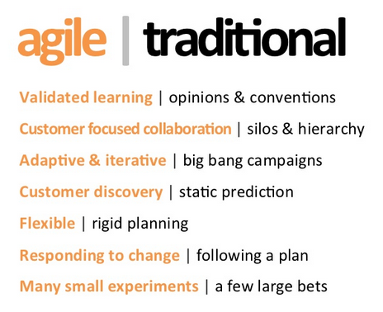
To a new state of mind

Slide 7
Has your NREN implemented an agile development ?

Slide 8
Agile organisation at RENATER
New agile « ceremonies »
Product canvas
Users Requests examination
Story Mapping
Sprint Planning
Daily Meeting
Démo
Rétro
Sprint Review
Target :
a cross functional team per service
Product Manager
Product Owner
Scrum Master
Developers
Notes:
GROOMING = Recueil / Mûrissement du besoin
Itérations successives et continues
Planning = on fixe les objectifs du sprint
Daily = Avancement et partage des problèmes
Démo en fin de sprint
A chaque itération = rétro pour amélioration continue
Test
Review = on décide de ce qui est de qualité suffisante pour partir en production
Product Manager = Vision stratégique / Recueil du Besoin / Valorisation des fonctionnalités
Product Owner = Spécification et Priorisation des Besoins lors du Planning
Scrum Master = Garant de la méthode / Facilitateur / Protection de l’équipe

Slide 9
Agile process : 5 main steps
Identifying users needs
User statement need
Realization
- IT development
Qualification
Deployment

Slide 10



Agile method : detailed steps
Recueil du Besoin
Expression du Besoin
Réalisation
Qualification
Déploiement
Global Roadmap
Satisfaction surveys
User queries
Problem detection
Opportunity
Techno watch
Technical assistance
User requests
User statement needs
PO/PM
Requests examination
PO/PM
Story Mapping
Experts meeting
PO/PM
Technical
Exploitation
Security
Legal
Supply
Sprint 1
EPIC
Version 1.0
User Story
Prod
Pré-Prod
User Story
Recommentations
Version 1.1
User Story
Sprint 2
…
Notes:
As a < type of user >, I want < some goal > so that < some reason >.

Slide 11
An iterative change at RENATER
Start : 09/2018
02/2019
05/2019
End 2020
2021
Preparation
Training
Experimentation
Sprints planning
Gradual switch
Test / process improvment
Generalization
Setting up sprints for other services
All services in agile mode
Continuous deployment
Deployement « on demand »
Tools
Process
Qualification « on demand »
Choice of tests services
Identifying users needs
Building Product Backlogs
End of current "Projects" and switch to agile mode
Continuous process improvement
"Continuous" qualification
EVENTO
UNIVERSALISTES
SOURCESUP
EVENTO
FILESENDER
PARTAGE
ANTISPAM
RDV
RENAVISIO

Slide 12
What is agile marketing ?
A challenging change :
Product positioning and portfolio management: focusing on the need redefines how we position our services
End users content : see my presentation about iterative releases of users focused content !
Definition :
A high-communication, low-documentation, rapid iteration process designed to provide more frequent, more relevant, and highly measureable marketing programs.

Slide 13
How has your NREN implemented agile development for services ?

