Slide 1
Analytics and privacy protection - Matomo
ARNES

Slide 2
Why?
Notes:
Why would you use any kind of analytics? To see what‘s the most interesting article for your visitors and what‘s the number of monthly visitors for the webpage you manage. But it‘s much more than this. It enables you to have a broader view of your webpage, to see where your visitors come from, where are they searching for you, and when are they leaving you. What devices they use, software etc. And it is extremely useful to use it when you are redesigning your webpage. To see what works and what doesn‘t work and what do you need to change.

Slide 3

Notes:
Where are you in the web ecosystem?

Slide 4
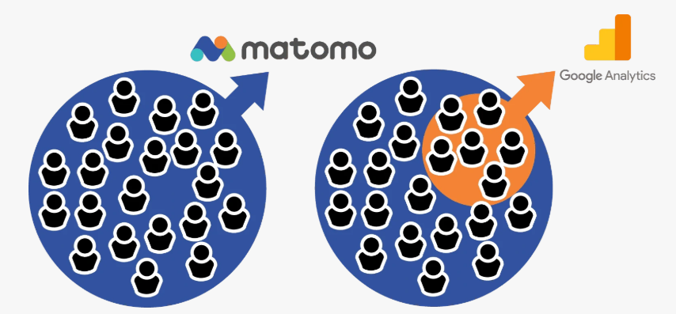

WHY
Free, opensource
Translated into 54 languages
PRIVACY
Anonymized, aggregated data
Complete control over your data
Cookies (2013 changes in ZEKom-1 and a cookie policy)
Notes:
Google Analytics standard version is free of charge. The only “cost” is your data shared with Google. And if you have huge numbers of visitors you can analyze only a portion of them or pay for a 360 version.
Matomo, formerly known as Piwik is a free and open source analytics that is gaining popularity and is a good alternative to google analytics. Why, because it gives more emphasis on privacy of your users and is let‘s say more in line with the demands of the EU about the privacy protection.
Matomo can be configured to automatically anonymize data so you don’t process any personal data for example age or gender of your visitors. And you keep the complete control over all of your data and don‘t share it with a third party. This allows you to completely avoid GDPR.

Slide 5
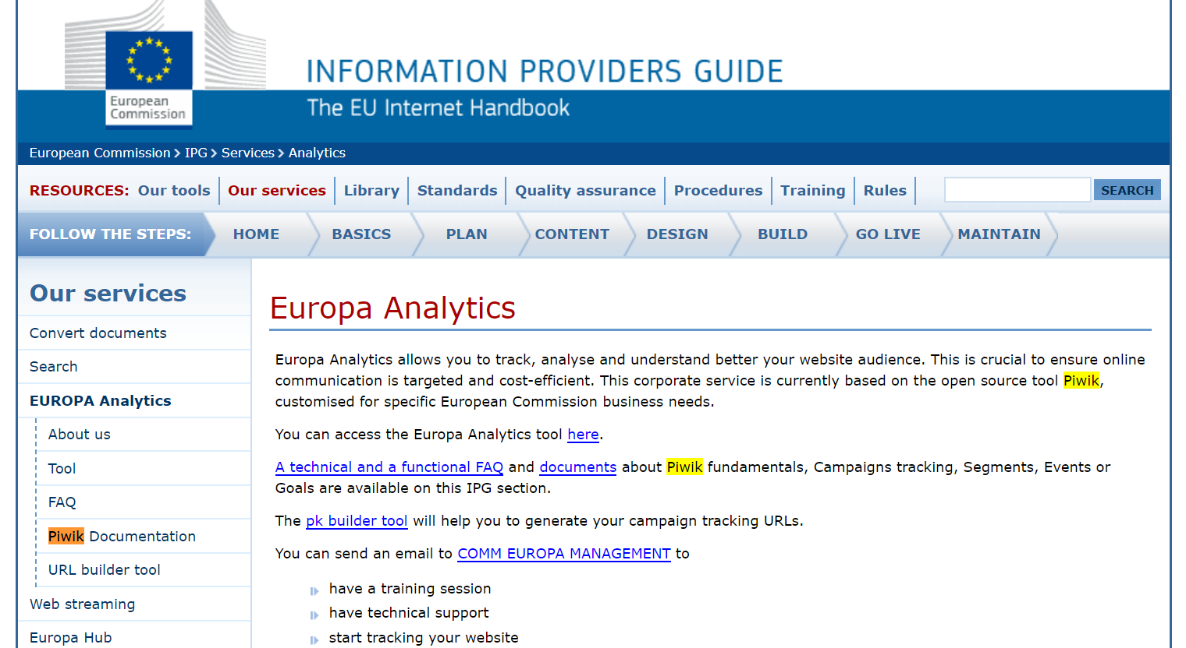
Notes:
One more detail. The European commission is using the Europa Analytics that‘s also based on Matomo. Among the users we can also find UN and NASA.

Slide 6
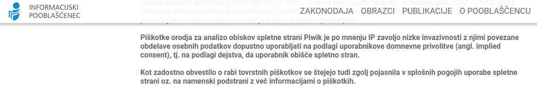
your own analytics cookies
the possibility of subsequent rejection
clearly defined privacy policy
anonymized IP address
No need for an individual‘s consent
Notes:
So first let‘s check the example of cookies. The cookies are a small files that are downloaded on your device and on which all analytic tools work.
Slovenian Information commissioner states that Matomo uses cookies with low invasiveness. So there is no need for an individual‘s cookie consent and you can allow cookies by default. In this case you don‘t lose data for your analytics.

Slide 7
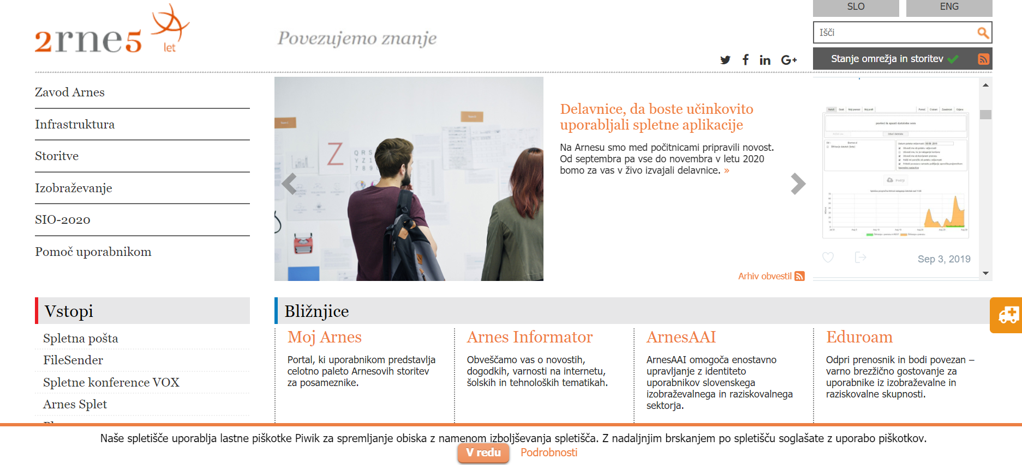
Notes:
So let‘s check this in pratice. It doesn‘t matter if the visitor agrees to allow cookies or not, they are automatically added and a notification appears. And if the user wants to know more he can click on details.

Slide 8
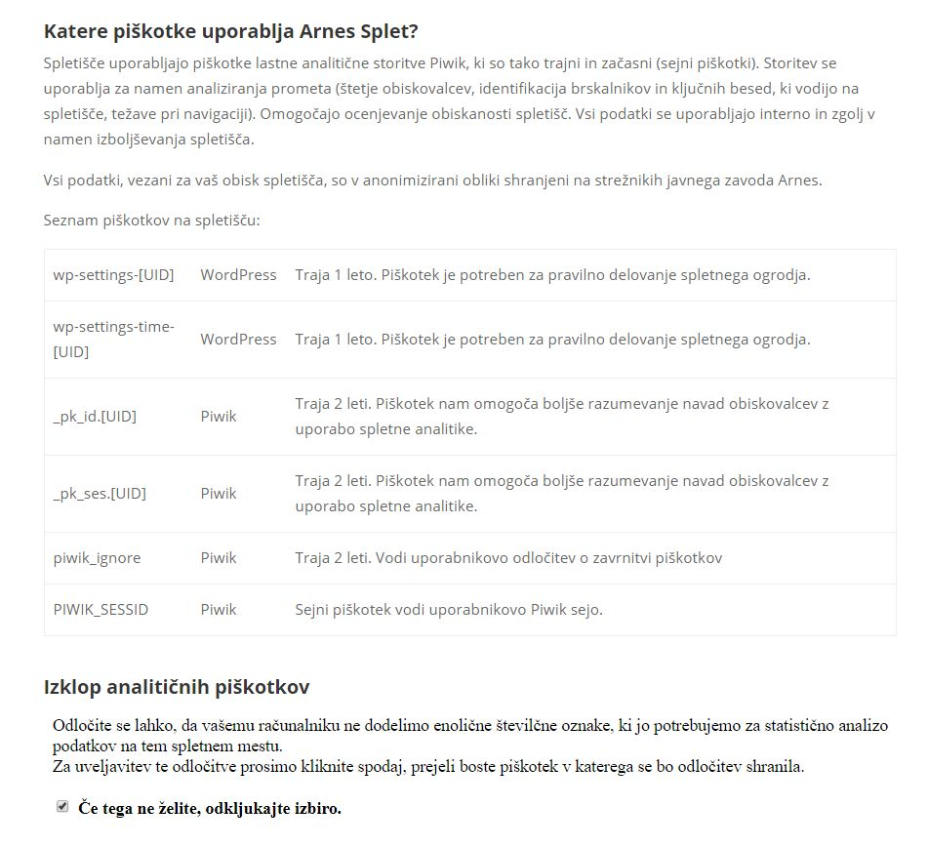
Notes:
Here there is a clear definition of what cookies we use and for how long they are stored. Here the user has an option to disable cookies.

Slide 9
How?
Notes:
Dashboard - user friendly, drag and drop principle
You can add more websites
Settings - timeframe for your data
Sending the automatic reports for example for the team leaders
VISITORS:
- export data
- annotations for different events, for example a conference, or different promotions
- cookie, after 30 minutes new visit, same unique visitor
- visit duration
- bounce rate, combine it with the other data
- pageviews
- max actions
VISITOR LOG:
- anonymised data
DEVICES:
- very useful, you have to optimise your webpage for mobile first
- visualisations
SOFTWARE AND LOCATIONS
ENGAGEMENT:
- returning visits over time
- high number of visits by visit number
TIMES:
- when are the people visiting your webpage and compare it to Facebook
- when you are publishing new posts
ACTIONS:
- telling you everything about your content
- this structure is the same as your page's structure
- transitions! so you can link your content based on the transitions
- page overlay! so you can see what are the people clicking on, for better UX
- row evolution
ENTRY PAGES and EXIT PAGES and PAGE TITLES
SITE SEARCH:
- internal search, what are the people looking for, what are they interested in
- create the content about the keywords
REFERRERS - ALL REFERRERES
- data about how people find your website
- direct entry, the high number is specific for Arnes / bookmarks and URL's
- usually 1/3
KEYWORDS:
- keyword not defined, google is using https, so the search data is not sent to you anymore, use site search for the content, or check the most visited posts, what are the people interested in
CAMPAIGNS

Slide 10
Campaigns
data about visitors who accessed the site as a result of a campaign you created
Matomo URL Builder
user adds several parameters to the desired link that allow tracking of visits from a specific source
https://matomo.org/docs/tracking-campaigns-url-builder/

Slide 11
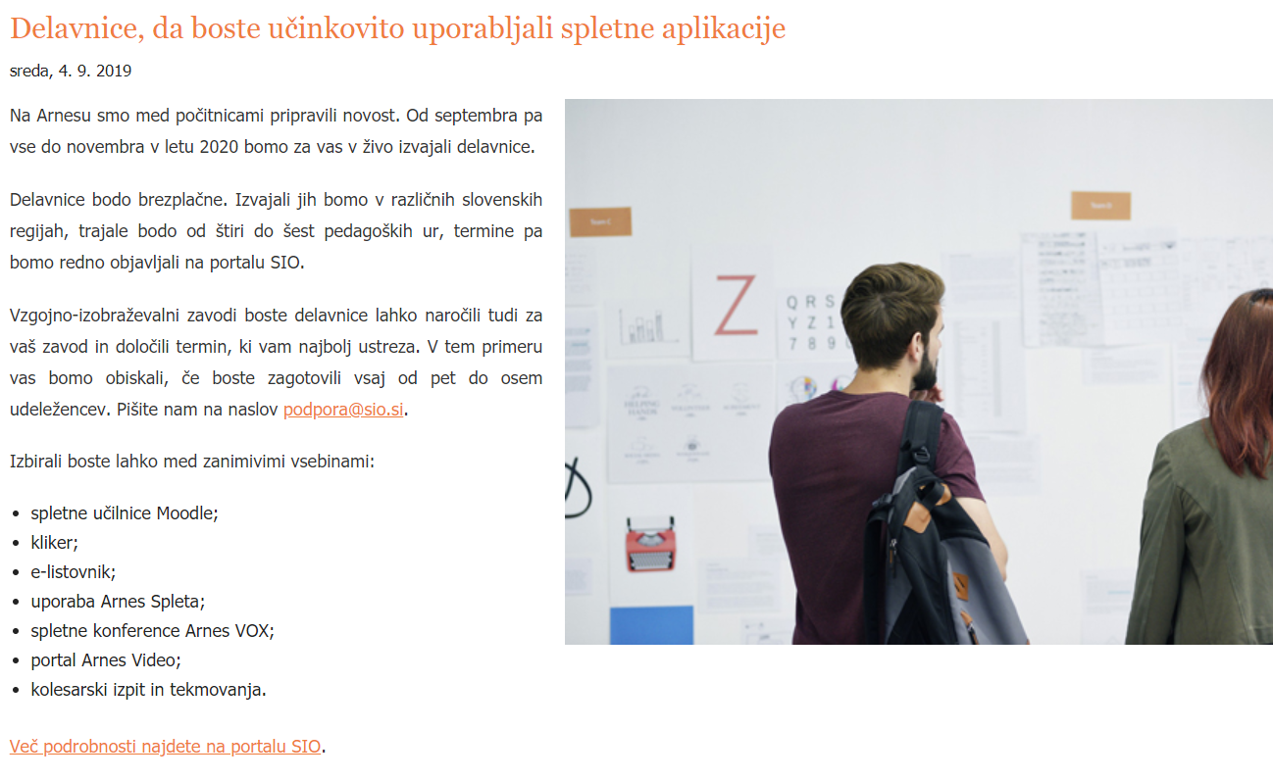
URL: https://www.arnes.si/delavnice-da-boste-ucinkovito-uporabljali-spletne-aplikacije
Notes:
Create campaings to follow the efficency of your campaings. Use any URL that you wish to follow and add parameters so you will know where the URL‘s will be placed.

Slide 12
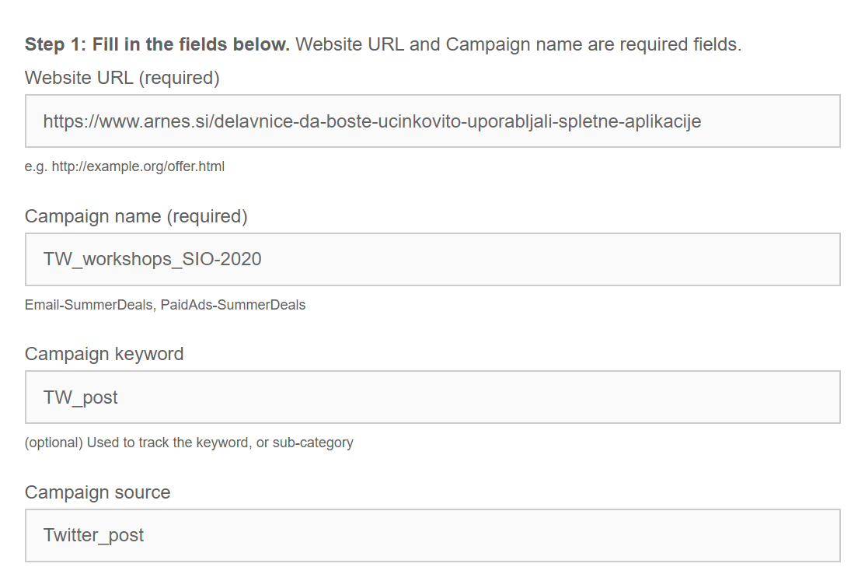
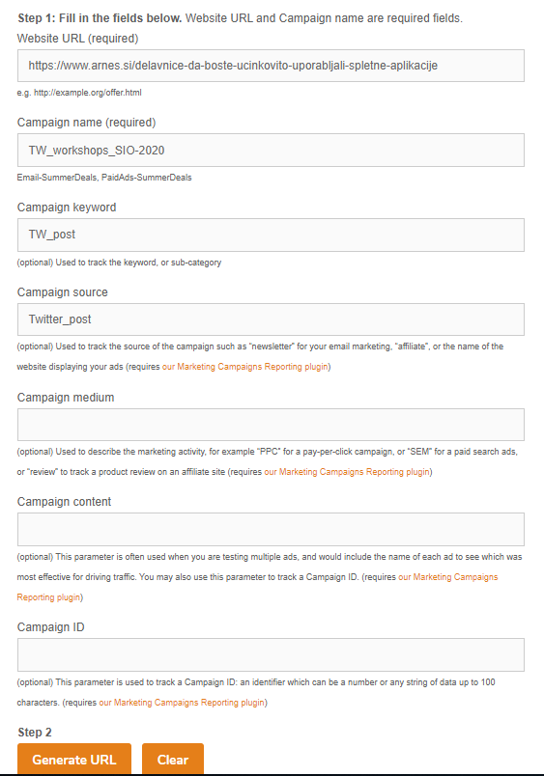
Notes:
For example twitter, FB, mailing. And see where you get the most success, where your money and time shoud be used.
And let‘s check the goals. You can add specific goals, depending on your interests. You use it for example for new subscribers for your newsletter. So you can add a thank you page after the user applies and mark this as a conversion … or a download … or an event. In our case we were interested how many users come to the webpage and emideately leave the page.
Segments – how many users stay on the pages for at least 5 minutes.

Slide 13
Thank you

