Slide 1

Marketing@surf
A view on Marketing & Communications activities at SURF
SIG-MSP, 18 Sept 2019, Montpellier
Walter, Lonneke & Michel.wets@surfnet.nl

Slide 2

Situation
Fragmentation of current marketing activities: product departments vs communications department
Need for overview of tasks and responsibilities in marketing related activities
The strategic added value of Marketing (and Communication) is not recognized within all SURF-companies
Marketing and communication are (partly) inseparable
Inspiration: ‘De marketing organisatie van de toekomst’ - Rob Beltman.

Slide 3
What is marketing for SURF?
Not the 'selling' of our services, but the entire process of creating added value for our customers.
Marketing is the activity and process of creating and communicating the SURF offering that adds value to the relationship.

Slide 4
SAVE
Not 4 P’s but SAVE
Solution: offering a solution to a customer's problem. This is about demand-driven but can also be push, taking into account the creation of actual latent demand and creating needs.
Access: offering (open) access to services, projects and knowledge products.
Value: not necessarily the price: value in experience, value in collaboration, in ….
Engagement: getting involved. Goes beyond promotion. Also involves training the target group so that they can make better choices. Activating the target group to participate in projects or collaborative services. Communities fit in very well with this. Also storytelling.

Slide 5
4 core responsibilities of marketing
Discovering value
What customer needs are not yet answered? What value can SURF's service add?
Organise value
Translate needs into new services and functionalities. Determining the positioning of the service and SURF's total offering
Communicating value
Communicating the value of the service value to target groups
Evidence of value
Measuring results, have we created value for customers? Market research, NPS score

Slide 6
Service delivery activities - an integrated view of marketing
Market and target group research
Branding and brand management
LCPM process – Innovation and product development
Portfolio management
Distribution policy / channel management
Tariff policy
Relationship management
Marketing communications campaigns
Internal marketing and communication

Slide 7
1. Market and target group research
Collecting, processing and disseminating insights into the customer experience and market environment
Activities:
Customer and service surveys - satisfaction
Sector/target group descriptions
Insight into the market environment and developments

Slide 8
2. Branding and brand management
Creating and safeguarding the positive and relevant distinctive character of SURF and its services and activities, leading to familiarity, recognition, and preference for the brands and activities that SURF carries out.
Activities:
Brand policy and positioning
Corporate identity, branding and naming
Media and PR
Sponsorship

Slide 9
3. Innovation and product development (LCPM process)
Process to connect with customer requirements, improve or renew value propositions. Create new services demand-driven and tech-push (important that the customer is involved).
Innovating together is ! SURF's core activity
Activities:
Ideas generation, PoCs and technology foresight exercises
Service development LCPM

Slide 10
4. Portfolio management
Creating and monitoring the mutual coherence of and added value of SURF’s portfolio (products, services, and activities).
Activities:
Assortment management
Determine the positioning of services
Close involvement of Clients

Slide 11
5. Distribution policy / channel management
Supporting institutions in making optimal use of our services.
Activities:
Organizing our online channels that presents our offer (surf.nl/dashboard/applications/wiki/etc)?
Service Delivery process

Slide 12
6. Tariff policy
Establishing and monitoring the pricing of our services (separate and as complete offer). Value for money strategy.
Activities:
Transparent Pricing policy
Insight in costs and incomes
Determine qualitative added value of offer - PM's, CM strategic partner
In collaboration with clients – they are invited to give advise

Slide 13
7. Relationship management
Establishing, maintaining and developing relationships with institutions/clients to optimize customer satisfaction and purchasing. An involved client is more likely to participate.
Activities:
CRM management
Strategic customer relationship management
Tactical customer relationship management
Operational customer relationship management
Promote outside-in thinking internally

Slide 14
8. Marketing communications campaigns
Optimizing the customer experience, service and interaction with customers through the appropriate use of various communication channels.
Activities:
SURF Marketing communication strategy
Communication plans per expertise, service, project

Slide 15
9. Internal marketing and communication
Stimulating and safeguarding the brand and customer experience among SURF's employees. SURF employees are ambassadors.
Activities:
Internal marketing communication plan
Employee engagement
Internal communication

Slide 16

SURFcumulus builds on the 2016 GEANT IaaS tender
Compliancy
Tendering
      Contract administration
    Compliancy statements on Privacy
      Data classification analyses
      Workshops
      Cost comparison tool
Fit for use
Pay as you go
  Transparency on costs and T&Cs
    Institutions are involved in roadmaps
      Cloud Management Portal
      Trainings
      Not for profit, not for loss

Slide 17
Understanding the typical institution cloud journey
Understand the value proposition of cloud services, adopt a cloud strategy
Answer all questions (often multiple times) on
                Legality -> Procurement officers
        Compliance -> Privacy and security officers
        Functionality -> Administrators, architects, IT managers
        Costs -> IT Managers, board members
Having peer reference cases or visionary institution sponsor helps a lot
Prepare
Reason to start
Test
Go (easy), get confident and migrate more
Notes:
Legality: they can use it without tendering
Compliance on Privacy, Security and Data Classification
Costs: it’s not that much more expensive as their own infrastructure

Slide 18
SURFcumulus taking off
2015: External advise recommended using dedicated account managers
  2016: We decided to call them Service Delivery Managers (sounds less commercial)
    2016: Communications helped creating the service description
      2016: Started bi-monthly SURFcumulus newsletter
2017: 2nd SDM, Initial marketing expertise to help with SWOT, BM changes
  2018: 3rd SDM + dedicated 0.4 FTE marketing capacity, cloud event
    2019: The Why, How & What: Evolve from transaction based relation to partnership
      2019: each SDM has it’s own sectors
2020: New BM and adding new services (local CMP & Professional Services)
Using communication and marketing expertise has been instrumental to the success of SURFcumulus

Slide 19
SURFcumulus Customer involvement
Tactical level meetings (technology driven)
  Strategic level meetings for IT managers, involving them in roadmap
    Provide workshops for all expertise's involved in decision making process
      Ask feedback on new Service Descriptions and Business Models
Provide PoC’s on functionalities, generate use cases
    Provide free Azure and AWS trainings (funded by Microsoft and Amazon)

Slide 20
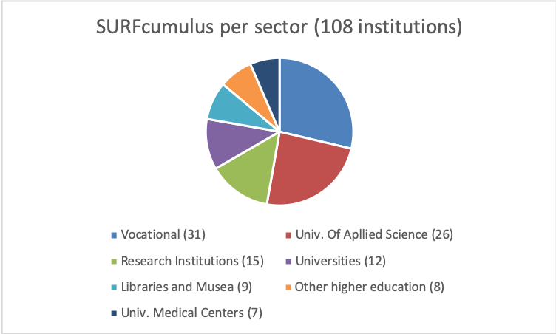
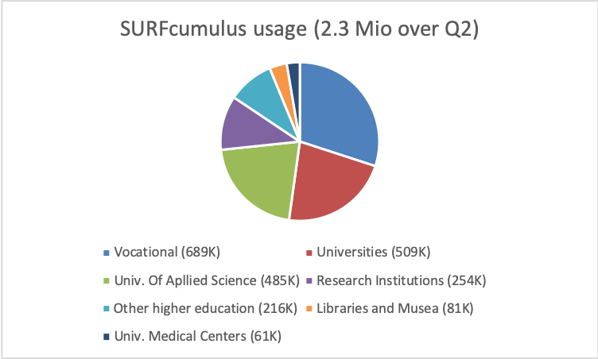



SURFcumulus has become the default delivery model for public cloud services within R&E in the Netherlands
108 institutions use SURFcumulus
  Annual gross turnover grew from 2 Mio in 2017 to 5.5 Mio Euro in 2018
    Gross turnover Q2 2019: 2.3 Mio; Expected turnover 2019: 10 Mio Euro

Slide 21
Why, How, What
WHAT
HOW
WHY: We believe in the enormous chances cloud services offer to education and research.
HOW: SURF removes, as an independent partner of institutions and researchers, the barriers for using cloud services in areas like security, privacy, costs, accessibility and compliancy and supports innovative usage.
WHAT: (strategical) advise, sharing knowledge and cloud services with answers on questions and challenges of education and research on clouds
  SURF Research Cloud (RSC), Portal in which you can easily create a digital research environment which connects with other functionalities.
  SURF HPC Cloud, Highly adaptable SURF owned infrastructure for large data and compute research
  SURFcumulus, support on the way from administration to control with commercial cloud services, professional services and a Cloud Management Platform
  SURF licenses, centrally procured SURF licenses
WHY

Slide 22
Driving innovation together
Notes:
De tekst zonder aanhalingstekens en zonder vraagteken.
We willen hier graag ook nog de lijn plaatsen aan de rechterkant, maar dan in het wit.

