Slide 1
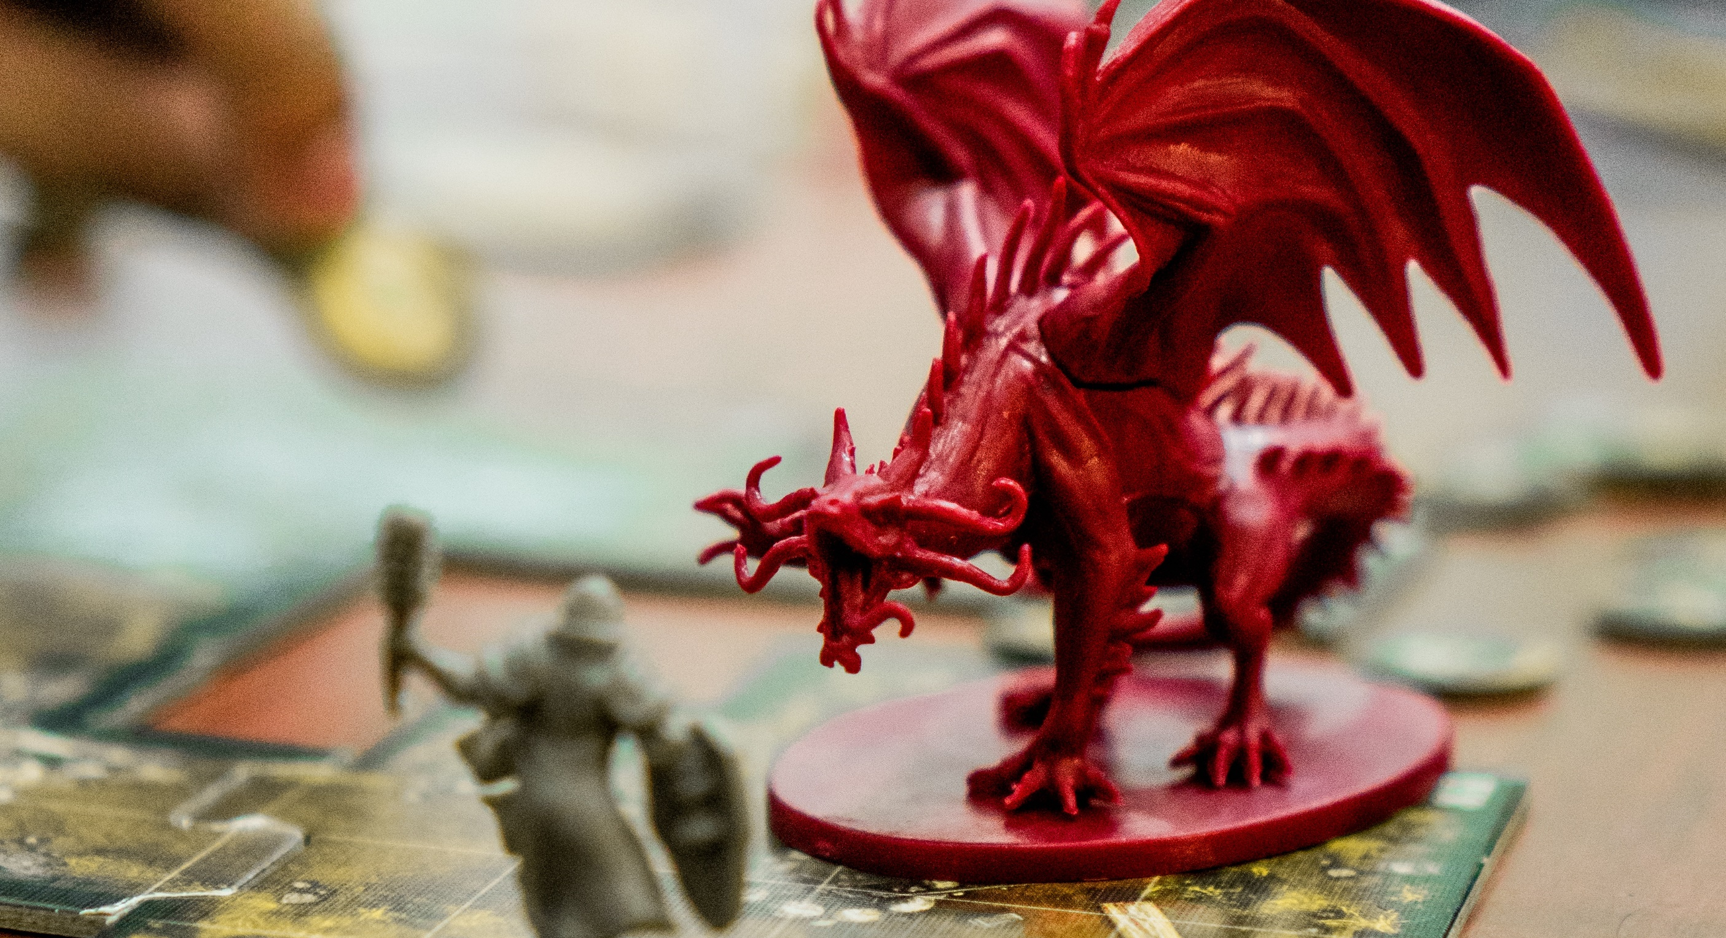
Cybersecurity month 2019
SIG-Marcomms Meeting Montpellier September 2019
Charlie van Genuchten, SURFnet

Slide 2

European Cyber Security Month
Since 2012
Overall objectives:
  generate general awareness about cyber security
  promote safer use of the Internet for all users
  increase national media interest through the European and global dimension of the project

Slide 3

Is your organisation doing something with the Cybersec Month?

Slide 4
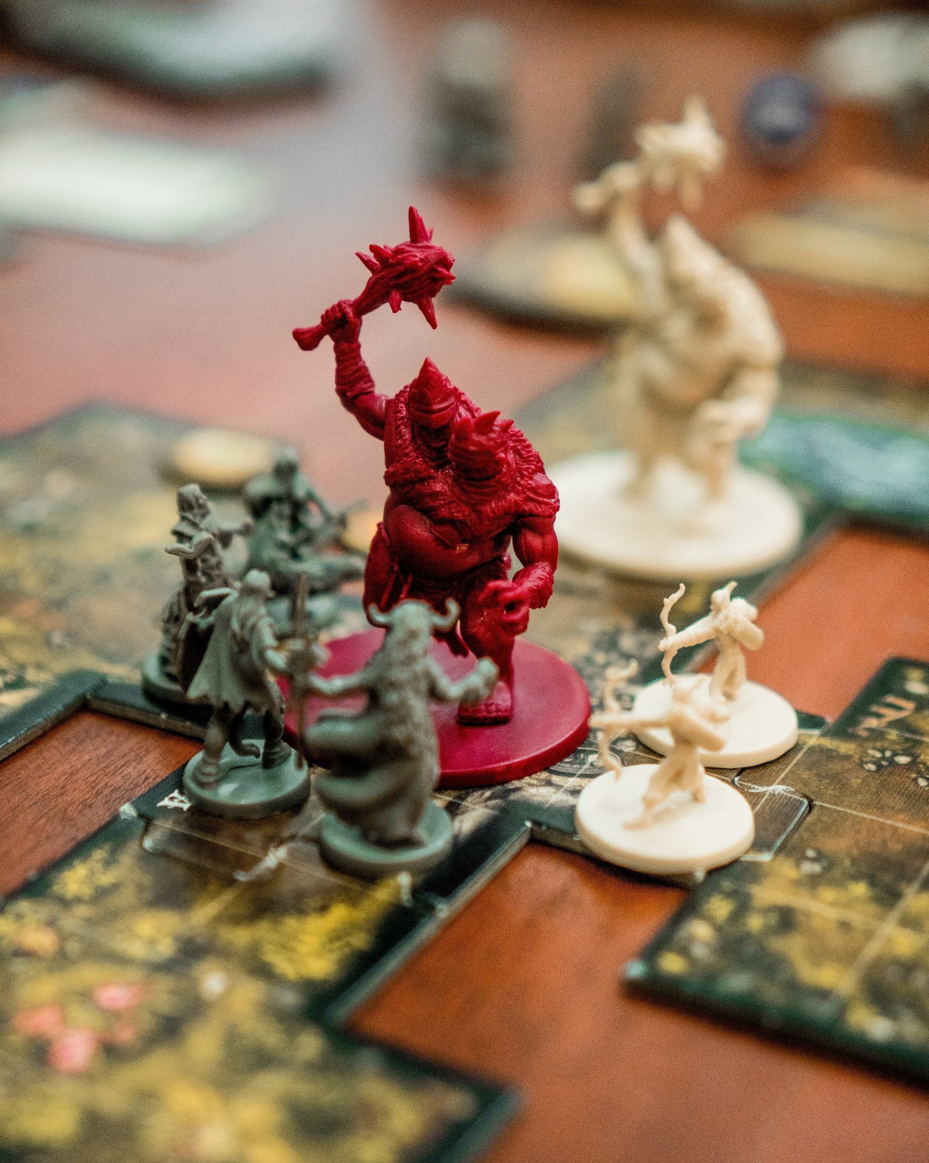
NREN Community in ECSM
This year
  Highlighting what NRENs are already doing
    Blogs from SWITCH, Arnes, CSC, SURF
  Materials for all to use:
    Boiler plate blog
    Poster pack
  Social media campaign
    #CyberSecMonth
Participating as a community the coming years

Slide 5


Slide 6


Slide 7


Slide 8


Slide 9

What should we do next year?
Notes:
In groups
10 minute discussion
Could we do something more inventive?
Should we just keep highlighting what we already do?
Is there a way to make it more overarching?

Slide 10

Thank you…

Slide 11

…and come to CLAW!
Internal communications training
Talks about network outtage during 9/11 and best practice aviation sector
New inventive crisis exercise
Poznan, November 6 and 7 2019
https://eventr.geant.org/events/3087

