Slide 1
Recruitement strategy
Laetitia Lagneau
SIG MarCom – 18th of September 2019
Notes:
There are 3 different title slides. You can choose another one by clicking “Home” > “New Slide”
To insert a chapter slide, click ‘Home’ > ‘New Slide’ > section header green / fuchsia / yellow
- You can choose a different color for each chapter
- Or put every chapter in the same color
To insert a slide with a different composition, click ‘Home’ > ‘New Slide’ (title and content, two colums, chart and content, title only, etc.)
To insert a quote, click ‘Home’ > ‘New Slide’ > Quote

Slide 2

Notes:
We are a public service
Branding for recruitement started in 2015

Slide 3
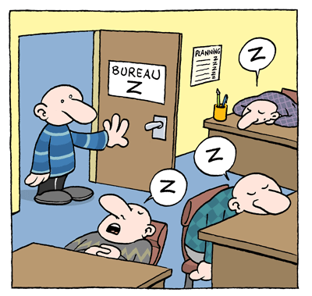

Challenge #1 : attract candidates

Slide 4
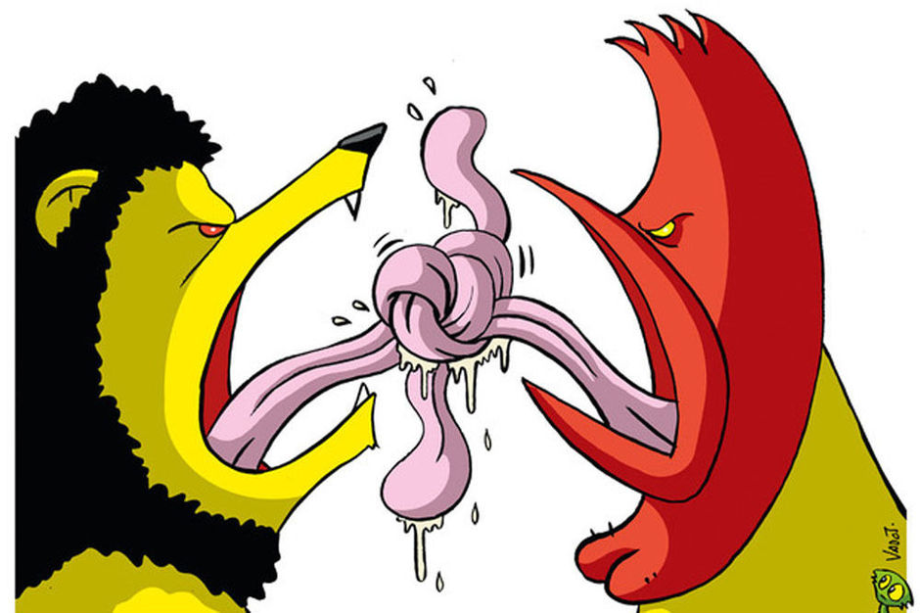

Challenge #2 : specific belgian constraint

Slide 5

Challenge #3 : long recruitement process

Slide 6


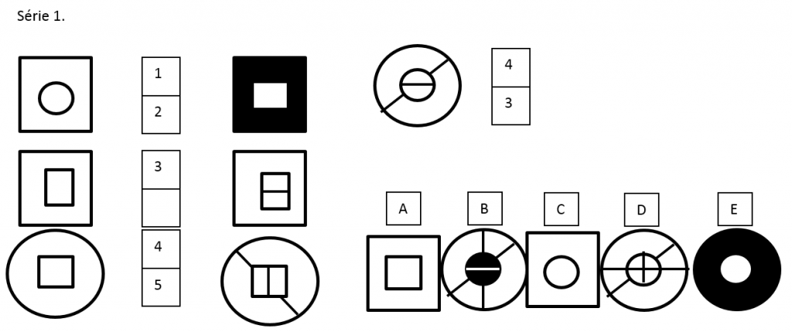
Challenge #4 : non-adapted recruitement process

Slide 7
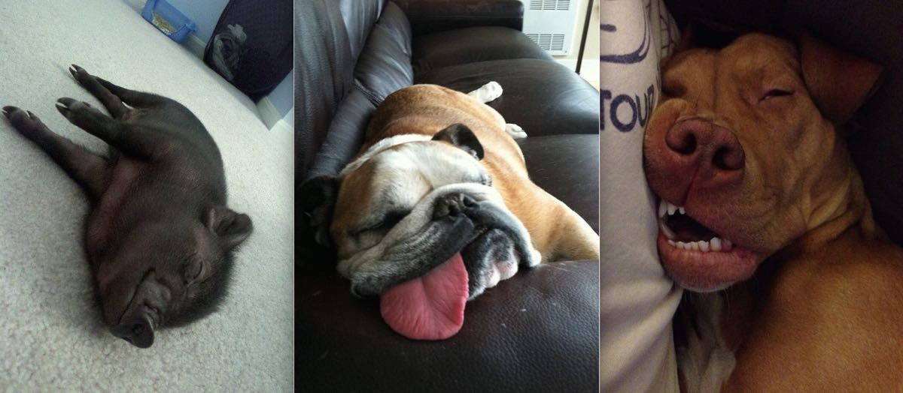

Challenge #5 : high effort – low result

Slide 8
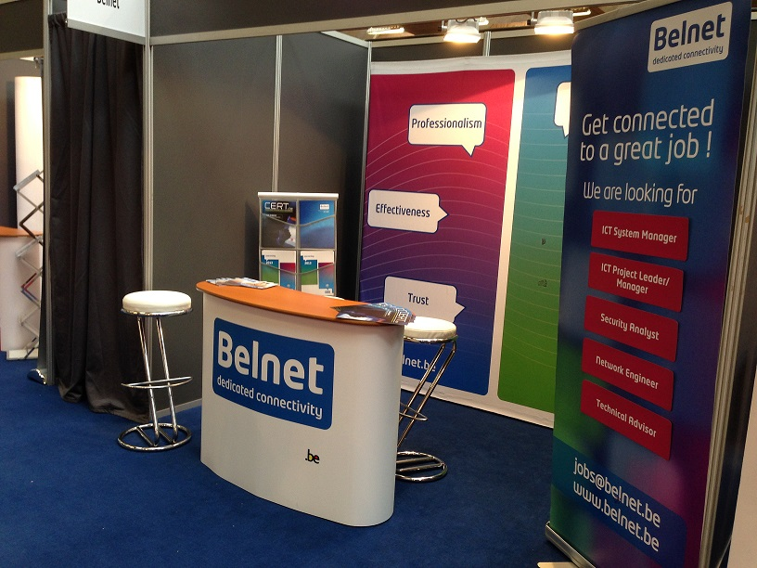
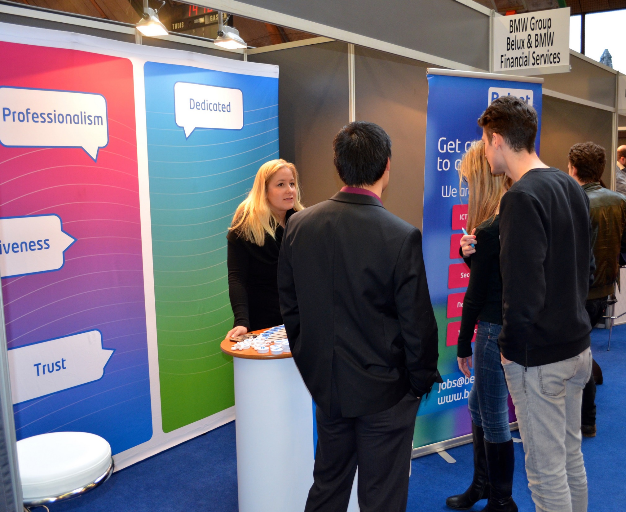
Action plan : # 1 = meet the students
Job days and student forum in Belgian universities

Slide 9

Action plan #2 : LinkedIn Campaigns

Slide 10

Action plan #3 : Dedicated website content

Slide 11
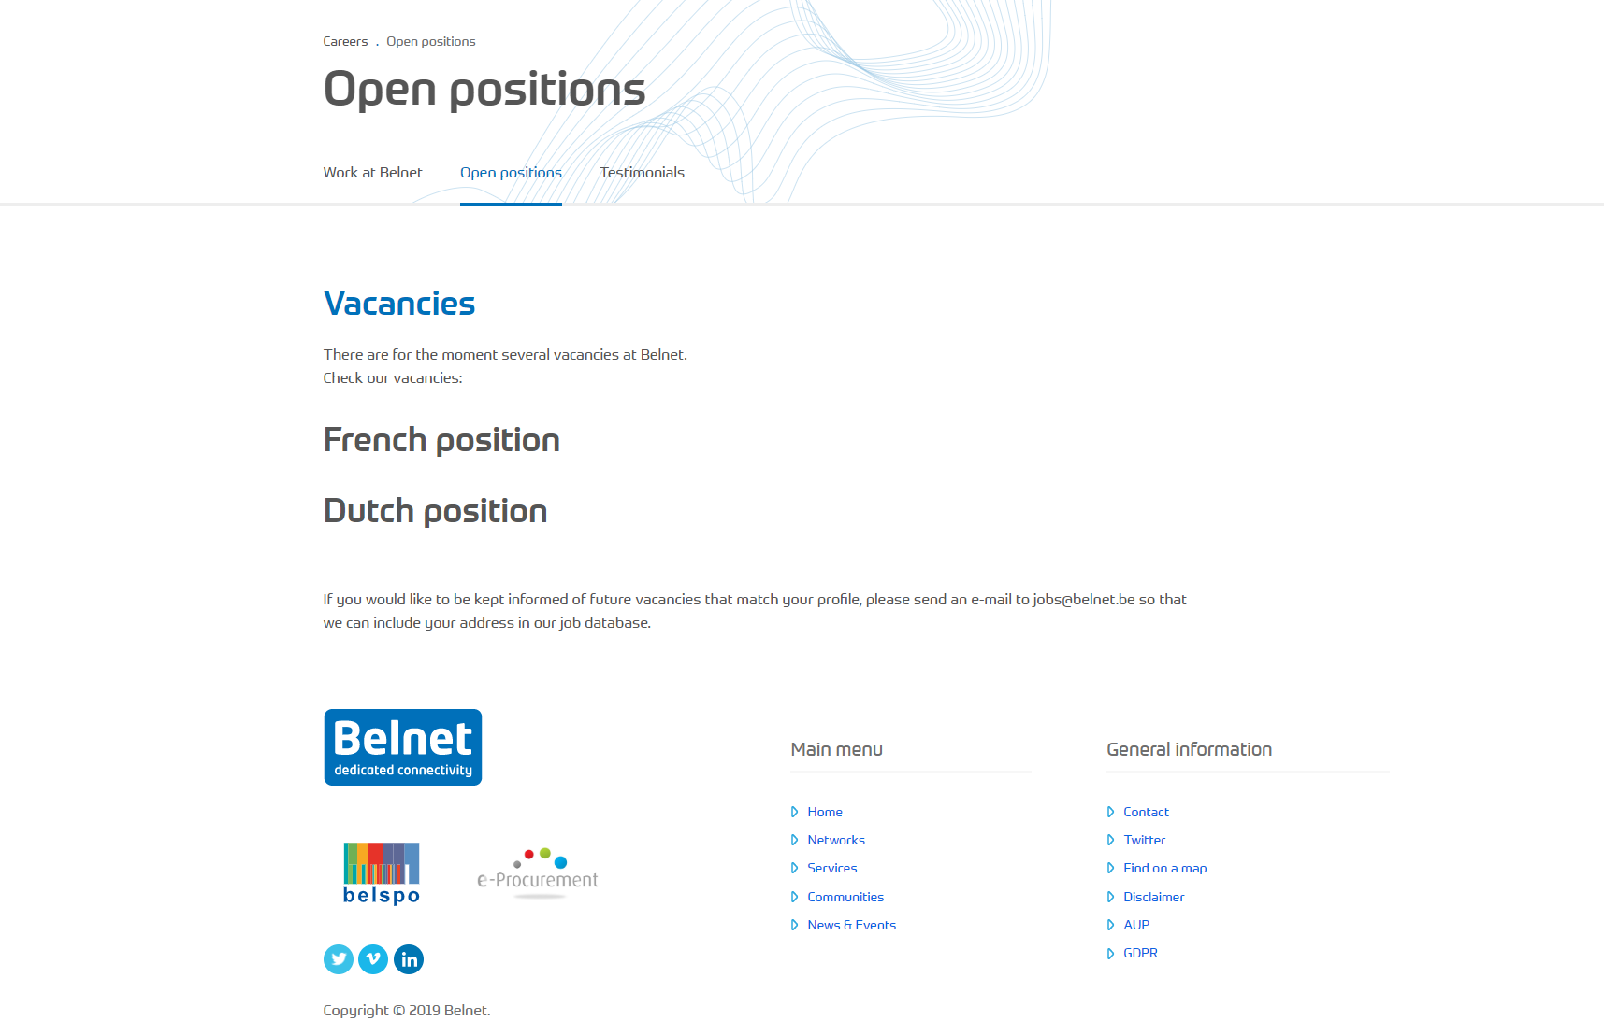
Action plan #3 : Dedicated website content

Slide 12
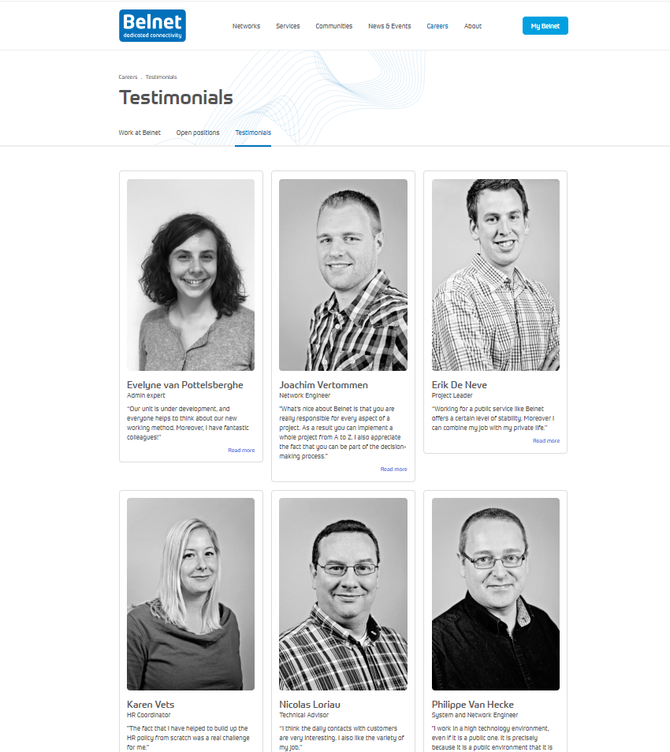
Action plan #3 : Dedicated website content

Slide 13

Action plan #4 : Targeted newsletter

Slide 14
Next steps
Improve web content
    Present teams
    Show diversity
    Increase attractivity : show team activities, well-being efforts
Increase visibility of Belnet within and outside of our community :
    PR
    on campus communication actions (not only job fairs)

Slide 15
Thank you
  for your attention
Notes:
There a different ‘thank you’ slides. To choose another one, click ‘Home’ > ‘New slide’

