Slide 1
What we’ve implemented in Portugal with ideas raised in sig-marcomms
Salomé Branco
salome@fccn.pt
Date: 17-set-2019

Slide 2
2015 started my Sigmarcomms Journey

Slide 3
Brainstorming @SIGMarcomm
01. Community Survey
03. Campaigns
Awareness of our services
Quality and usefulness of our services
Suggestions for improvements
#love2eduroam
Women in STEM & Women’s day
02. Internal Comunication
04. Strategy
2018 Christmas Tree
“Oscars” – FCCN ‘Connectors’
Brand Strategy
User segmentation

Slide 4


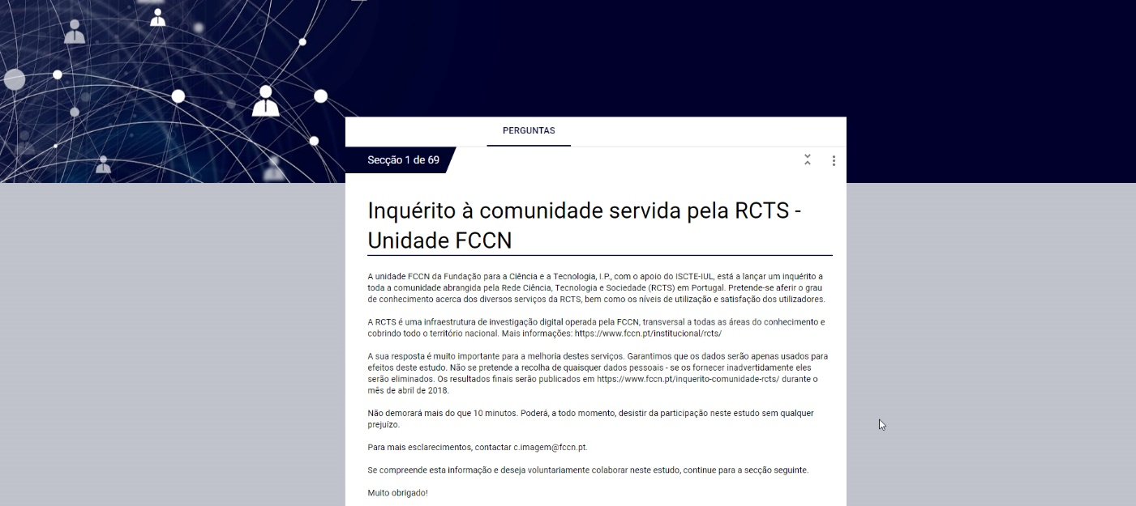
Community Survey
01. Community Survey
&
Kindly shared their surveys with us.
Raised in PSCN meeting
Subcontracted a University with experience in surveys and statistics analysis.
Objectives:
Awareness of our services
Quality and usefulness of our services
Suggestions for improvements

Slide 5
01. Community Survey
How:
Electronic form sent to member institutions communication offices, with a request to forward the filling invitation to the defined target audience.
Whom: teachers, researchers, phd students and higher education institutions technical and administrative staff
When: 23-02-2018 a 23-03-2018
Answers: 1131 answers

Slide 6
01. Community Survey
Results / Conclusions:
There is a low level of awareness on many services, especially the Computing offer (housing/cloud), and also in some infraestructure and security services.
Users show high interest in most services and want to know more.
Most used services are RCAAP (repository), Colibri (videoconferencing), Arquivo.pt (digital preservation) and Filesender (file sharing).
Collaboration services arouse more interest from users = videoconferencing, elearning, and filesharing.
Users preferred communication channels: email, website, phone.
User satisfaction is rarely below 70%

Slide 7
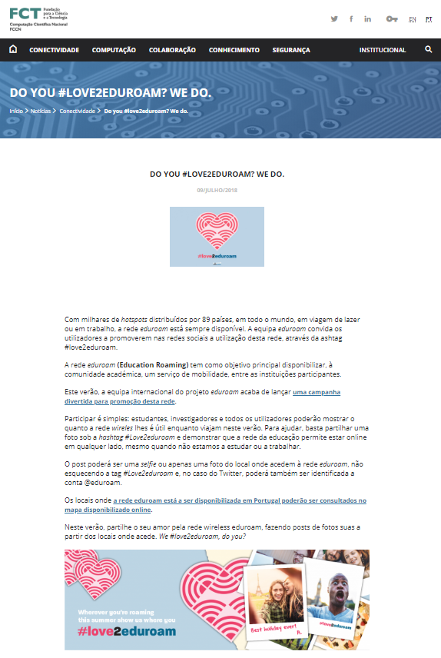
Eduroam campaign
03. Campaigns

Slide 8
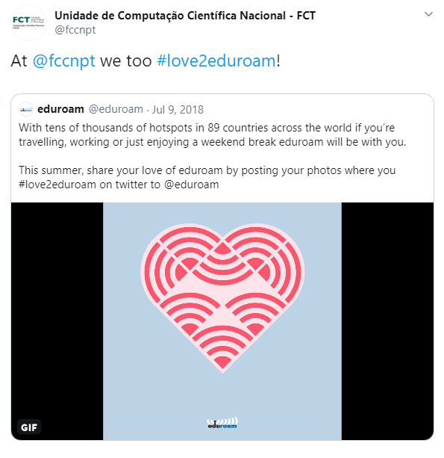
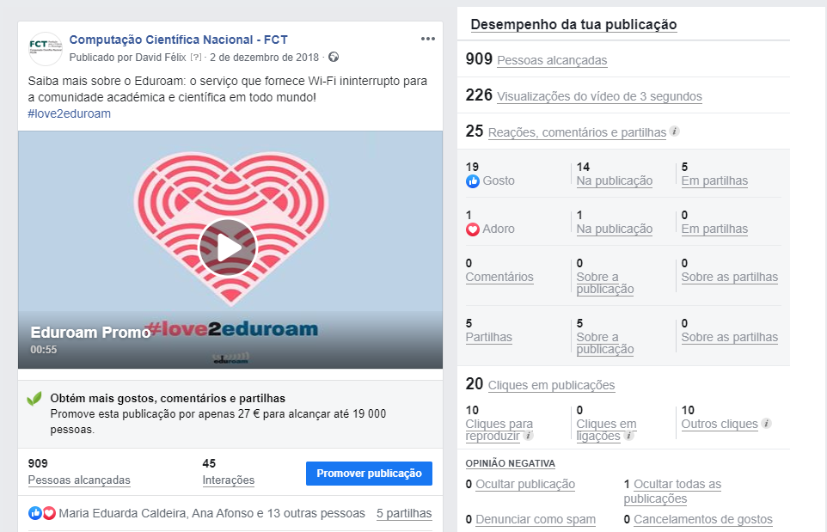
Eduroam campaign
03. Campaigns

Slide 9
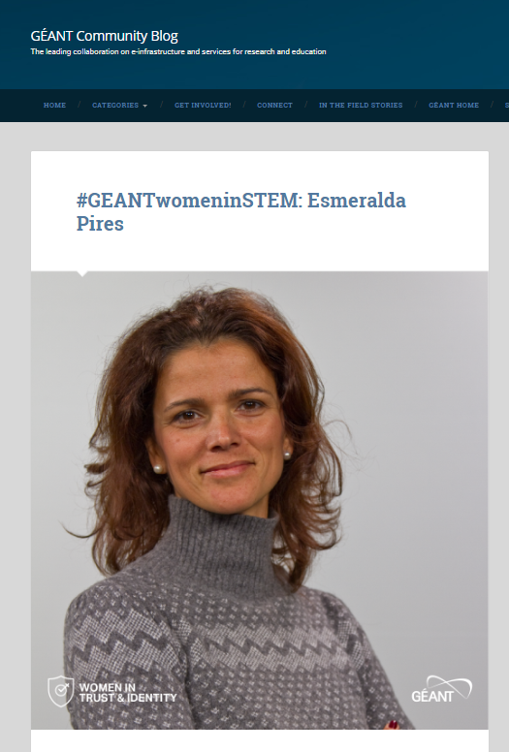


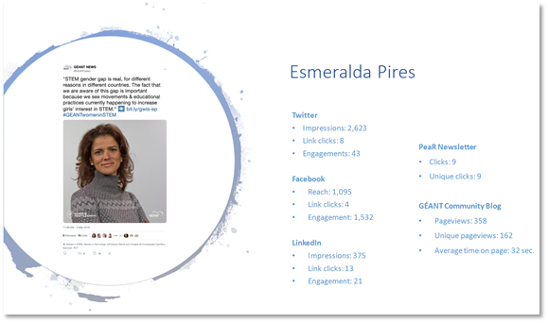
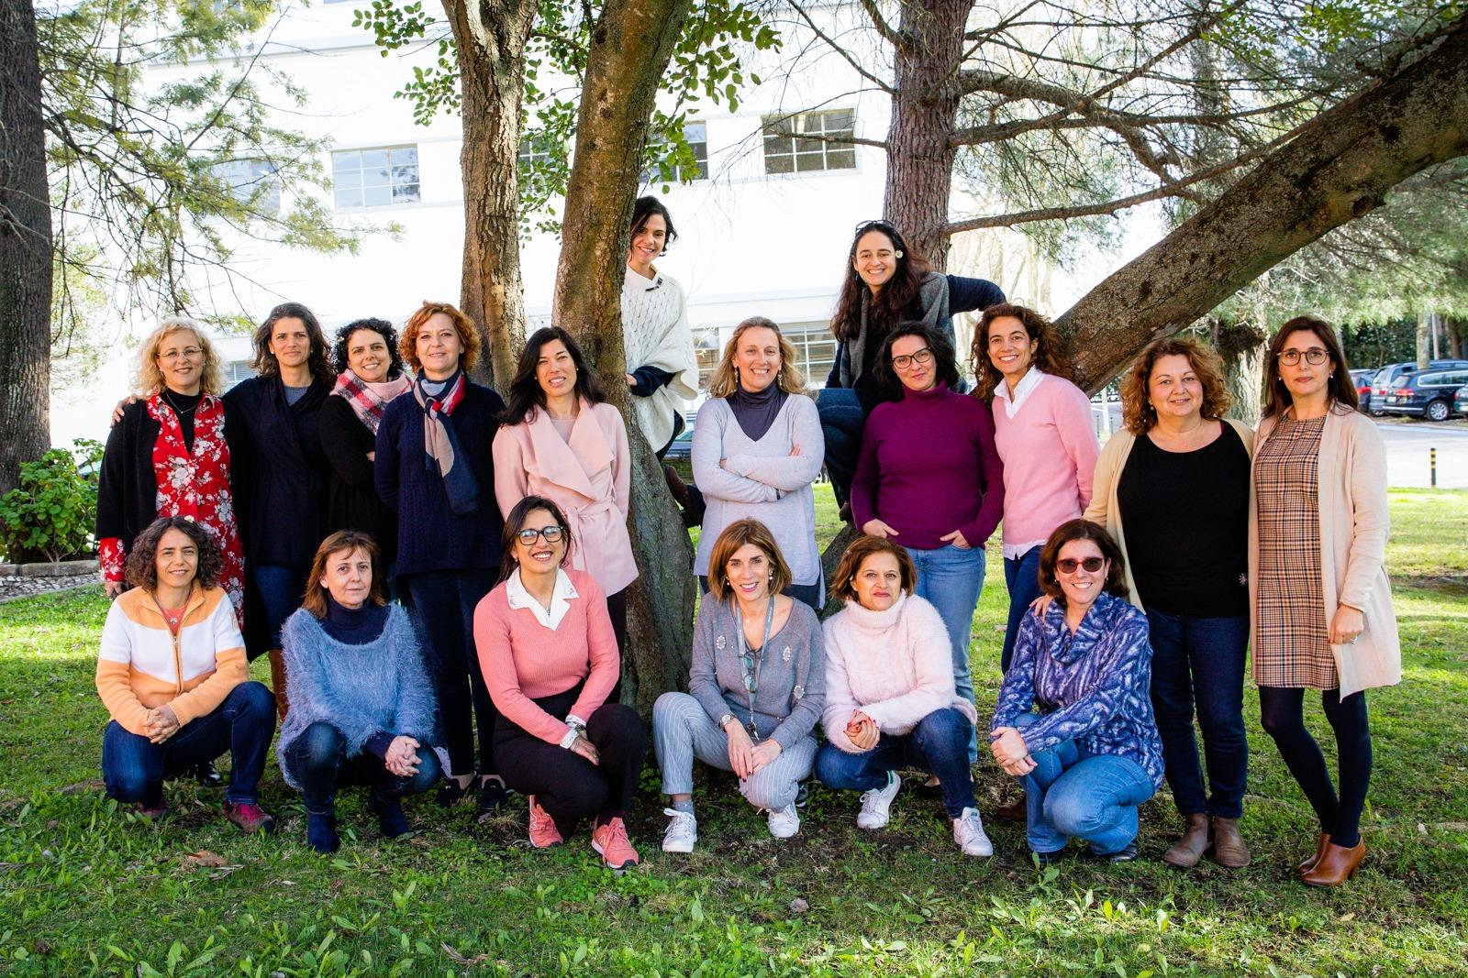
03. Campaigns
Women in STEM campaign participation
Women’s day with aligned image

Slide 10
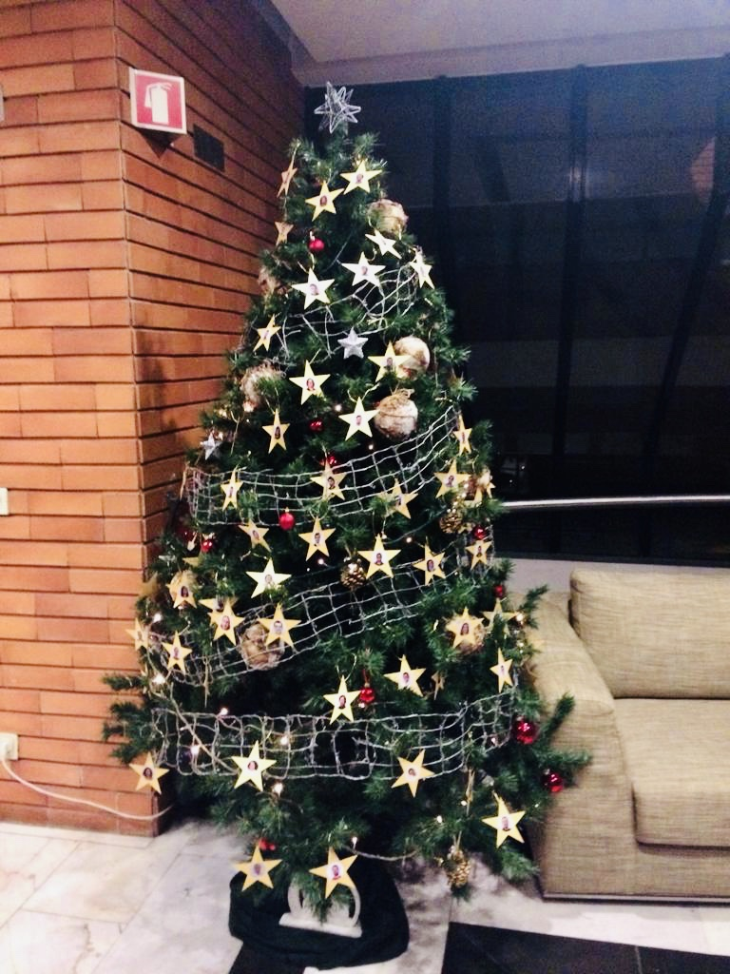
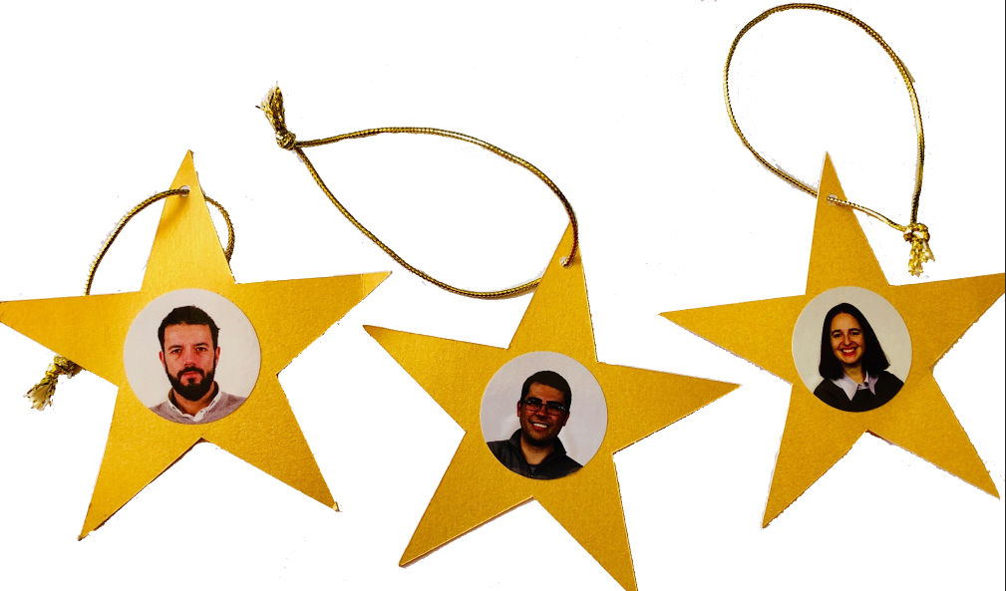
2018 Christmas Tree
02. Internal Comunication
Each employee had his/her own star decorating the Christmas tree.

Slide 11
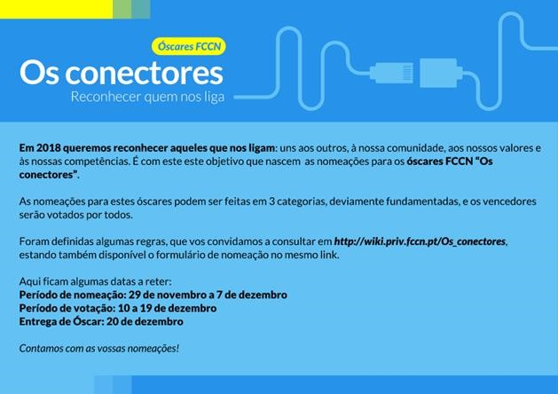
02. Internal Comunication
Nominations: Workers were challenged to appoint a colleague by category
  Categories: Collaboration| . Knowledge | . Free
Nominees were announced by surprise one morning through photos on one of our walls
Voting by stickers glued on each nominee. Each colleague could cast 5 votes.
Winners revealed during Christmas afternoon snack

Slide 12
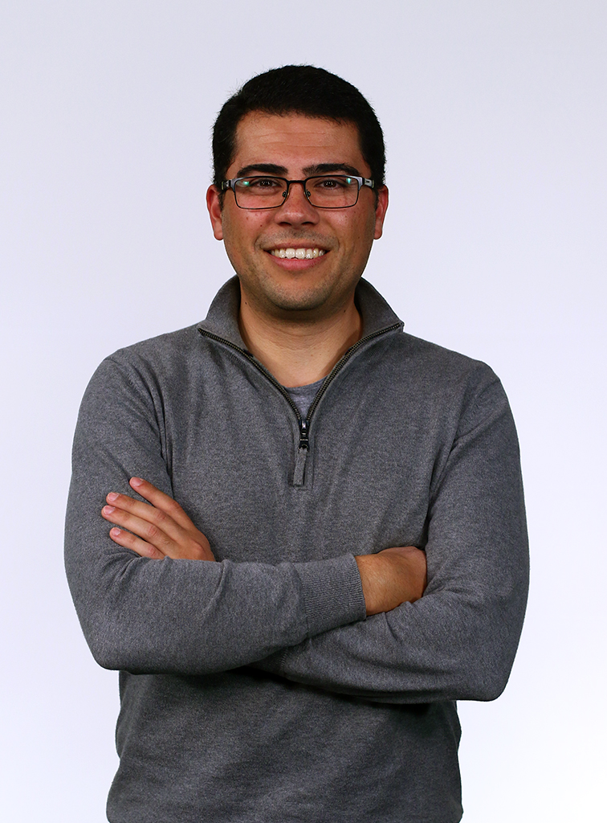
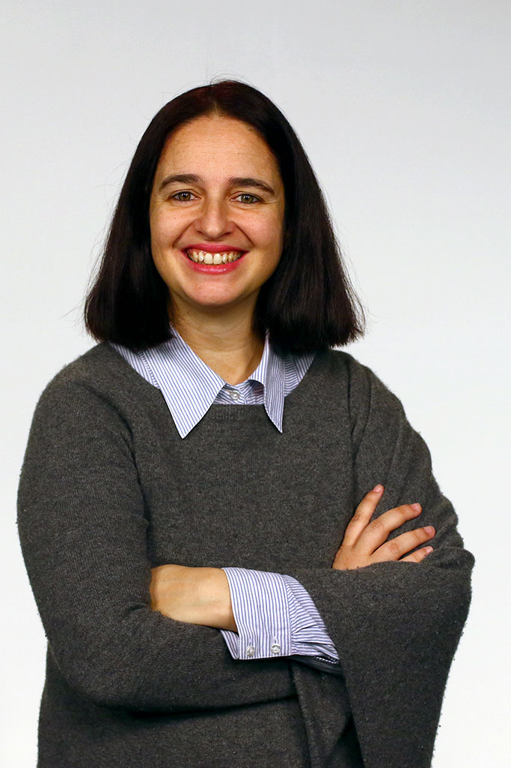
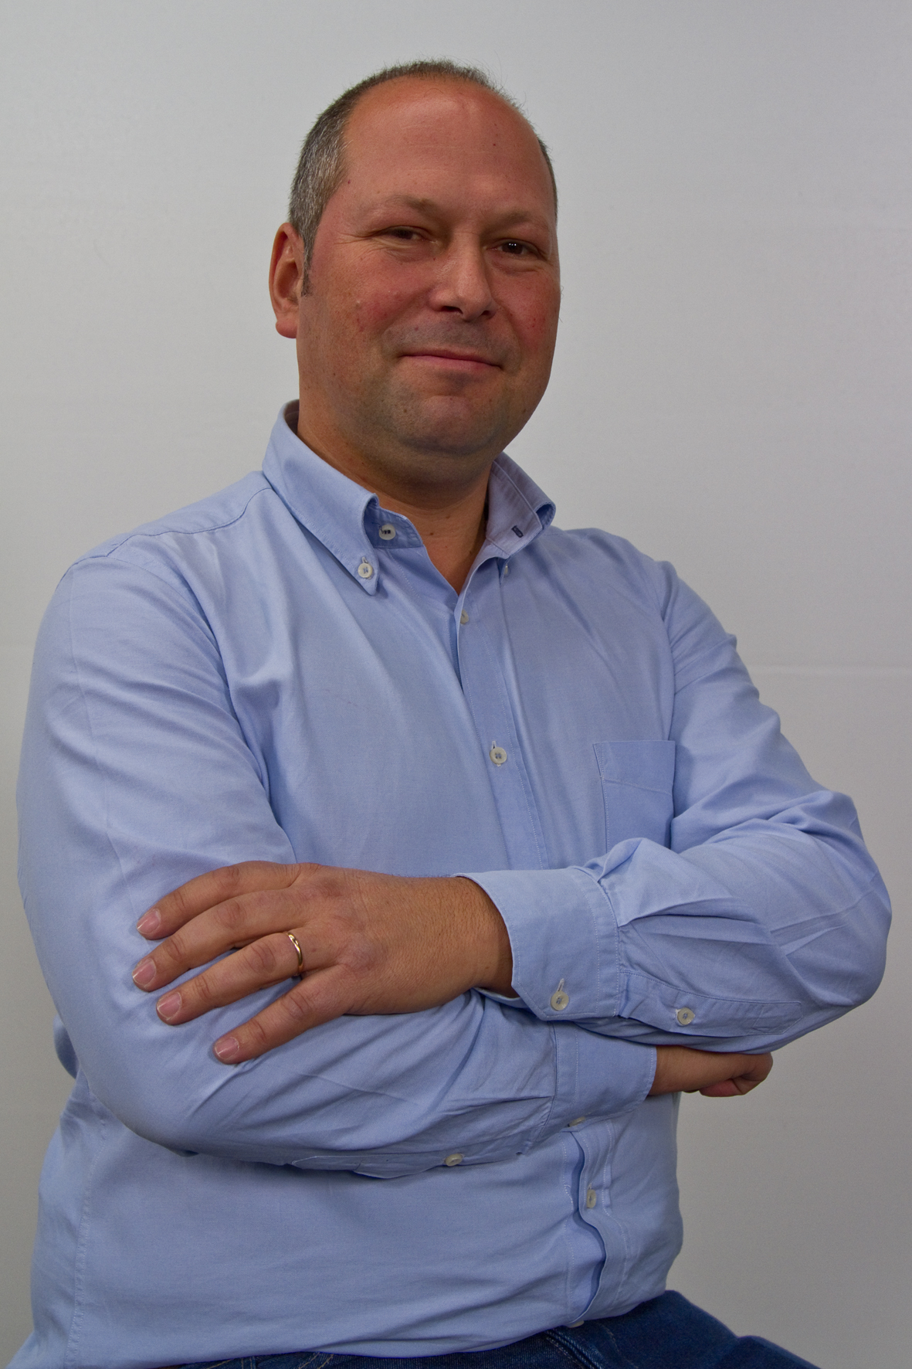
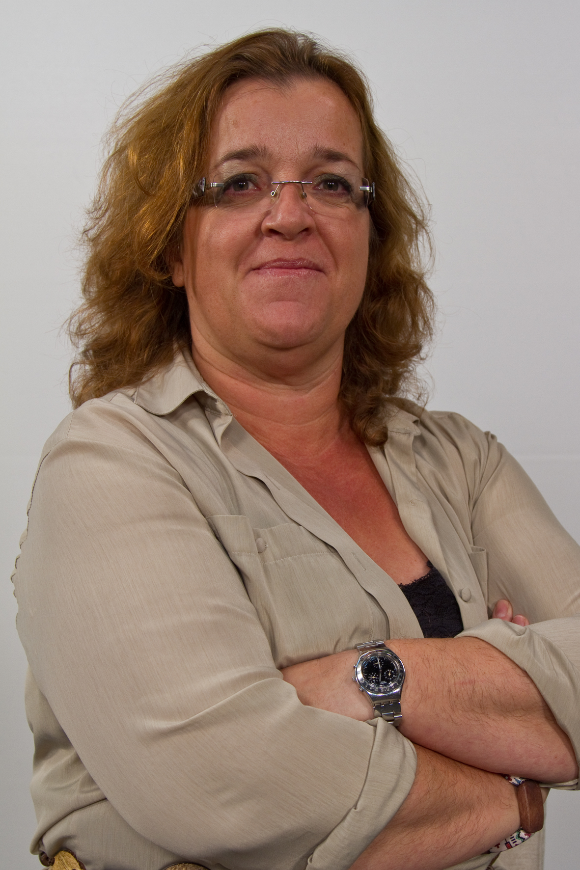
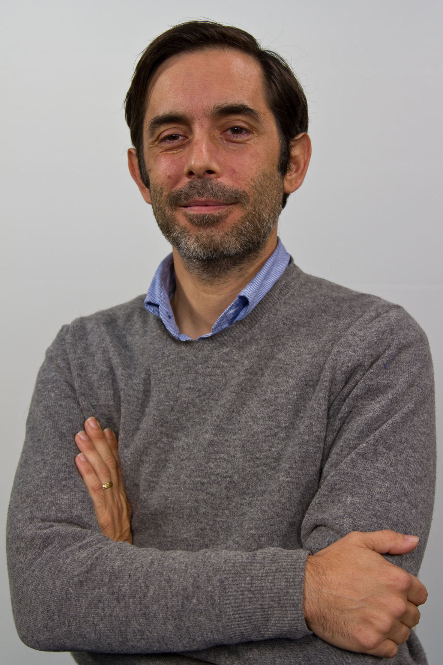
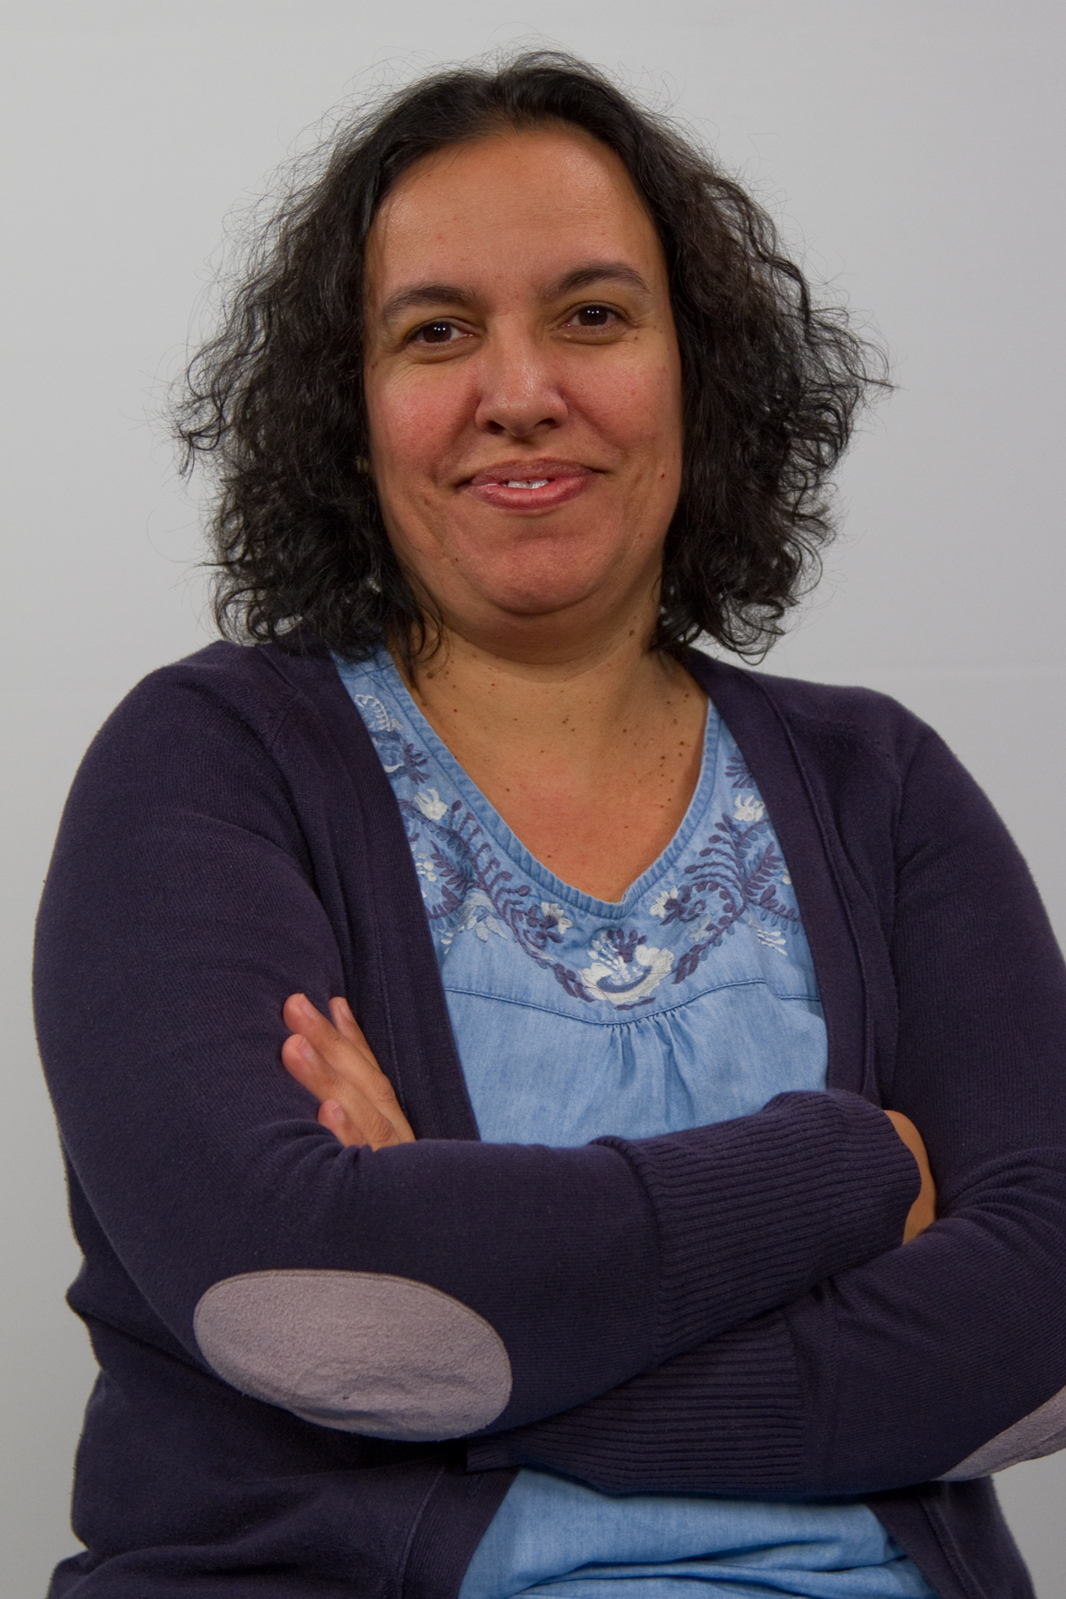
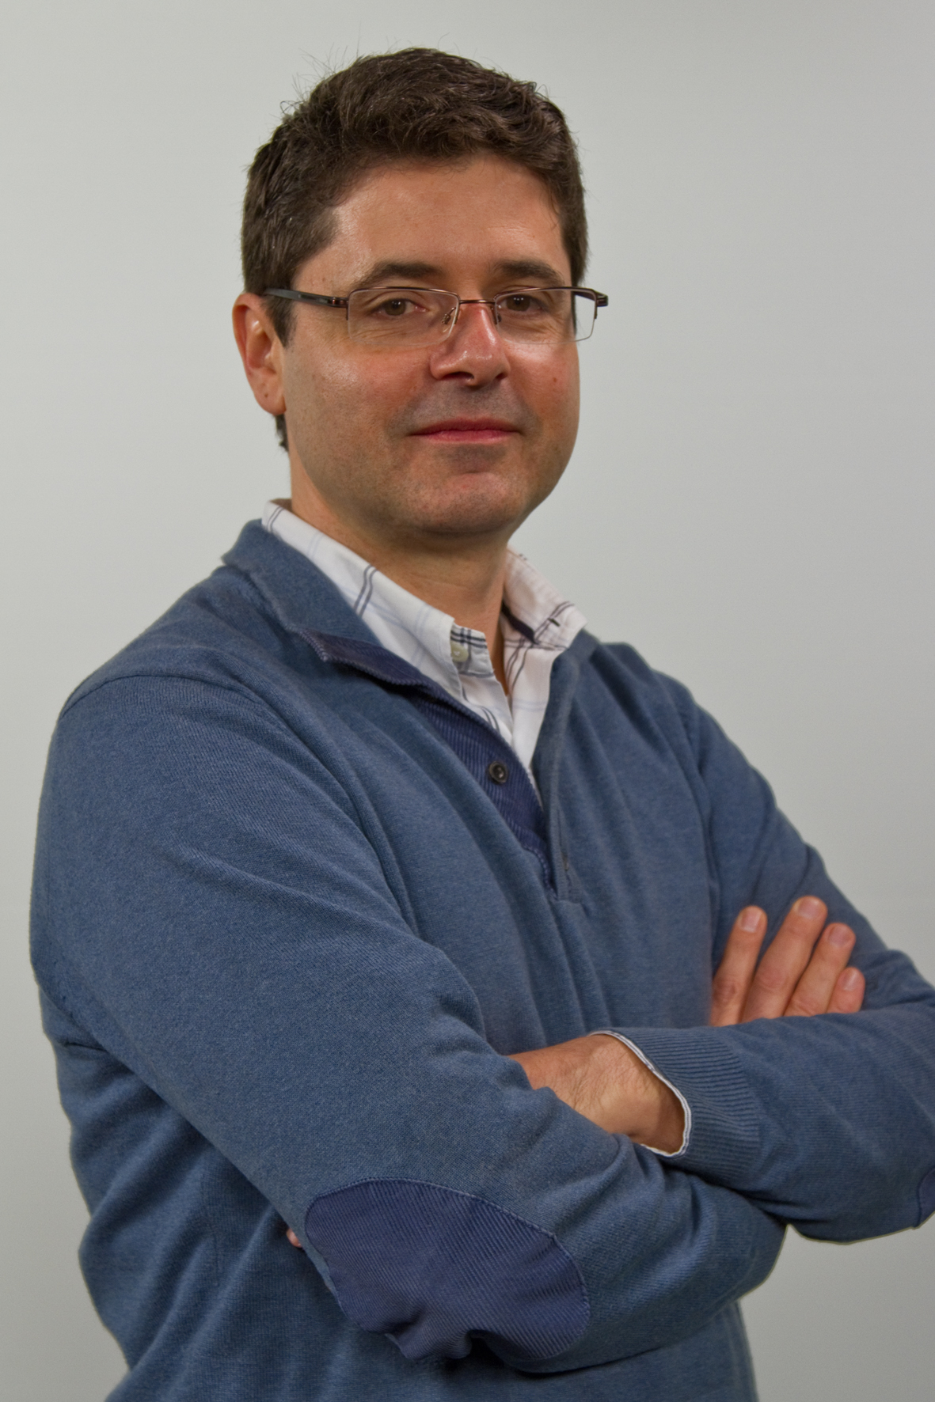
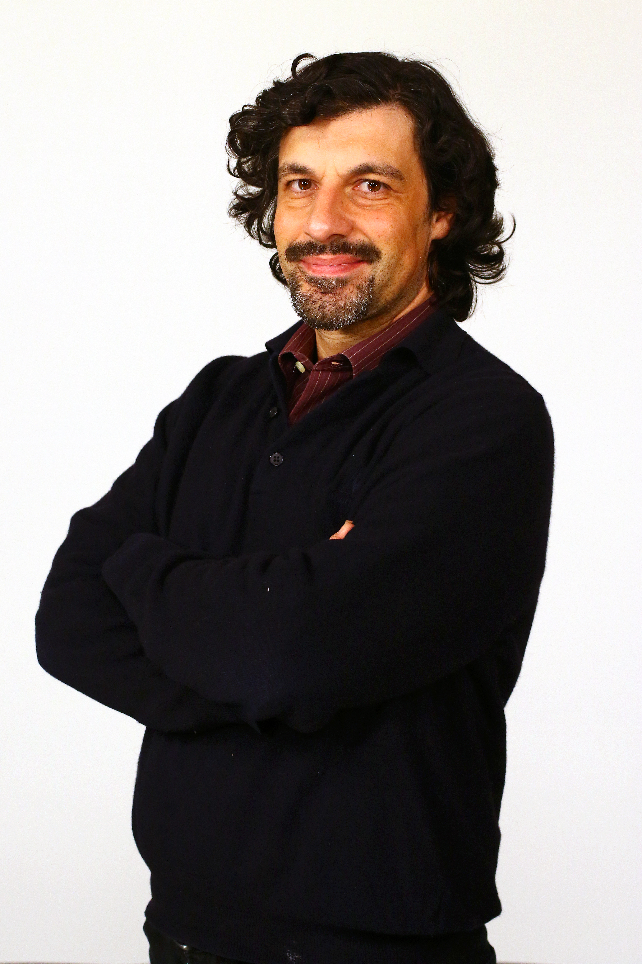
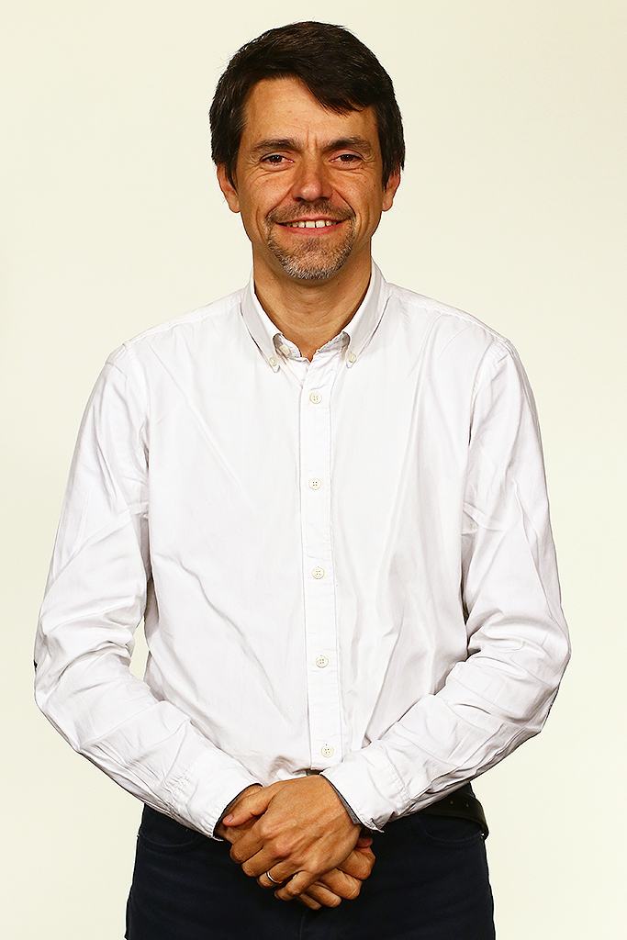
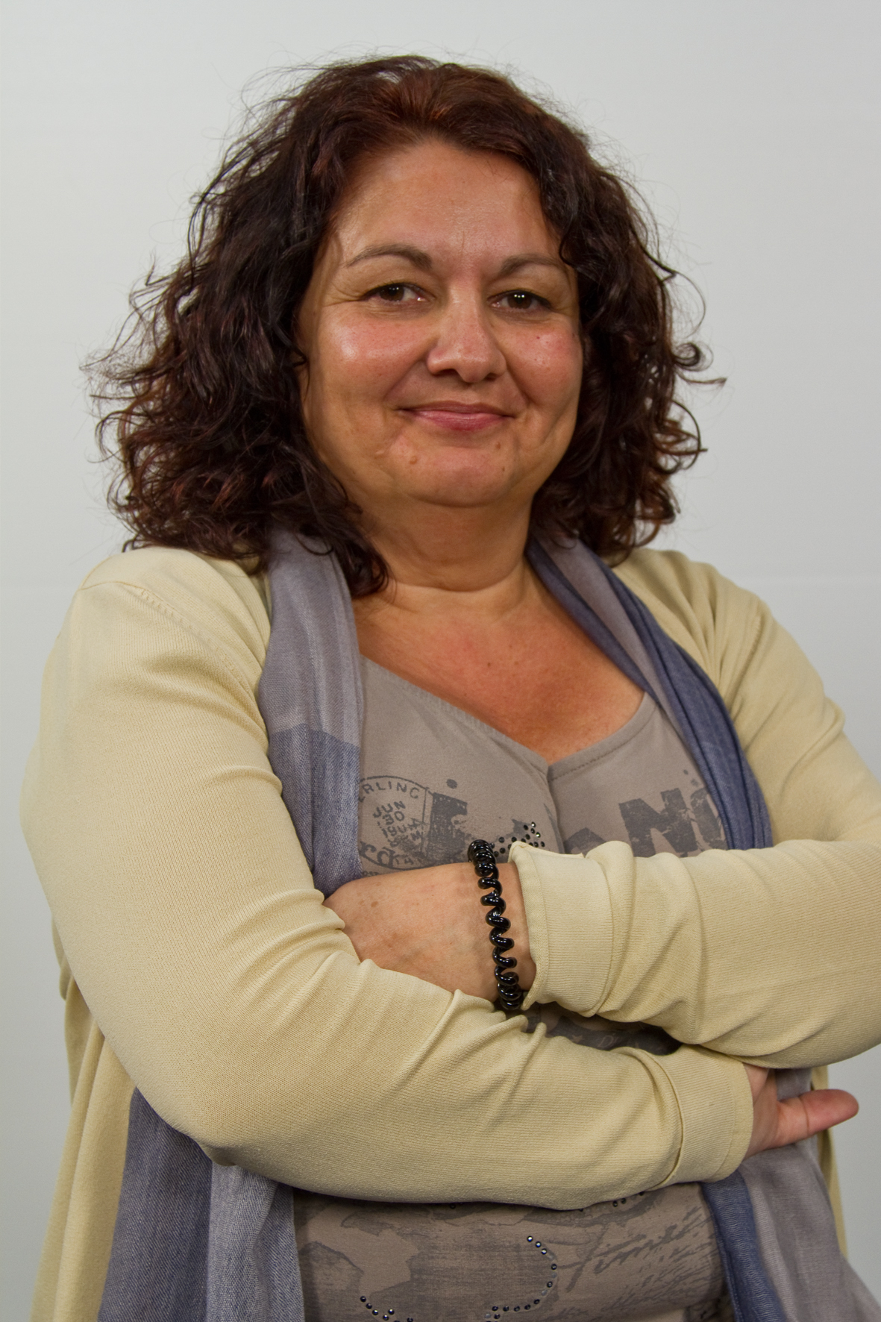
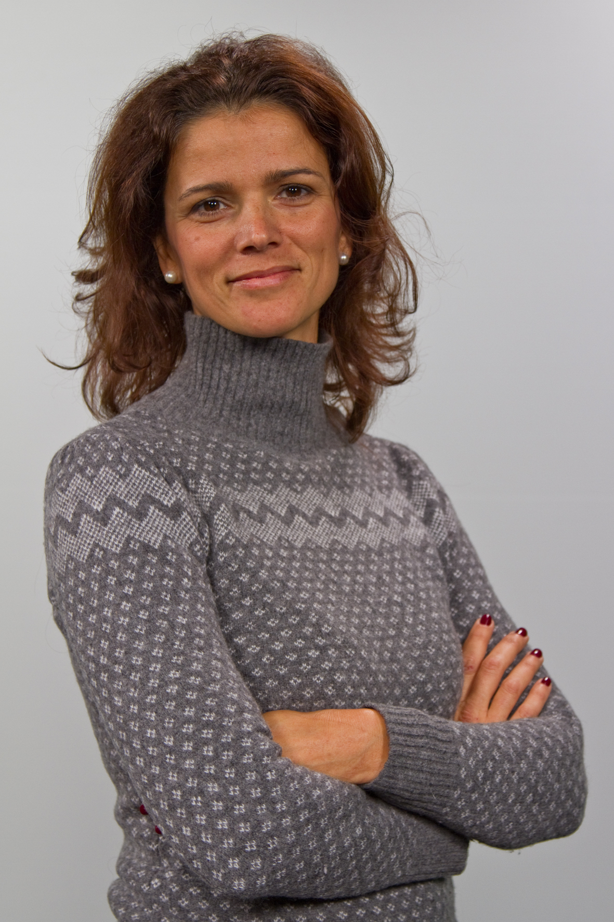
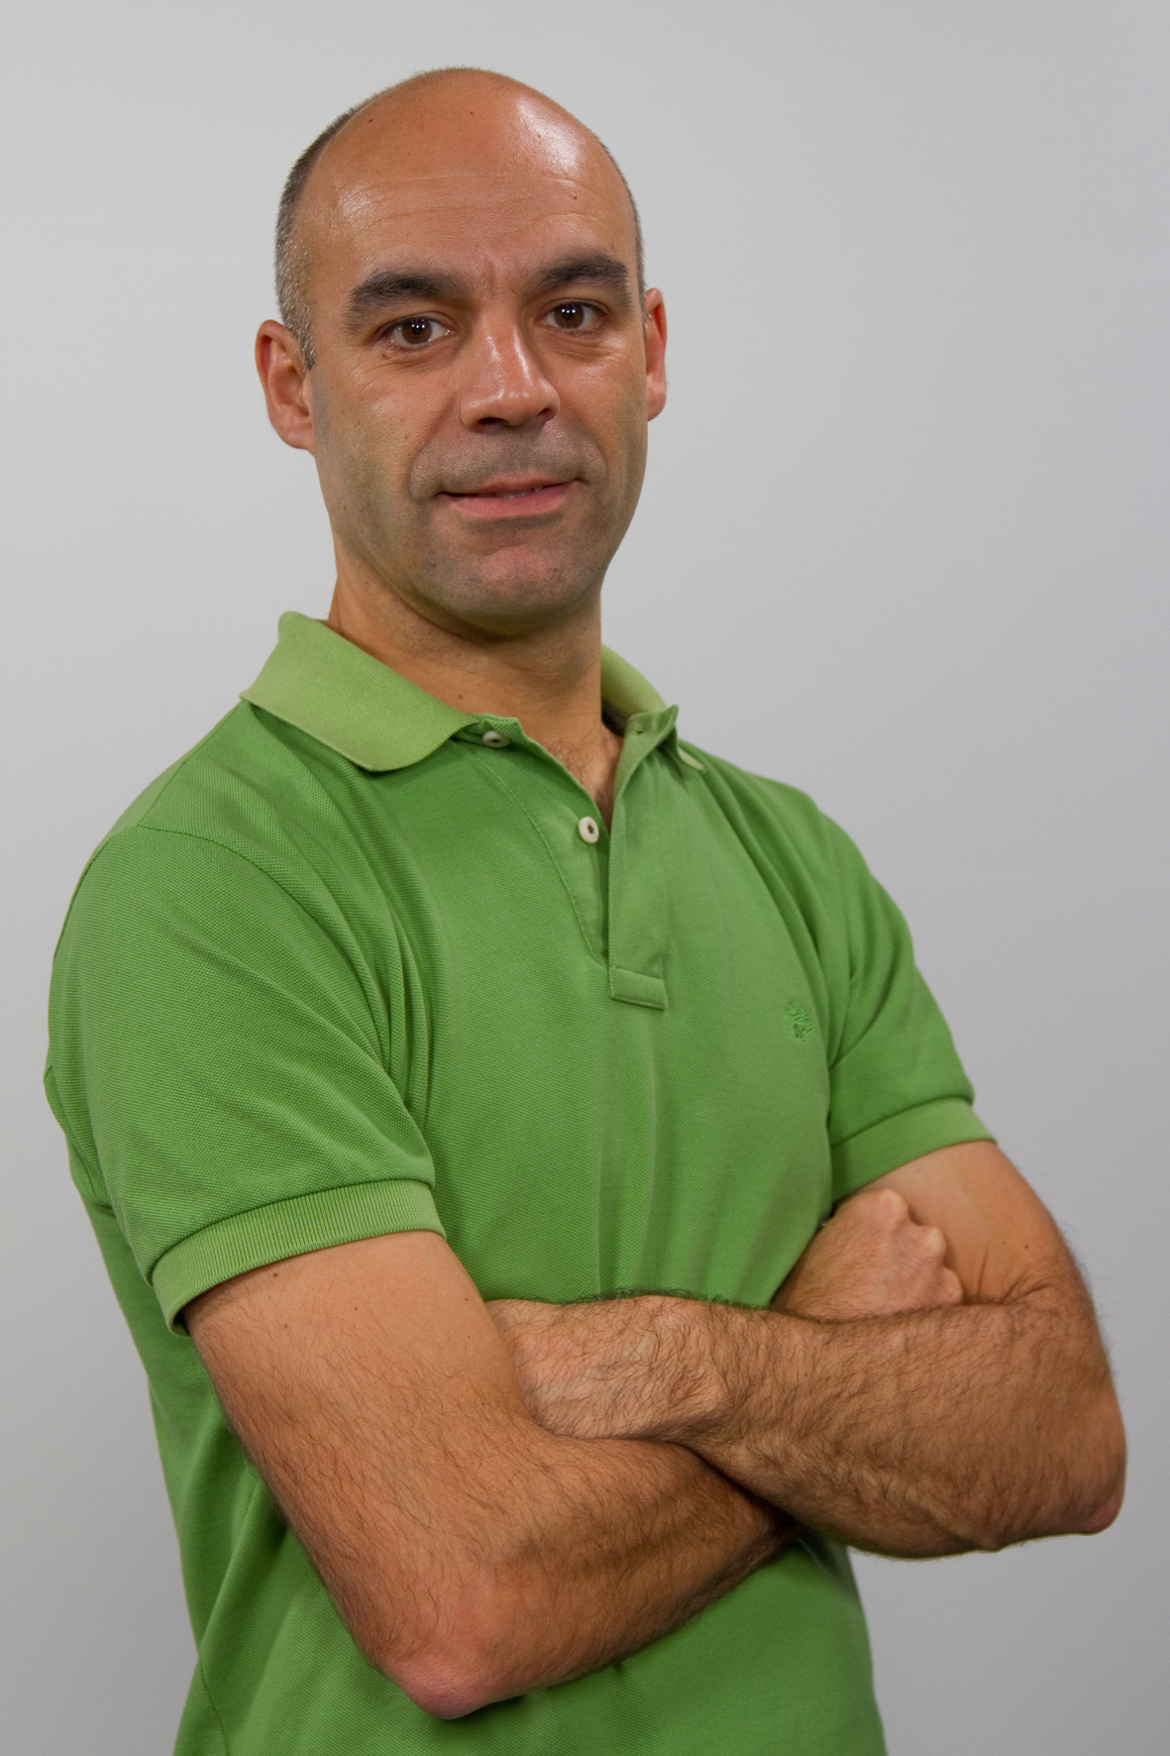
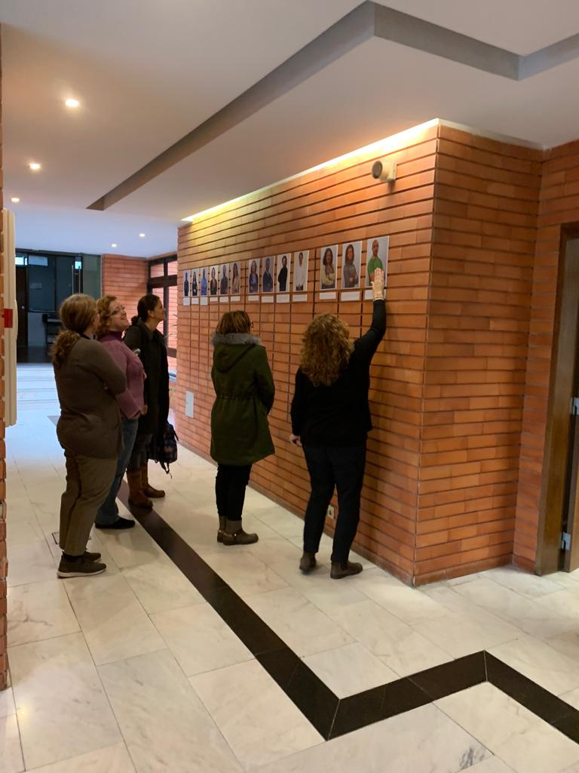
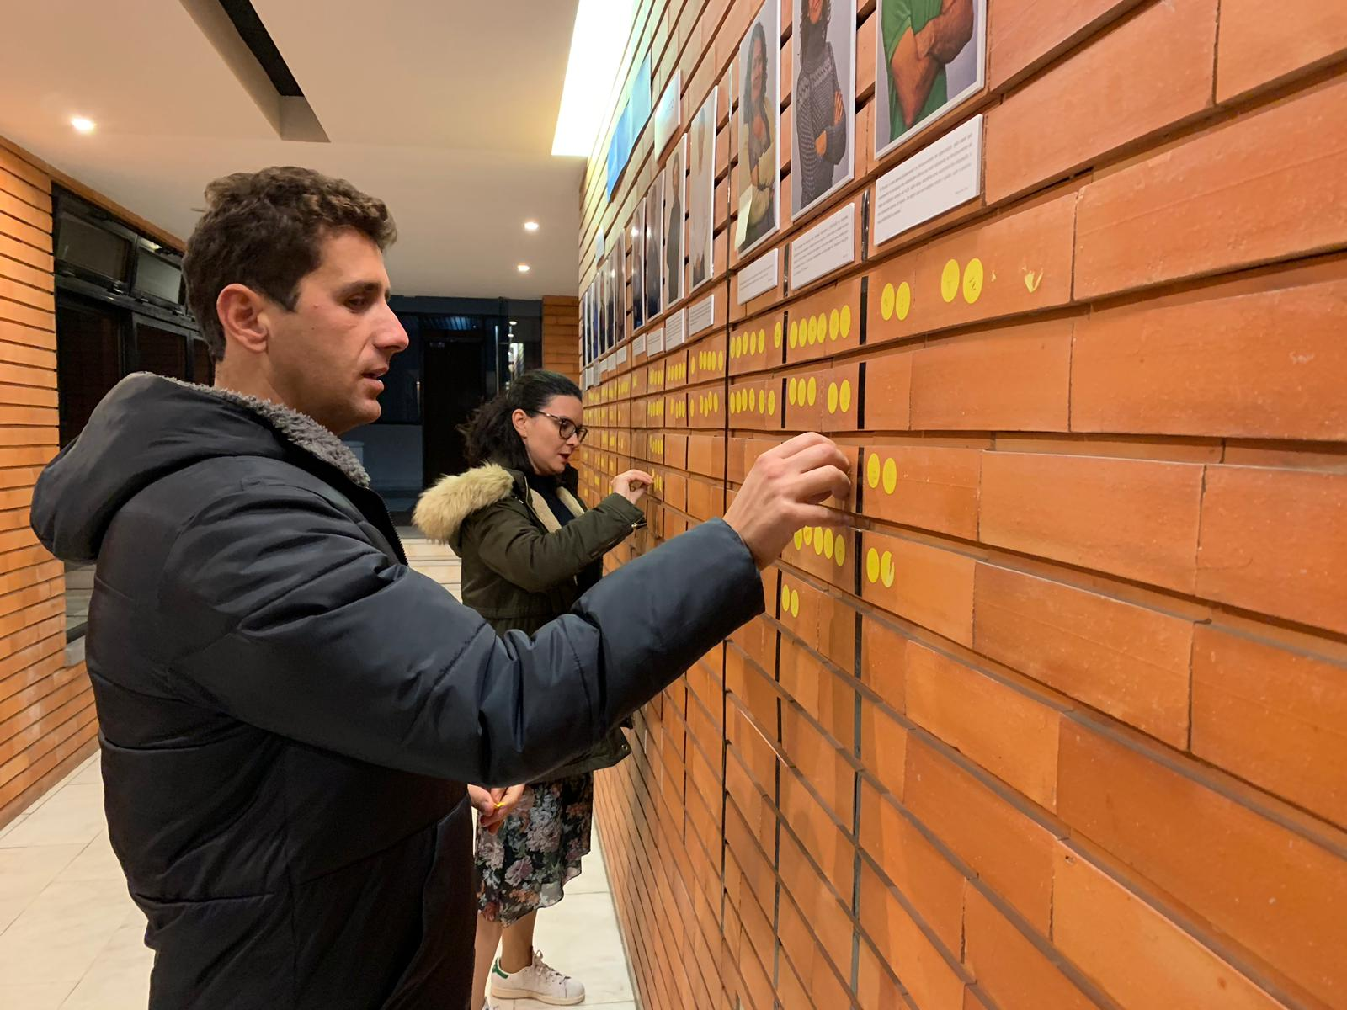
02. Internal Comunication

Slide 13
User Segmentation
04. Strategy
Brand positioning
Business model and strategy for growth
Characterize internal and external Publics
Strategies to imporove communication with both publics
Subcontracted a project aims to
Define
End date: december 2019
.

Slide 14
Thank you!

