Slide 1
RENATER services : focus on end users
17 September 2019
Sig Marcomms - Montpellier
Notes:
Bonjour à tous,
Merci d’assister à cette conférence
Je suis Alice Thorel, responsable marketing chez RENATER. L’équipe marketing (que vous avez pu rencontrée sur notre stand) est rattachée à la direction Relations usagers et développement, dont le directeur Jean-François Guézou est dans la salle. Notre rôle est de tisser un lien entre les activités réseau et services de RENATER et les établissements de la communauté en recueillant les besoins, comprenant les usages et les accompagnant dans leur compréhension de notre offre. C’est pourquoi nous vous proposons aujourd’hui une présentation sur comment mieux vous accompagner dans les démarches d’adoption de nos services auprès de vos utilisateurs.

Slide 2
The strategy comes from several observations
Our surveys show that end users are not familiar with our servicesLogically,
RENATER is also not well known to users and is therefore considered in the same way as market solutions market
As a result, end-users use unsuitable business tools
RENATER must offer better support in the communication on the RENATER services made by the establishments to their users
Notes:
Cette démarche part de plusieurs constats
J’ai construit cette présentation de manière à répondre à de grandes questions : pourquoi, qui, quoi, comment, quand ?

Slide 3
Why ?
Improve brand awareness and use of our services with end users
Help referees within institutions to better communicate RENATER services to all users of their institution.
Facilitate user learning through standardized documentation with clearer and more understandable information for users.
Maximize the appropriation of these supports and the integration into existing channels of the establishment
Facilitate the relay work of information RENATER services to end users
Notes:
On commence donc avec le pourquoi, les objectifs de cette démarche

Slide 4
Who ?
The teams in charge of the digital services of the establishment or user relations are the trusted interlocutors of your users!
Notes:
C’est ensuite posée la question de qui pouvaient porter ces messages auprès des utilisateurs finaux,

Slide 5
How ?
We talked with institutions
10 representative ESR institutions surveyed in February-March 2019
Format: qualitative interviews with ESR institutions
Content: 3 themes around the existing, 1 part test concept (reaction to proposals + choice)
Despite the diversity in nature (university, school, research institute, COMUE, etc.) and in size of users: a remarkable homogeneity of responses
Notes:
Pour mieux comprendre la situation et nous assurer de proposer la meilleure solution possible, nous vous avons interrogé

Slide 6
Which RENATER services are used by end users?
Institutions Answer
Our analysis
RENATER services available to end users are: Evento, RENAvisio, FileSender, eduroam
Users access it via their intranet.
Collaborative services are the most used and can be accessed via a referral from the intranet.
Source : entretiens qualitatifs avec des établissements ESR – février/mars 2019

Slide 7
How do you receive information about RENATER services?
Institutions Answer
Our analysis
No defined channels, little knowledge of catalogs, word of mouth
Technical information for IT staff but very little for end users
Very strong need to define a communication channel
well recognizable
addressed to the right profiles of DSI staff in contact with end users
conveying understandable information to end-users
Source : entretiens qualitatifs avec des établissements ESR – février/mars 2019

Slide 8
How do you communicate RENATER services internally ?
Institutions Answer
Our analysis
Institutions develop their own information media in-house
made available on the intranet via mailing lists, the IT solutions catalog of the institution or internal presentations (descriptions, usage arguments vs commercial solutions, videos tutorial)
RENATER services are presented in the same way as other digital services
Very strong need for a material
ready to use
understandable end users
integrable into usual communication
kept up to date
Source : entretiens qualitatifs avec des établissements ESR – février/mars 2019

Slide 9
What media and channels for receiving information ?
Information material
Reception channels
 | Ranking
Service card printed | 4
Service card digital | 1
Tutorial videos | 2
Presentaion videos | 3
Posters | 5
 | Ranking
Integration in website renater.fr | 1
Dedicated website | 4
Communication kit by email or post | 3
Print partnership | 5
Newsletter | 2
Source : entretiens qualitatifs avec des établissements ESR – février/mars 2019

Slide 10




What ?
Information material selected
Service card
Presentation and tutorial videos
Website
renater.fr
Digital
Customizable and embeddable in institutions presentations
printable
Presentation video of the service (objectives, positioning, functionalities) of less than a minute
Tutorial "My first steps with ..." of 1 min format demonstration on screen
Enrichment with information material
Resources
+ Explanatory note of the approach (for the DSI)
+ RENATER information material and its services (for end-users)

Slide 11
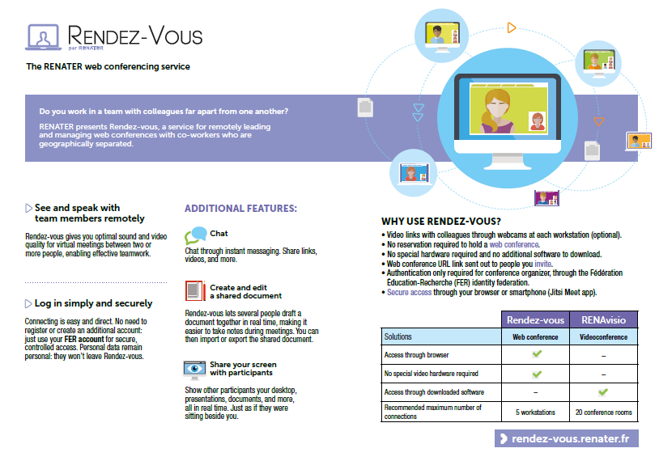
Institution logo
Reasons to use the service
The solution to a problem
How to choose between a particular service
The main features
What is the service for ?

Slide 12
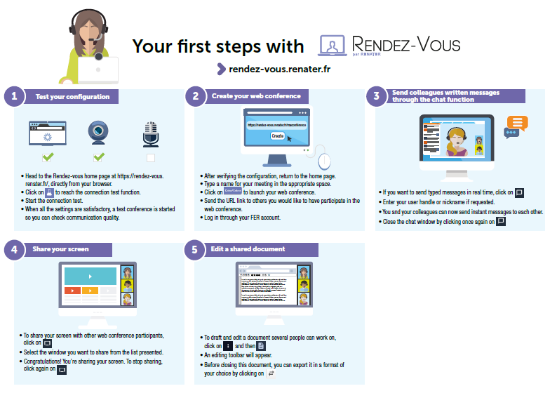
Institution logo
A quick start guide
Your specific information
Your technical contacts
Your technical support

Slide 13
https://www.youtube.com/watch?v=PIDyJYg6Ai8
https://www.youtube.com/watch?v=8If5jMVrxac&t=11s

Slide 14






What ?
Iterative process
Release 1
Mai-Juin 2019
Release 2
Sept-Octobre 2019
Iterative process
  Allows better monitoring of service developments
  Update the supports of the previous release
  Integrates institutional feedback and improvements
Notes:
Nous avons choisi de fonctionner par vagues, dans la lignée de la méthode agile afin de

Slide 15
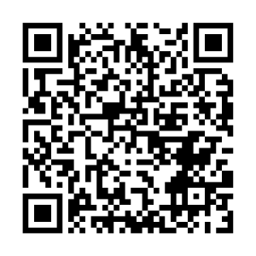
How to access information ?
Via the website renater.fr:
  on the page of each service concerned
  Resources on renater.fr
Via subscription to the newsletter :
  Quarterly frequency
  Content: news services, provision of user cards and videos, surveys to capture feedback on the device
  For teams in charge of the institution's digital services or user relations
listes.renater.fr/sympa/subscribe/newsletter-services-renater
Notes:
Si vous retournez sur le sondage en direct slido.com vous trouverez l’URL pour vous inscrire directement ou la faire passer à vos équipes en charge et vous pouvez également nous faire part anonymement de vos retours sur la démarche, de vos suggestions pour la prochaine vague, etc.

Slide 16
A virtuous circle for end users, institutions and RENATER
Inform
User insights
.
Customizable Collaborative Services Information Materials for End Users
Involve end-users: collecting feedback, listening to needs and understanding uses. Evolve services
Accompany
Tutorials for collaborative services for end users
Notes:
En conclusion, cette démarche s’inscrit dans un cercle vertueux, gagnant-gagnant pour toutes les parties prenantes : il s’agit de
vous aider à informer au mieux les utilisateurs finaux de l’existence des services RENATER pour éviter qu’ils n’utilisent des outils peu appropriés
les accompagner dans leur utilisation, les consulter sur leurs usages
Les consulter sur leurs usages et prendre en compte leurs retours et leurs besoins afin de faire évoluer nos services et repartir dans un cycle.

