Slide 1
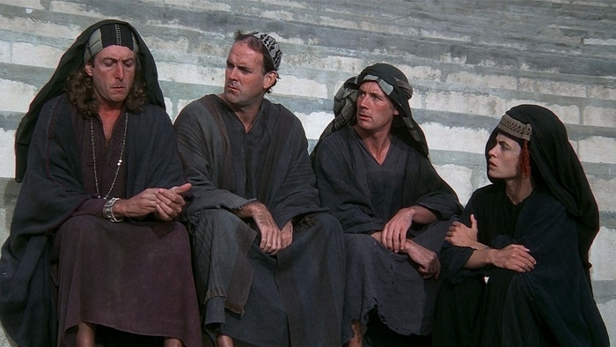
What have the Task Forces ever done for us?
Info-share, 22nd April 2016
Nicole Harris (with apologies to Monty Python)

Slide 2
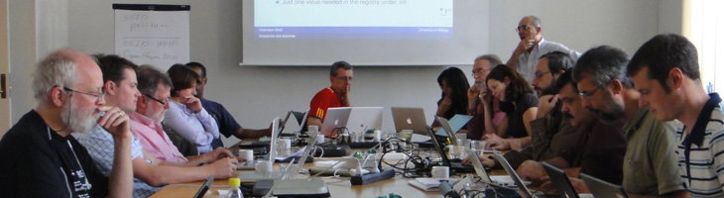
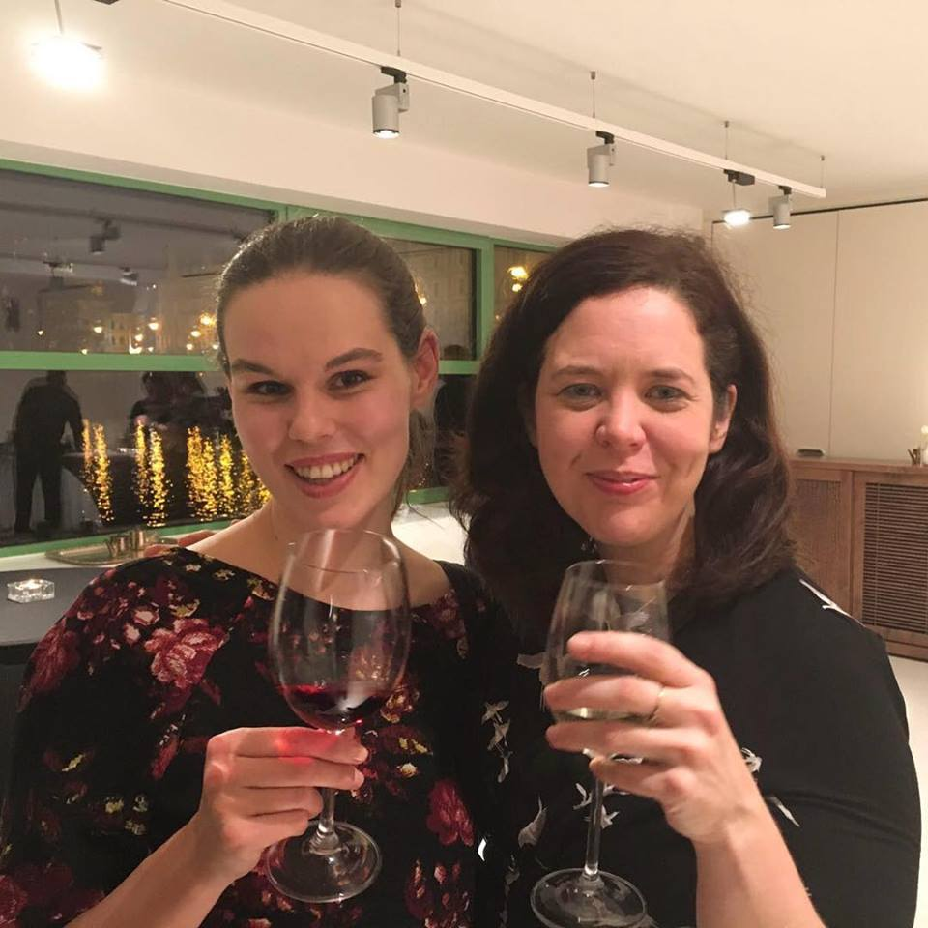
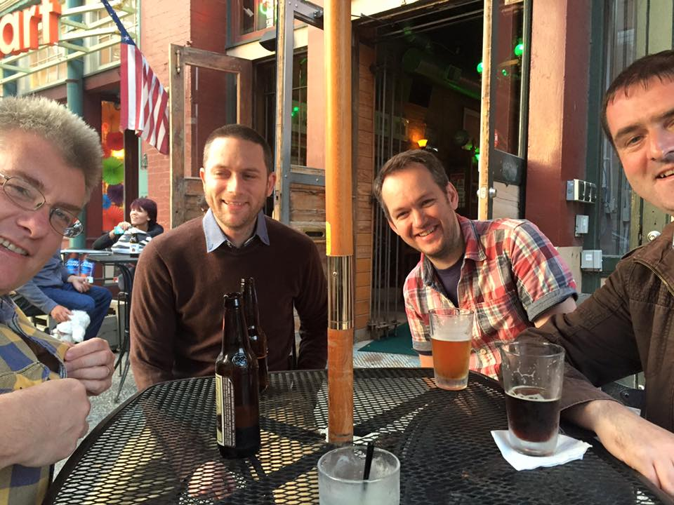
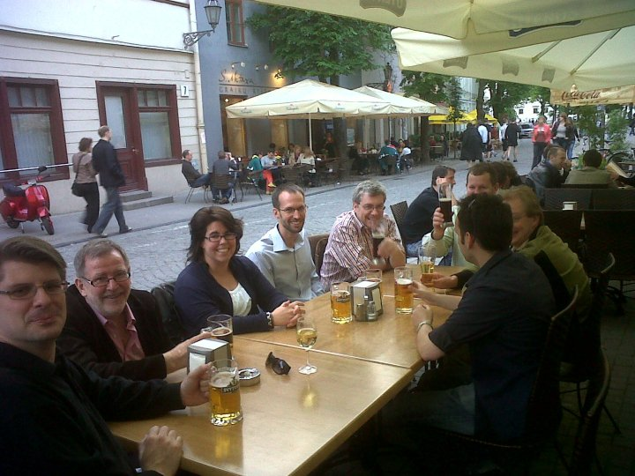
Pictures of people looking at computers on the website
Pictures of people drinking on Facebook

Slide 3
The Case for Face-to-Face

Slide 4
“large-group face-to-face meetings and events are the best option when a business or organization needs to capture attention necessary for a new or different strategy, relationship or product. It is the best option for inspiring people and building a positive emotional climate that influences decision-making and performance at every level. It is the best option for building strong relationships and community that are powerful, informal levers for success in our post-recession business world. Finally, face-to-face is the only option for celebration and recognition rituals that enliven the human spirit and shape the cultural norms of the organization.”
http://www.themaritzinstitute.com/perspectives/~/media/files/maritzinstitute/white-papers/the-case-for-face-to-face-meetings-the-maritz-institute.pdf

Slide 5
a notional form of human social organization based on a set of smaller groups (known as bands), having temporary or permanent political integration, and defined by traditions of common descent, language, culture, and ideology.
TRIBES
TRUSTED INTRODUCER

Slide 6
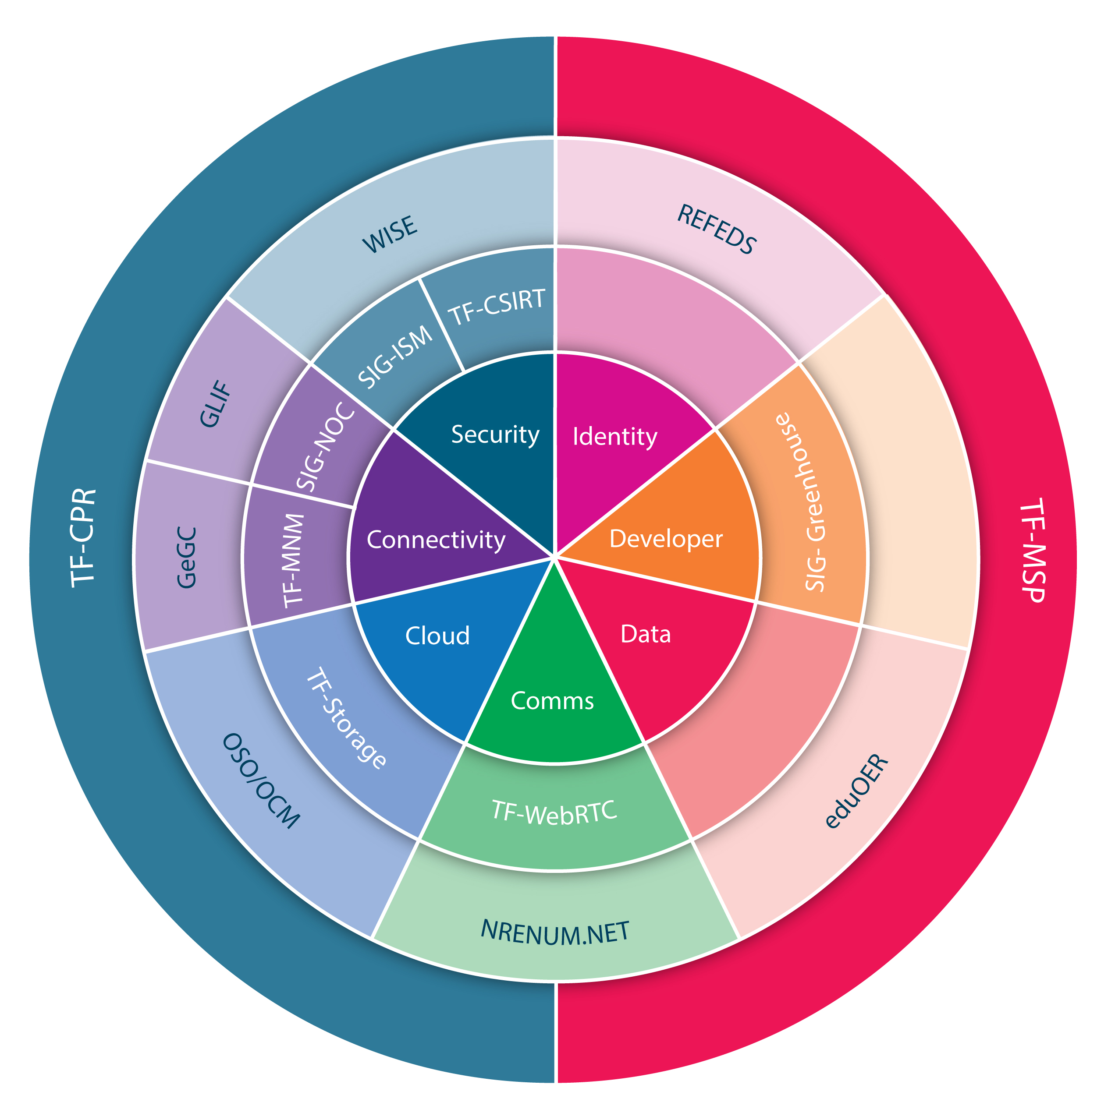
Current Task Force and SIG Portfolio
(+ Special Projects)
Small amount of manpower per group
(secretariat function)
Some travel for chairs
Volunteers
30 – 180 attendees per meeting
Oversight by GÉANT Community Committee

Slide 7
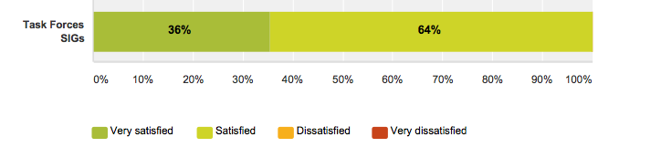
What do our NRENs think?

Slide 8
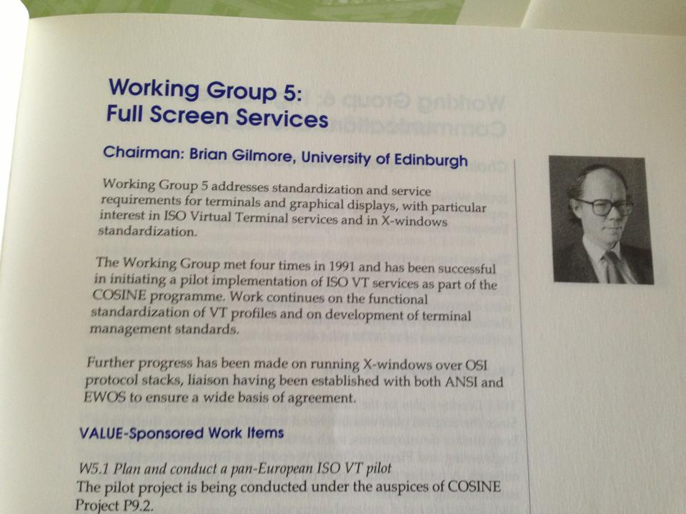

Slide 9
1990
The very first CERT in Europe was established by the French Space Physics Analysis Network (SPAN)
1993
RARE CERT Task Force investigated but not implemented.
1995 - 1999
TERENA Security Incident Response Coordination for Europe (SIRCE).
1999
CERT-coord
2000
1st TF-CSIRT meeting, Trusted Introducer established
TF-CSIRT Timeline

Slide 10

Incubator

Slide 11
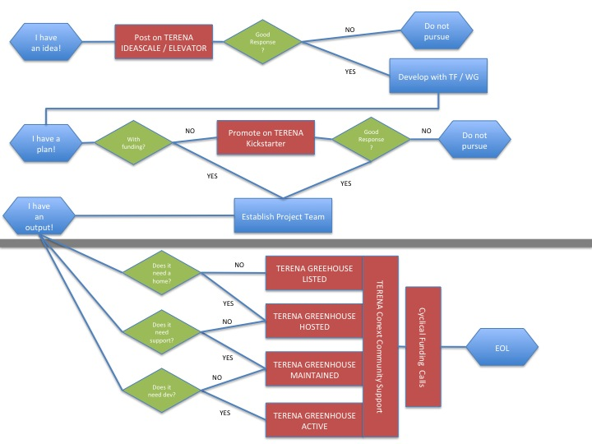

Slide 12

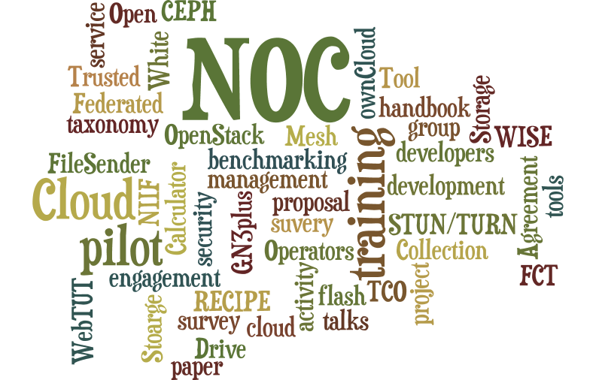





Slide 13


Slide 14
Value of Hosting
Mapping Ideas to Development
Price Is What You Pay,
Value Is What You Get
NREN Involvement Impact
Improving the GCC
Coherent Portfolio

