Slide 1
ACME self-service
Certificates for the masses :-)

Slide 2
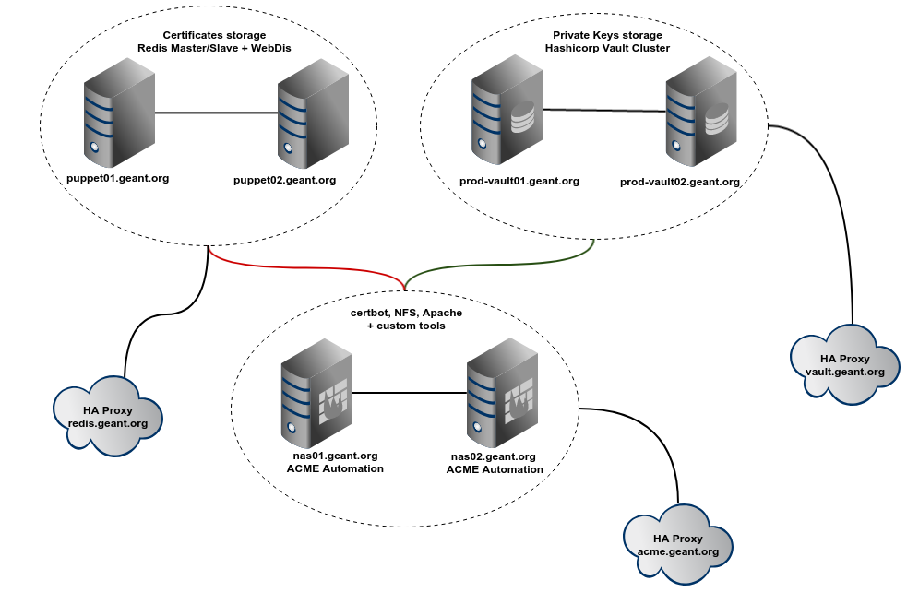
overall architecture

Slide 3
architectural details
“certbot” is the tool developed by Electronic Frontier Foundation (EFF), to manage the certificates in an ACME infrastructure
nas01 and nas02 are two NFS servers replicating to each other. It’s a low end NAS solution: https://forge.puppet.com/modules/maxadamo/tiny_nas
the certificates are declared in gitlab: hieradata_extra/production_acme.yaml
for each new certificate that we declare, a job is triggered and a crontab entry it’s added
the cron entry checks the expiration date of the certificate
if the certificate is expiring the tools geant_acme.py is triggered
geant_acme.py creates a DNS challenge on Infoblox and triggers certbot with a DNS custom hook (this line was missing during the presentation)
geant_acme.py uploads the public key to Redis and the private key to Vault
for each new certificate a new monitoring check is added to Sensu

Slide 4
crontab example (on nas servers)
38 4 * * * /bin/check-ssl-cert.rb -c 30 -w 30 -P /etc/sectigo_ev/live/test-certificate.geant.org/fullchain.pem >/dev/null || /root/bin/geant_acme.py -p sectigo_ev -u dream_team -d test-certificate.geant.org -d certificate.geant.org -d another-sna.geant.org -x --force-renewal

Slide 5
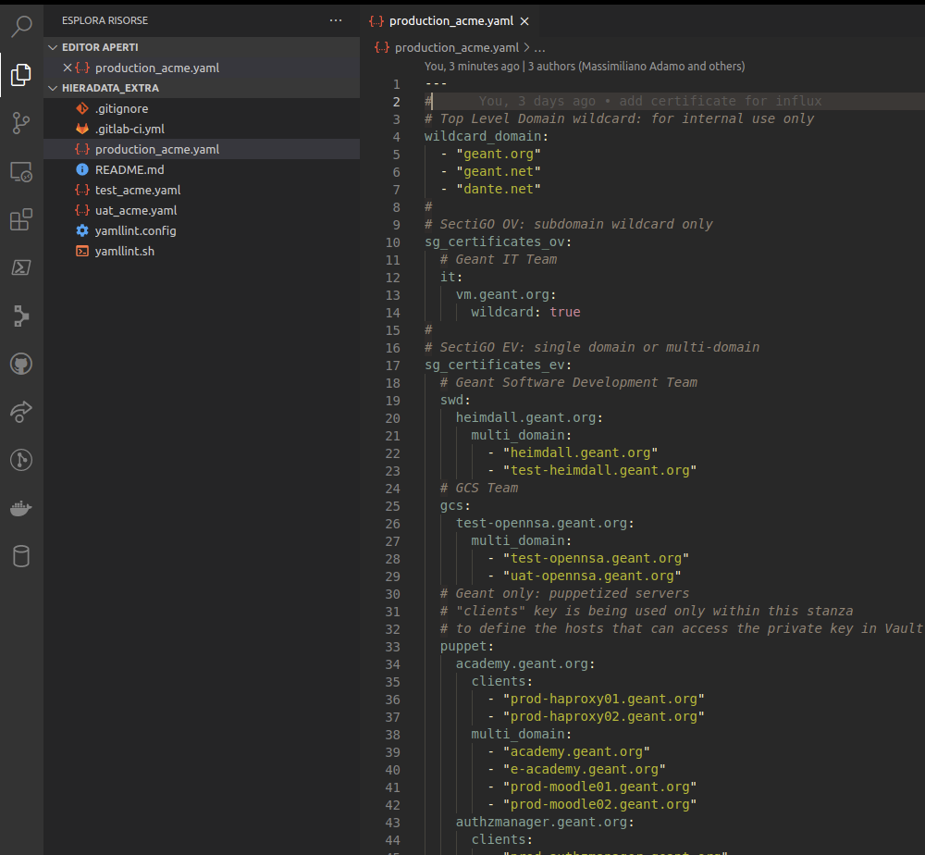
adding new certificates gitlab@gitlab.geant.net:puppet/hieradata_extra.git

Slide 6
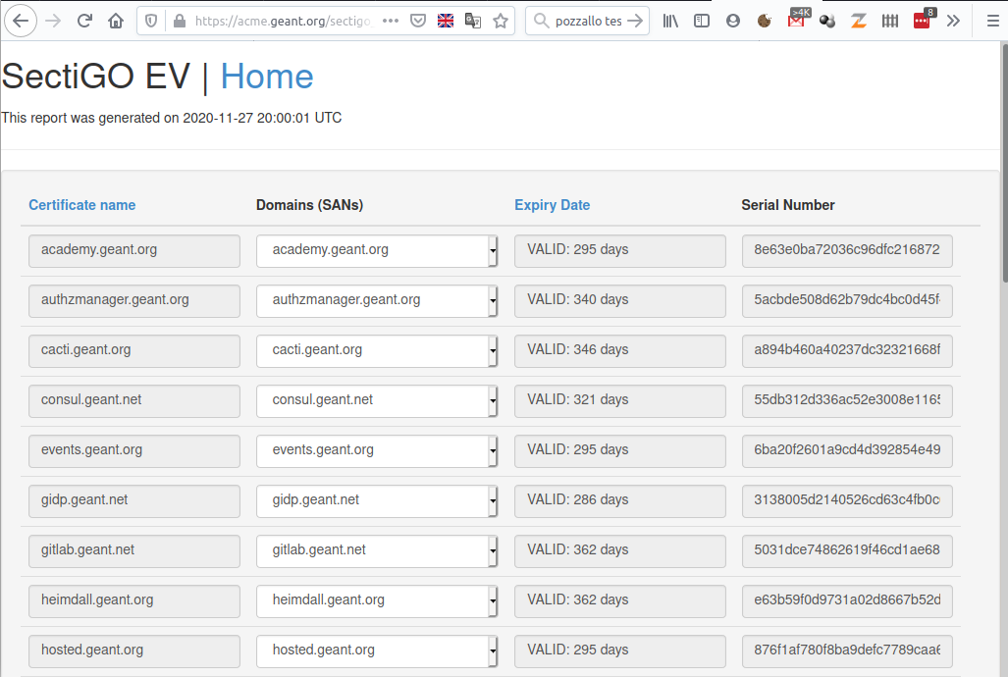
https://acme.geant.org

Slide 7
clients
puppet agent
geant_acme::client { "${consul_influx_service}.service.ha.geant.org":
provider => 'sectigo_ev',
cert_owner => 'influxdb',
cert_group => 'influxdb',
notify => Service[$service_name],
before => File["/etc/influxdb/${conf_file}"];
}
advantages:
it comes with the advantages of your configuration management: for instance it notifies the application (service reload)
disadvantages:
it can be used only internally on servers running the puppet agent
shell script
http://repositories.geant.org/pub/acme/acme-download.sh
advantages:
smaller and easy to modify
disadvantages:
it requires openssl, curl, jq, bash
Go application
https://gitlab.geant.org/massimiliano.adamo/acme-downloader
advantages:
- it is tested on Linux and Windows but it compiles on 43 different platforms
- zero dependencies
disadvantages:
- bigger size

Slide 8
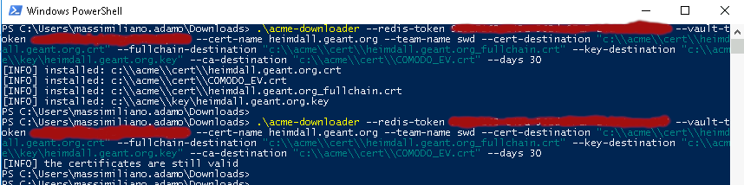
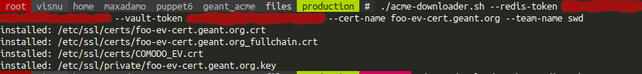
acme-downloader output

Slide 9
process flow: Foo user wants to create the certificate bar.geant.org
Foo adds a certificate definition for bar.geant.org to production_acme.yaml, commits & pushes
waits around 15 minutes for puppet to run either on nas01 or 02 (or run puppet manually)
he can optionally check https://acme.geant.org/ to ensure that bar.geant.org is present
imagine Foo having a certificate installed on Apache. He can create a crontab entry using the following command:
acme-downloader.sh --redis-token <redis-token> --vault-token <vault-token> --team-name dream_team --cert-name bar.geant.org; if [ $? -eq 64 ]; then systemctl restart httpd; fi

Slide 10

ToDo ?

Slide 11
Useful Links
Hiera Redis for Puppet: https://forge.puppet.com/modules/maxadamo/hiera_redis
Hiera Vault for Puppet: https://forge.puppet.com/modules/petems/hiera_vault
Tiny NAS: https://forge.puppet.com/modules/maxadamo/tiny_nas
Geant ACME (not general purpose): https://gitlab.geant.org/massimiliano.adamo/geant_acme
ACME Downloader (Go): https://gitlab.geant.org/massimiliano.adamo/acme-downloader
ACME Downloader (shell): https://gitlab.geant.org/massimiliano.adamo/geant_acme/-/blob/master/files/acme-downloader.sh

Slide 12

Final thoughts & considerations
You do not have Puppet?
SaltStack has a pillar for Vault and several pillars fit to store the public keys
Ansible/Chef? Ask the experts!

