Slide 1
CARNET’s Moodle national instance
TF-EDU:
Moodle scaling up collaborative solutions
March, 4th, 14-15:30 CEST
Gordana Jugo, CARNET

Slide 2
Why Moodle was selected?
WebCT – commercial LMS
Switch to Moodle in 2008
Advantages of Moodle
  Open source
  Teachers were familiar with Moodle
  Developed by a massive community
  Modular (adaptable)

Slide 3
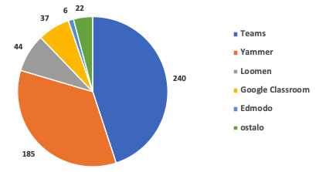
Croatian schools in lockdown
Schools went online in just five days
We were not able to provide service for all schools
  Schools used alternatives (MS Teams, MS Yammer, Google Classroom)
  Not all services were adequate
Loomen = CARNET’s Moodle

Slide 4
Challenges of rapid scale up - Moodle
We provided
  Additional instances for primary and secondary schools with basic service
  Additional Infrastructure
Basic level of service in new instances
Additional load on administrators (some features were not functioning on the new instances)
Service was very slow so we lost many users in the first month

Slide 5
What we didn’t provide
Huge increase in user queries
A lot of new users
Many schools wanted to deliver synchronous teaching
No additional support
No training
No videoconferencing tool

Slide 6
Key challenges with scaling up?
Fast decisions and implementation, not enough time and staff
Cluster solution was developed in CARNET only months later
  Not in line with CARNET infrastructure strategic plan to move to containers
  Still can’t address all user needs (such as national online competitions, online graduation exam, videoconferencing etc.)
Common values, cooperation and planning between Moodle team and infrastructure team is critical

Slide 7
Up2U plus 4 NRENs proposal – why?
GEANT developed a worthwhile educational service – UP2U
However, centralised solution even locally hosted is not adequate for all NRENs
  Local adjustments can’t be implemented
    Automatic course creation
    Courses grouped in categories for each school in which school administrator can open courses
  Local data can’t be migrated
  Local needs can’t be met (such as additional plugins)
Basic idea was to create a solution that would answer all these issues

Slide 8
Main benefits for the community
Availability of Moodle and other solutions adequate for each NREN’s context
Savings in solution development
Savings in solution administration
Savings in future maintenance

Slide 9
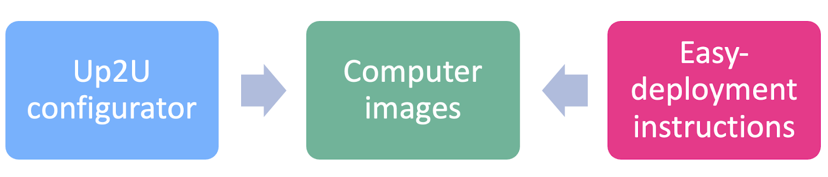
Up2U plus 4 NRENs Solution

Slide 10
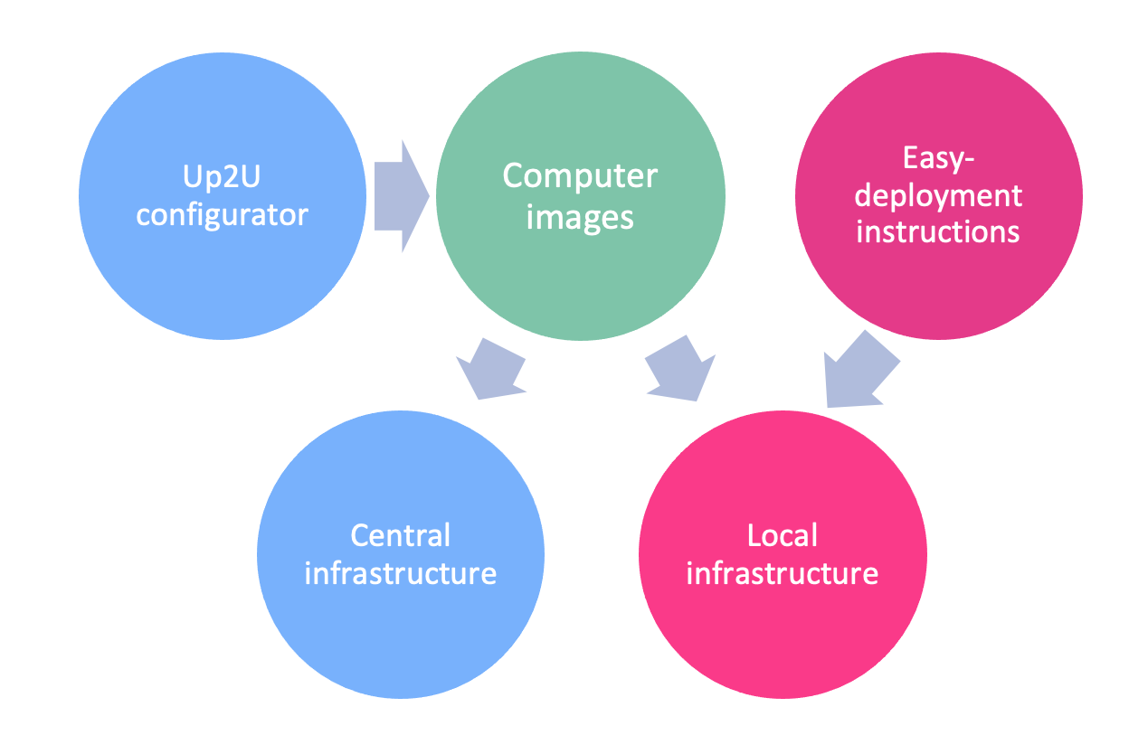
Up2U plus 4 NRENs Infrastructure

Slide 11
Activities in the project
Design and development
Solution initial deployment, testing and optimisation
Support center for included NRENs
Exploitation, evaluation and sustainability
Dissemination
Project Management

Slide 12
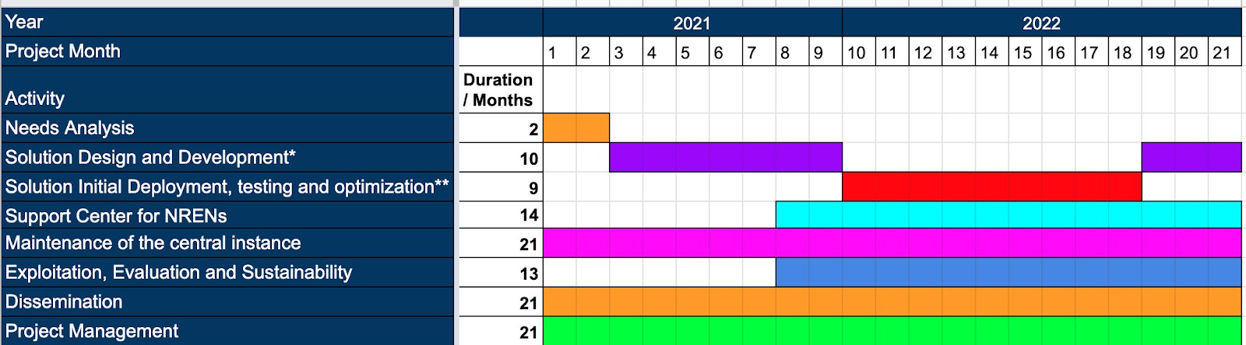
Timeline

Slide 13
Included partners
Albania, RASH
Croatia, CARNET
Cyprus, CyNet
Greece, GRNET
Kosovo, KREN
North Macedonia, UKIM (on behalf of MARNET)
Poland, PSNC

Slide 14
Thank you for your attention
Gordana.jugo@carnet.hr

