Slide 1



TF-Edu Community Session: Moodle
Gyöngyi Horváth, GÉANT
TF-EDU Community Session
4 March 2021
© GÉANT Association
As part of the GÉANT 2020 Framework Partnership Agreement (FPA), the project receives funding from the European Union's Horizon 2020 research and innovation programme under Grant Agreement No. 856726 (GN4-3).

Slide 2
TF-EDU Community sessions
The purpose of creating community space was to intensify our engagement with the community, addressing broader scope of challenges and opportunities.
Shorter and more frequent community discussion meetings (1-1.5 hour every month) alternating between morning / afternoon slots to accommodate global participation.
Topic to be identified by the community.
Format:
  5-10' minutes intro, the rest of the hour free discussion
  Collaboration space that can be revisited every meeting
  Rotate hosting
https://wiki.geant.org/display/NE/TF-EDU+Community+discussion+agenda+and+topics

Slide 3
Outline
Welcome and Introduction – Gyöngyi Horváth (GÉANT)
Presentation about CARNET’s Moodle national instance – Gordana Jugo (CARNET)
Presentation from Lithuania about Moodle / Up2U - Gytis Cybulkis (KTU)
Questions to the audience
Short break
Discussions on common questions / challenges - Break out sessions (if time allows)
Closing

Slide 4
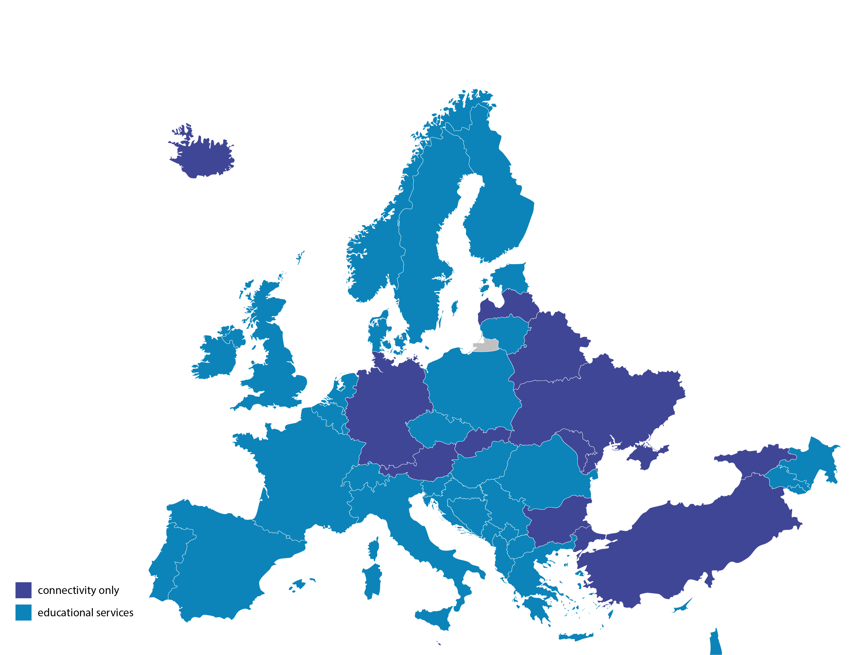
GÉANT NRENs educational services
Notes:
Connectivity: 43 NRENs
Additional edu services: 31
Only connectivity: 12

Slide 5
GÉANT NRENs educational services
Notes:
Connectivity: 43 NRENs
Additional edu services: 31
Only connectivity: 12

Slide 6
GÉANT NRENs educational services
Notes:
Connectivity: 43 NRENs
Additional edu services: 31
Only connectivity: 12

Slide 7
Thank you
gyongyi.horvath@geant.org
© GÉANT Association
As part of the GÉANT 2020 Framework Partnership Agreement (FPA), the project receives funding from the European Union's Horizon 2020 research and innovation programme under Grant Agreement No. 856726 (GN4-3).

