Slide 1


TF-EDU infoshare & discsussion– February 11th 2021
TF-EDU annual survey 2020
Survey analysis: Dragana Kupres, Mojca Makovac, Klara Bilić Meštrić (CARNET)
Survey authors: TF-EDU Steering Committee
As part of the GÉANT 2020 Framework Partnership Agreement (FPA), the project receives funding from the European Union's Horizon 2020 research and innovation programme under Grant Agreement No. 856726 (GN4-3).​​​

Slide 2
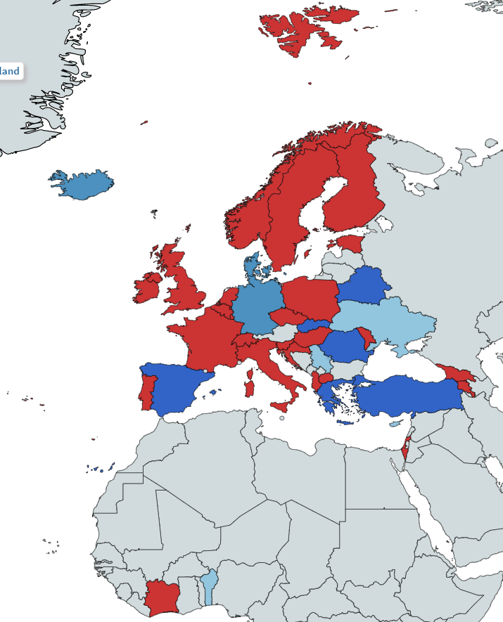
Overview of NRENs providing educational services / activities beyond digital infrastructure, network and network services
YES
Education not within organisation’s remit
Lack of resources (e.g. cost, time, staff)
Other (Ministry of Education and Regional Governments, universities
42 NRENs
Notes:
Iceland Cyprus Slovakia Germany Belarus Serbia Denmark Greece Romania Denmark Turkey Spain Benin Ukraine – NO
Finland Italy United Kingdom of Great Britain and Northern Ireland Montenegro The former Yugoslav Republic of Macedonia Albania Sweden Luxembourg Portugal Israel Armenia Slovenia Norway Lithuania Ireland Switzerland Poland Czech Republic Belgium Republic of Moldova Côte D'Ivoire Netherlands Estonia France Georgia Croatia Hungary Azerbaijan - YES

Slide 3
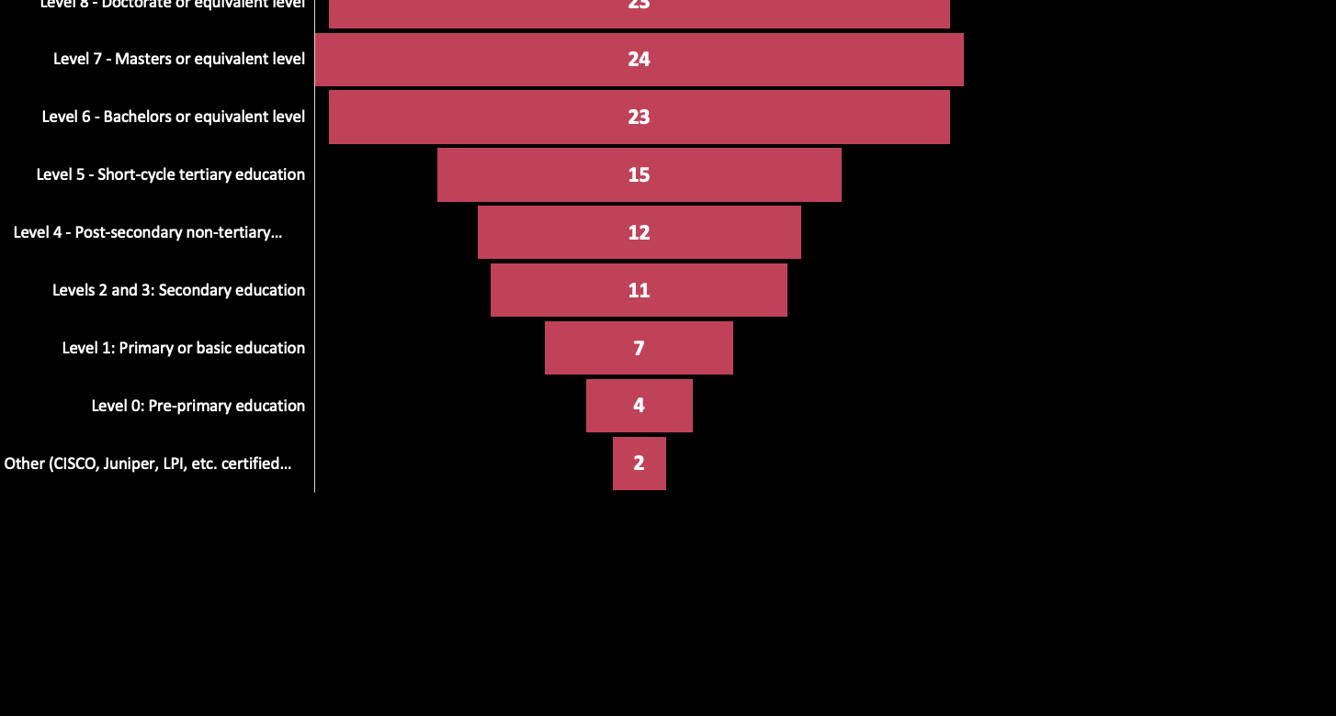
Levels of education supported by NRENs
(based on ISCED 2011 classification system)

Slide 4
Educational services are defined as:

Slide 5
Level of maturity of education services / activities

Slide 6
Levels of education for each educational services / activities supported by NRENs
(based on ISCED 2011 classification system)

Slide 7
Organisational strategy for developing these services / activities

Slide 8
Maturity of the processes of developing and delivering education services/activities

Slide 9
Collaboration with other NRENs (or universities / companies) in developing and offering educational services / activities

Slide 10
Interest in collaboration on specific services / activities

Slide 11
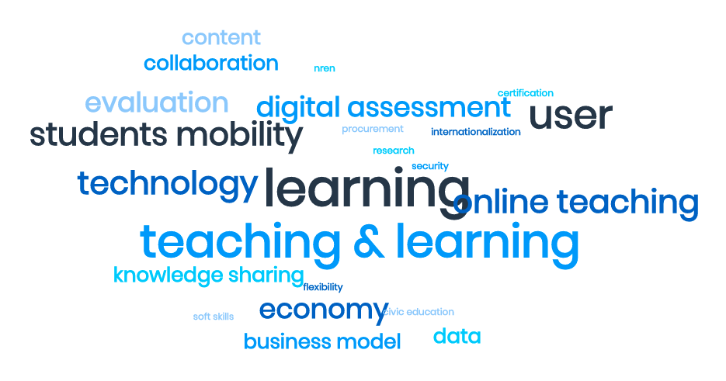
Big questions in educational services (now, short and long-tem)

Slide 12
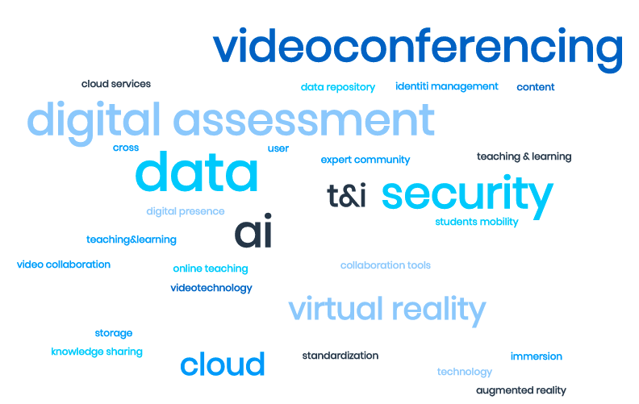
TECHNOLOGIES that exist or will need to be developed to support education services?

Slide 13
THANK YOU!
Any questions?

Slide 14
Partnering organisation when collaborating
NORDUnet
Many
EBSCO (USA), Akademia(Kosovo)
Nordic countris, joint procurement via NORDUnet.
CARNET, National Institute for Education, Pedagogical faculties
GÉANT
GÉANT, NRENs, other national institutions, universities
We have no formal collaborations yet, but are for ex. in close contact with SURF for eduVPN.
WACREN, RENATER

Slide 15
Levels of education supported by NRENs
(based on ISCED 2011 classification system)
Country/Level | 8 | 7 | 6 | 5 | 4 | 2&3 | 1 | 0
Albania
Armenia
Azerbaijan
Belgium
Côte D'Ivoire
Croatia
Czech Republic
Estonia
Finland
France
Georgia
Hungary
Ireland
Israel
Italy
Lithuania
Luxembourg
Montenegro
Netherlands
Norway
Poland
Portugal
Republic of Moldova
Slovenia
Sweden
Switzerland
The former Yugoslav Republic of Macedonia
United Kingdom of Great Britain and Northern Ireland
Grand Total | 23 | 24 | 23 | 15 | 12 | 11 | 7 | 4
Level 8 - Doctorate or equivalent level | 23
Level 7 - Masters or equivalent level | 24
Level 6 - Bachelors or equivalent level | 23
Level 5 - Short-cycle tertiary education | 15
Level 4 - Post-secondary non-tertiary education | 12
Levels 2 and 3: Secondary education | 11
Level 1: Primary or basic education | 7
Level 0: Pre-primary education | 4

Slide 16
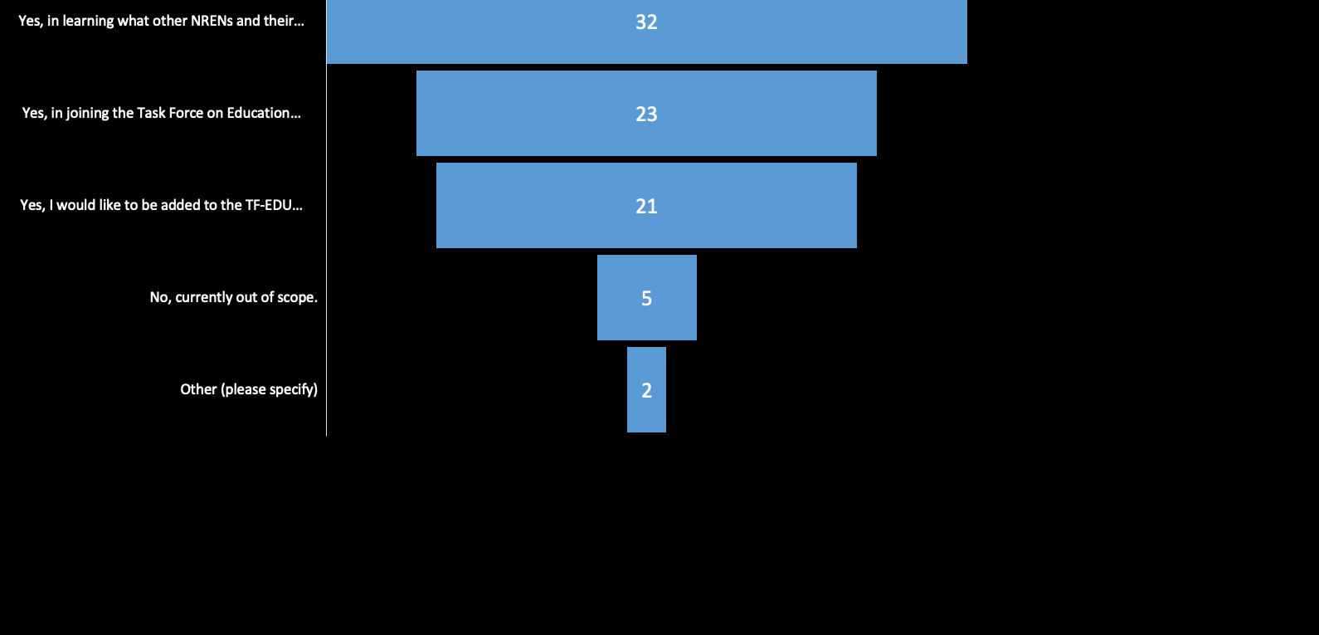
Interest in collaboration on specific services / activities

