Slide 1

Challenges and Opportunities for Developing and Supporting
National Up2U Infrastructure in Lithuania
G. Cibulskis, R. Kutas
E-Learning Technology Centre,
Kaunas University of Technology

Slide 2
Challenges for offering
LMS services to Schools
Every school wants its own LMS instance
Support and the updating of the infrastructure
Scalability to handle big amounts of users
Lack of teachers’ skills in using tools

Slide 3
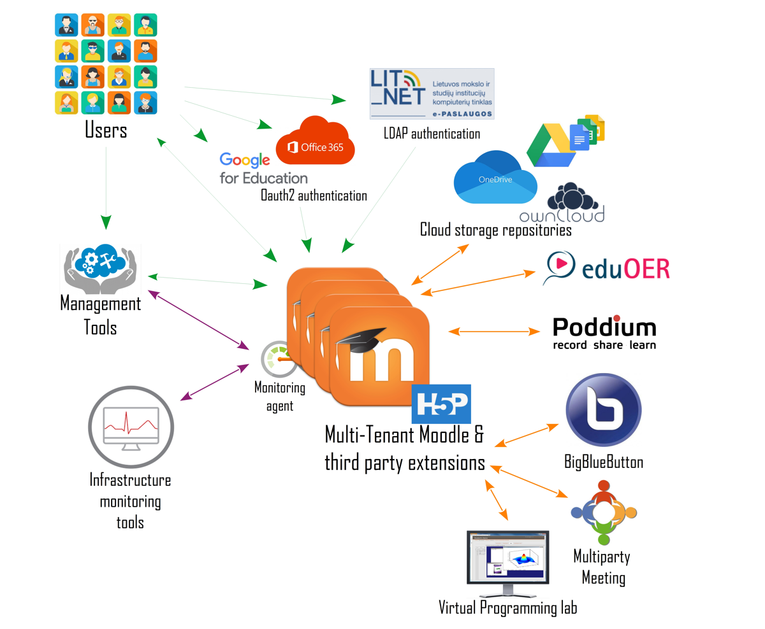
Setting up Infrastructure

Slide 4
Setting up of Up2U Infrastructure
2018
Multi-tenant Moodle offered to schools as part of Lithuanian NREN (LITNET) services
2019
Integration of tools from Up2University toolbox (H5P, VPL, Poddium, eduOER, etc.)
2020
Integration with LITNET Identity Provider epaslaugos.lm.lt
Scaling up for large scale piloting and COVID-19
Adding new services (BBB, video.lm.lt, MS Teams meetings)

Slide 5
Site with school registration and FAQ vma.lm.lt

Slide 6
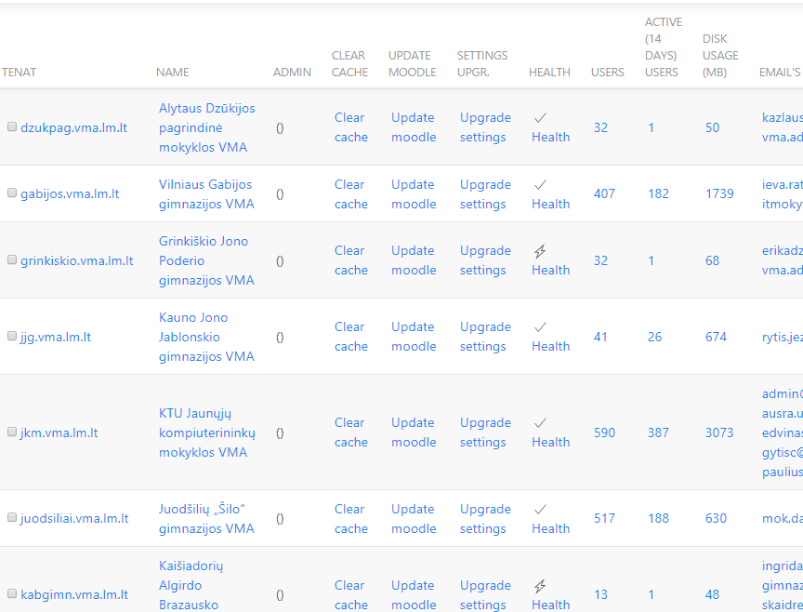
Maintenance dashboard

Slide 7
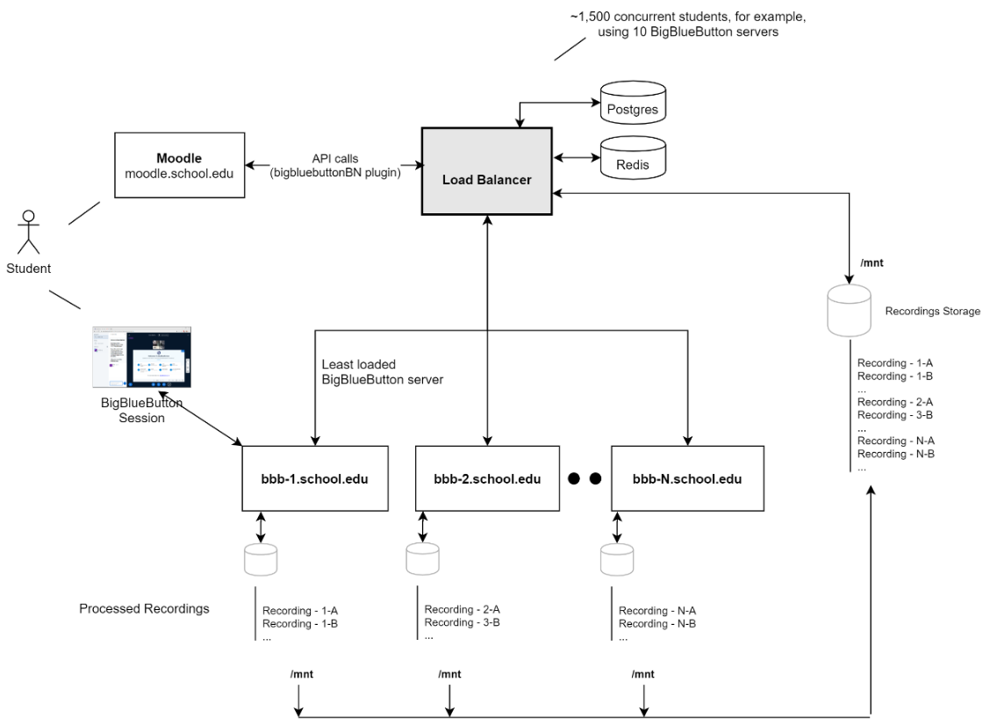

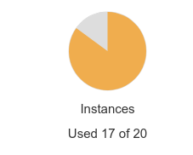
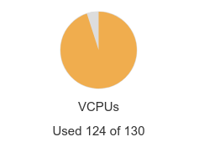
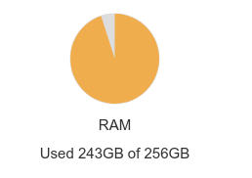

Slide 8
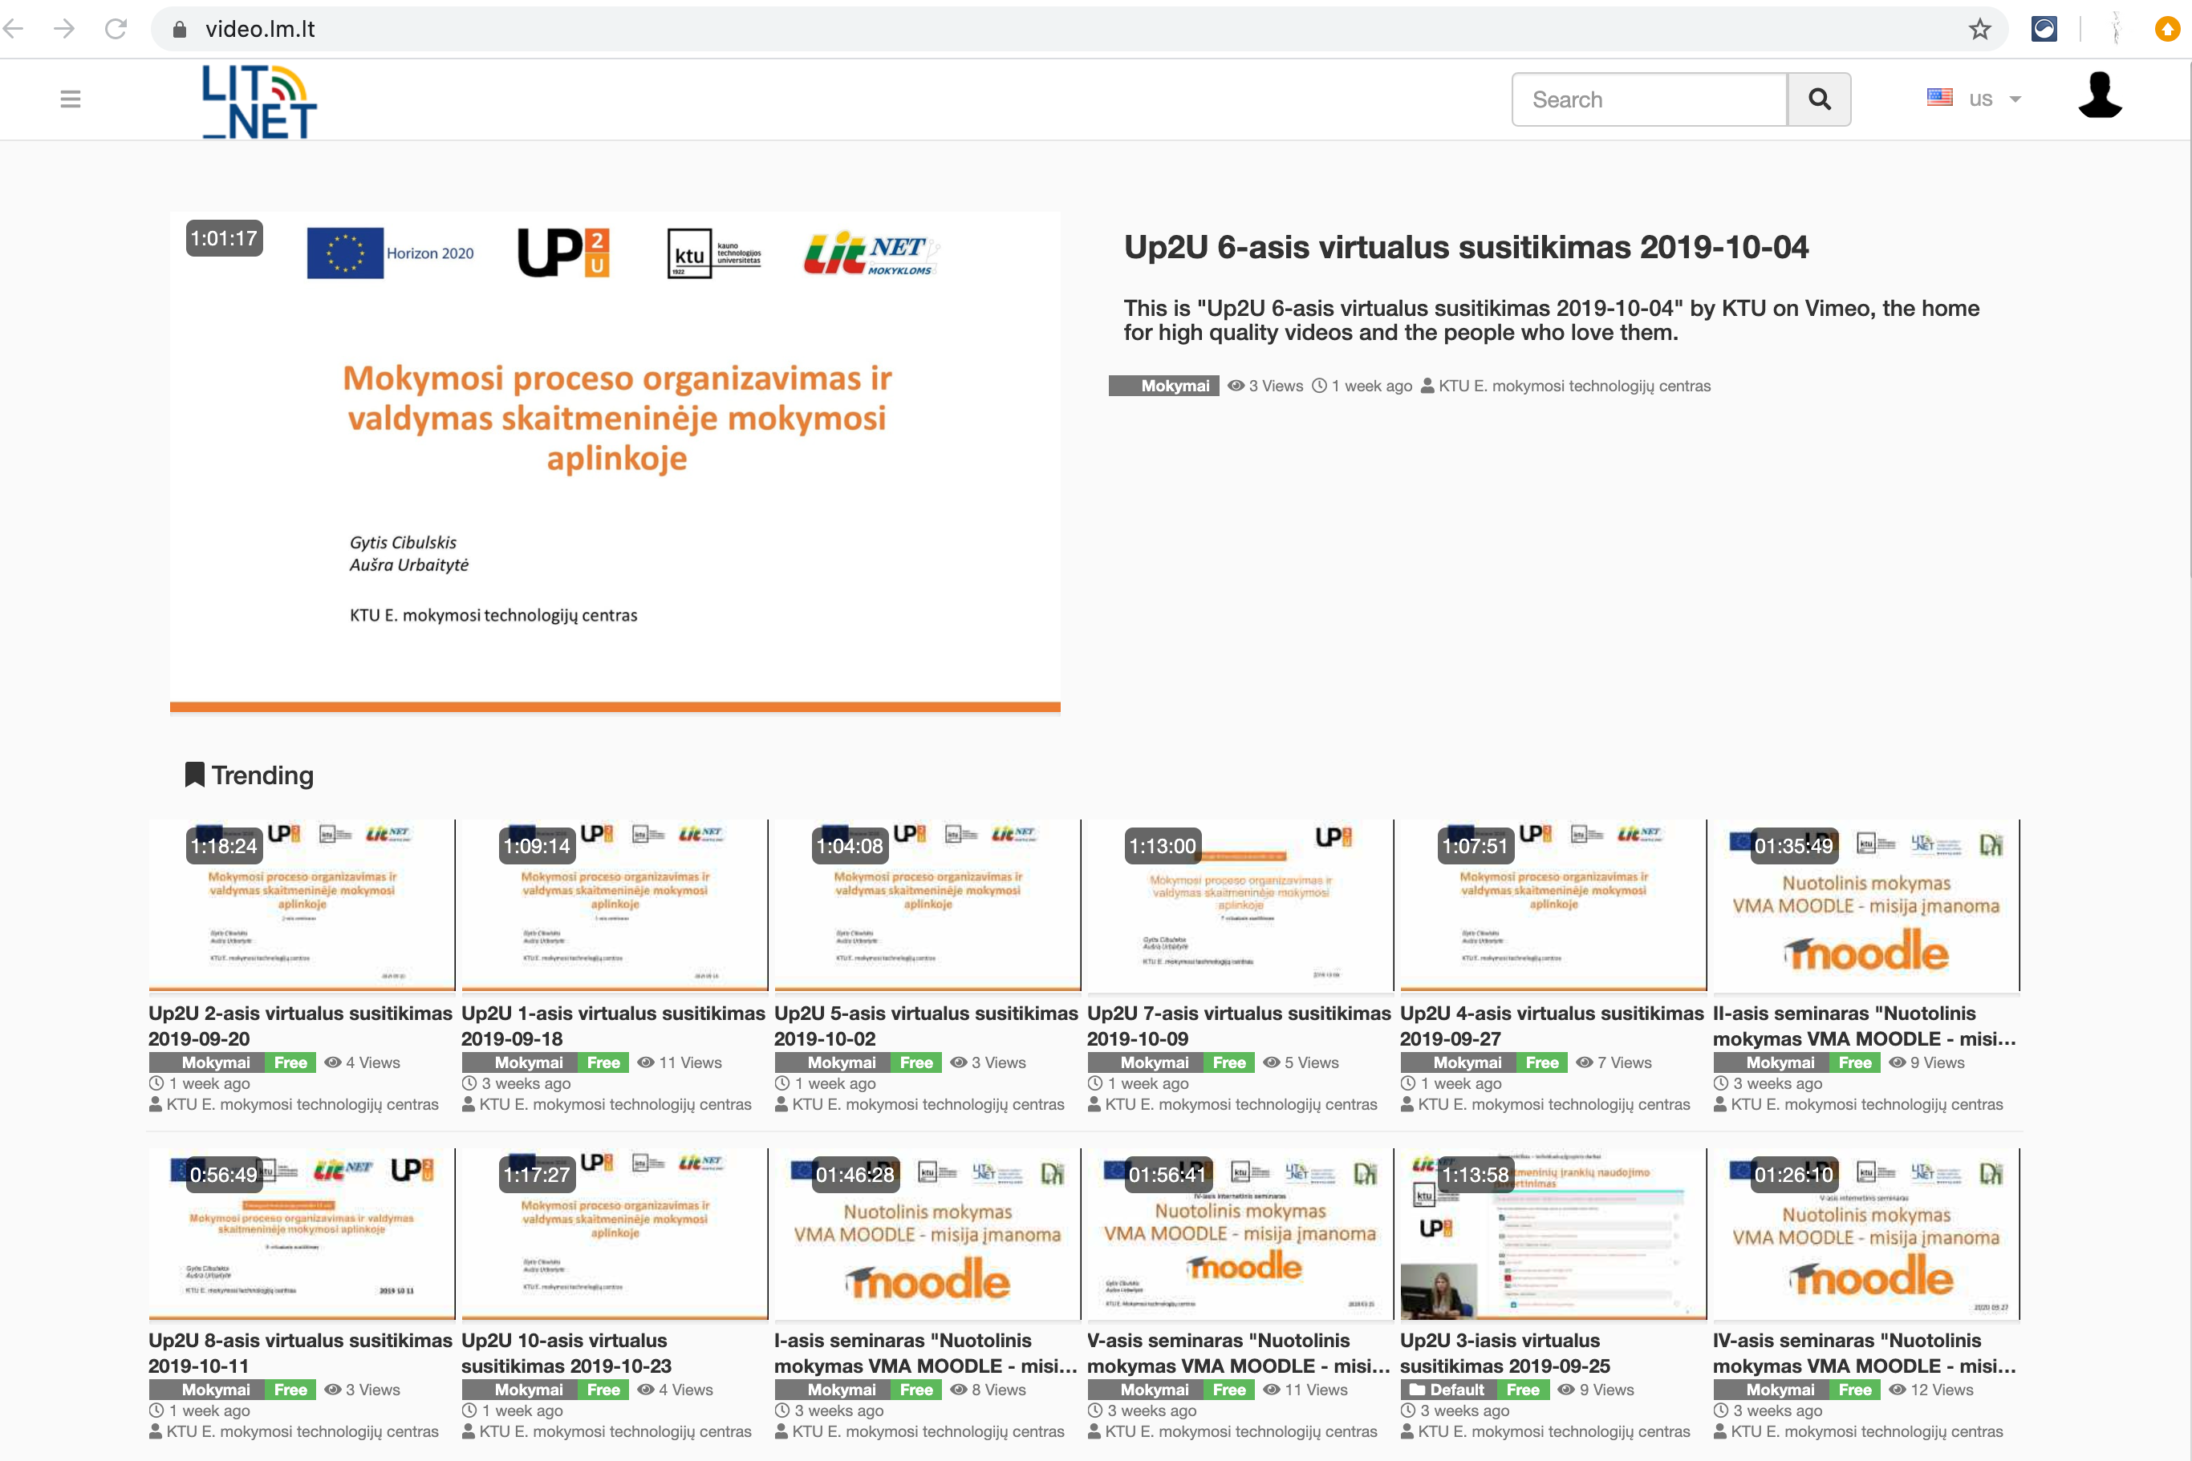
Open Source
Video Platform
video.lm.lt
safe and secure platform for educational video content
integrated with IDP epaslaugos.lm.lt
only teachers can upload

Slide 9
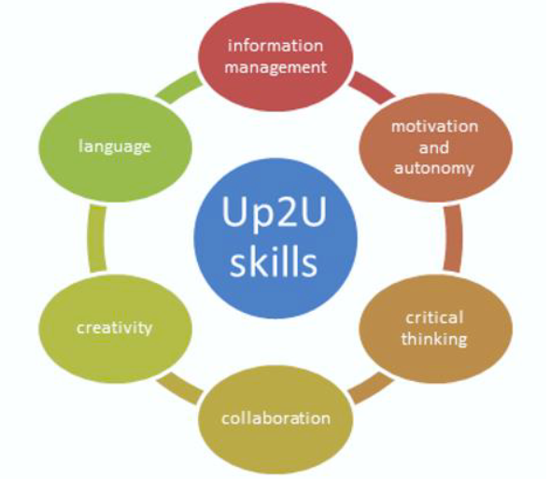
Up2U Continuing Professional Development (CPD) for teachers
CPD aims at DigComEdu competences
Module 1 - Introduction and Orientation
Module 2 - Hands-on implementation and practice (Teachers who graduated Module 1 will apply learned skills in their own classrooms, with their students)
Module 3 - Cascade or ‘train-the-trainer’ model to facilitate scaling up

Slide 10
CPD Module 1
30 hours (40 academic hours) qualification improvement program developed in Lithuanian and officially approved
Dedicated VLE established at https://mokymai.vma.lm.lt
Face-to-face delivery for 15 selected teachers in 2018
Online learning program is developed and delivered in
3 iterations during 2019:
  January-February - 166 teachers
  March–April - 352 teachers
  September-October – 472 teachers

Slide 11
CPD Module 2 & Module 3
CPD Module 2 officially approved as a 30 hours (40 academic hours) online learning qualification improvement program
Delivered for 253 teachers in December 2019 – February 2020
90 successful graduates of Module 2 were involved in Module 3 - provided with Module 1 materials (Moodle course backup file) and instructed on how to organize teacher trainings

Slide 12
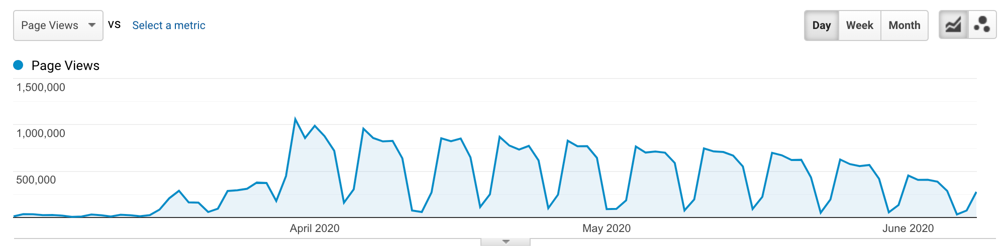
COVID-19 Spring hit in
Lithuania
>1K teachers involved in trainings
>8K teachers joined webinars
270 Moodle instances
>15K courses
>75K students registered
>50M page views

Slide 13
COVID-19 implications
60 new schools added
5 COVID-19 dedicated webinars attended by 8K teachers
Peak loads (up to 3K concurrent users)
  increased number of CPU up to 100
  multiple DB servers
Big amounts of students’ uploaded data
  SSD storage used for better performance
  ~4T of storage occupied
National strategy to facilitate use of VLEs and provide further support for Up2U national infrastructure is needed

Slide 14
Lessons Learned
CPD success factors:
officially recognized certificates increased teacher's motivation
effective organization of the learning process allowed large number of participants
positive recommendations from previous participants helped to grow interest

Slide 15
Short Learning Program
„DigCompEdu in Virtual Learning“ is planned on the basis of CPD
CPD Module 1
(2 ECTS)
CPD Module 2 (2 ECTS)
CPD Module 3 (2 ECTS)

Slide 16
Fall 2020 - Updated CDP Module 1
“Organizing and Managing Learning Process in a VLE Moodle”
2 ECTS – 45 hours (60 academic hours)
  October – December 2020
927 teachers from 205 schools
  among them - 412 paid participants aiming for certificate

Slide 17
Challenges for the future
Most schools has already chosen among GSuite, MS Teams and Moodle, thus attracting new schools might be difficult
Scaling up brings technical challenges
  Virtual servers approaching size of physical machines
  Moodle data approaching 10T
Question of centralised funding is still pending

