Slide 1


Popular Topics in the User Space
Enzo Capone
Head of Research Engagement and Support
www.geant.org

Slide 2






User groups we liaise with
Physics sciences
High-energy physics (LHC, BELLE II, CERN, etc.) Gravitational wave observation (LIGO, VIRGO)
Neutrino observation (KM3NET, CTA)
Astronomy and Earth observation
Earth observation (EUMETSAT, COPERNICUS, GEO)
Radio-astronomy (eVLBI, SKA, AENEAS)
Satellite operations (ESOC)
E-Infrastructures
EGI
EUDAT
PRACE
HelixNebulaSC
Future Internet projects
(XiFi, Confine, SmartFire, etc.)
Life sciences
Genomics (Elixir, EBI, EMBL)
BioImaging

Slide 3
The people
WP3 T2 Task in the GN4-3 project:
  9 people from GÉANT, DFN, CESNET, MARNET, RENAM
Research Engagement and Support Team
  5 people

Slide 4

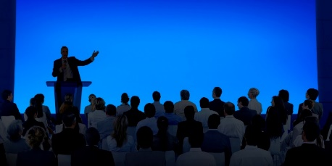
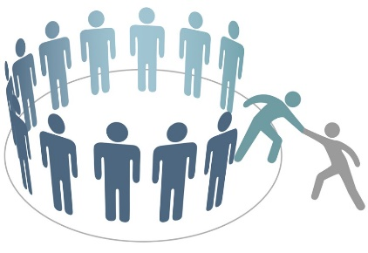

The strategy
Have some science-savvy people on board
Attend users’ events
Get involved in the science collaborations
Organize community-specific workshops

Slide 5





























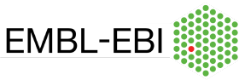
Astronomy/Physics
Earth Observation
DOMA
Arts and Humanities
eInfras
Outreach
Life Science

Slide 6
High Performance Computing
AI
Digital twins

Slide 7

Earth Observation
Data cubes (iRods)
Seismic research
Digital twins
  (also falls under the HPC area)
Notes:
A data cube is a geo-temporal and geo-spatial collection of data, organised in a codified and schemed way so that data can be injected from multiple sources and accessed in repeatable and structured ways.
iRODS (integrated Rule Orientated Data System) could be used as an abstraction layer between a nationally hosted Datacube and underlying existing infrastructure (namespace), and a student/researcher using a web accessible compute platform such as a jupyter notebook.

Slide 8
Quantum Technology
Quantum key distribution
Quantum communication
  Maybe a topic for SIG-NGN?

Slide 9
Network Performing Arts
Distributed theatre, dance, music performances across the globe
Expanding user base: some of the tools designed for networked performing arts are now used in telemedicine
Close collaboration with Internet 2 and involved NRENs in EU
Network Performing Art Production Workshop (NPAPW) 2019 in Prague
Work with Internet 2 to provide around-the-globe support to NRENs, institutions and local communities involved with distributed performance

Slide 10
Other topics
eHealth
Time and Frequency distribution
  CLONETS-DS
  Maybe a topic for SIG-NGN?
SKA/NREN Forum

