Slide 1


Security and the GÉANT Community
Sigita Jurkynaitė and Nicole Harris GÉANT
GCC virtual meeting
28 April 2020

Slide 2
Task Forces and SIGs
TF-CSIRT
Partial online meetings
SC meeting more regularly
Introduced chat service
Looking at virtual voting
SIG-ISM
Online meeting
Adapted Crisis Management
WISE
Online meeting
Encourage to meet more regularly

Slide 3
Community Activities
Trusted Certificate Service
In the middle of a vendor change
Issued blog advice
Messaging to GA
TRANSITS
Cancelled
Currently no facility to offer online
Trusted Introducer
No significant impact

Slide 4
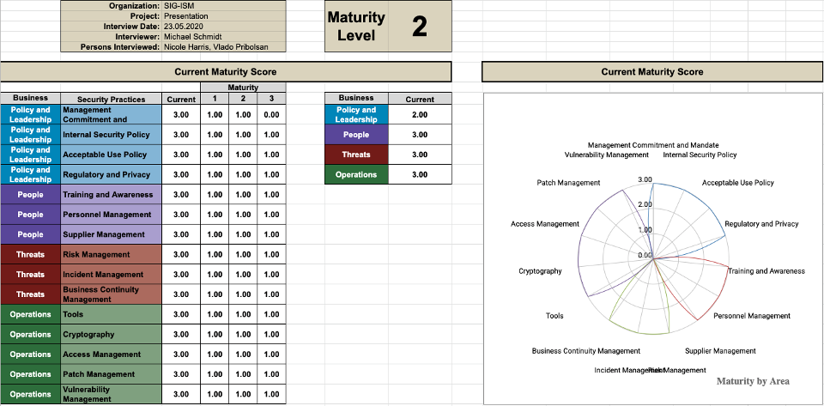
Security Baseline
GÉANT Security Baseline
https://wiki.geant.org/x/iDH5Bw
Baseline Assessment Sheet
https://wiki.geant.org/x/bwGMC

Slide 5
Training, Awareness and Outreach
Security Training:
more focus to creating online trainings rather than F2F
working together with GLAD
Security Awareness:
2 new hires for the team to work solely on the cyber security awareness month campaign
Security Strategy
being looked at by Alan Lewis

Slide 6
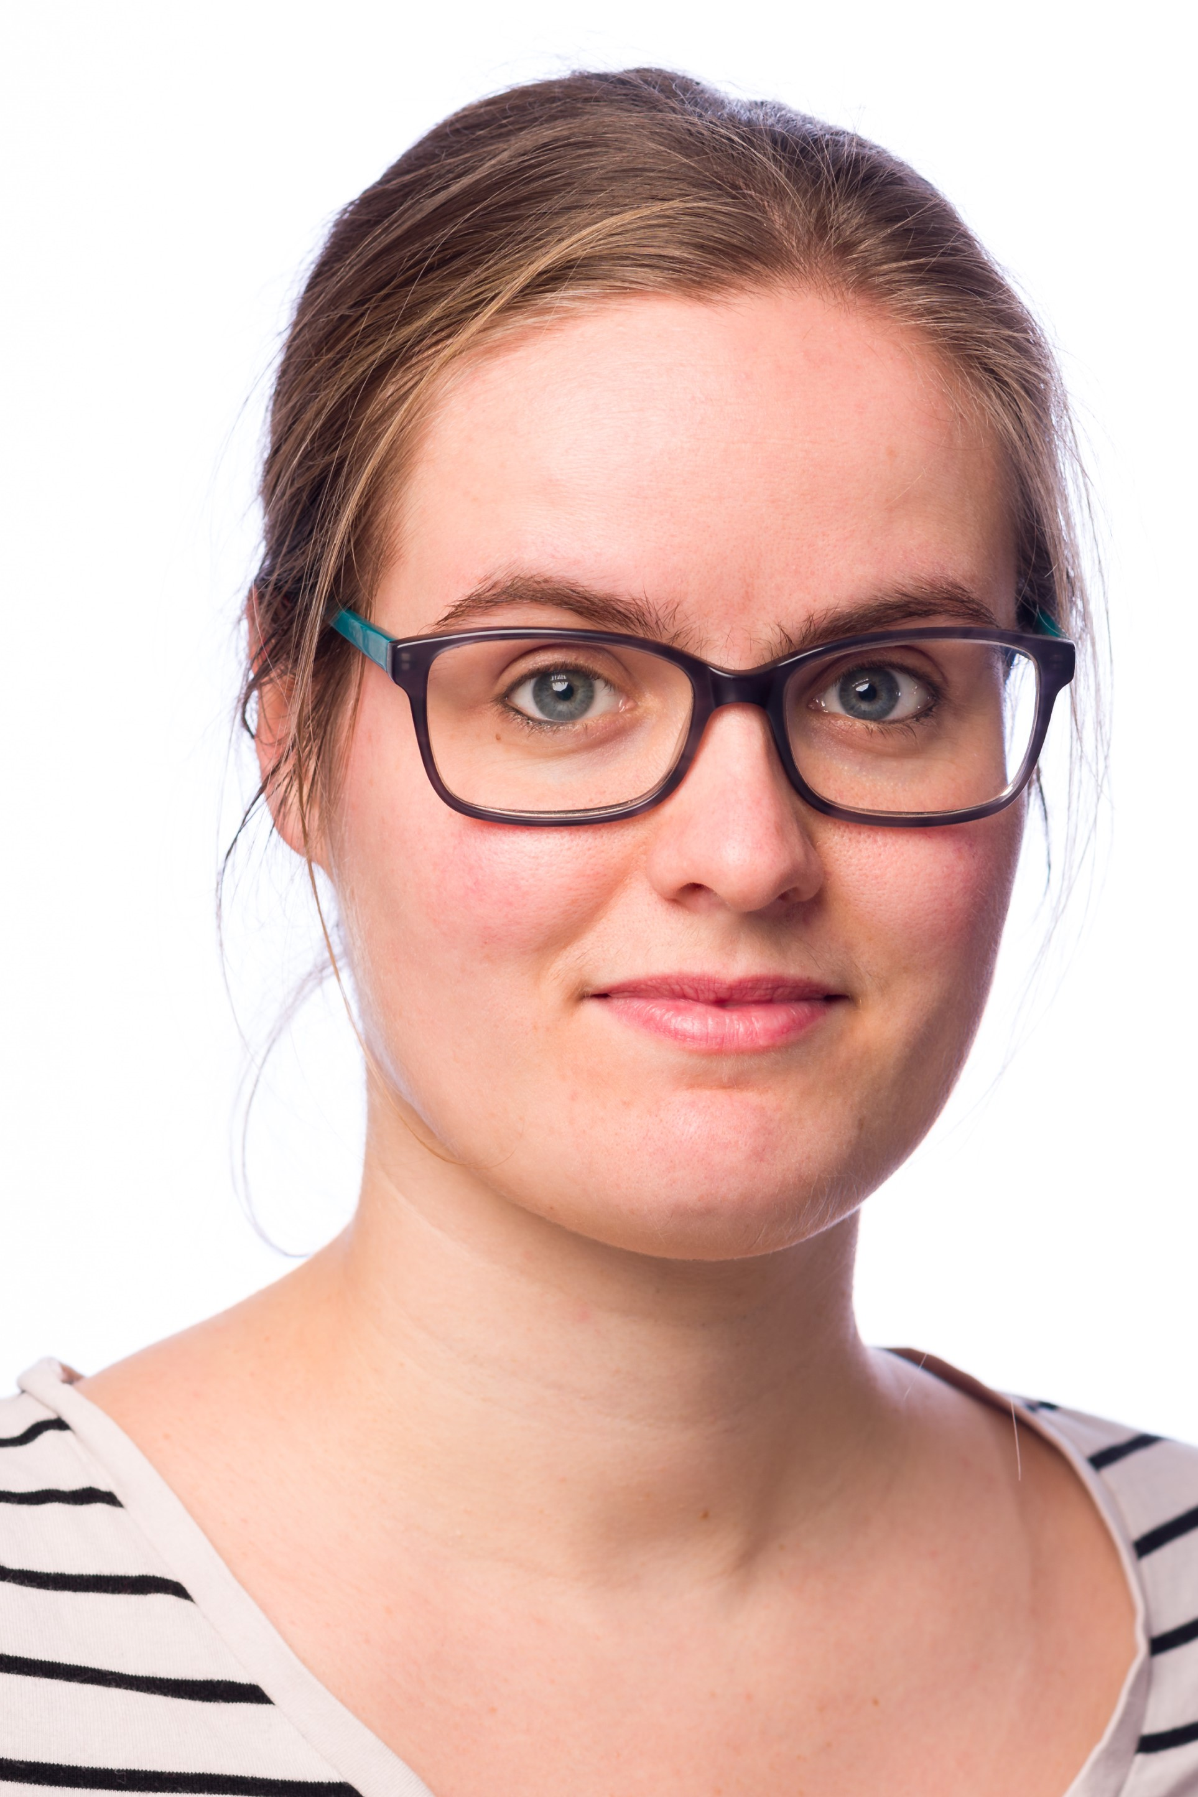
New Task Established in GN4-3 Security
Task 4: Crisis Management
assisting NRENs in setting up and improving crisis management plans and procedures;
helping NREN staff to improve their skills related to crisis management, such as stress management, internal and external communication, leadership and decision making.
CLAW 2020 – 1-2 December, Poznan, Poland
Themes:
    Working with external stakeholders
    How to triage information and time management
    Creative problem solving
    How to deal with media
Registration in Open:
https://eventr.geant.org/events/3277
Task leader
Charlie van Genuchten

Slide 7
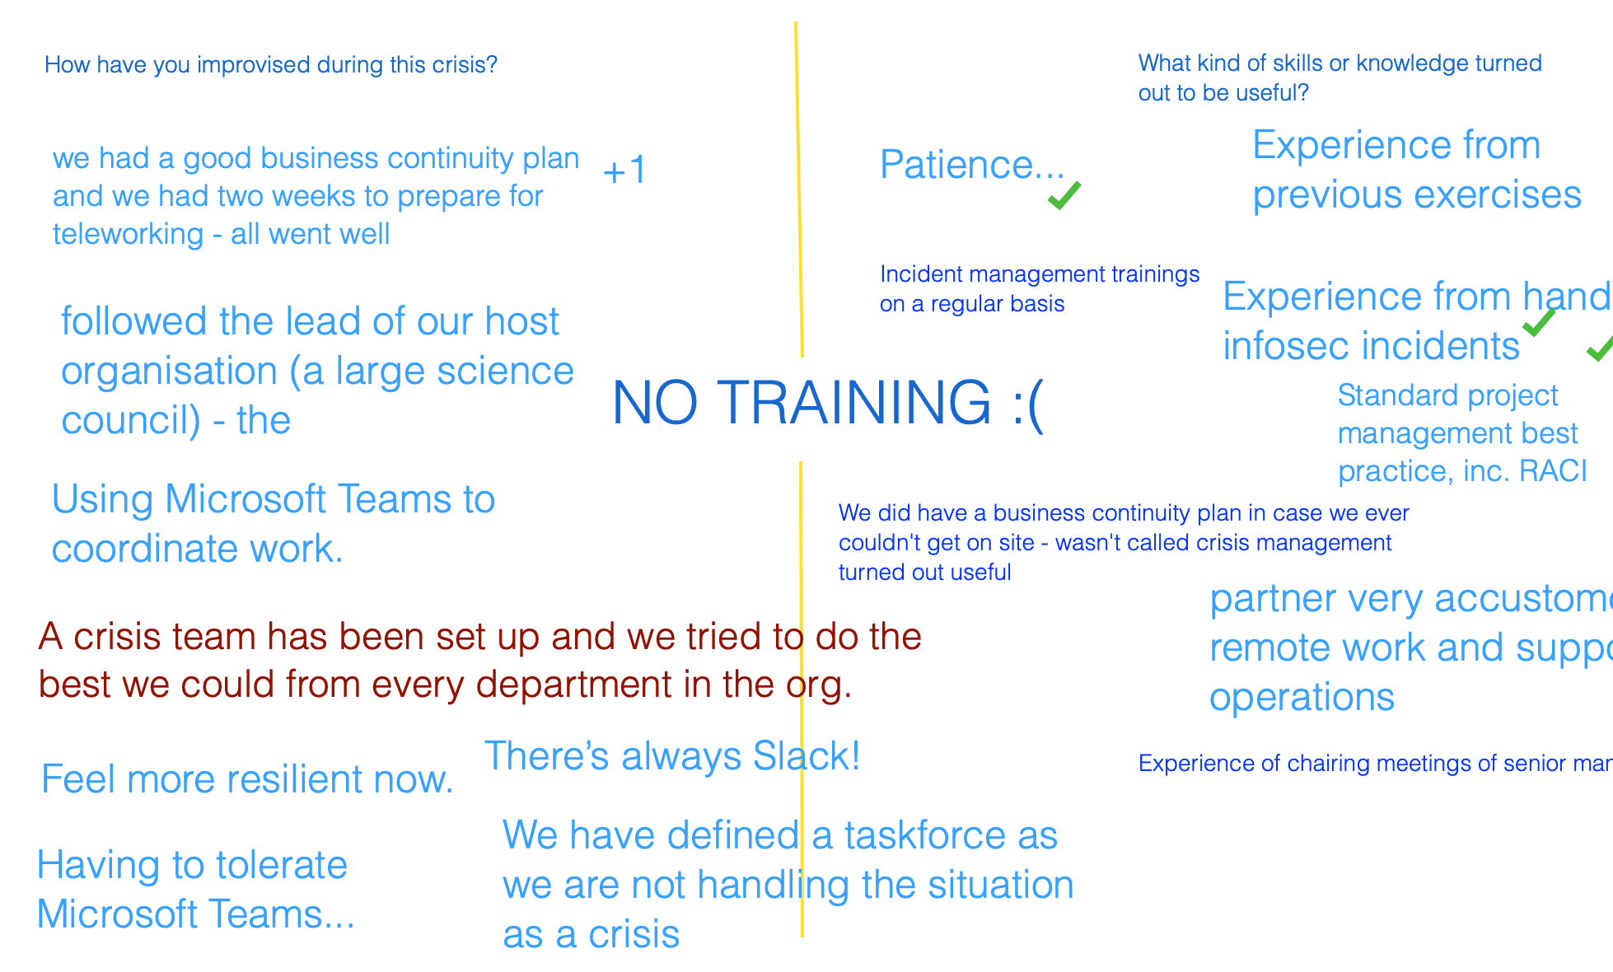
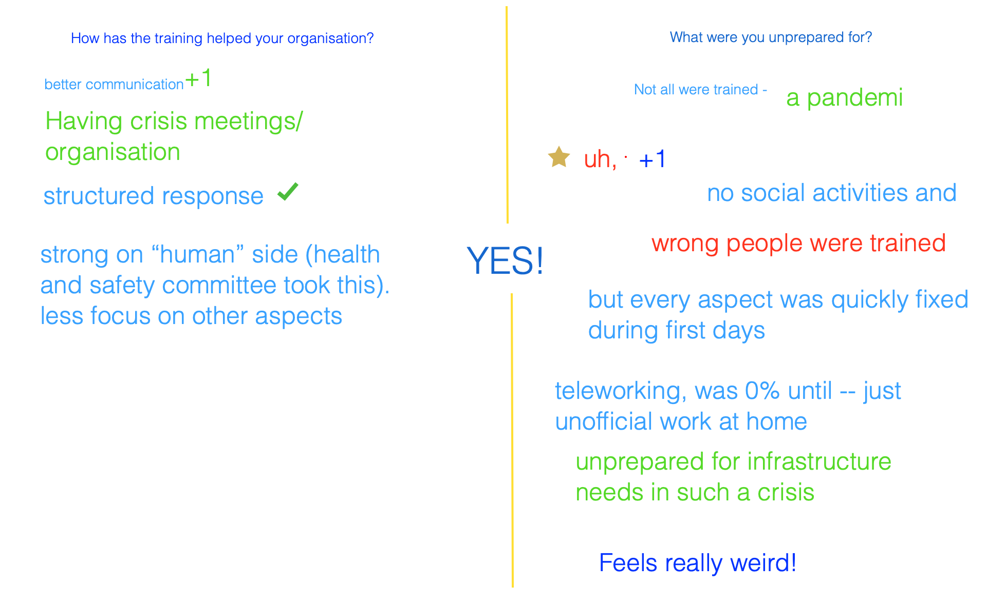
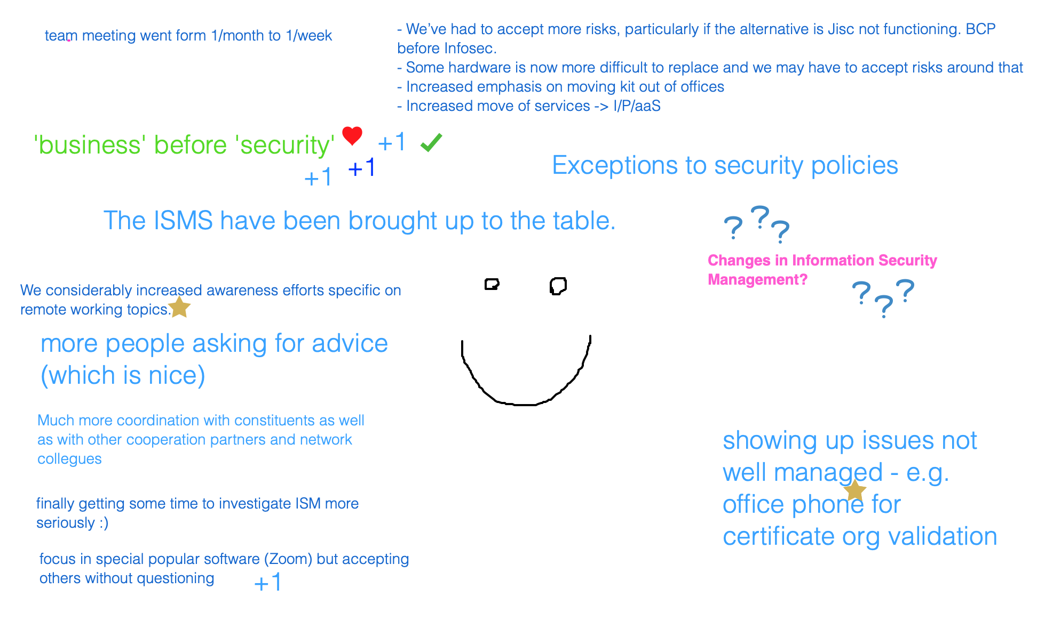
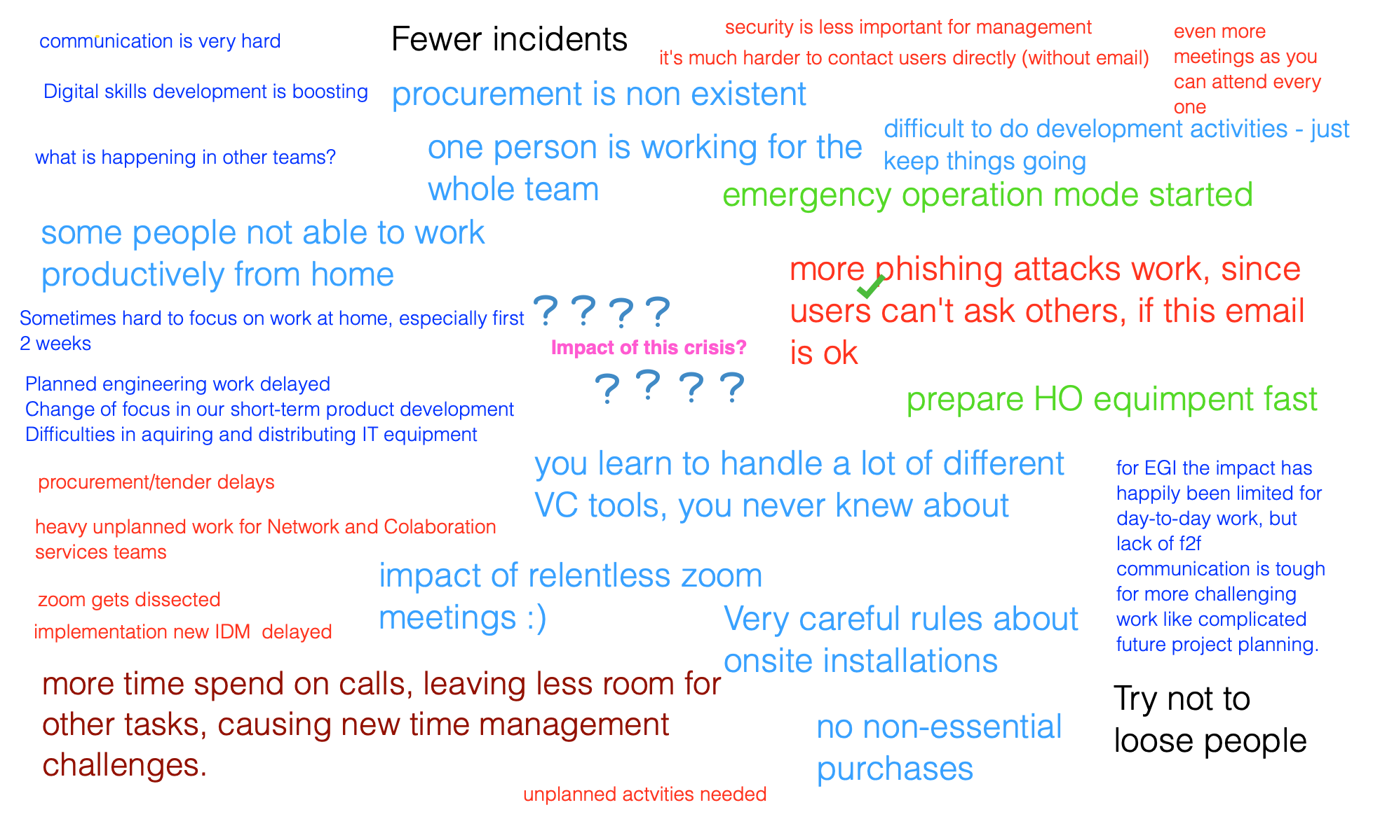
Virtual Crisis Management Session

Slide 8
Crisis Management: Lessons Learned
Opportunistic phishing
Many orgs don’t have a crisis plan
Gained experience from general incident response
NRENs are effective at working remotely
NRENs are accepting more risks than normal
Hardware replacement is difficult
Very little procurement taking place
Reports of fewer or no change in number of incidents
Wrong people trained for crisis

Slide 9
COVID-19 and Security: Working From Home

Slide 10
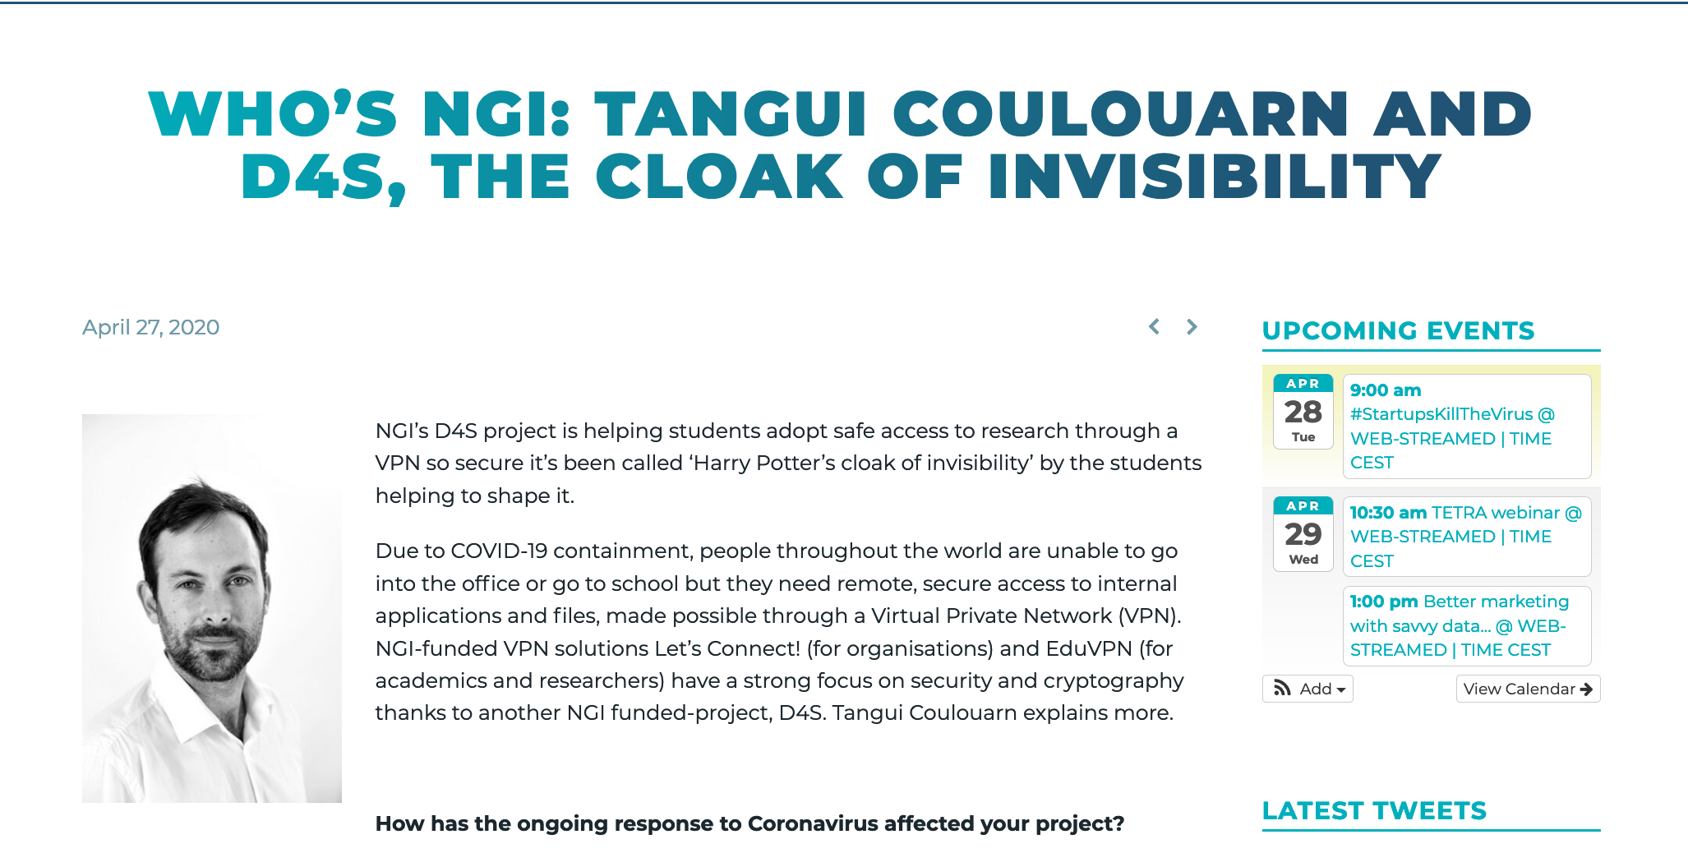
COVID-19 and Security: eduVPN
eduVPN
Adding one or two universities every day
more support is needed
more feature requests
Complex funding model

Slide 11
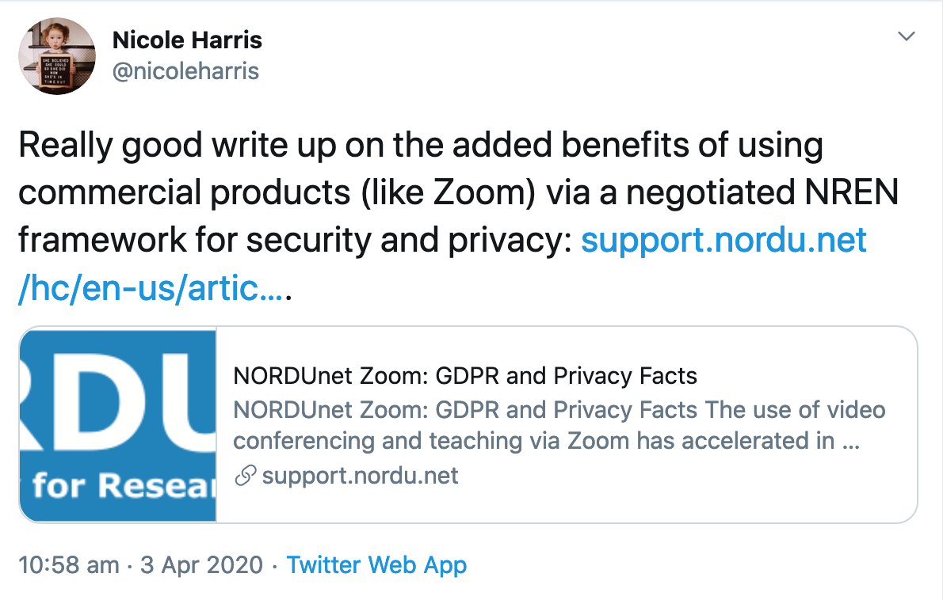
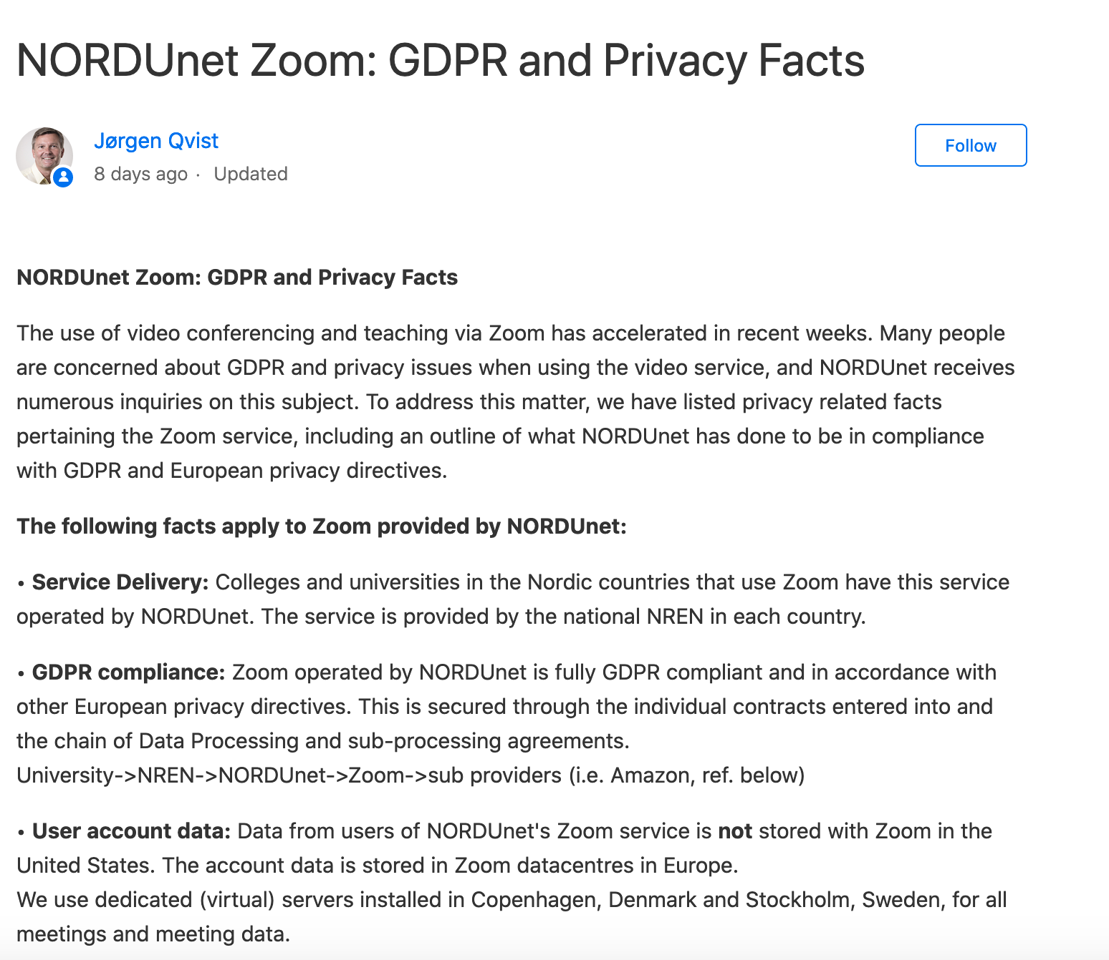
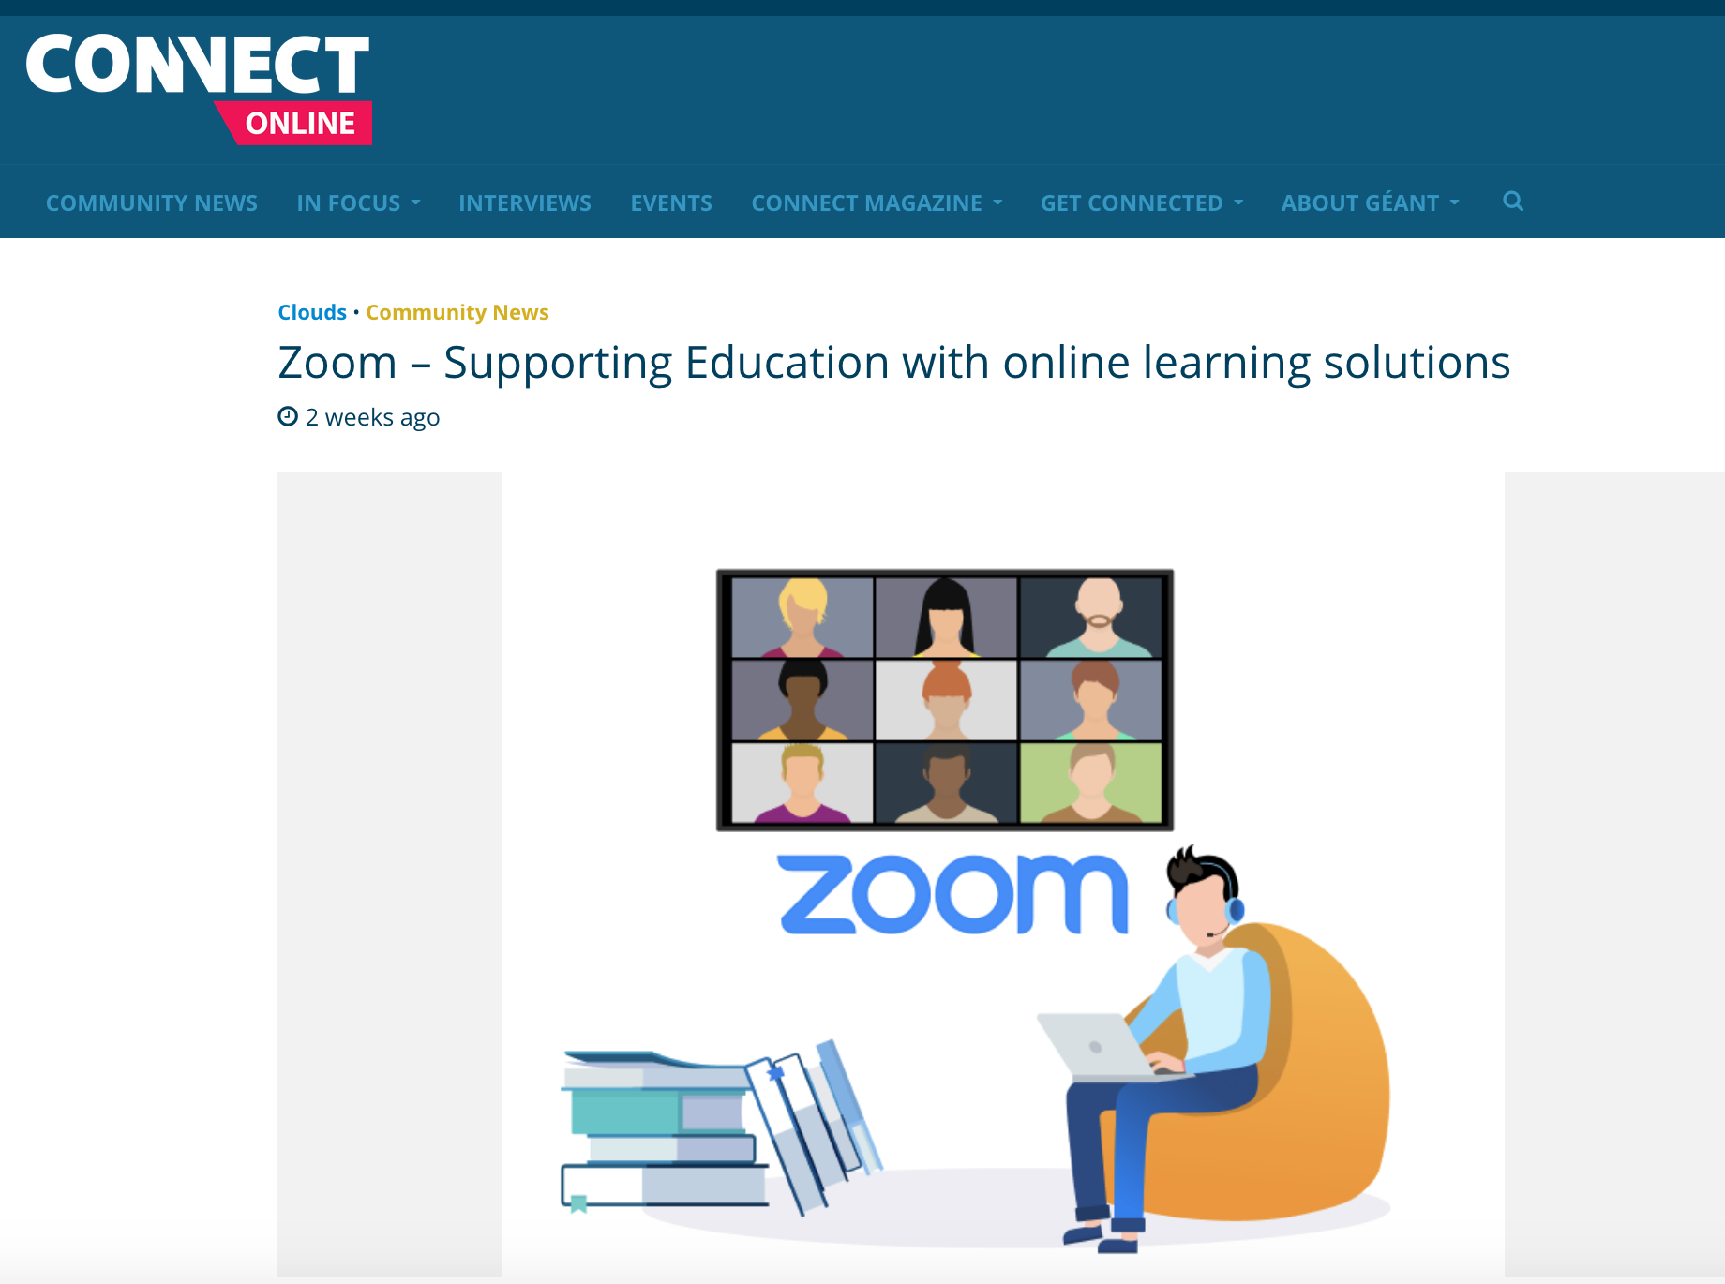
COVID-19 and Security: Zoom

Slide 12
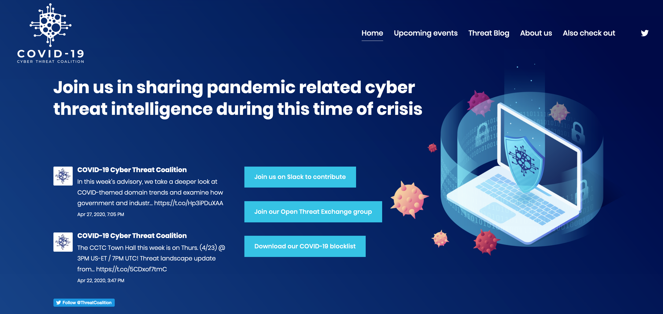
COVID-19 and Security: Cyber Threat Coalition

Slide 13
Thank you
Any questions?

