Slide 1
Enabling digital learning
Licia Florio
T&I Activity Leader
TF-EDU
9 June 2020

Slide 2






Challenges and opportunities
Student mobility is increasing.
Education is increasingly digital – starting already at primary schools
Demand for edu-services is also increasing
Federated Access to resources in the R&E sector started more 10 years ago

Slide 3

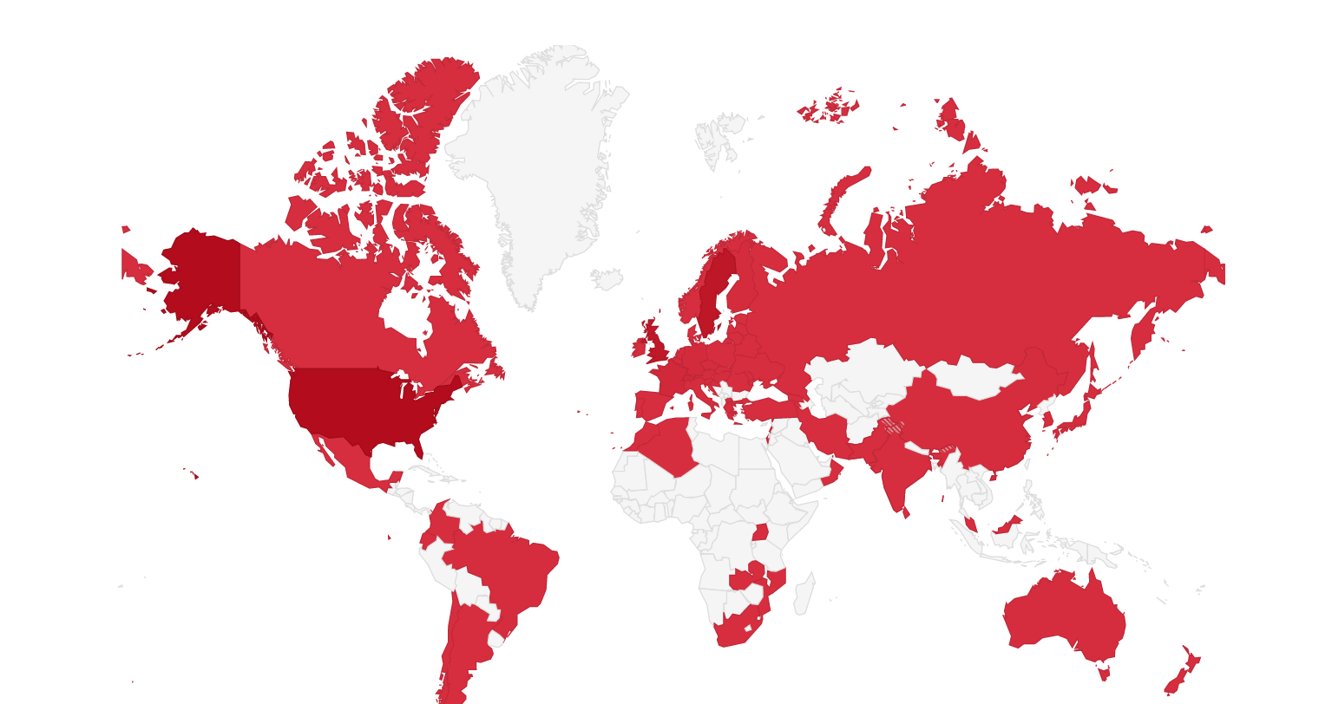
- Authenticate once and access thousand of resources
Federated access enable users to access a wide range of services using a single account managed by their 'home' institution
Improves access and security
Complies with GDPR
Reduces management overhead and costs.
Allows for higher credential assurance if required
Figures
68 Federations
3739 Institutions
2968 Services
~30M users
https://edugain.org

Slide 4

































eduGAIN – Building on national ID Federations to reach global coverage
4

Slide 5
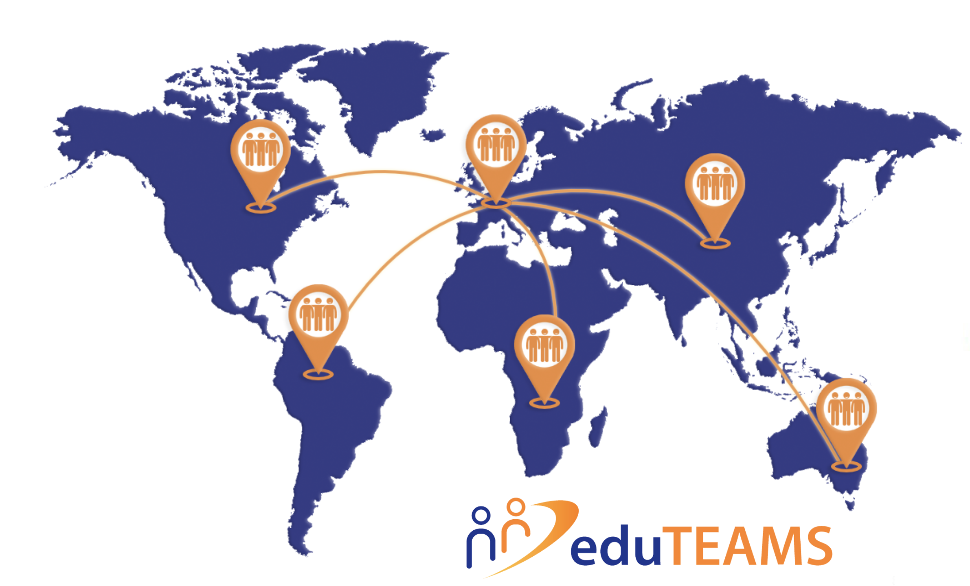
Expanding eduGAIN to support virtual teams and share resources
2
Augments identity sources in eduGAIN with a growing list of third parties' providers
Community specific attributes to manage teams and enable access control at individual and team levels
1
Offers first class support for OIDC, in addition to SAML2 to support more services
3
To support virtual teams to share resources

Slide 6
eduTEAMS Deployment
Working with several research infrastructures to deploy a production instance for them
Working with SURFnet to deploy an NREN version
Discussion started with eduMEET team, OpenUp2U project

Slide 7
Thank you!
Licia.Florio@geant.org
www.geant.org
@GEANTnews

Slide 8
How can educational services benefit ?
How is the service offered?
In the cloud?
Locally installed?
Run by the NREN?
Is stronger authentication really a requirement?
Is group management required ?
We should push for federated access whenever possible:
Better user experience
Higher R&E users are already familiar with that
Privacy preserving

