Slide 1
NREN’s tools, progress and challenges related to digital assessment
7.4.2020 2nd TF-EDU virtual meeting
Marjut Anderson, CSC

Slide 2
Agenda
EXAM concept
  EXAM concept for cross-institutional digital exams in Finnish Higher Education Institutes
  EXAM consortium
  EXAM: COVID-19 and future
CSC and digital assessment services

Slide 3

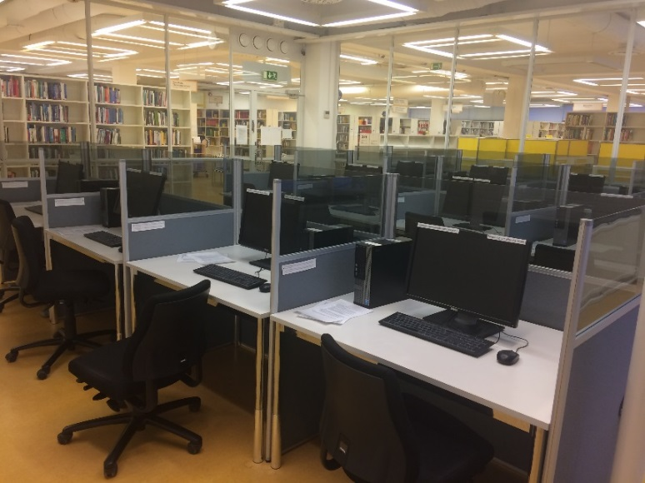
EXAM concept for online exams
Digital EXAMs to assess students’ learning achieved by independent learning, prior learning, during the studies and for final evaluations
All exams are taken in exam studios maintained by universities (concept for customized workstations and network environment, camera-controlling and the process to supervise the students)
Flexibility for the students and teachers
  Students: can freely choose their examination time, date and studio where to take the exam
  Teachers: question bank, no bad hand-writing anymore, computer resources in use, joint exams between universities

Slide 4
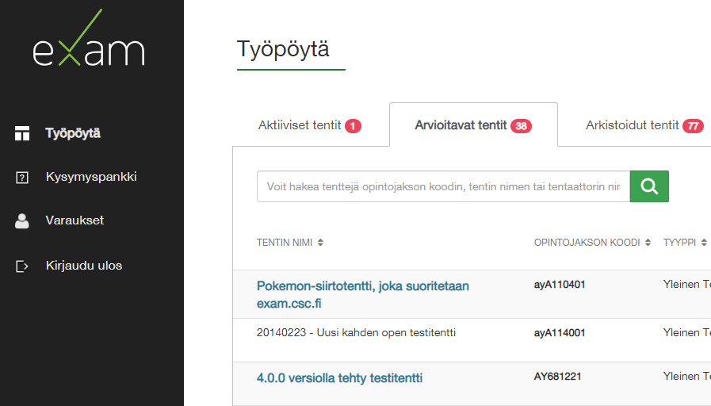
EXAM concept for online exams
Simple concept:
  Three roles: admin, teacher, student
  All user actions happen via web browser
  Integrated to HEI’s own assesment process
Made in Finland
  source code licensed under EUPL 1.1.
  https://github.com/CSCfi/exam
CSC offering EXAM software as a service, also local implementations
Connecting service for joint exams and exam visits hosted and maintained by CSC

Slide 5




























EXAM 2020
HEIs/FTE
27 / 200 000 (90%)
Exam records
170 000 (+40%)
HEIs offering
EXAM visit
13

Slide 6


EXAM organisation
EXAM Consortium
Management Group
Group of main users
Working Group
Product Owner Group
Theme Groups
Yearly fees
CSC's EXAM team
(project manager, coordinator, technical service manager)
DigiCampus-project
CSC service (SaaS)
Connecting service for joint exams and
exam visits (TBD)
Software developers
Other projects

Slide 7
EXAM: COVID-19 and future
COVID-19
Question export and import
Out of the EXAM studios → BYOD (Bring your own device) exams (at home and at campus)
Remote desktops (virtual exam premises)
Online proctoring sofware?
Entrance exams?
Future
..
Use of AI – Developing automation to essay evaluation
Learning Analytics

Slide 8
CSC and digital assessment services
At the moment
  Services for EXAM consortium
In the future:
  EXAM service for other education sectors
  Other assessment tools for HEI’s → Portfolio of assessment tools
  End-user support model

Slide 9

Marjut Anderson
Project manager
+35840724076
marjut.anderson@csc.fi

