Slide 1


4th TF-EDU virtual mini conference
9 June 2020

Slide 2
Why are we here today?

Slide 3

Digital identity for student mobility

Slide 4


Slide 5


Slide 6
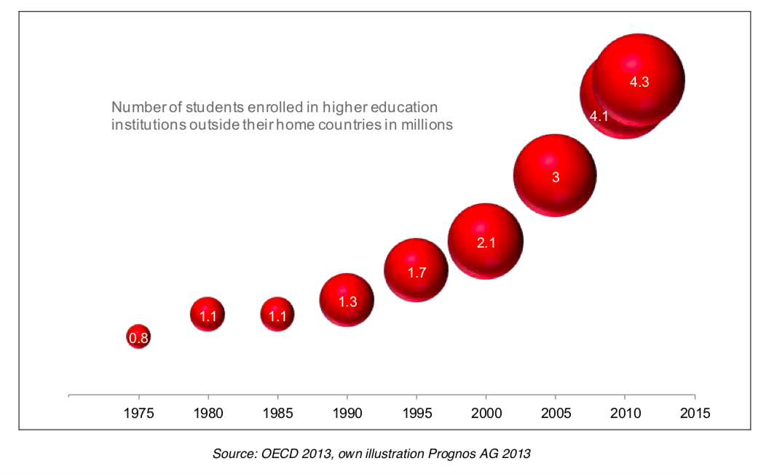

Slide 7












Notes:
Student mobility (e.g. Erasmus) requires knowing both who a person is and what their home university is

Slide 8
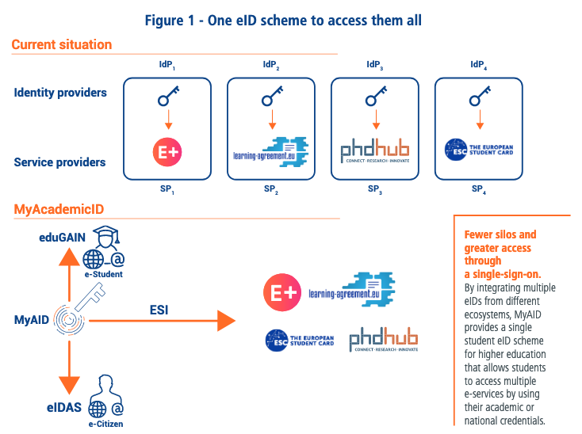


Slide 9


Slide 10
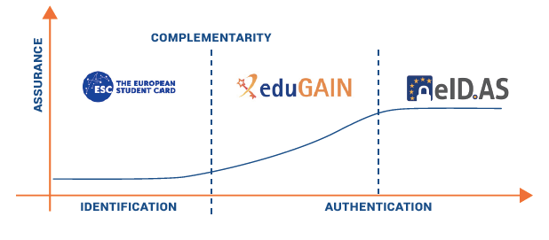

Slide 11

A Single European eID Scheme for Higher Education
Students will be able to:
  Authenticate their student status online in a reliable, consistent and safe way.
  Use their academic credentials to access multiple student e-services through a single sign-on.
  Use their citizen eID to enroll at higher education institutions and link their citizen and student digital identities.

Slide 12
Thank you! joao.bacelar@uni-foundation.eu

